Slide 1
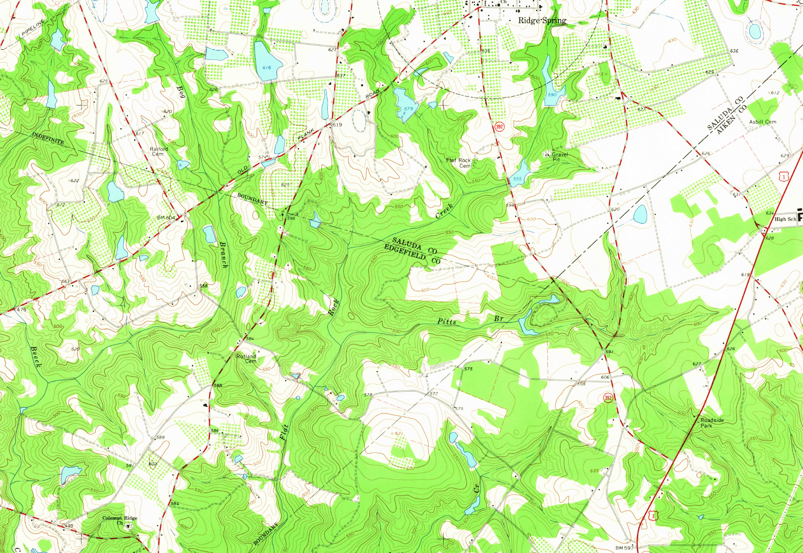

AIKEN/EDGEFIELD/SALUDA
COUNTY LINE RE-ESTABLISHMENT
David Ballard, PLS
Revenue and Fiscal Affairs
Geodetic Survey

Slide 2
SC CODE of LAW
-Section 4-3-20. Aiken County:
“…on the northwest by Edgefield and Saluda Counties from which it is divided by a straight line commencing at the mouth of Fox's Creek, where it empties into Savannah River, and running thence to where the south branch of Chinquapin Falls Creek (a tributary of the North Edisto River) intersects the Saluda and Lexington line…”
-Section 4-3-240: Edgefield County:
“…on the southeast by Aiken County…”
-Section 4-3-470: Saluda County:
“…the corner of Lexington and Aiken Counties; thence the old Edgefield and Aiken line to a point three miles north of where the public road crosses said line near Lybrand's old mill…”

Slide 3
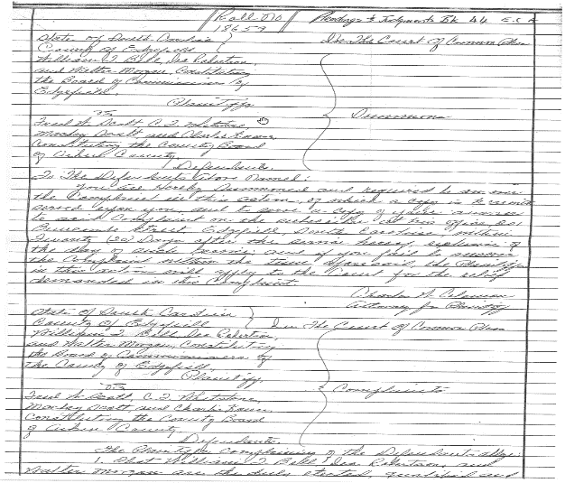
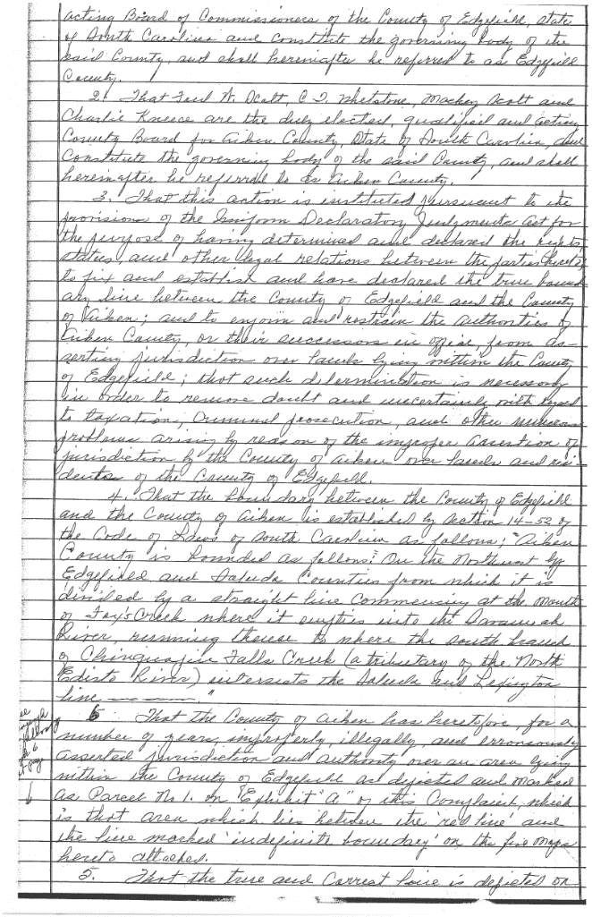
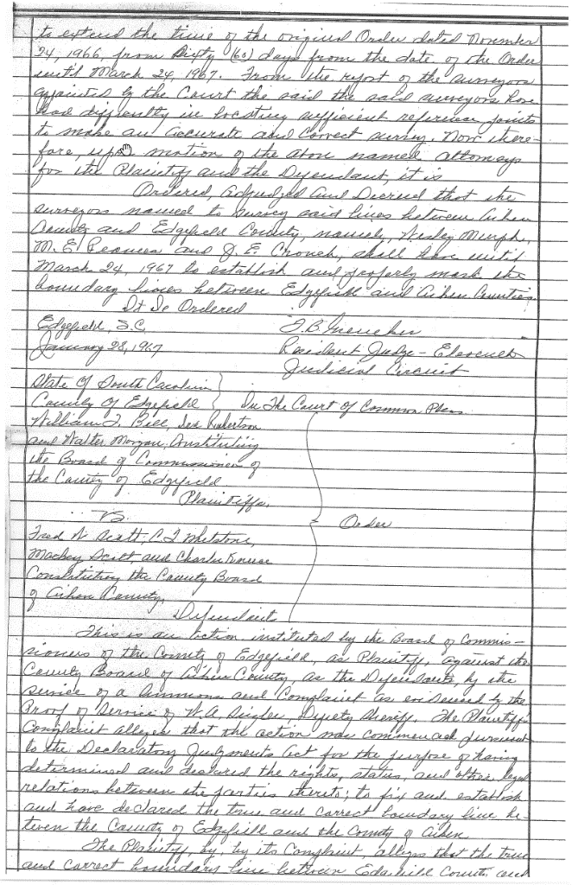
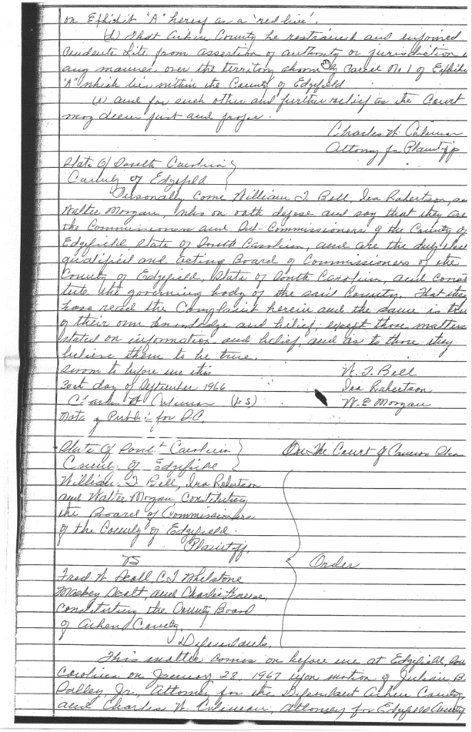
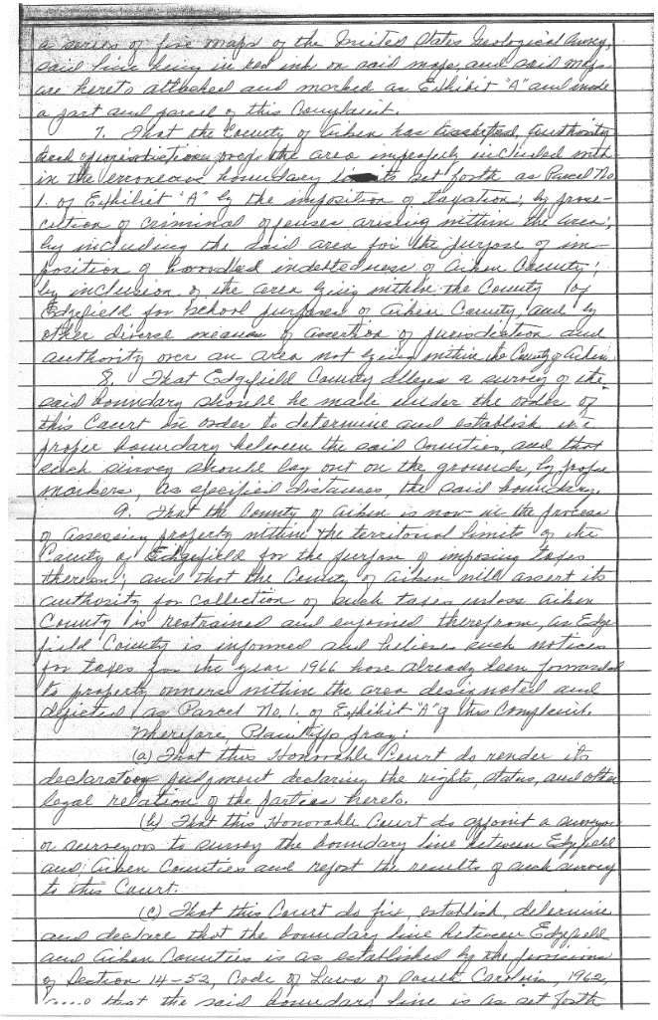
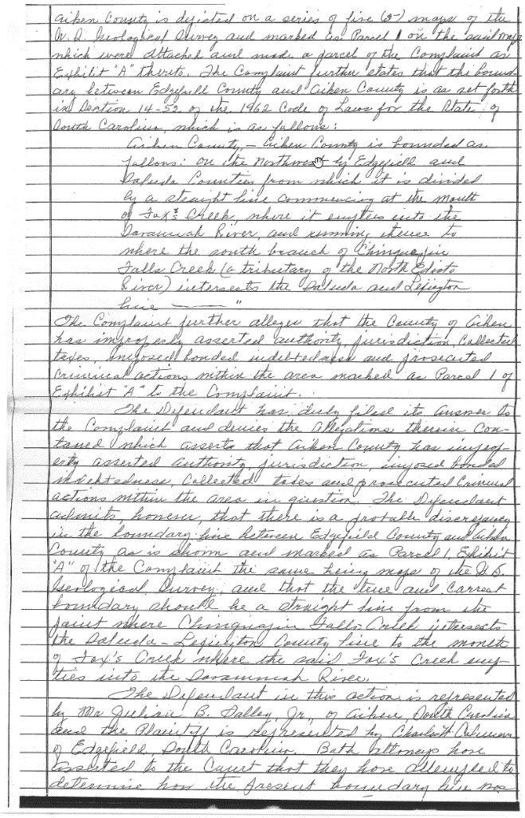
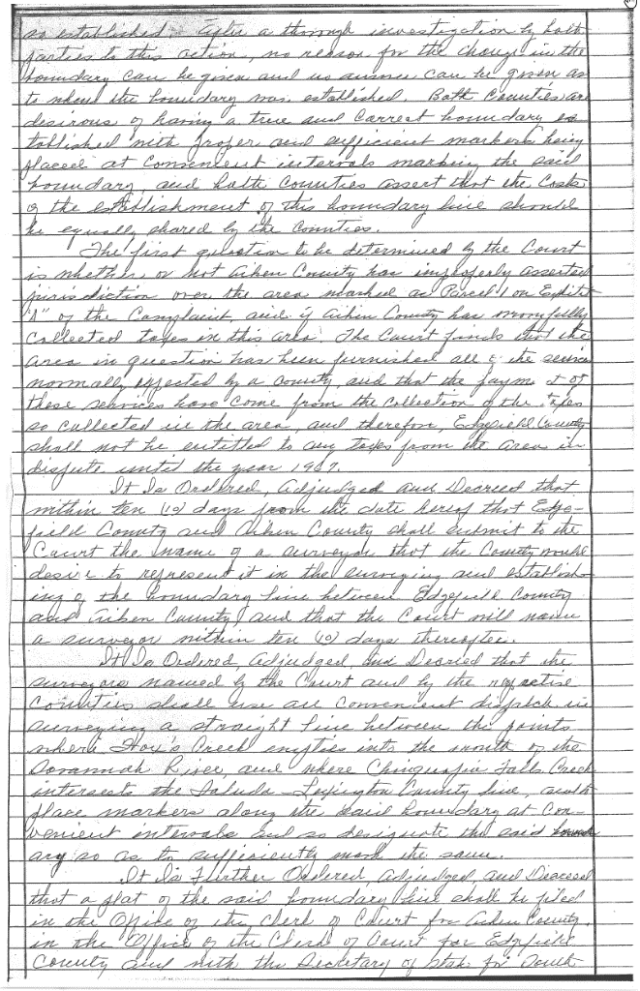
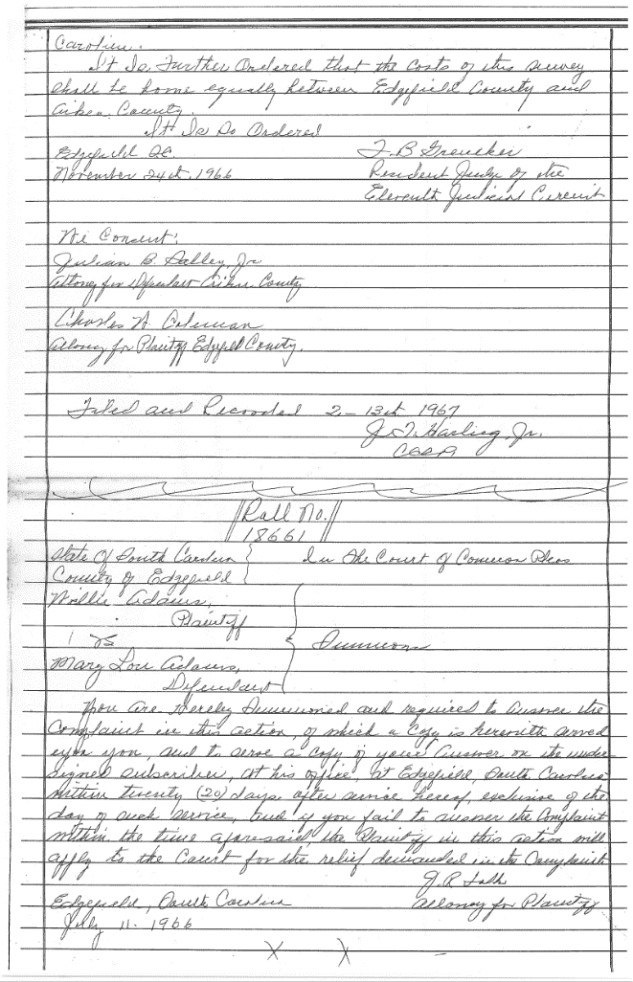
1966 Declaratory Judgement
“a straight line commencing at the mouth of Fox’s Creek, where it empties into the Savannah River and running thence to where the south branch of Chinquapin Falls Creek (a tributary of the North Edisto River) intersects the Saluda and Lexington Line”
Notes:
”

Slide 4
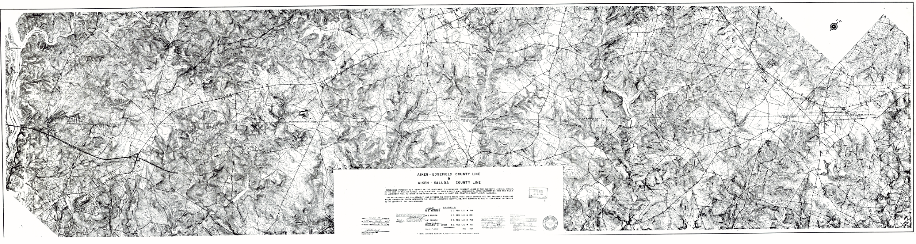
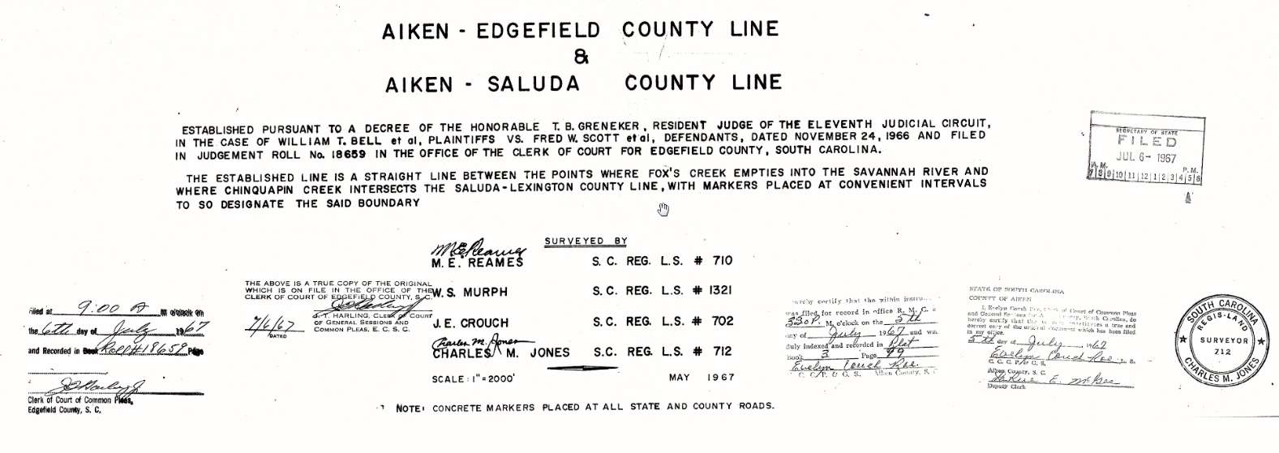
1966 Plat of Survey

Slide 5
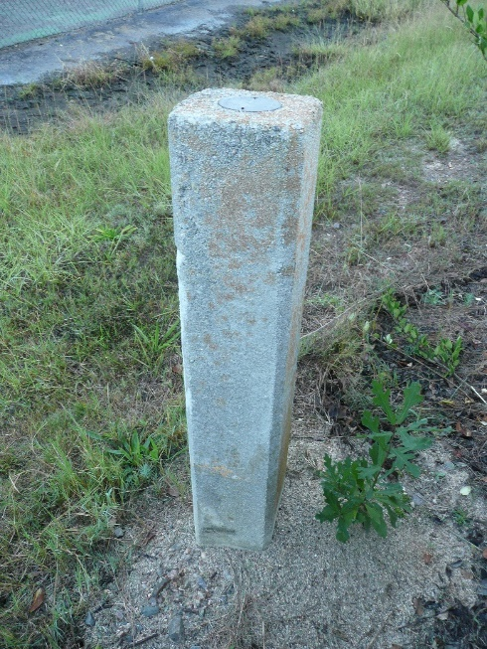
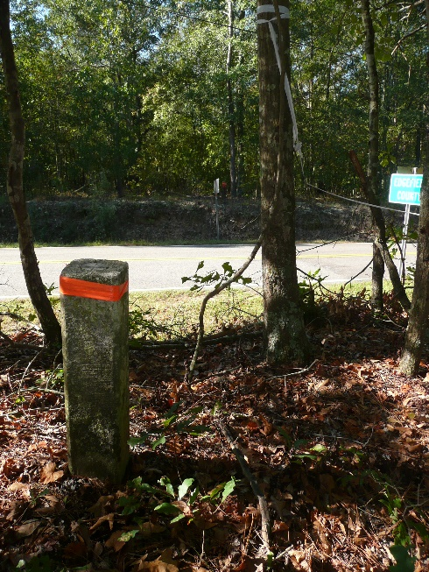
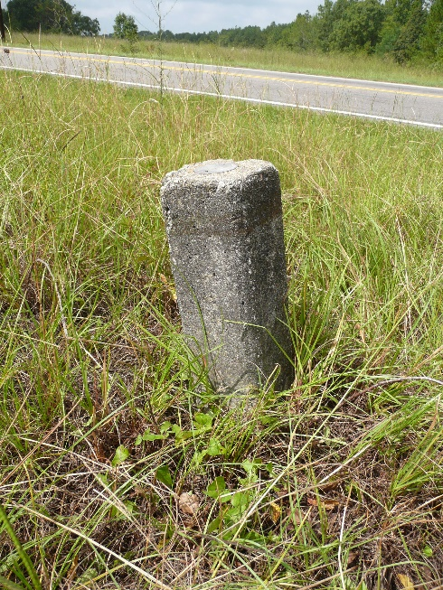
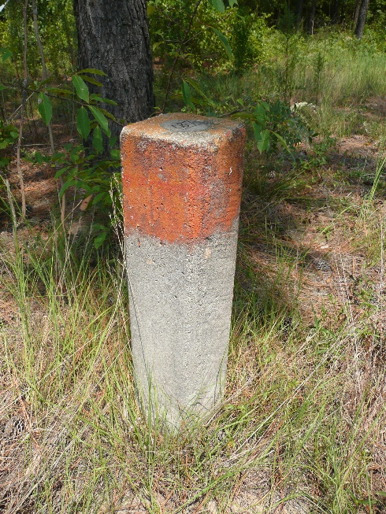
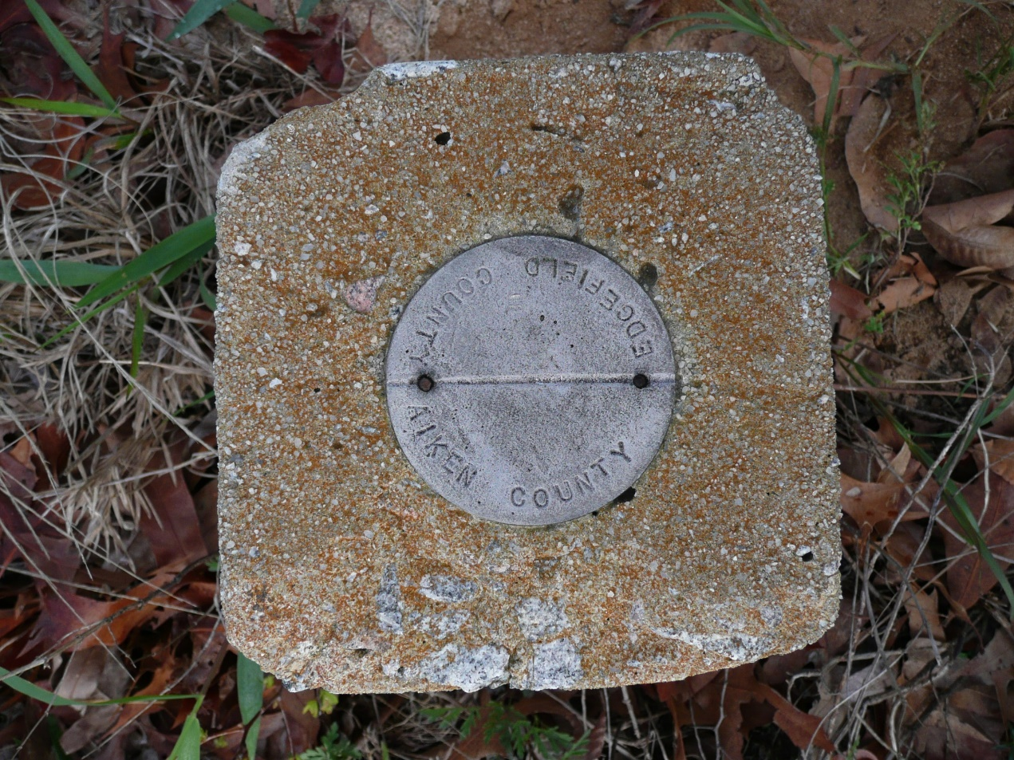
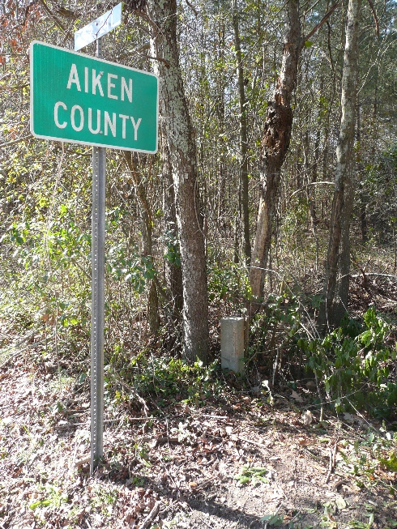
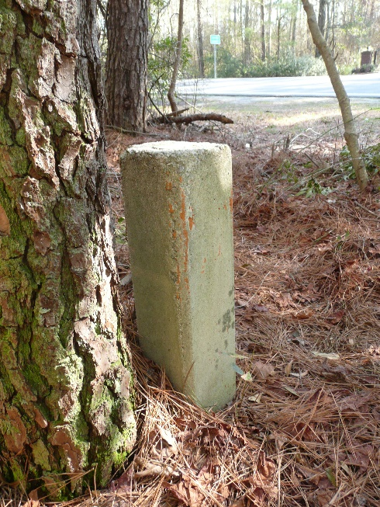
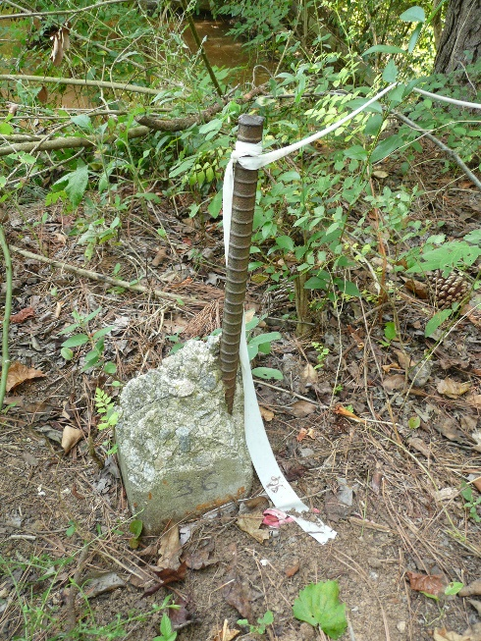
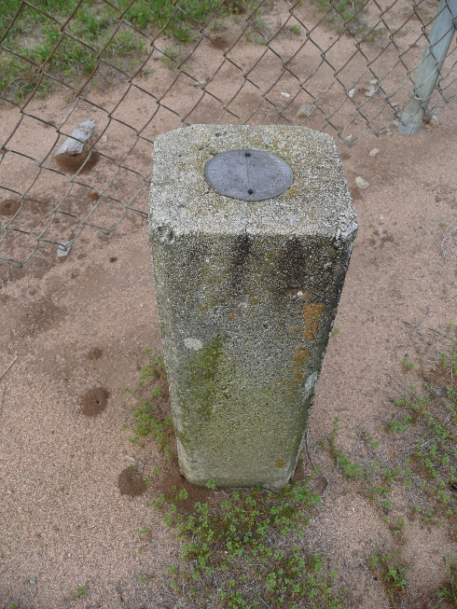
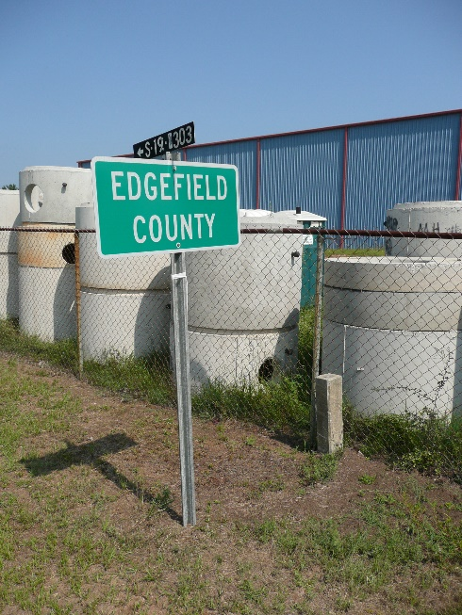
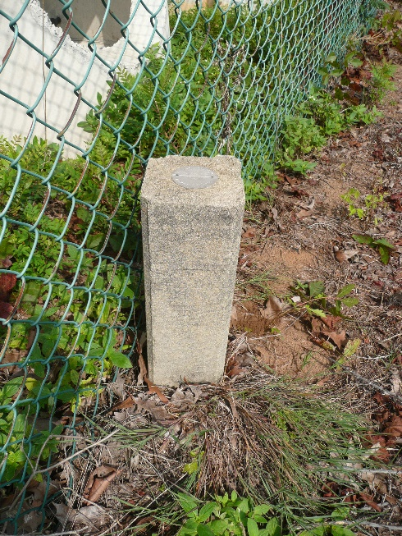
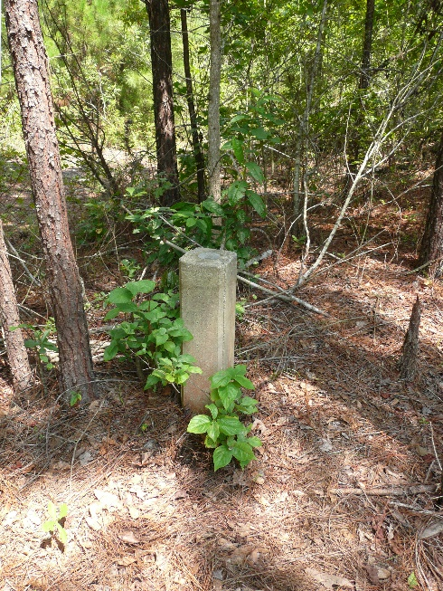
Monuments

Slide 6
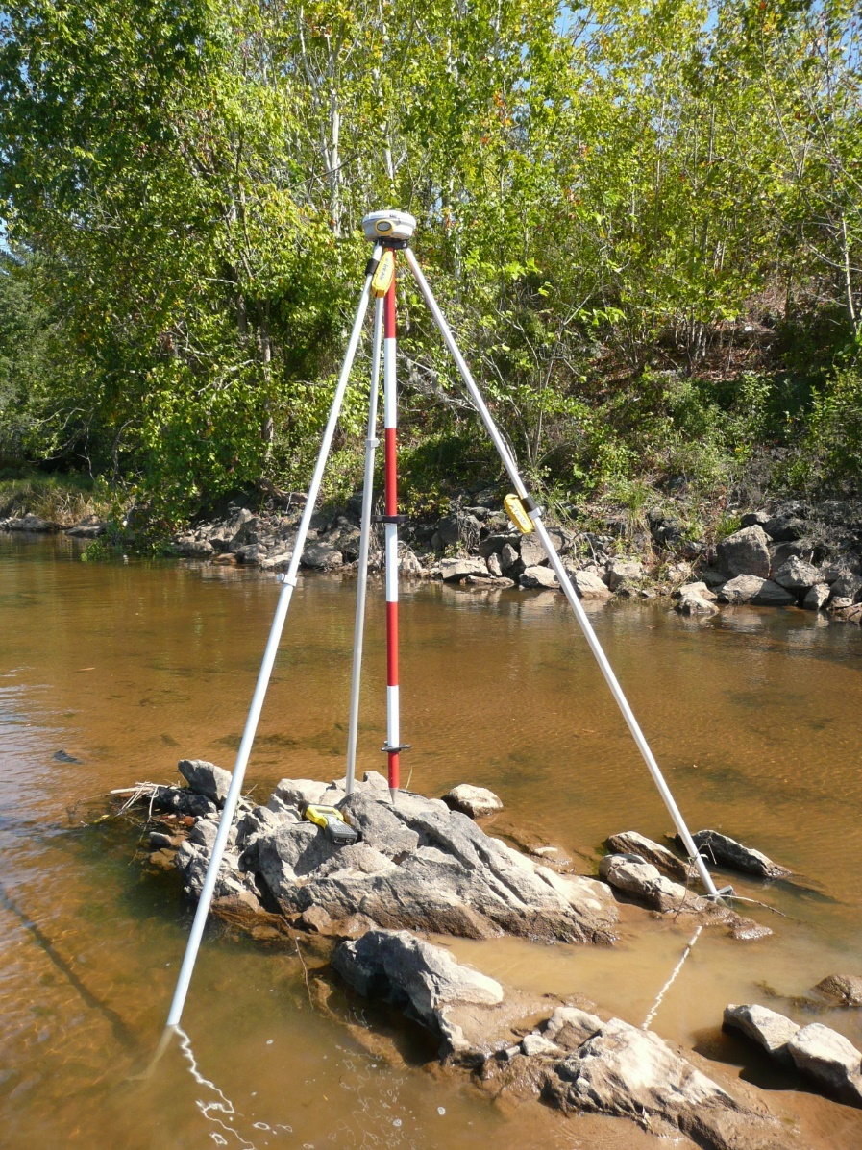
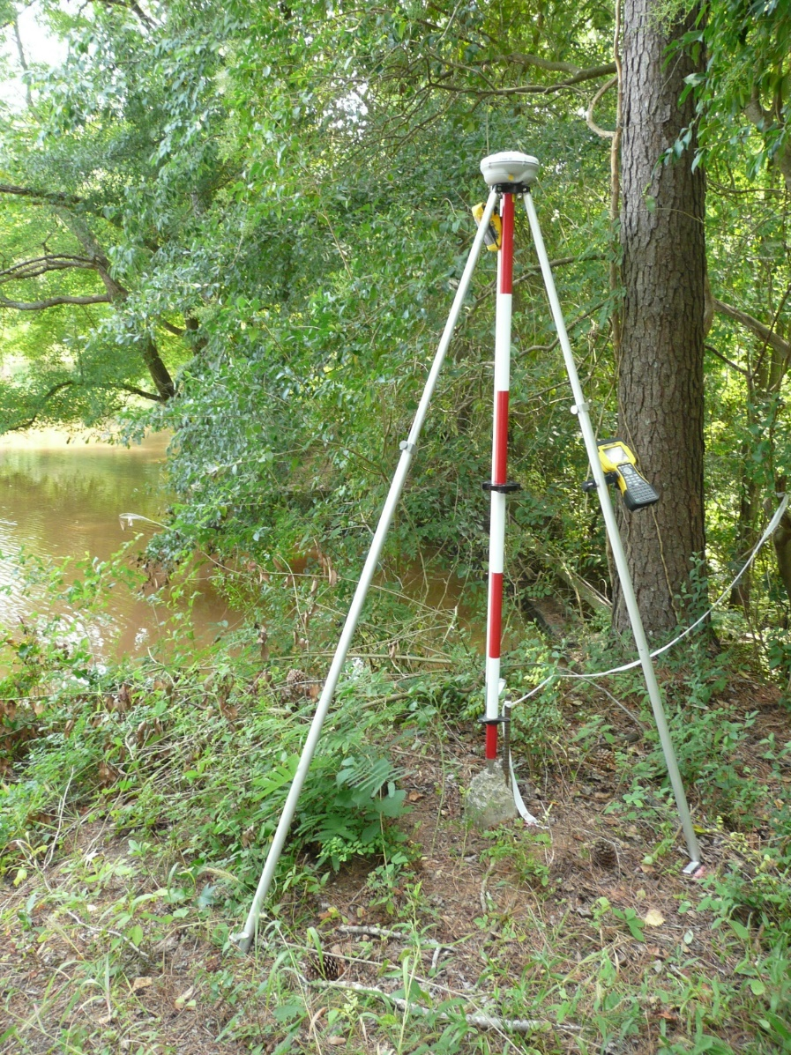
Monuments

Slide 7
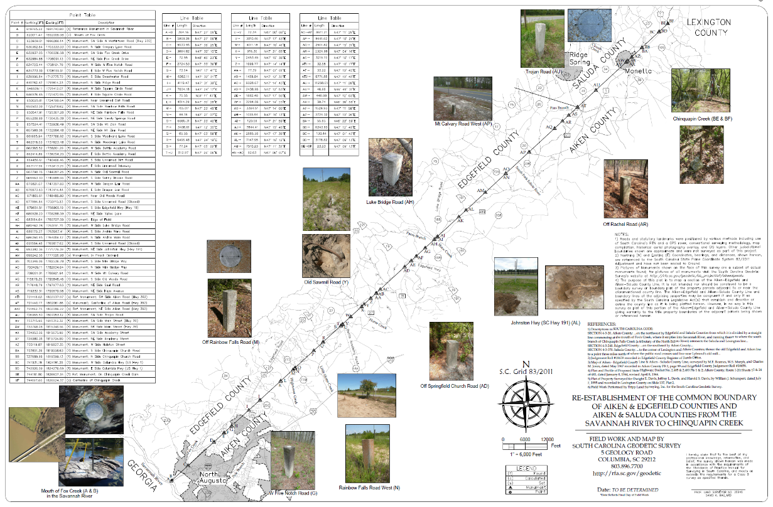
Draft of Current Survey

Slide 8
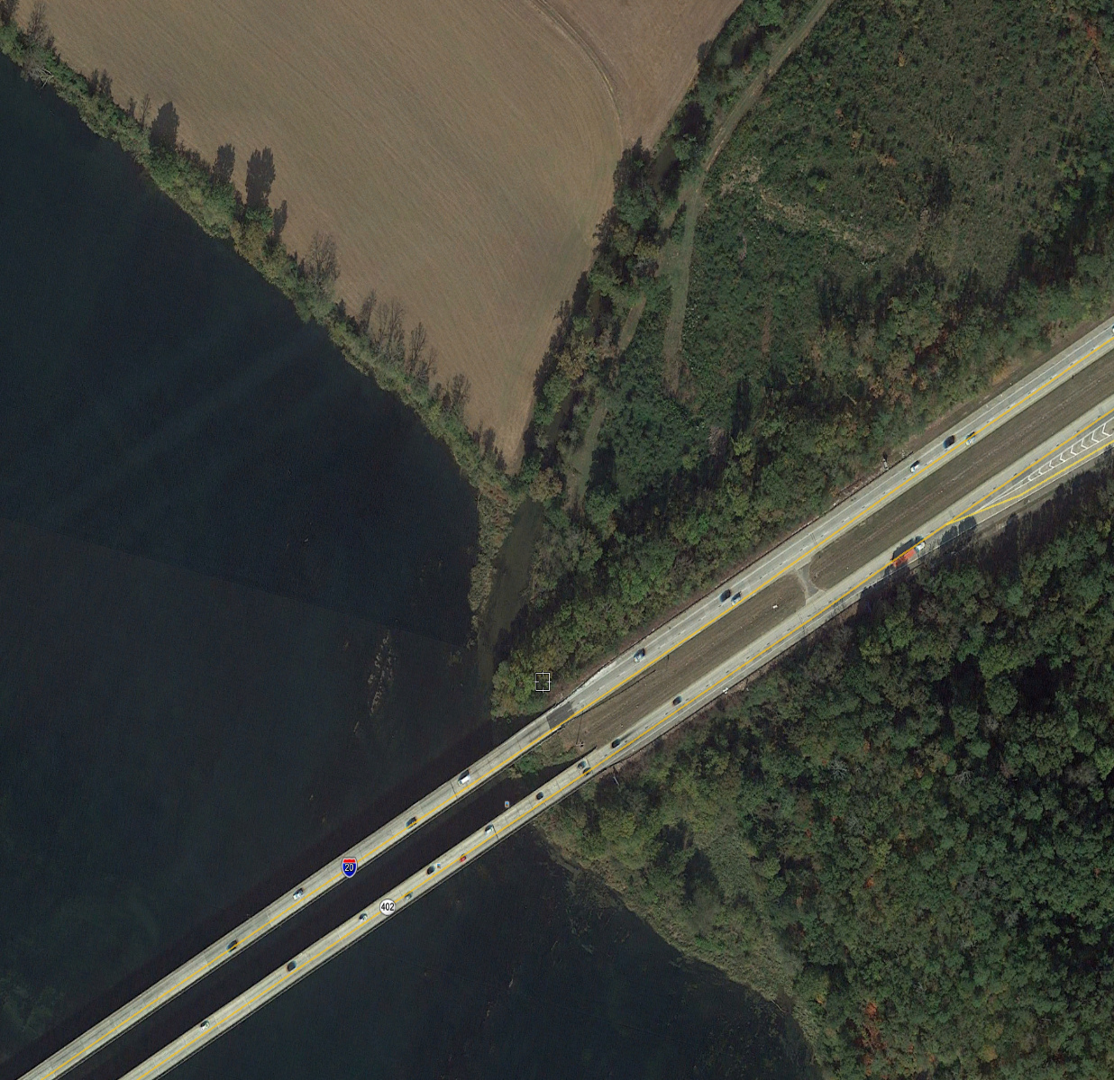
Mouth of Fox’s Creek
Current Determination
Previous Determination

Slide 9
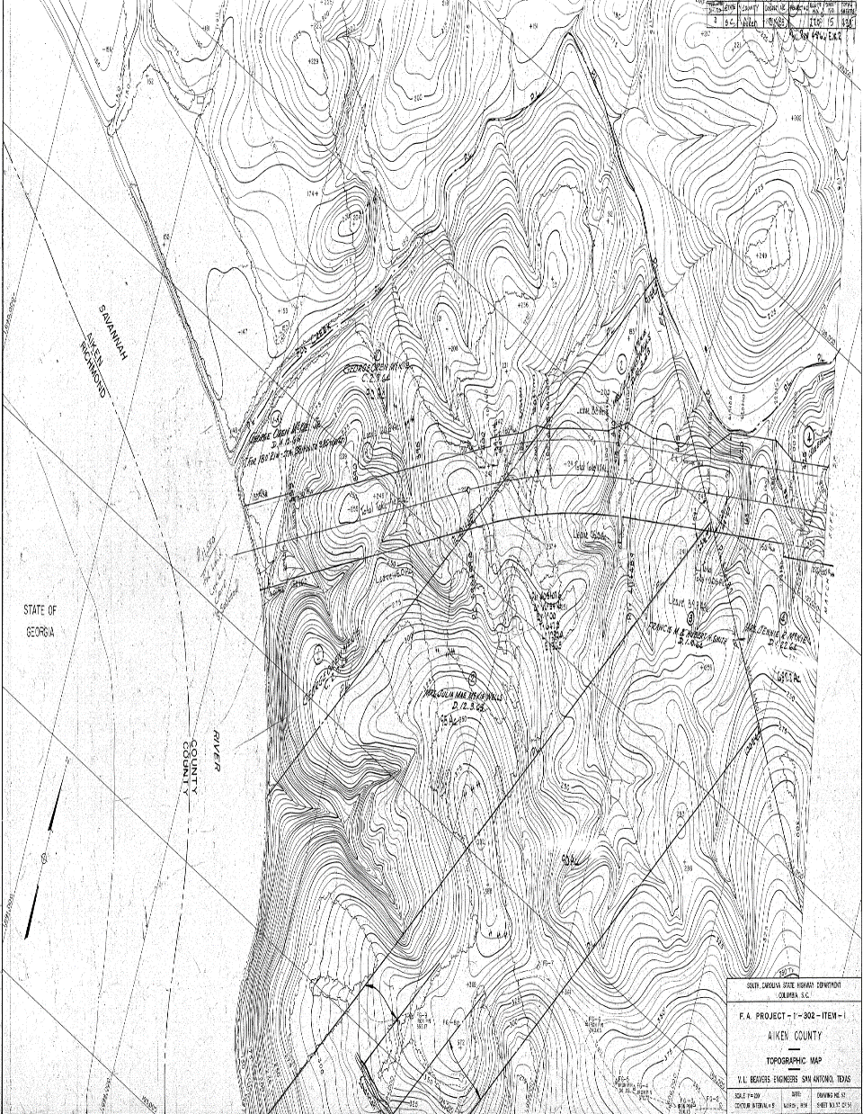
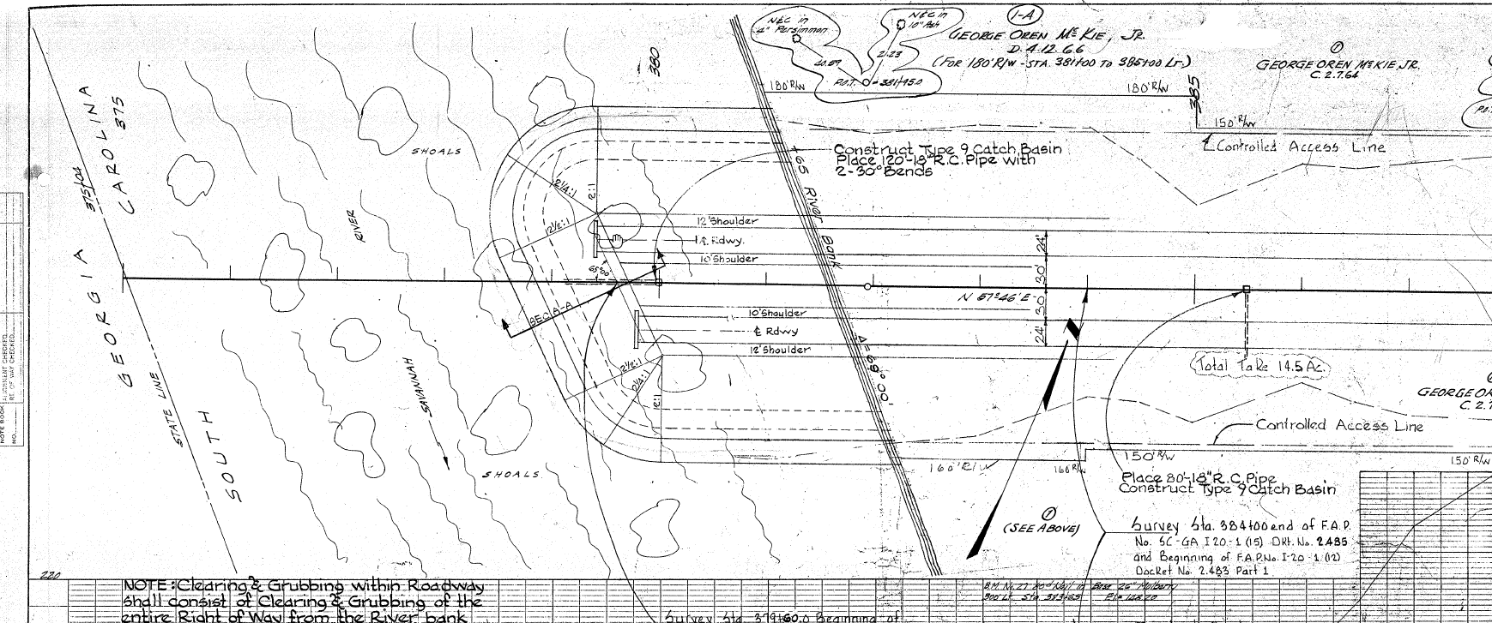
1964 Highway Plans

Slide 10
Mouth of Fox’s Creek
Current Determination
Previous Determination

Slide 11
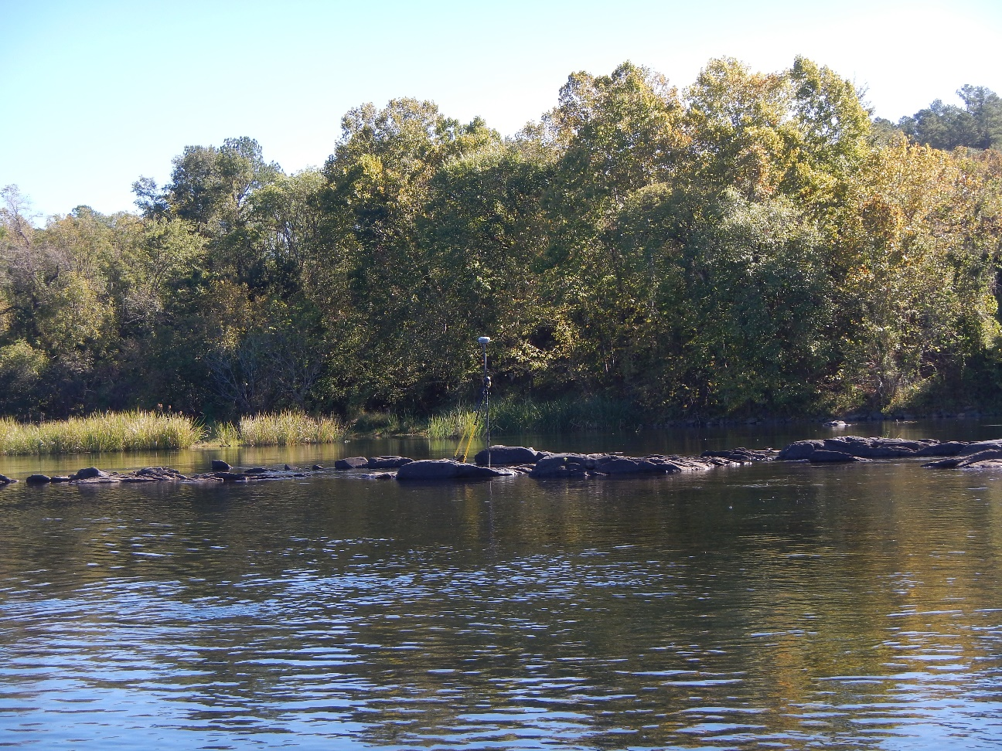
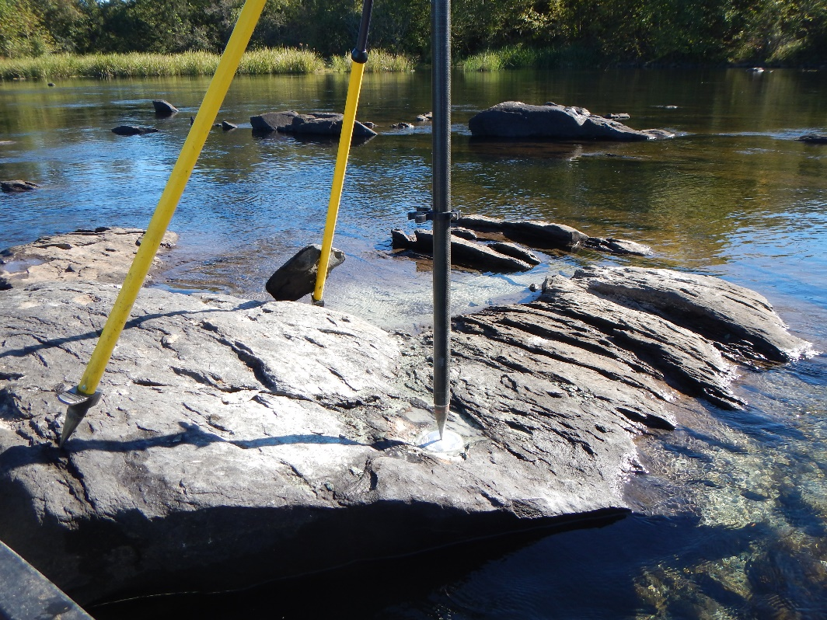
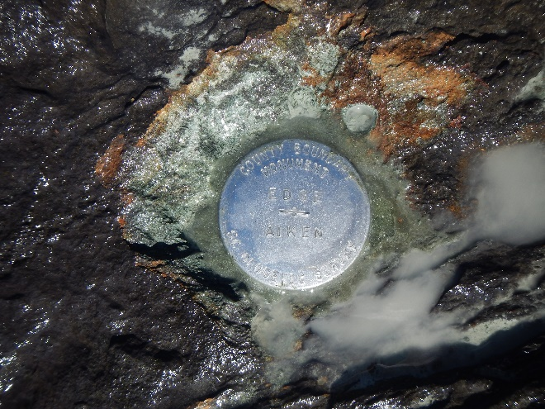
Mouth of Fox’s Creek

Slide 12
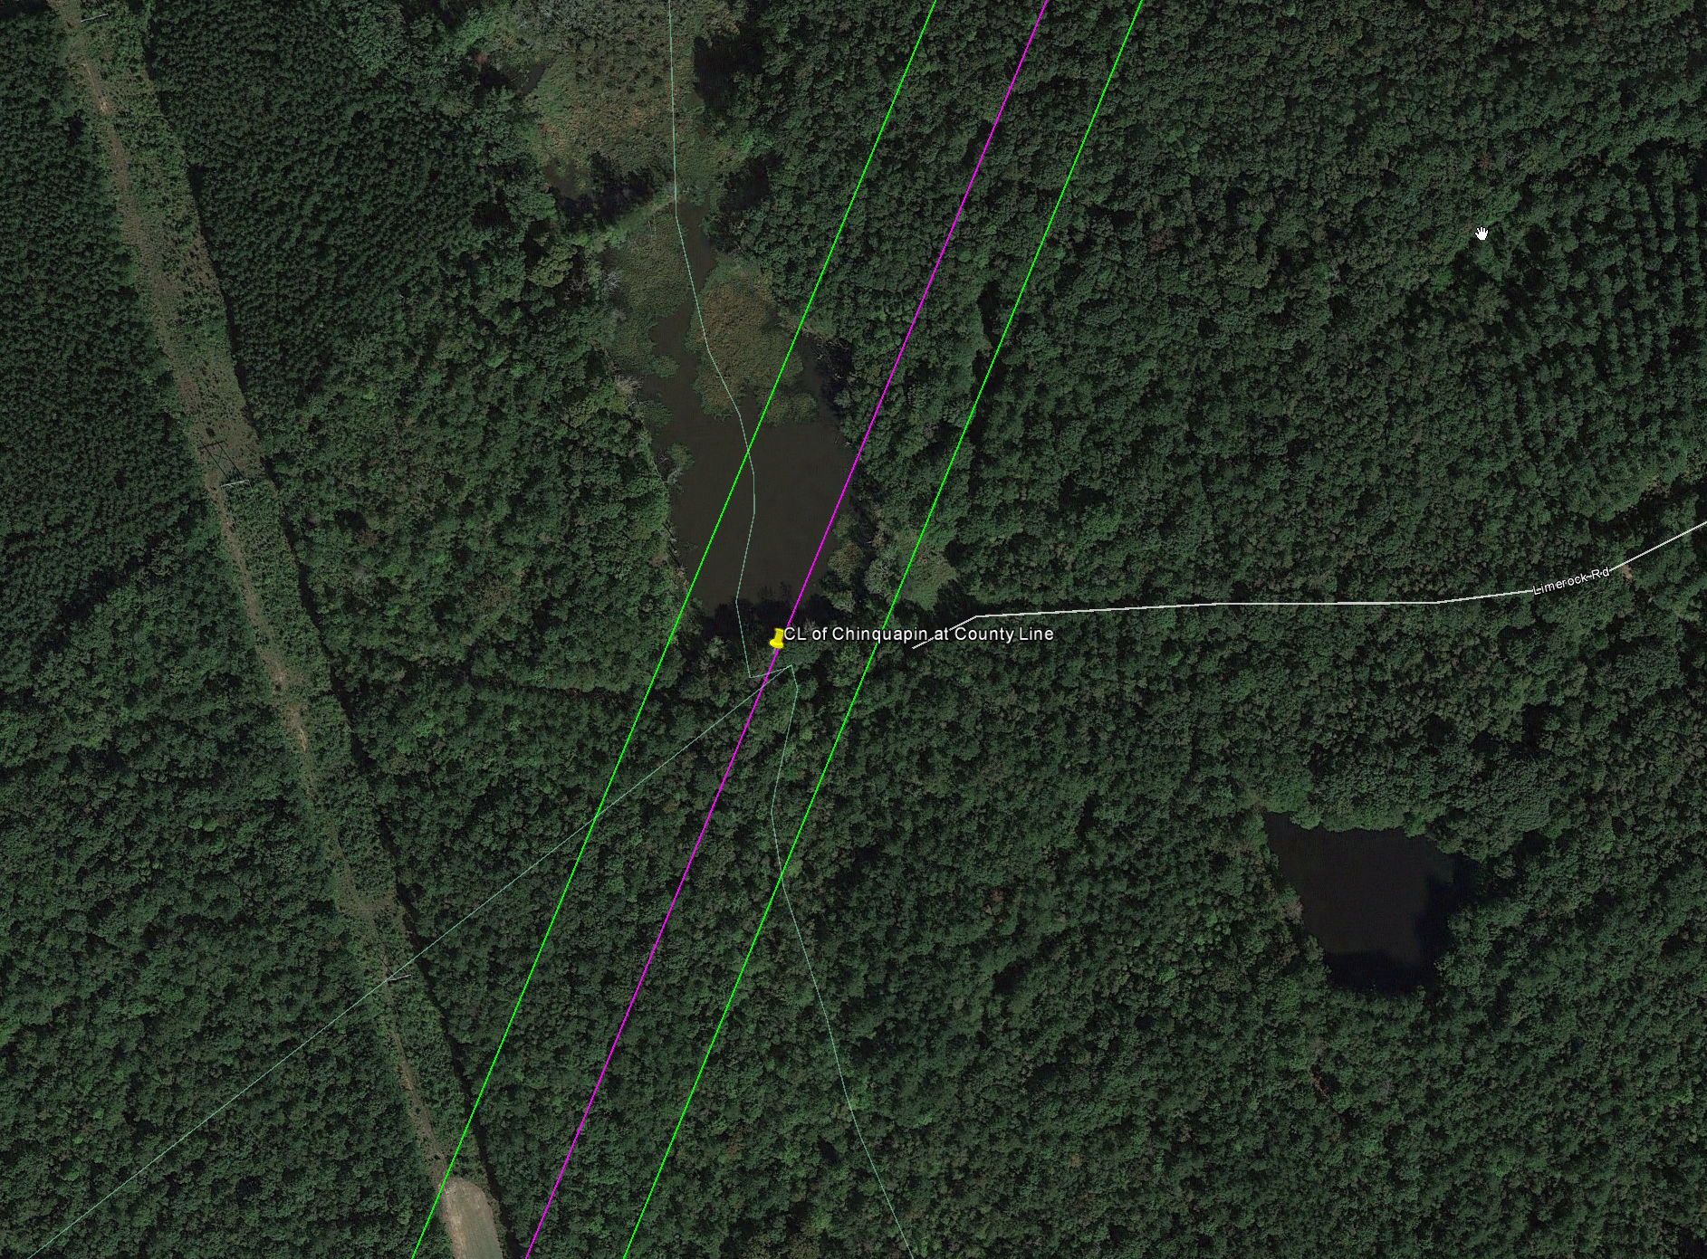
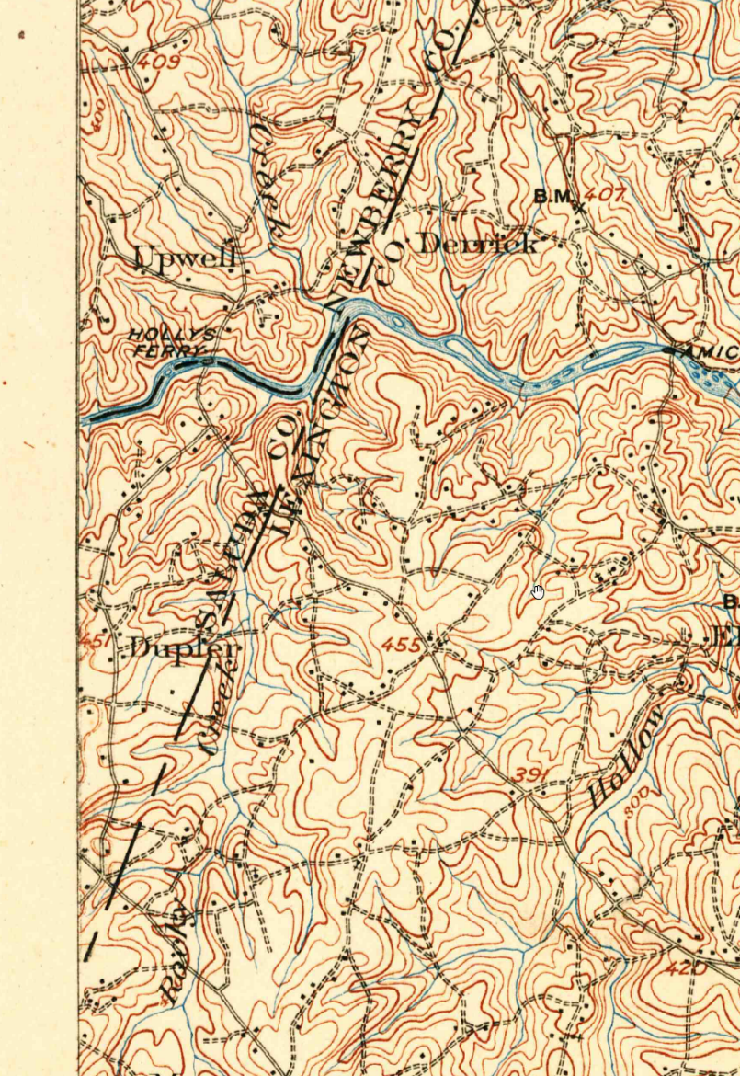
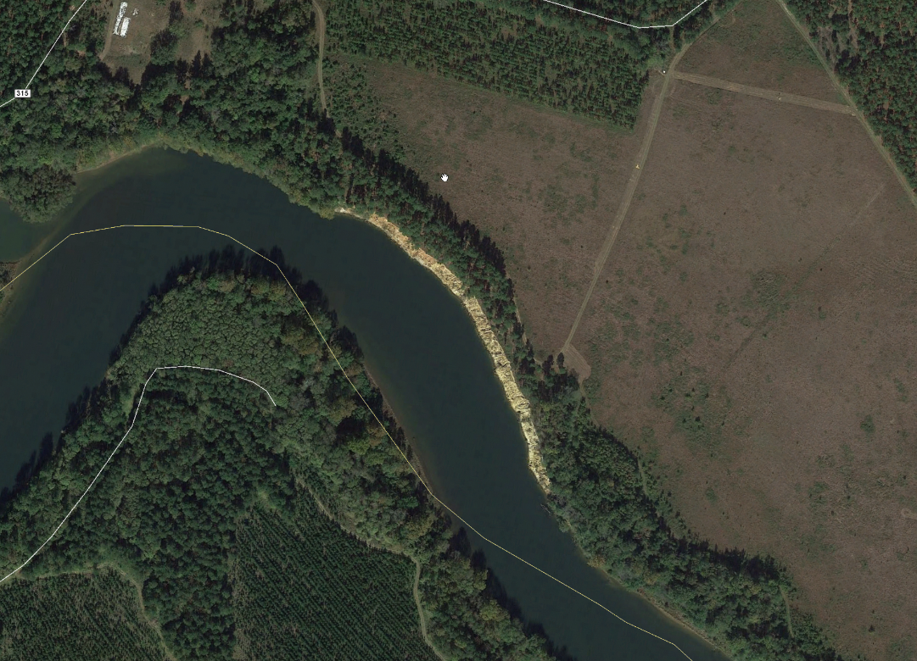

Slide 13
Draft of Current Survey

Slide 14
SC Code of Law and Act 262 Of 2014
Role of South Carolina Geodetic Survey
      (1994) Dispute between two or more counties- SCGS will act as mediator to resolve the dispute
      (1994/2014) SCGS to assist counties in defining and monumenting the locations of county boundaries and positioning the monuments using geodetic surveys where counties are ill-defined, unmarked, or poorly marked
      (2014) SCGS will clarify county boundaries as defined in Chapter 3, Title 4
      (2014) SCGS will analyze archival and other evidence and perform field surveys to position geographically all county boundaries in accordance with statutory descriptions

Slide 15
Steps for Clarifying Boundaries
Notify County Administrators in advance of planned work
Conduct historical research for documentary evidence of boundaries
Perform field work to locate monuments and corroborating evidence and position on State Plane Coordinates
Share preliminary findings with county officials for impact analysis and to plan public meetings
Receive feedback and input from local officials and public
Review and update findings, as appropriate
Work to build cooperation with affected parties

Slide 16
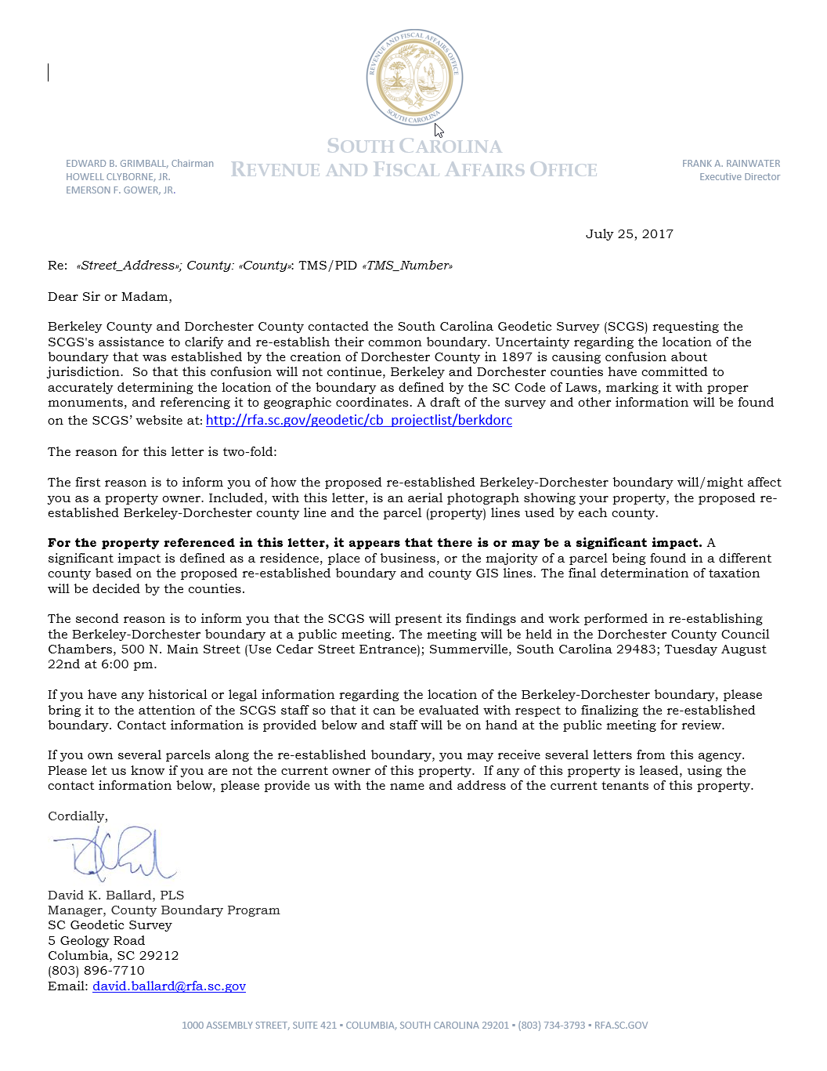
Public Meeting Notification

Slide 17
Scatter Gram of Differences
Between Observations
2 – Five Minute Sessions
RMSE(2-D) = 0.020m @95%
0.015m = ~0.05’
Axis Units in Meters

Slide 18

Scatter Gram of Differences
Between Observations
2 – Five Minute Sessions
RMSE(2-D) = 0.020m @95%
0.015m = ~0.05’
Axis Units in Meters

Slide 19
Act 262 of 2014
Steps for Clarifying Boundaries
SCGS Requirements:
    Upon reestablishing county boundary, SCGS shall certify its work and within 30 days of certification:
        Provide copies to the administrator of each affected county;
        Provide written notification to affected parties
        Provide notice and copies to the public through its official website and or other means it considers appropriate; and
        Notify as it determines appropriate, other affected state and federal agencies
    (Initiates 60 Day Appeal Process)
  Certified Surveys submitted to Secretary of State, Register of Deeds Offices, and South Carolina Department of Archives with Cover Letter
  Date of the cover letter is the date the surveys become effective
  Introduce Legislation to update Code of Law to reflect clarified boundary with State Plane Coordinates

Slide 20
Act 262 of 2014
Affected Parties Disagreeing with SCGS:
    May file request for a contested case hearing with the SC Administrative Law Court
    This decision may be appealed
    “Affected Party”
              Governing body of an affected county
              Governing body of a political subdivision of this State
              An elected official, other than a statewide elected official
              A property owner or an individual residing in the certification zone
              A business entity located in the certification zone
              A nonresident individual who owns or leases real property situated in the certification zone

Slide 21
SIGNIFICANT IMPACTS?
A significant impact for this section of boundary has been defined as a residence, place of business, or a the majority of a parcel being found in a different county based on the re-established boundary.
Reviewed Over 550 Properties Along the nearly 34.75 Mile Section of Re-established Boundary:
Determined 0 Significant Impacts

Slide 22
QUESTIONS?

