Slide 1
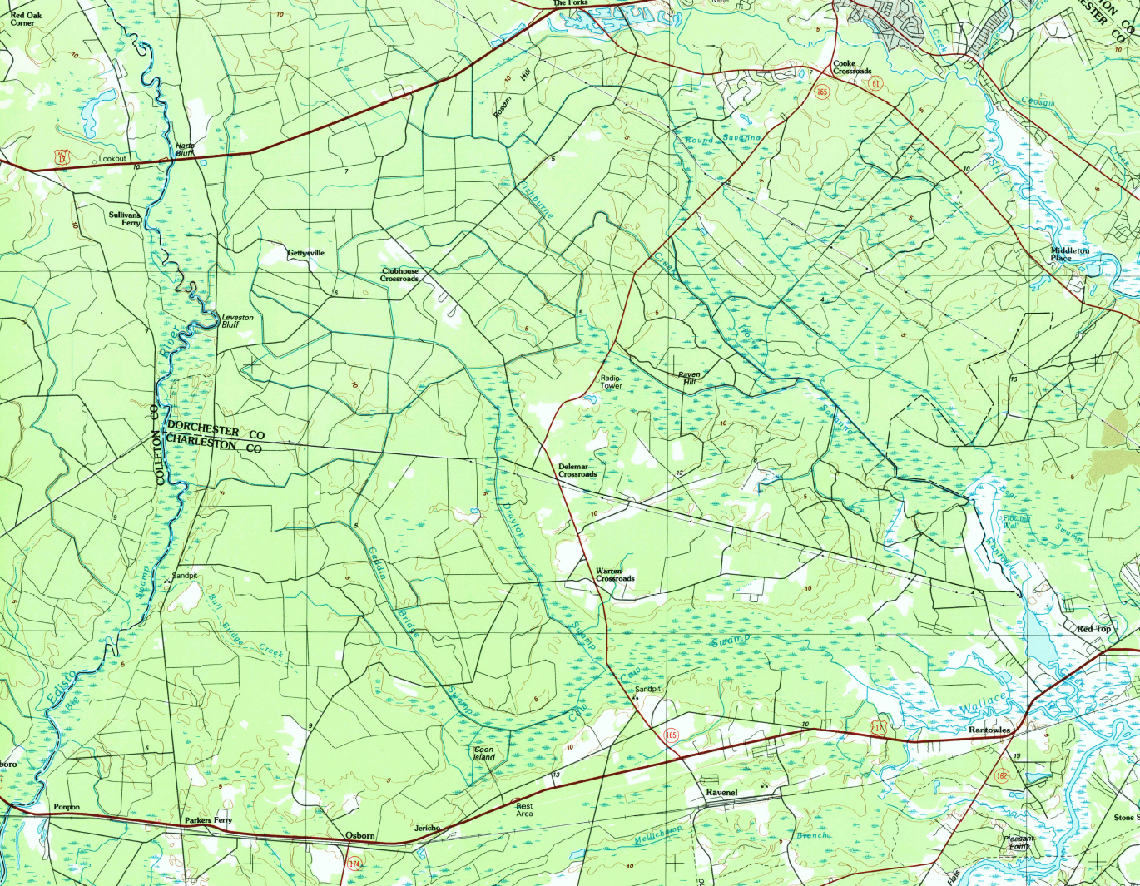
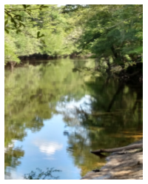
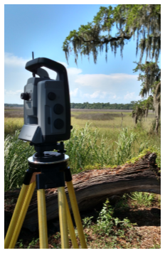
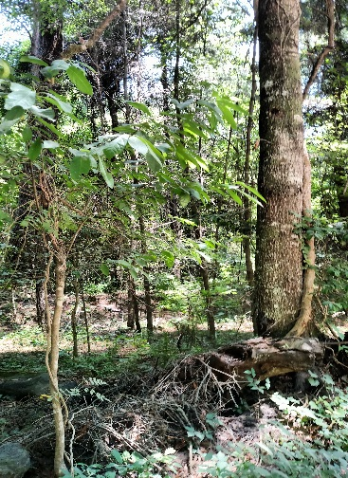

CHARLESTON/DORCHESTER COUNTY LINE RE-ESTABLISHMENT
PROJECT:
In 2014, South Carolina Geodetic Survey was asked by Charleston and Dorchester counties to assist in re-establishing their common boundary along County Line Road.
David Ballard, PLS
Revenue and Fiscal Affairs
SC Geodetic Survey
2014-2016

Slide 2
CHARLESTON/DORCHESTER COUNTY LINE RE-ESTABLISHMENT
Act 346 of 1897 “AN ACT to establish Dorchester County” and Code of Laws of South Carolina 1902:
… lying north of the public road leading from Parker’s Ferry upon the Edisto River to a public landing known as Loundes Landing upon Rantowles Creek…
Act 346 of 1897 “AN ACT to establish Dorchester County”
Act 346 of 1897 “AN ACT to establish Dorchester County”
Act 171 of 1911:
Act 165 of 1953 and Code of Laws of South Carolina 1962:

Slide 3
CHARLESTON/DORCHESTER COUNTY LINE RE-ESTABLISHMENT
… lying north of the public road leading from Parker’s Ferry upon the Edisto River to a public landing known as Lowndes Landing upon Rantowles Creek…
Act 346 of 1897 “AN ACT to establish Dorchester County” and Code of Laws of South Carolina 1902:
Act 171 of 1911:
Act 165 of 1953 and Code of Laws of South Carolina 1962:

Slide 4
CHARLESTON/DORCHESTER COUNTY LINE RE-ESTABLISHMENT
… lying north of the public road leading from Parker’s Ferry upon the Edisto River to a public landing known as Lowndes Landing upon Rantowles Creek…
Parker’s Ferry
Public Road
Lownde’s Landing

Slide 5
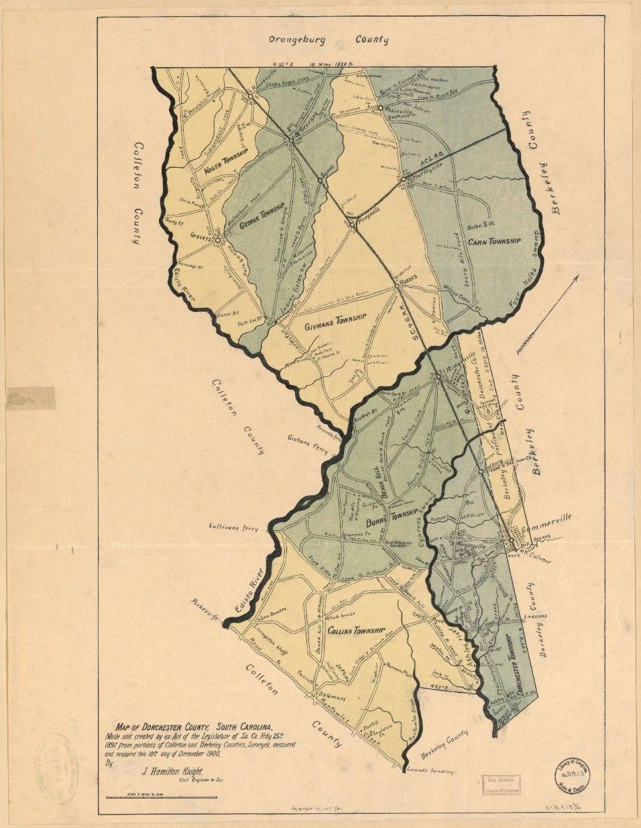
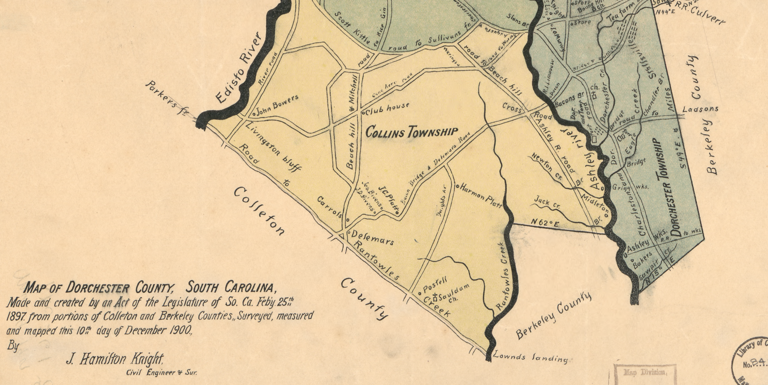
CHARLESTON/DORCHESTER COUNTY LINE RE-ESTABLISHMENT

Slide 6
CHARLESTON/DORCHESTER COUNTY LINE RE-ESTABLISHMENT
Act 346 of 1897 “AN ACT to establish Dorchester County” and Code of Laws of South Carolina 1902:
… lying north of the public road leading from Parker’s Ferry upon the Edisto River to a public landing known as Lowndes Landing upon Rantowles Creek…
… Beginning at a point on Rantowles Creek, where the Dorchester and Colleton county lines now come together; then running west along the lines [sic] between Dorchester and Colleton county to Edisto River; …
Act 171 of 1911: Annexation of a portion of Colleton County into Charleston County
Act 165 of 1953 and Code of Laws of South Carolina 1962:

Slide 7
CHARLESTON/DORCHESTER COUNTY LINE RE-ESTABLISHMENT
Parker’s Ferry
Public Road
Lownde’s Landing

Slide 8
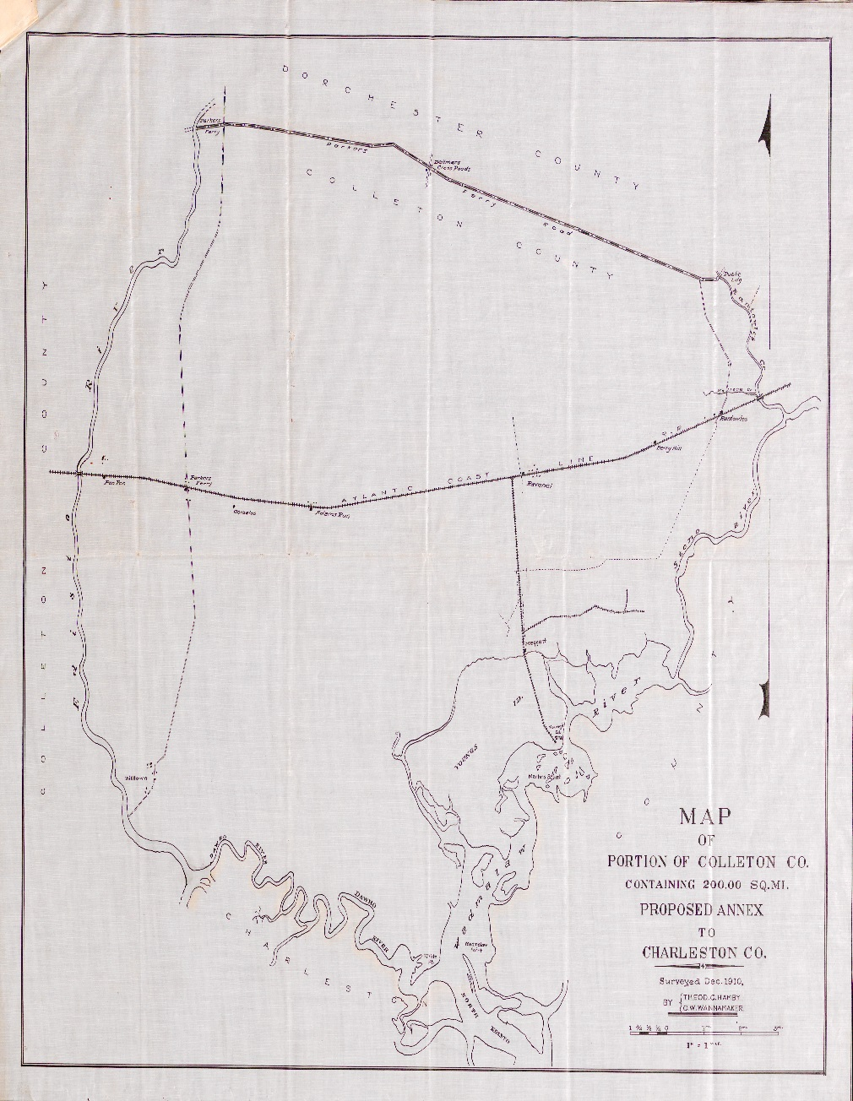
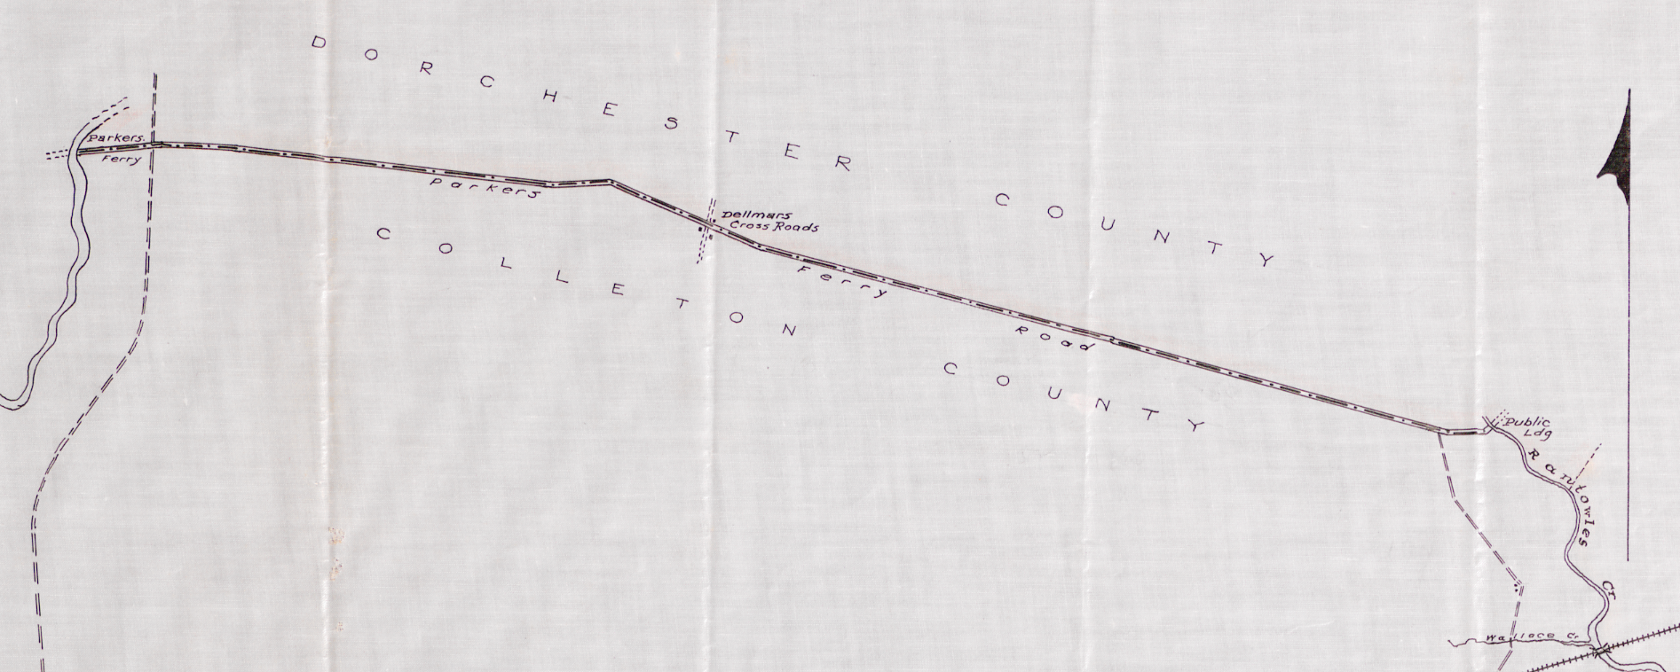
CHARLESTON/DORCHESTER COUNTY LINE RE-ESTABLISHMENT

Slide 9
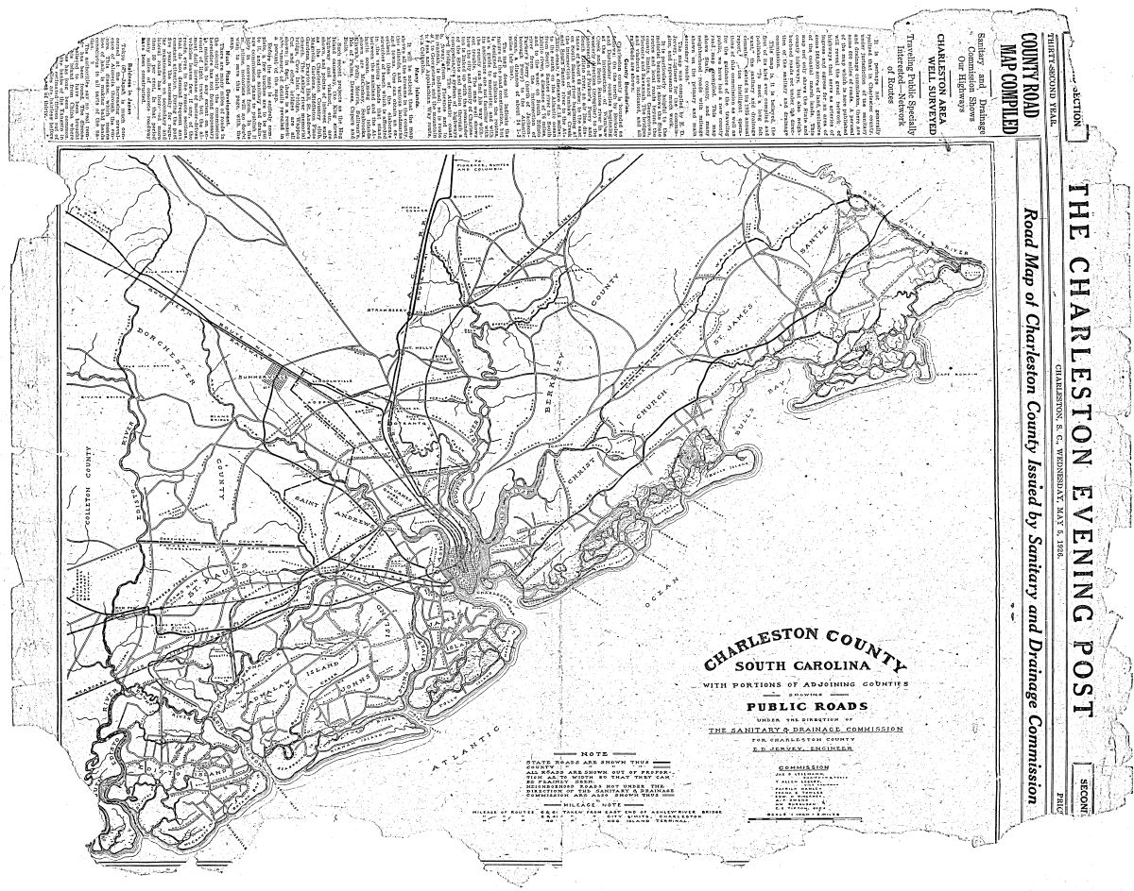
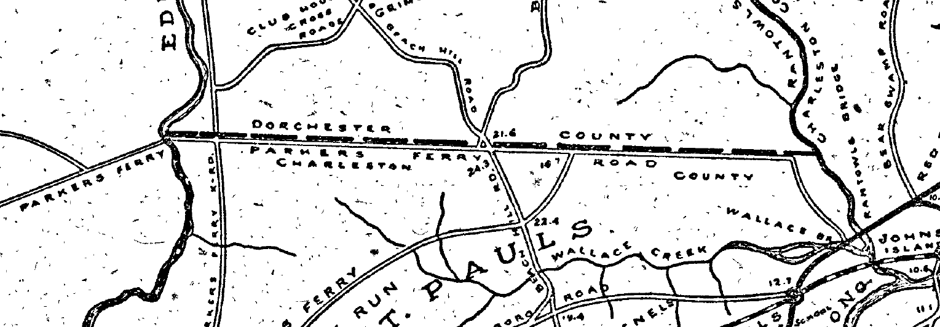
CHARLESTON/DORCHESTER COUNTY LINE RE-ESTABLISHMENT

Slide 10
CHARLESTON/DORCHESTER COUNTY LINE RE-ESTABLISHMENT
Act 346 of 1897 “AN ACT to establish Dorchester County” and Code of Laws of South Carolina 1902:
… lying north of the public road leading from Parker’s Ferry upon the Edisto River to a public landing known as Lowndes Landing upon Rantowles Creek…
Act 171 of 1911:
… Beginning at a point on Rantowles Creek, where the Dorchester and Colleton county lines now come together; then running west along the lines [sic] between Dorchester and Colleton county to Edisto River; …
… where the Dorchester County line intersects the Edisto River; thence easterly along the center line of the Parker’s Ferry Road to the intersection with Rantowles Creek; thence northerly up Rantowles Creek …
Act 165 of 1953 and Code of Laws of South Carolina 1962:

Slide 11
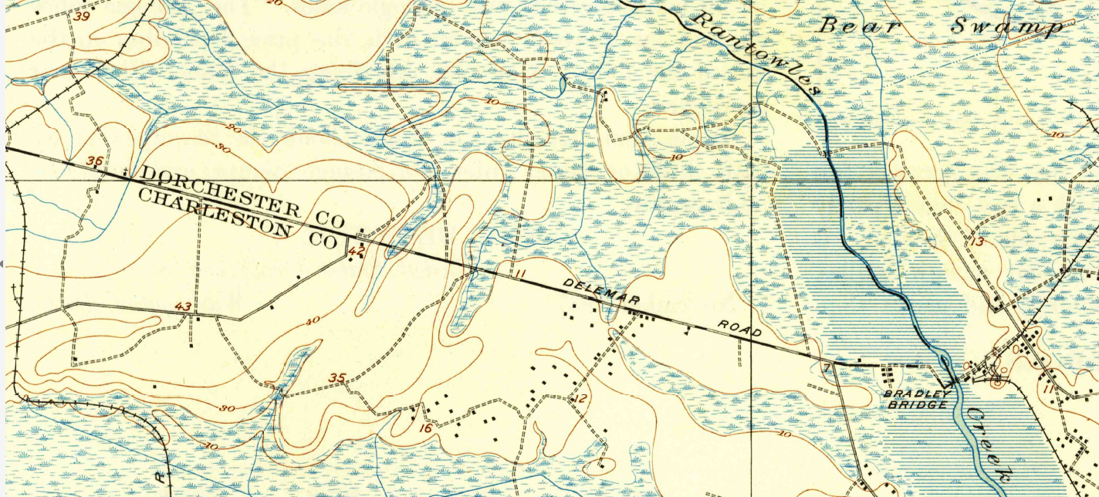
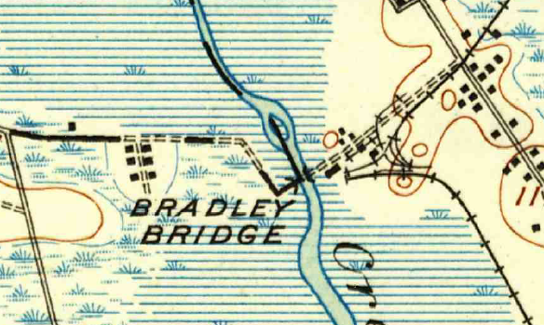
CHARLESTON/DORCHESTER COUNTY LINE RE-ESTABLISHMENT
…along the center line of the Parker’s Ferry Road to the intersection with Rantowles Creek…
Lownde’s Landing
Bradley’s Bridge

Slide 12
CHARLESTON/DORCHESTER COUNTY LINE RE-ESTABLISHMENT
North of the Public Road
vs
Center Line of the Road
Lownde’s Landing
vs
Bradley’s Bridge

Slide 13
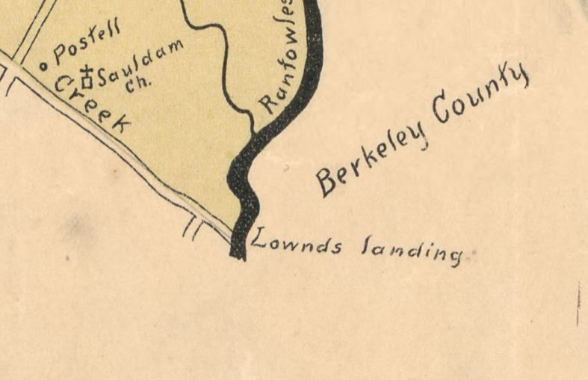
BULOW LANDING aka LOWNDE’S LANDING
…to a public landing known as Lowndes Landing upon Rantowles Creek…

Slide 14
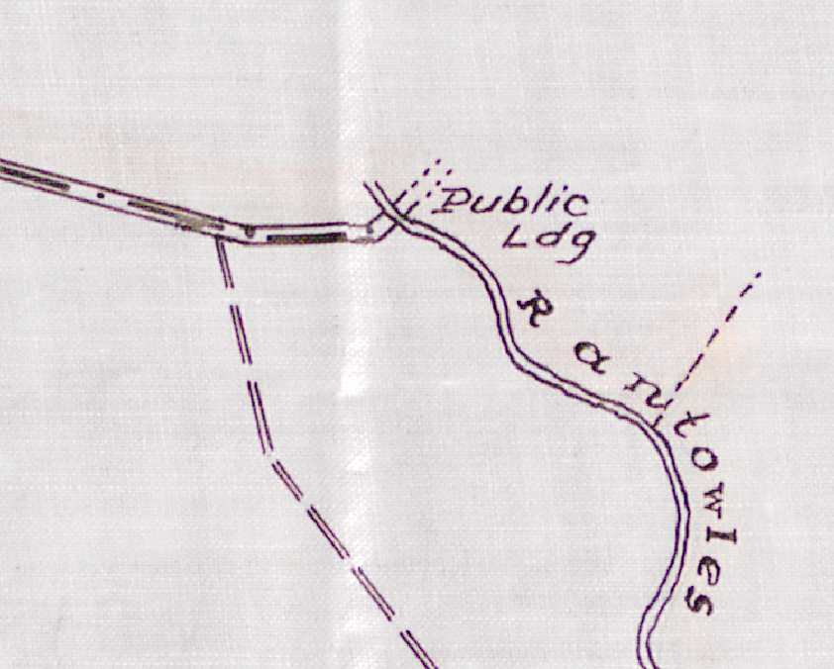
BULOW LANDING aka LOWNDE’S LANDING
…to a public landing known as Lowndes Landing upon Rantowles Creek…

Slide 15
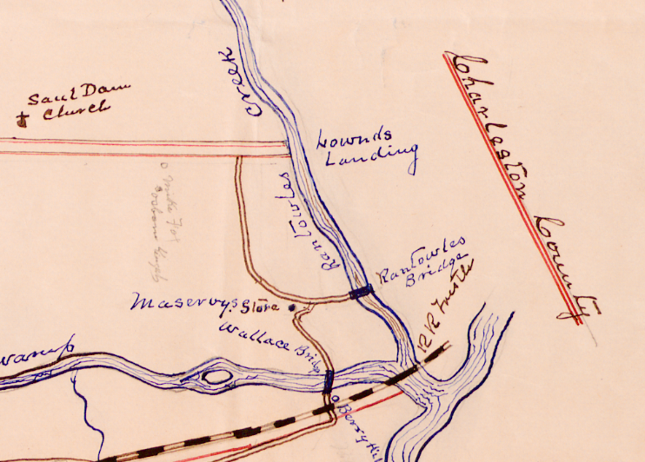
BULOW LANDING aka LOWNDE’S LANDING
…to a public landing known as Lowndes Landing upon Rantowles Creek…

Slide 16
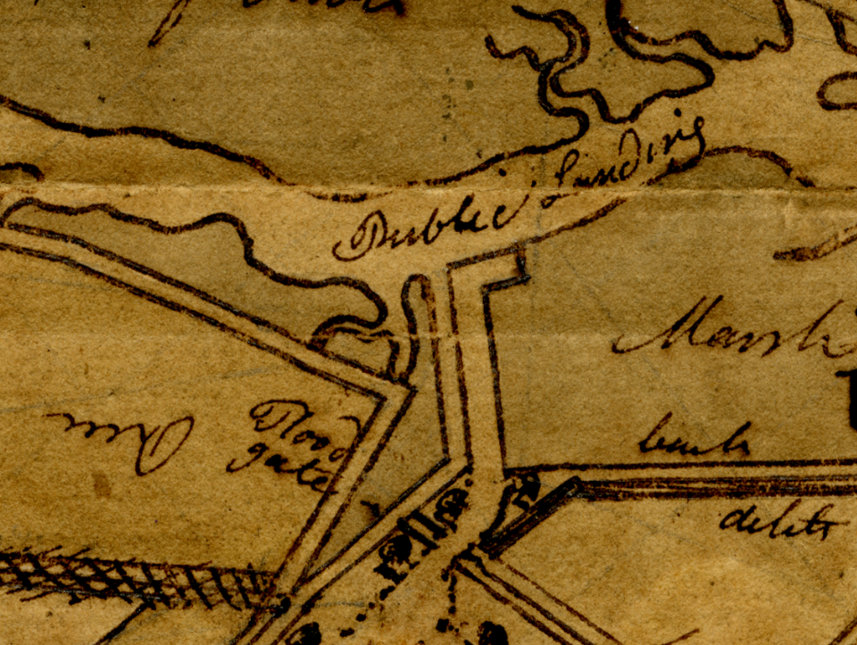
BULOW LANDING aka LOWNDE’S LANDING
…to a public landing known as Lowndes Landing upon Rantowles Creek…

Slide 17
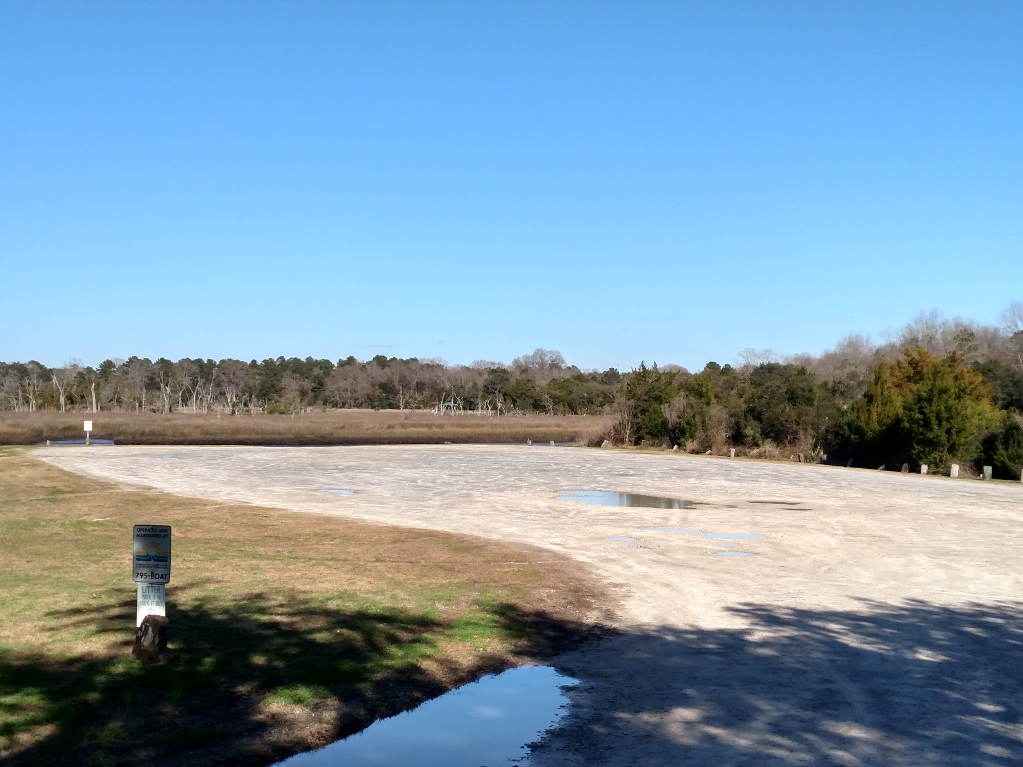
BULOW LANDING aka LOWNDE’S LANDING
…to a public landing known as Lowndes Landing upon Rantowles Creek…

Slide 18
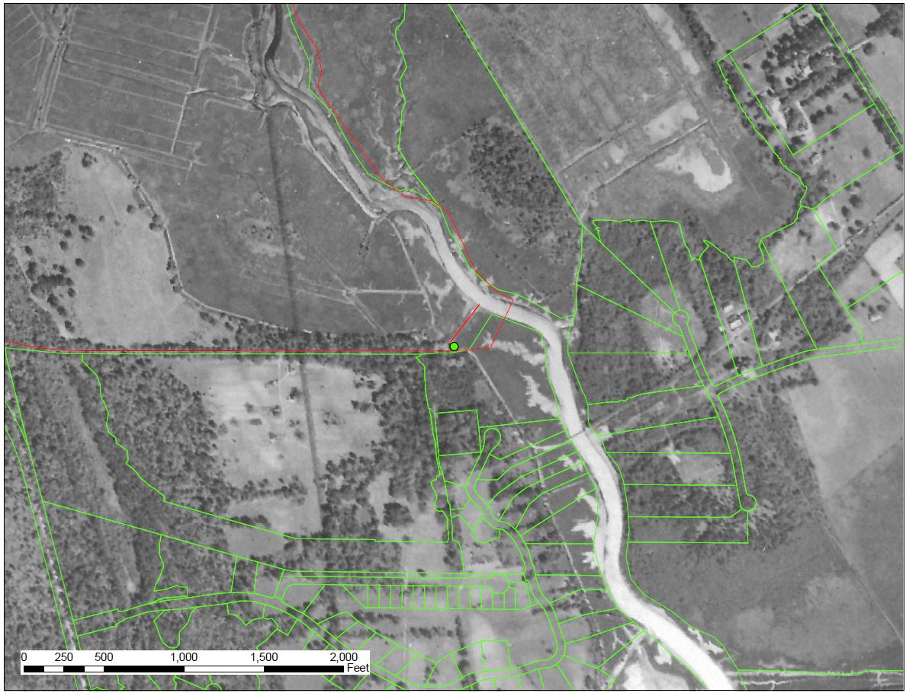
BULOW LANDING aka LOWNDE’S LANDING
…to a public landing known as Lowndes Landing upon Rantowles Creek…
Lownde’s Landing

Slide 19
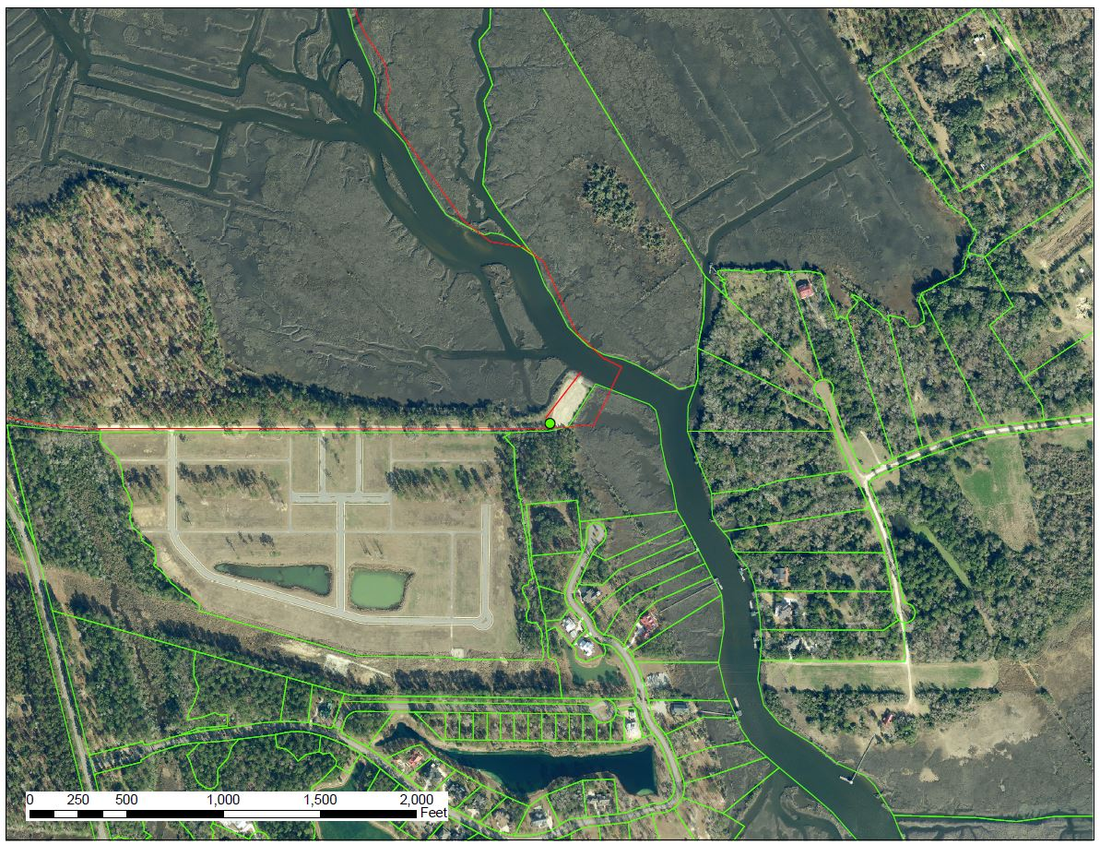
BULOW LANDING aka LOWNDE’S LANDING
…to a public landing known as Lowndes Landing upon Rantowles Creek…
Lownde’s Landing

Slide 20
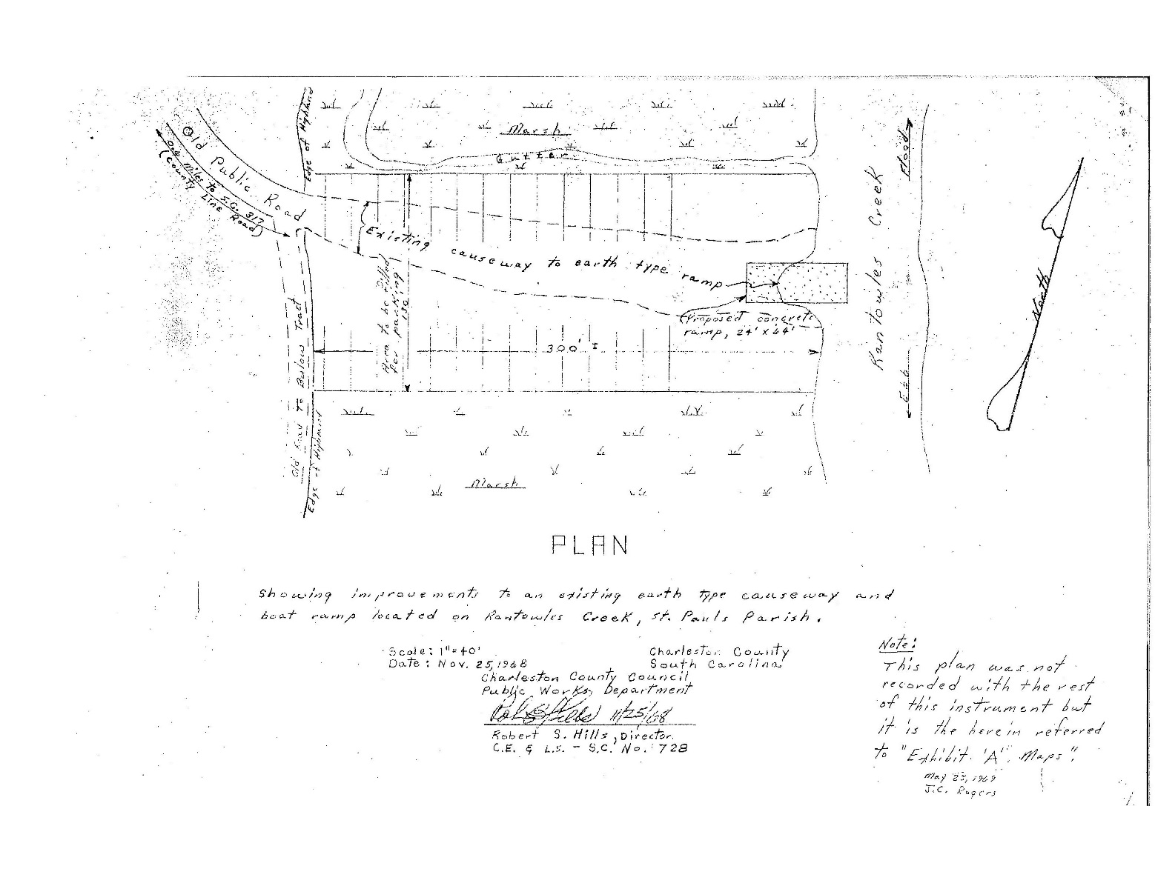
BULOW LANDING aka LOWNDE’S LANDING
…to a public landing known as Lowndes Landing upon Rantowles Creek…

Slide 21
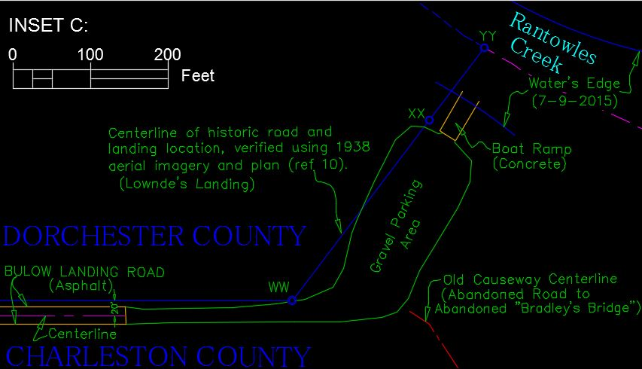
BULOW LANDING aka LOWNDE’S LANDING
…to a public landing known as Lowndes Landing upon Rantowles Creek…

Slide 22
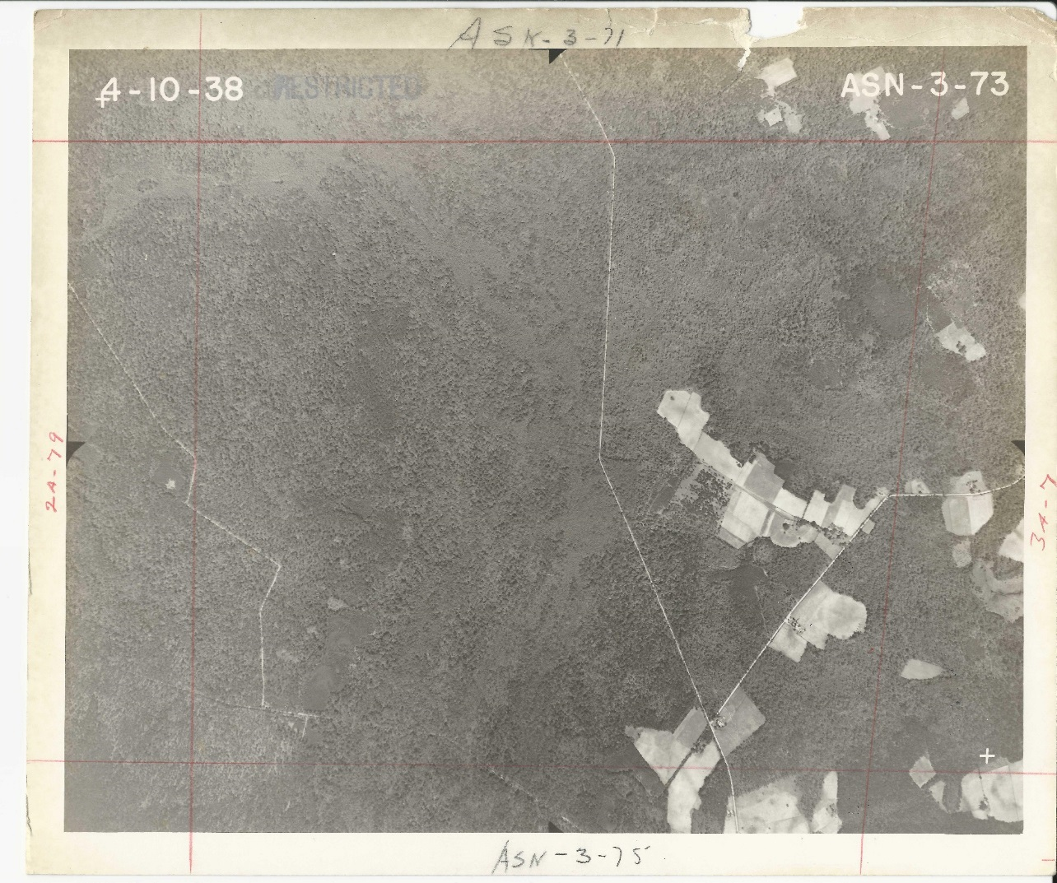
PUBLIC ROAD aka COUNTY LINE ROAD aka PARKER’S FERRY ROAD
… lying north of the public road leading from Parker’s Ferry upon the Edisto River to a public landing known as Lowndes Landing upon Rantowles Creek …

Slide 23
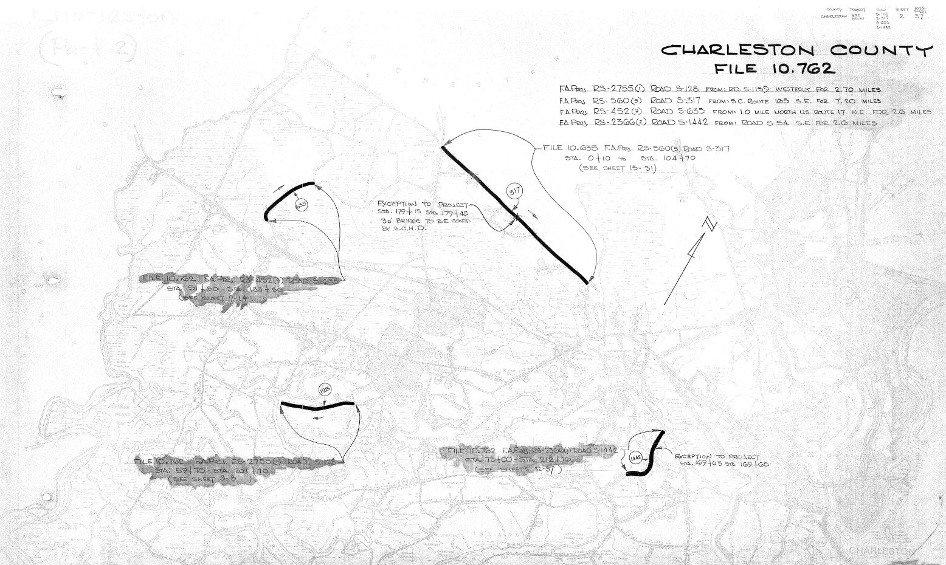
PUBLIC ROAD aka COUNTY LINE ROAD aka PARKER’S FERRY ROAD
… lying north of the public road leading from Parker’s Ferry upon the Edisto River to a public landing known as Lowndes Landing upon Rantowles Creek …

Slide 24
PUBLIC ROAD aka COUNTY LINE ROAD aka PARKER’S FERRY ROAD
… lying north of the public road leading from Parker’s Ferry upon the Edisto River to a public landing known as Lowndes Landing upon Rantowles Creek …

Slide 25
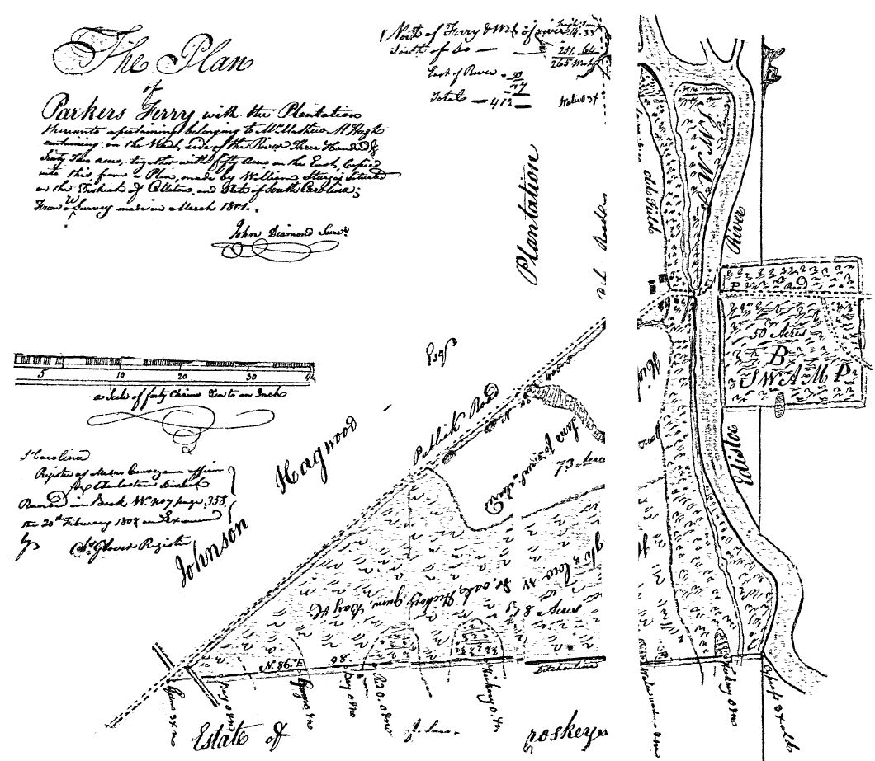
PUBLIC ROAD aka COUNTY LINE ROAD aka PARKER’S FERRY ROAD
… lying north of the public road leading from Parker’s Ferry upon the Edisto River to a public landing known as Lowndes Landing upon Rantowles Creek …

Slide 26
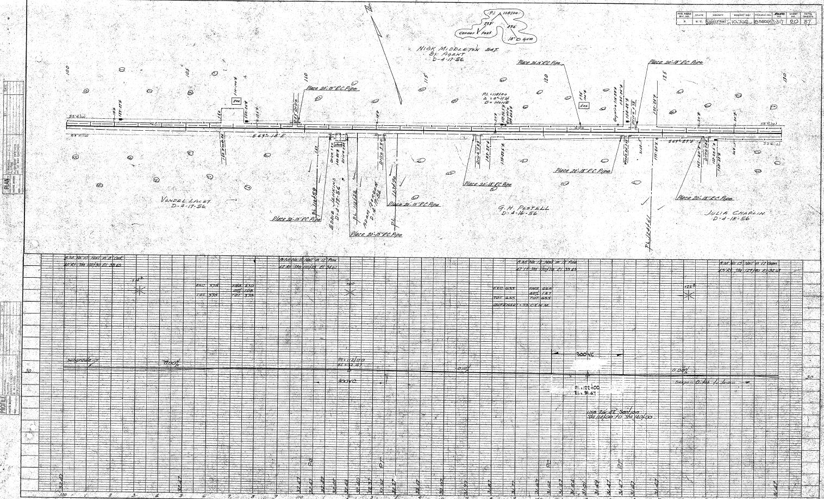
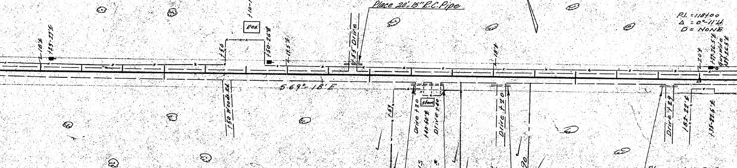
PUBLIC ROAD aka COUNTY LINE ROAD aka PARKER’S FERRY ROAD
… lying north of the public road leading from Parker’s Ferry upon the Edisto River to a public landing known as Lowndes Landing upon Rantowles Creek …
18’ CL
19.5’ CL
18’ CL
20’ CL
22’ CL

Slide 27
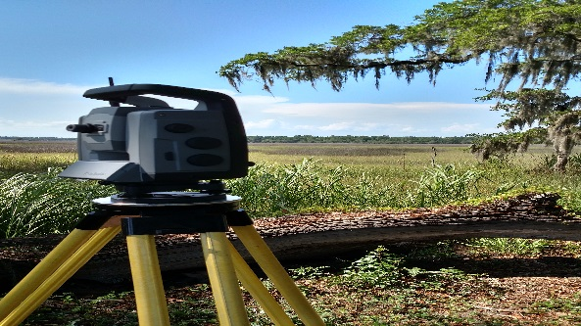
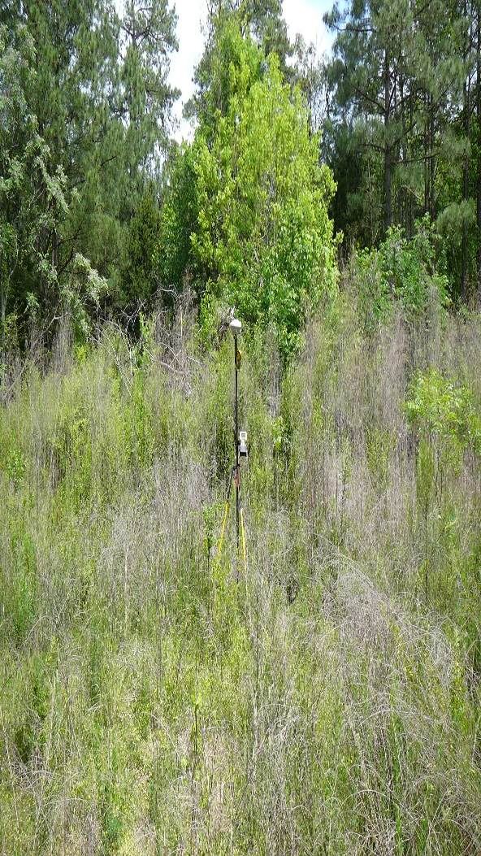
PUBLIC ROAD aka COUNTY LINE ROAD aka PARKER’S FERRY ROAD
… lying north of the public road leading from Parker’s Ferry upon the Edisto River to a public landing known as Lowndes Landing upon Rantowles Creek …

Slide 28
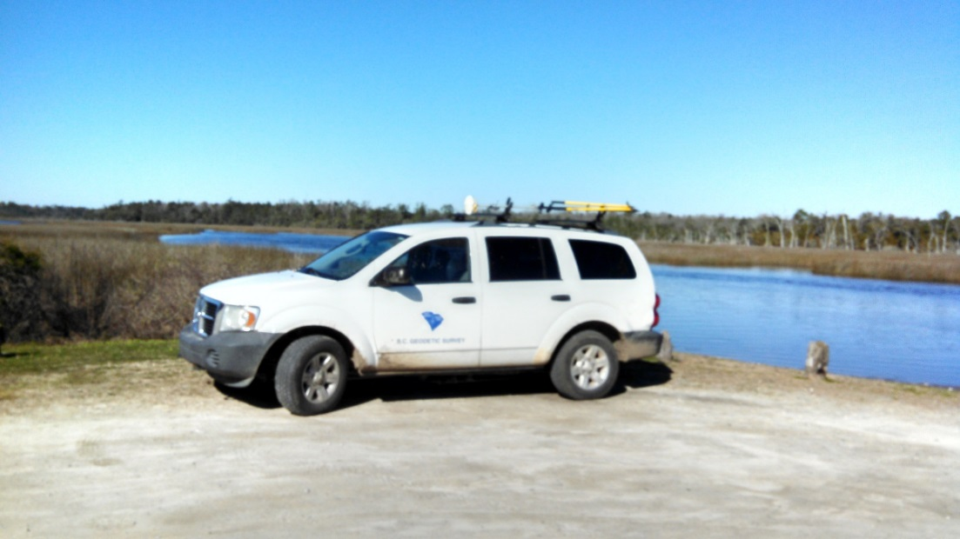
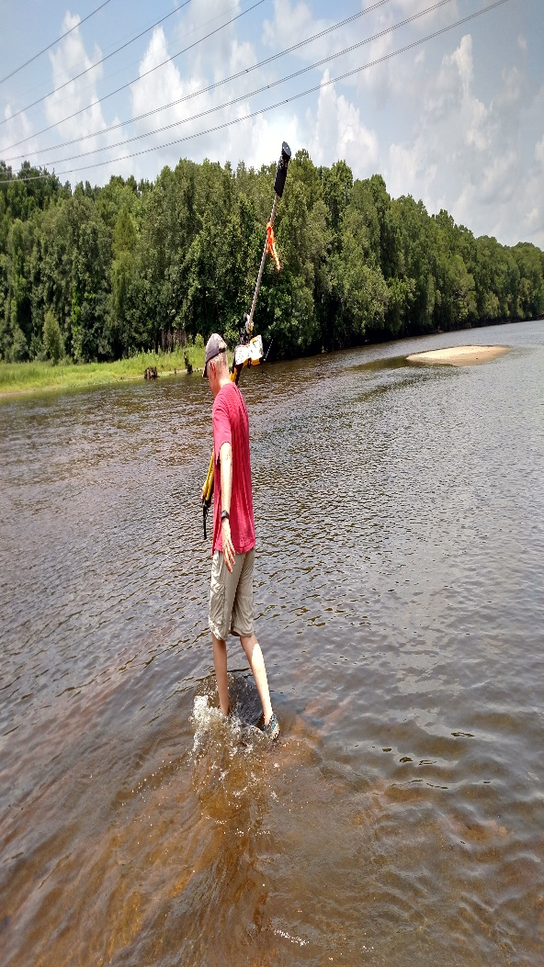
PUBLIC ROAD aka COUNTY LINE ROAD aka PARKER’S FERRY ROAD
… lying north of the public road leading from Parker’s Ferry upon the Edisto River to a public landing known as Lowndes Landing upon Rantowles Creek …

Slide 29
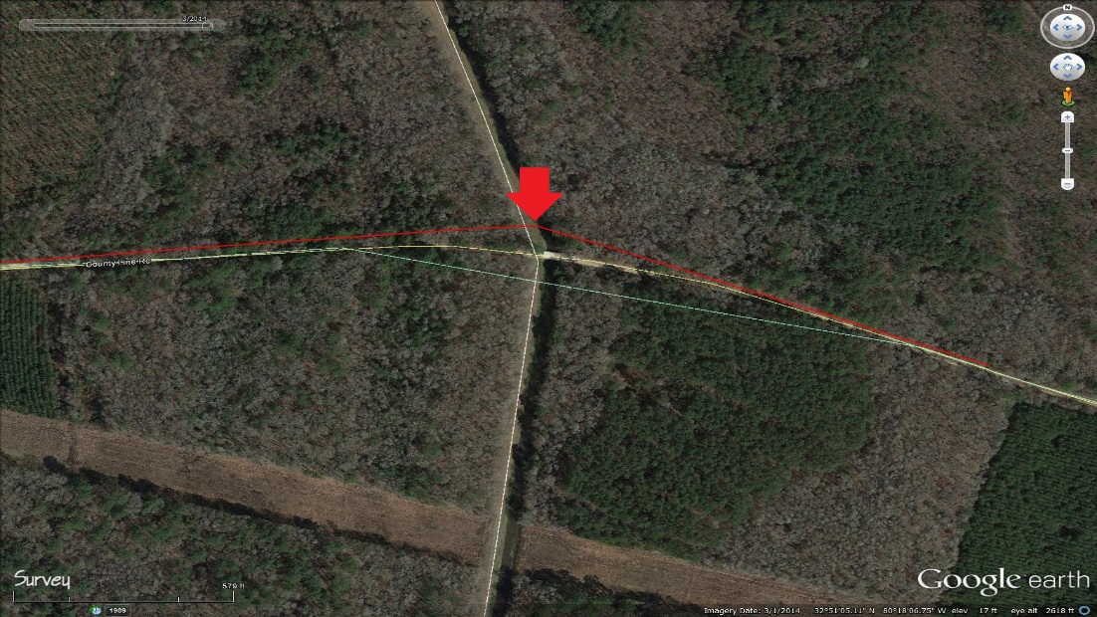
PUBLIC ROAD aka COUNTY LINE ROAD aka PARKER’S FERRY ROAD
… lying north of the public road leading from Parker’s Ferry upon the Edisto River to a public landing known as Lowndes Landing upon Rantowles Creek …

Slide 30
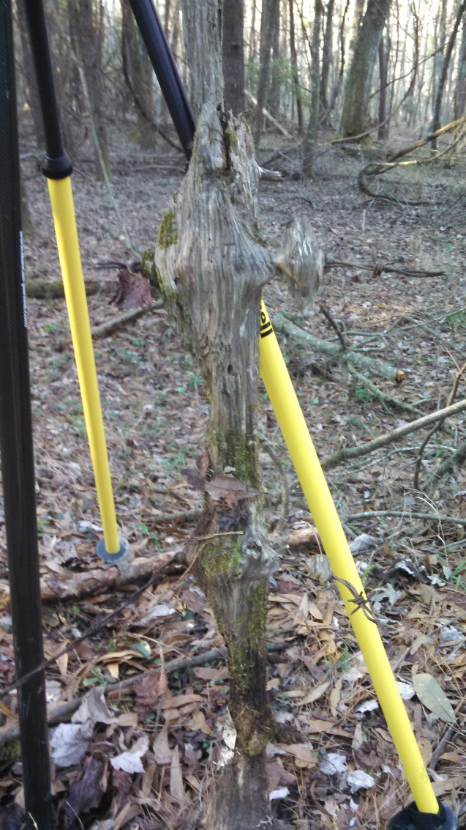
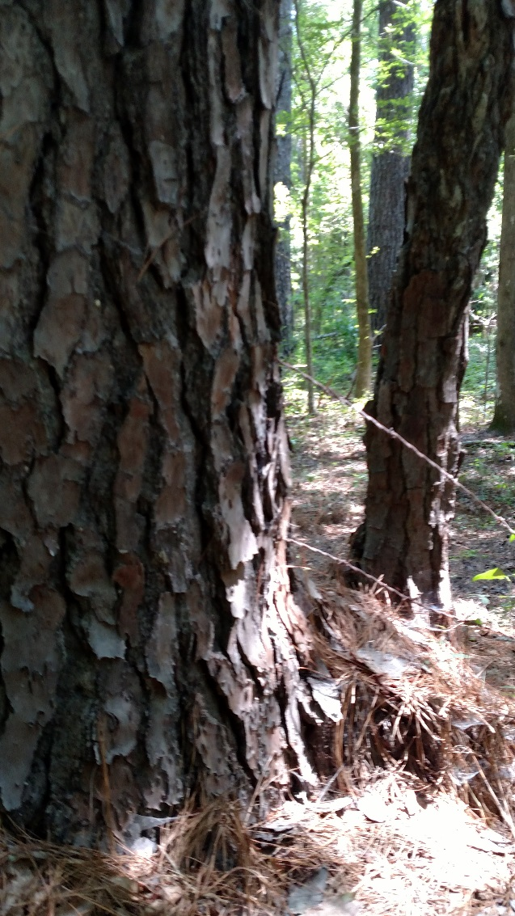
PUBLIC ROAD aka COUNTY LINE ROAD aka PARKER’S FERRY ROAD
… lying north of the public road leading from Parker’s Ferry upon the Edisto River to a public landing known as Lowndes Landing upon Rantowles Creek …

Slide 31
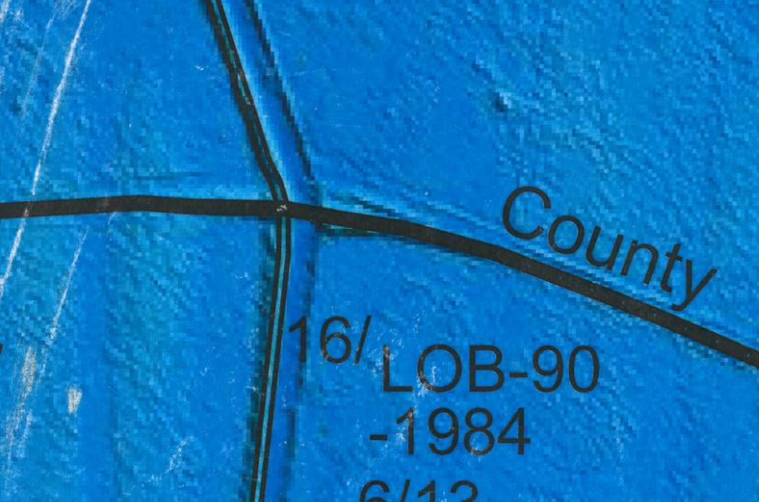
PUBLIC ROAD aka COUNTY LINE ROAD aka PARKER’S FERRY ROAD
… lying north of the public road leading from Parker’s Ferry upon the Edisto River to a public landing known as Lowndes Landing upon Rantowles Creek …
Causeway
Berm

Slide 32
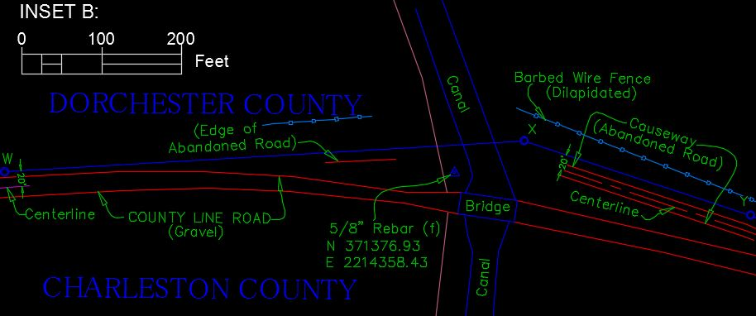
PUBLIC ROAD aka COUNTY LINE ROAD aka PARKER’S FERRY ROAD
… lying north of the public road leading from Parker’s Ferry upon the Edisto River to a public landing known as Lowndes Landing upon Rantowles Creek …

Slide 33
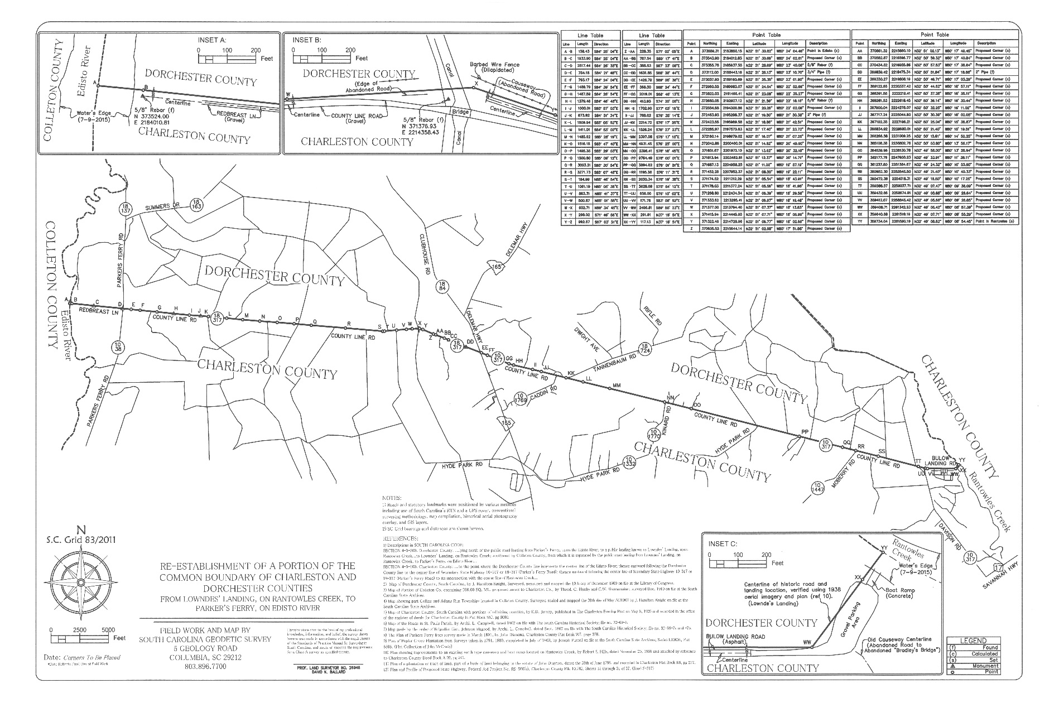
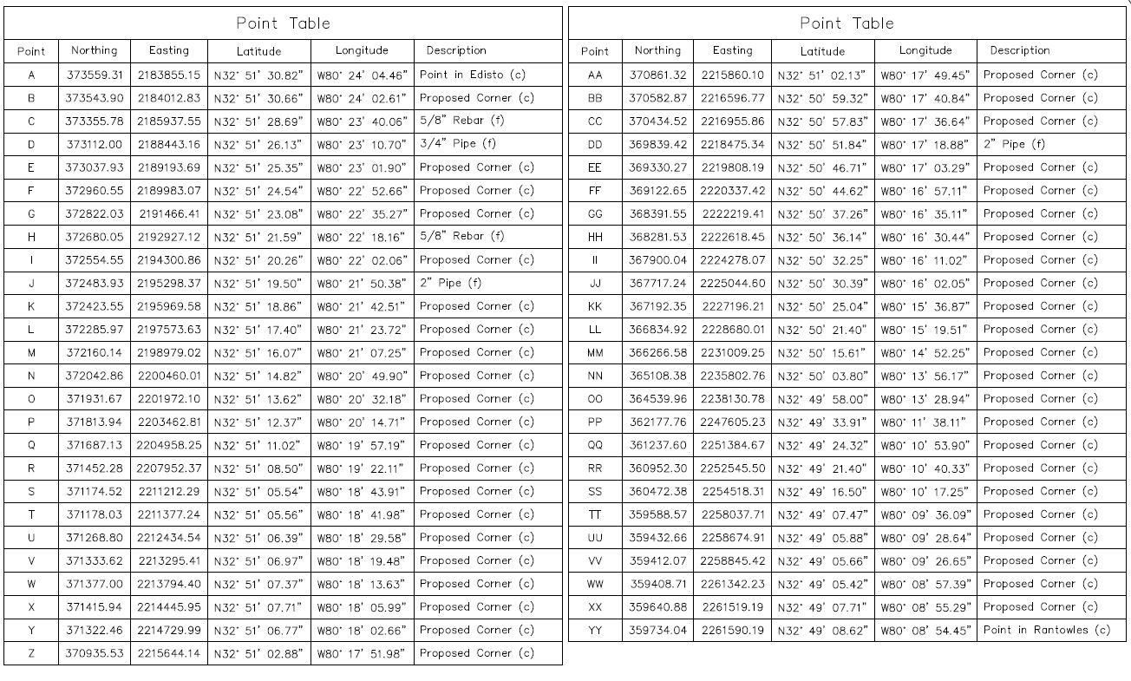
CHARLESTON/DORCHESTER COUNTY LINE RE-ESTABLISHMENT

Slide 34
CHARLESTON/DORCHESTER COUNTY LINE RE-ESTABLISHMENT
QUESTIONS?

