Slide 1
Cherokee – York County Line
From Kings Creek to the clarified North Carolina Boundary
Prepared by: CESI
2016

Slide 2
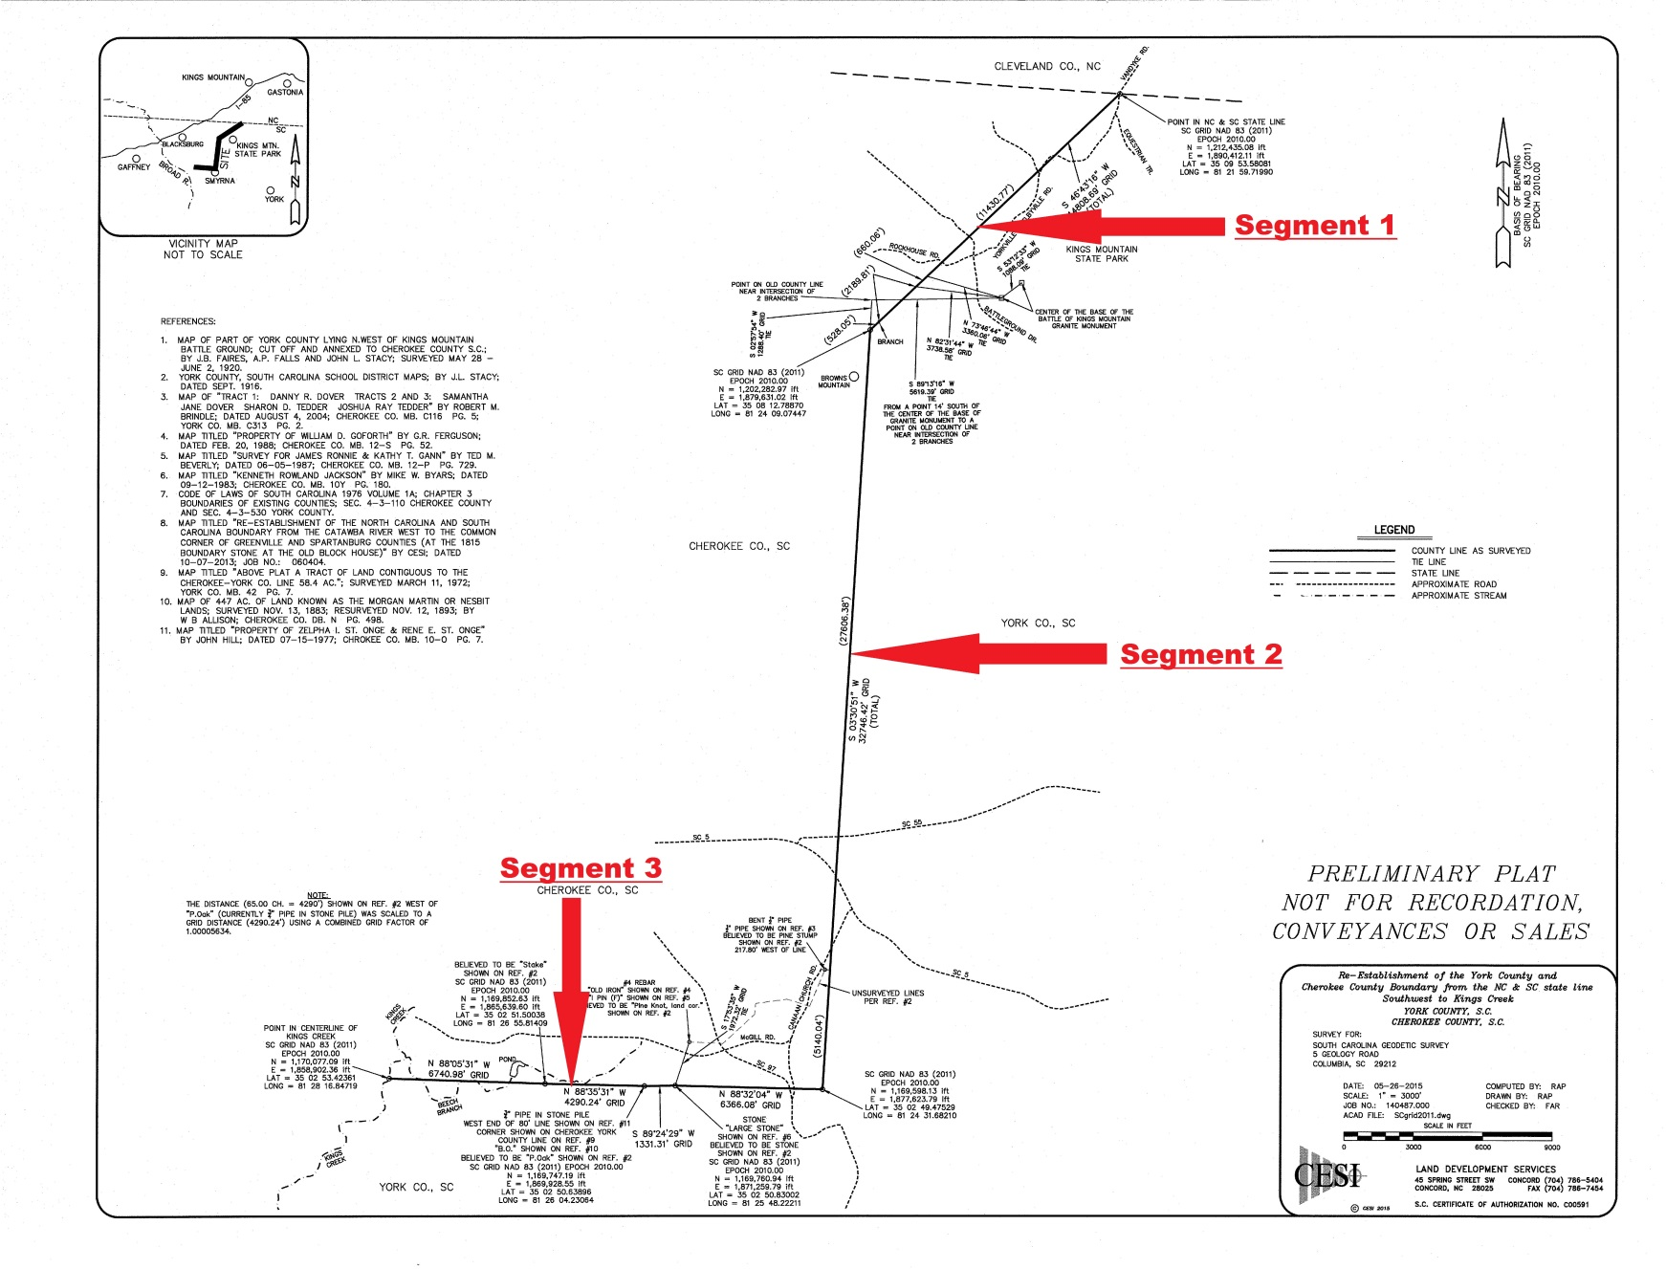
Cherokee-York County Line

Slide 3
Cherokee-York County Line
York County was created in 1785 with the Broad River as its western boundary
Cherokee County was formed in 1897 from parts of Spartanburg, Union, and York counties
Cherokee Township, York County, became the northeastern corner of Cherokee County, SC

Slide 4
Cherokee-York County Line
East of the Broad River the 1897 original boundary between Cherokee and York counties was what had been the township line between Cherokee township and Kings Mountain township, York County
The layout and surveying of the original York County townships is described in The 1868 Township Law and York County, SC

Slide 5
Cherokee-York County Line
11 February 1921 the SC General Assembly approved an addition of 2 sq. miles to Cherokee County, to be annexed from York County
A plat showing this annexation was filed with SC Archives 25 June 1920
The plat lists surveyors J. B. Faires, A. P. Falls, and John L. Stacy

Slide 6
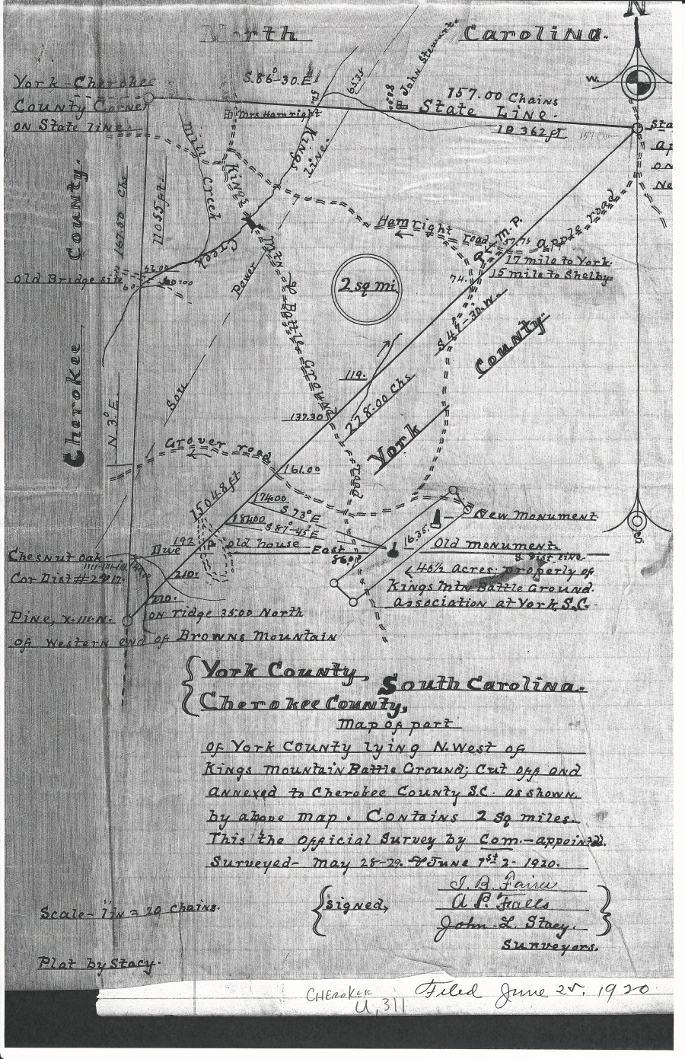
Cherokee-York County Line

Slide 7
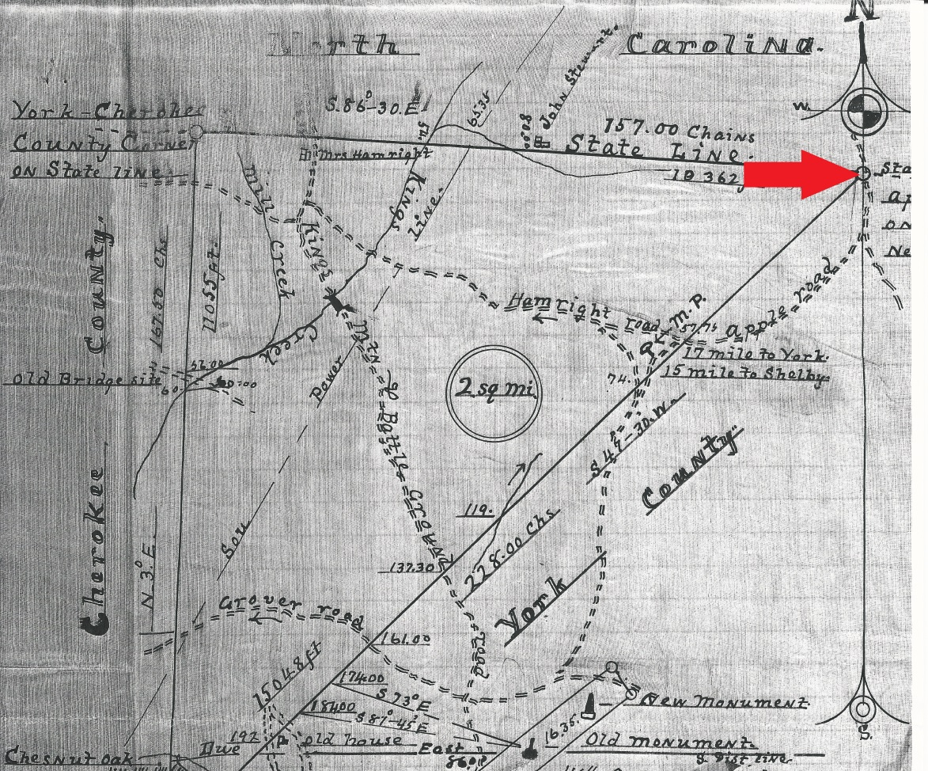
Cherokee-York County Line
This point is on the State Line (as determined by the property lines of 1920) and the centerline of the “old Apple Road…near the burnt grocery” (currently Vandyke-Yorkville-Shelbyville Road)

Slide 8
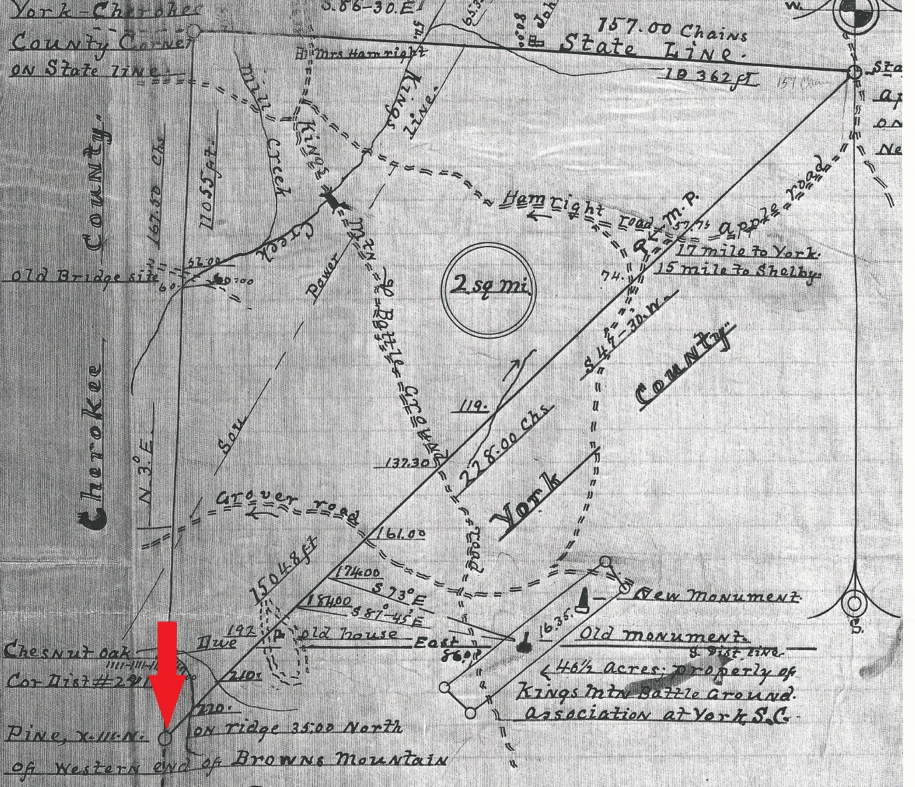
Cherokee-York County Line
This point is on the original township line – “Pine on ridge” described elsewhere as “large pine”

Slide 9
Cherokee-York County Line
Extensive field investigation showed that of the many features shown on the plat relating to the location of the annexation line (Segment 1), few provided an acceptable level of accuracy for reestablishing the line
The two most accurate things were the centerline of “the old Apple Road at State Line” and the ties to the battleground monuments

Slide 10
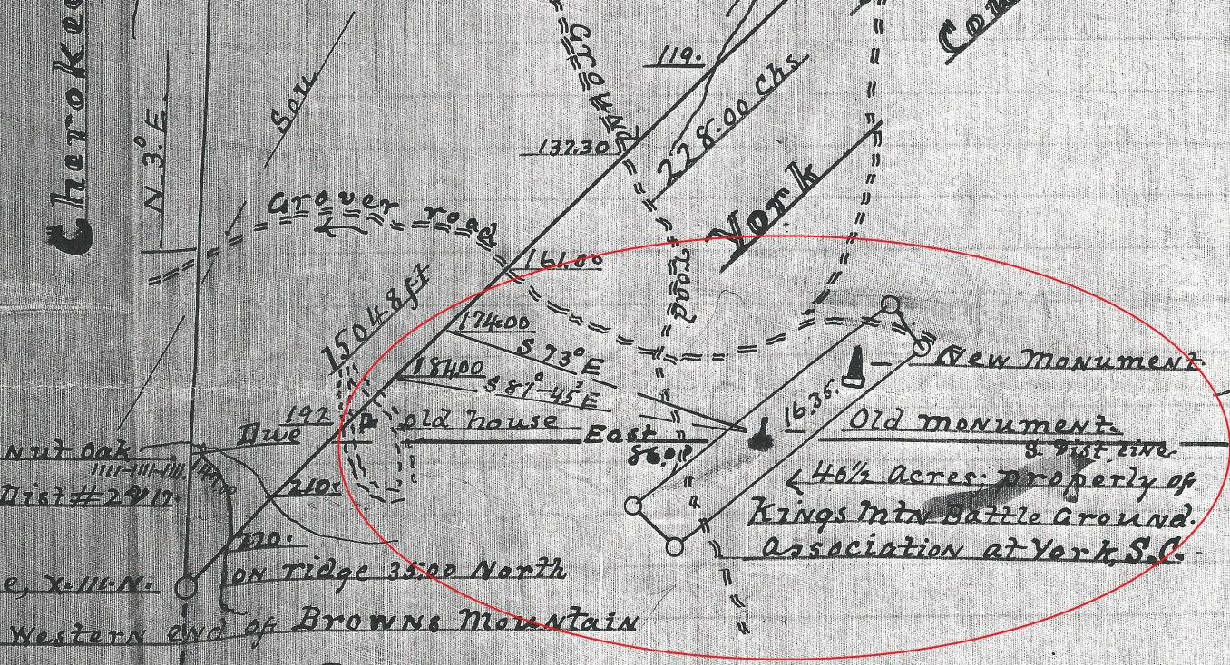
Cherokee-York County Line
The intersecting bearings to the “Old Monument” provide both a distance and orientation
The resulting alignment of “Segment 1” corresponds well with the roads and other general features shown on the plat

Slide 11
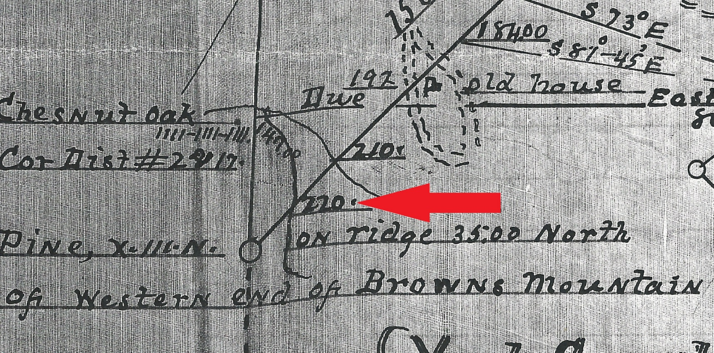
Cherokee-York County Line
The closest “hard” point to the corner is the stream crossing at 220 (out of 228 total) chains
Corner calculated on the alignment and 528’ (8 chains) from the creek

Slide 12
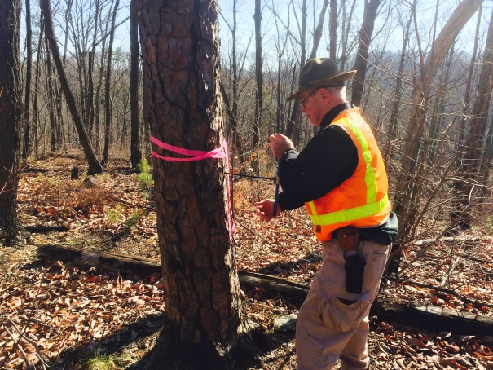
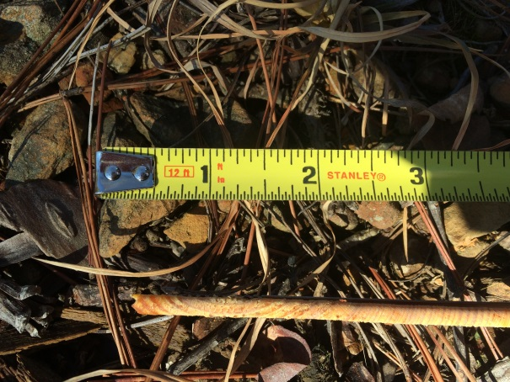
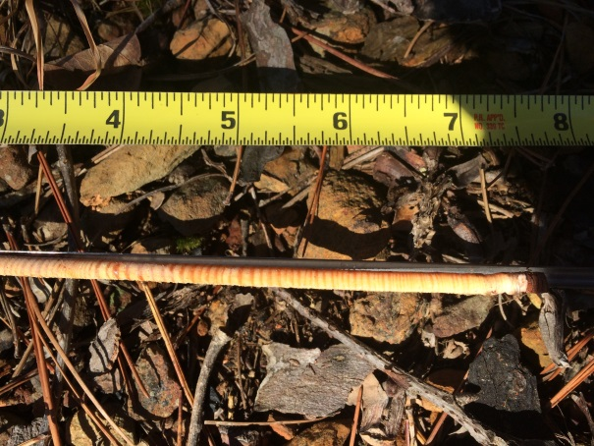
Cherokee-York County Line
The calculated corner fell squarely on top of a side ridge to the main ridge
We checked for a “large pine” but the largest one we found would have been only 5” DBA at the time of the 1920 survey

Slide 13
Cherokee-York County Line
The distance north (along the old township line) to the State Line checked within 162’ (less than 1.5% difference)
The distance to the center of the “old Apple road” checked within 263’ (less than 1.75% difference)
The resulting area was 1.9977 square miles (as opposed to plat area of 2 sq. mi.)

Slide 14
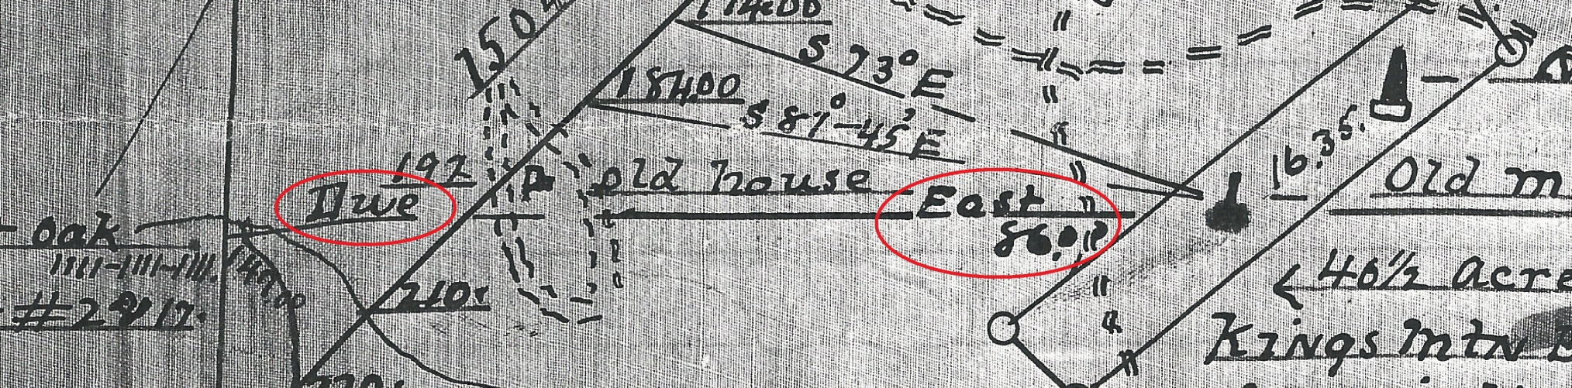
Cherokee-York County Line
The line “Due East” from the Old Monument (shown more clearly on School District Maps #2 and #17) measures within 57’ (a difference of 1.0%)
A bearing matching “Due East” from near the “Old Monument” crosses the intersecting creeks as shown on the plat

Slide 15
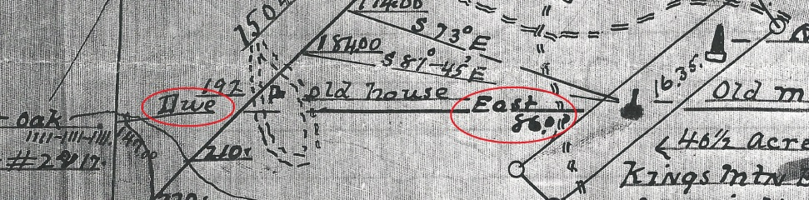



Cherokee-York County Line

Slide 16
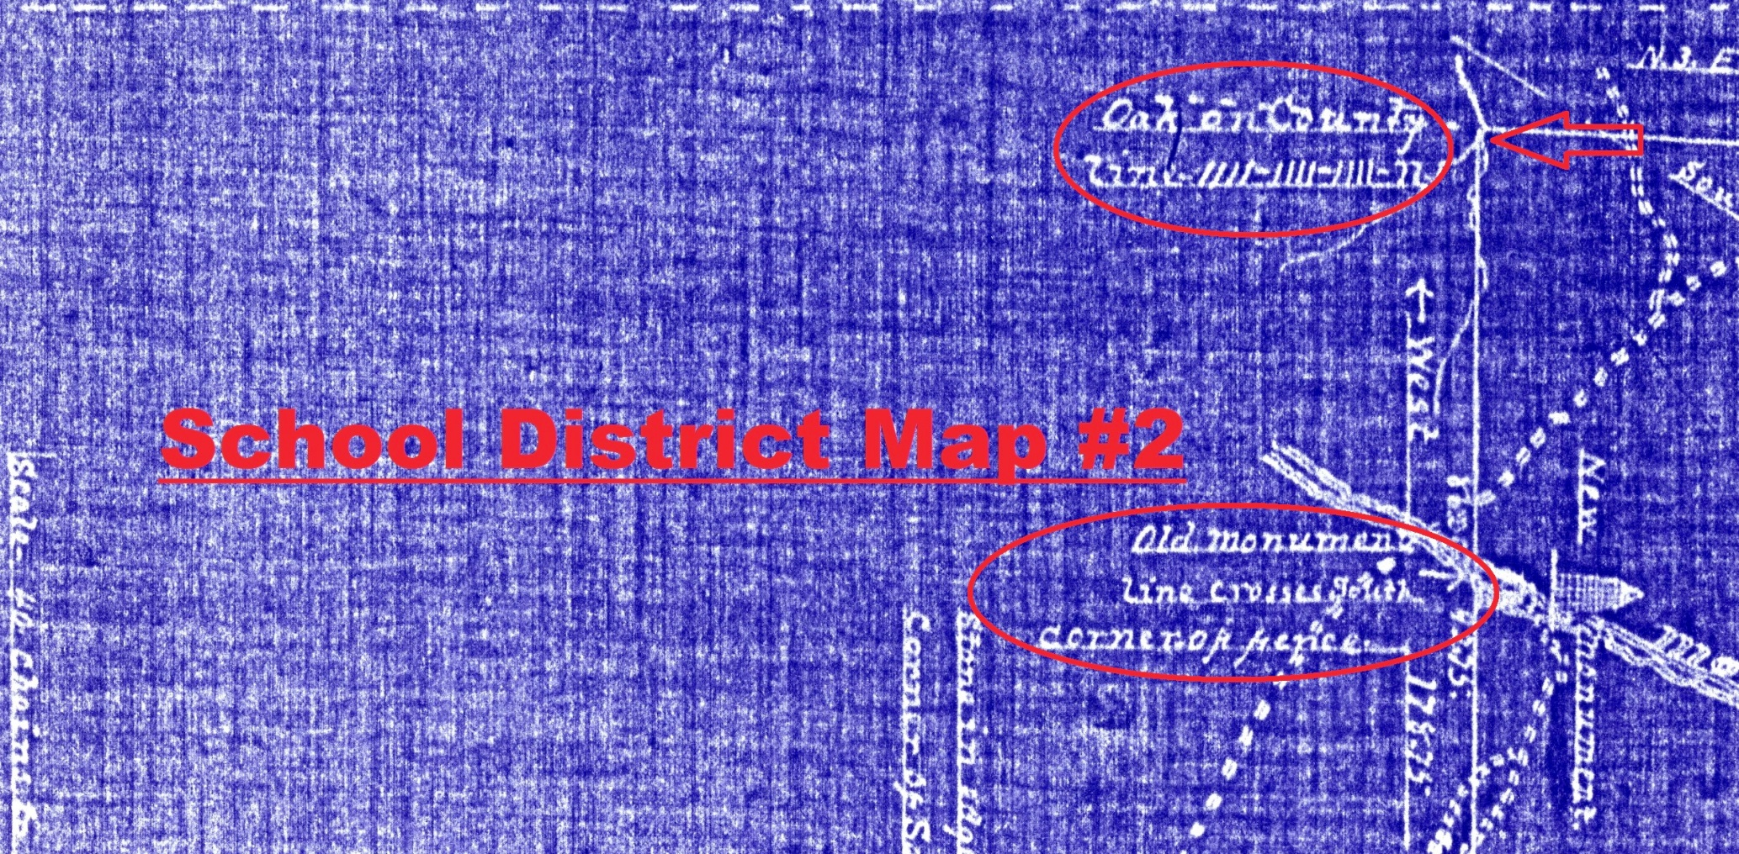
Cherokee-York County Line

Slide 17
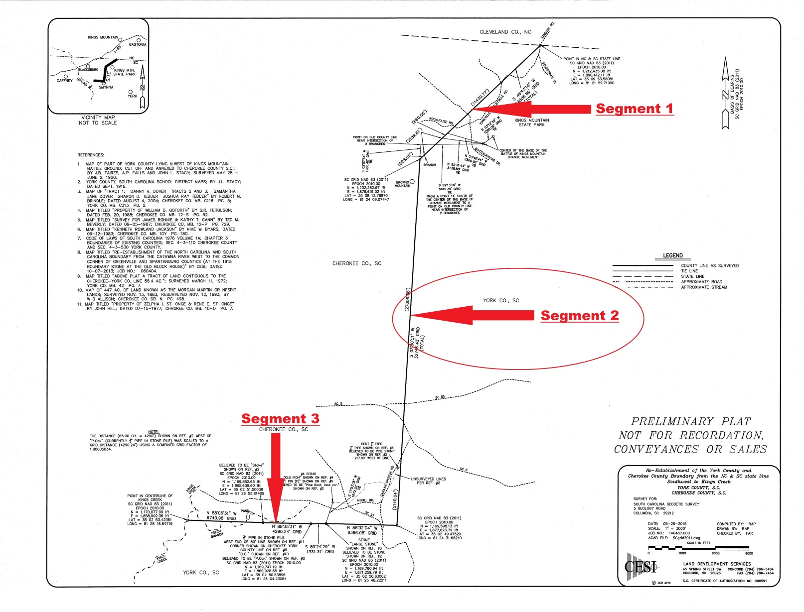
Cherokee-York County Line

Slide 18
Cherokee-York County Line
1868 Township Law and York County, SC by Robert Jerald L. West states that the common southern corner of Cherokee and Kings Mountain townships was in Henderson Borders’ field
Research failed to locate Henderson Borders property in the vicinity of Smyrna

Slide 19
Cherokee-York County Line
Additional research with the Historical Center of York County located school district maps for the western part of York County, first surveyed in 1913 and revised in 1915 and 1916
Wanda Fowler, Researcher, emailed PDFs of these drawings to CESI
The school district maps appear to all be by one surveyor – J. L. Stacy

Slide 20
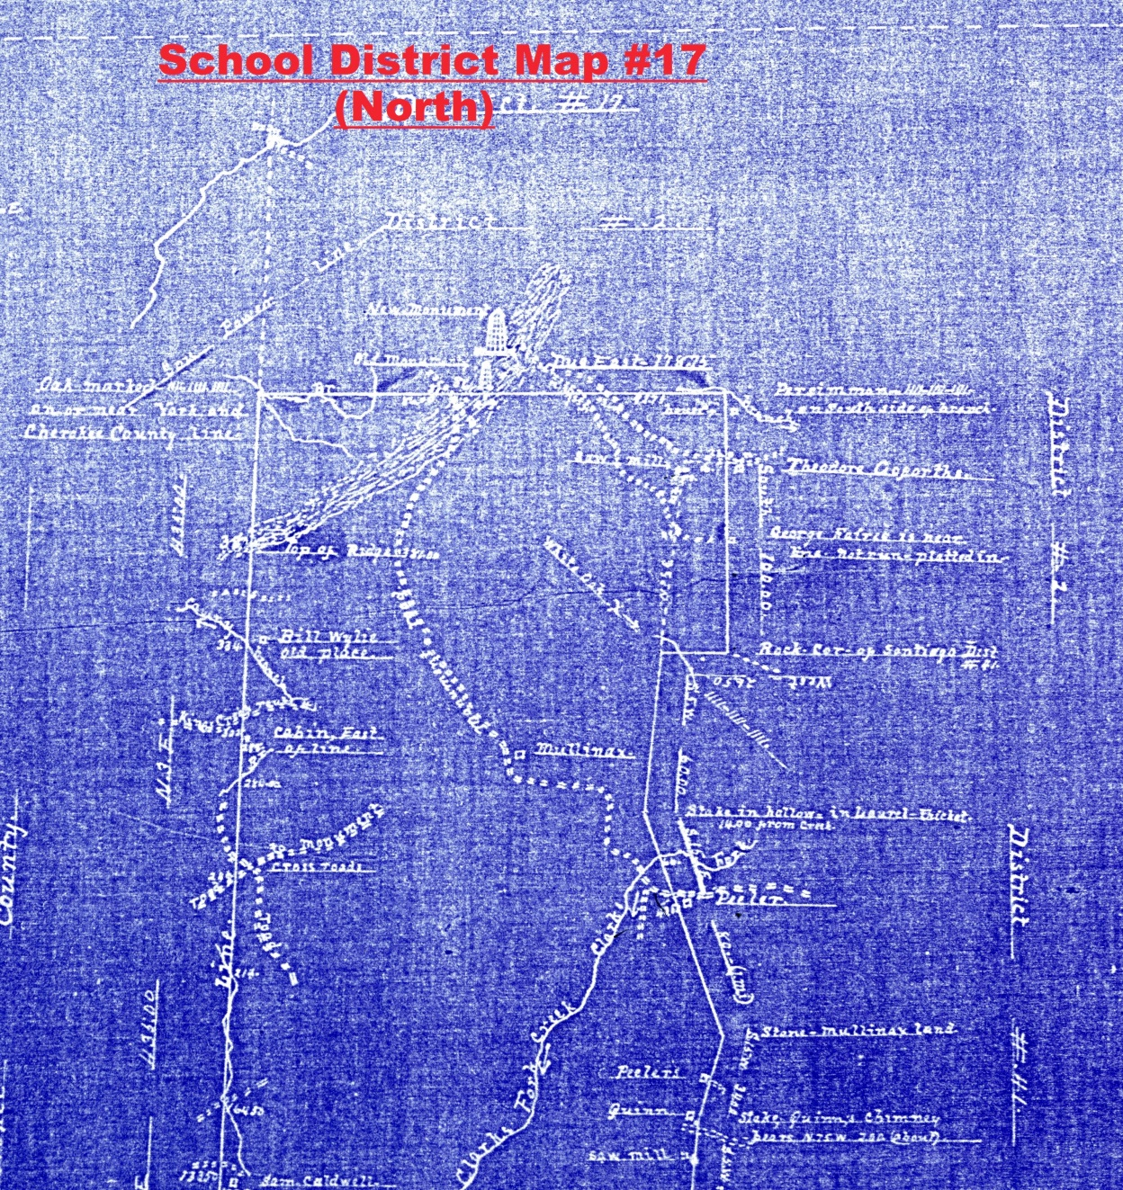
Cherokee-York County Line

Slide 21
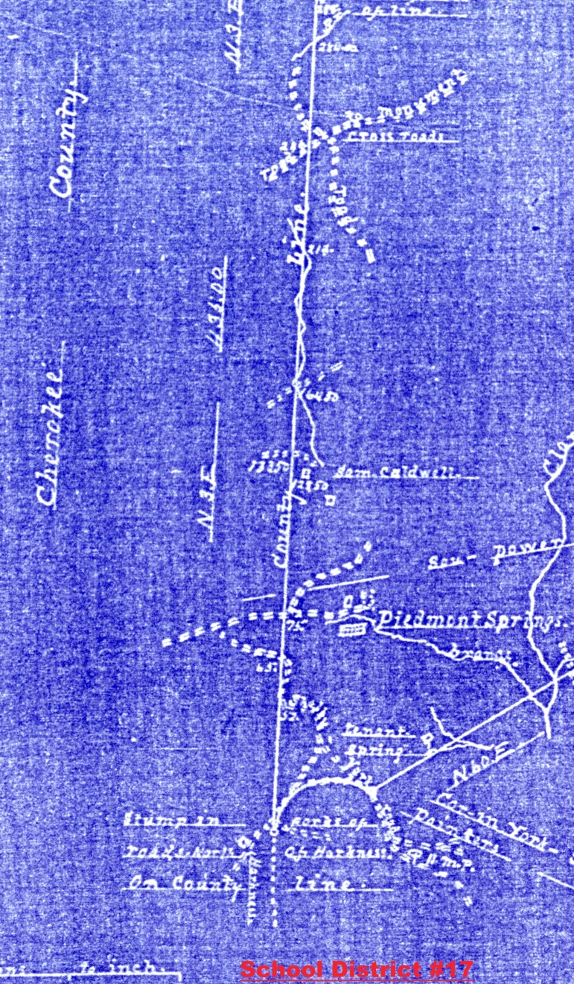
Cherokee-York County Line
School District Map #17 offers a lot of generalized information along its more than 5 mile length, but nothing definitive to allow a precise determination of the county (old township) line

Slide 22
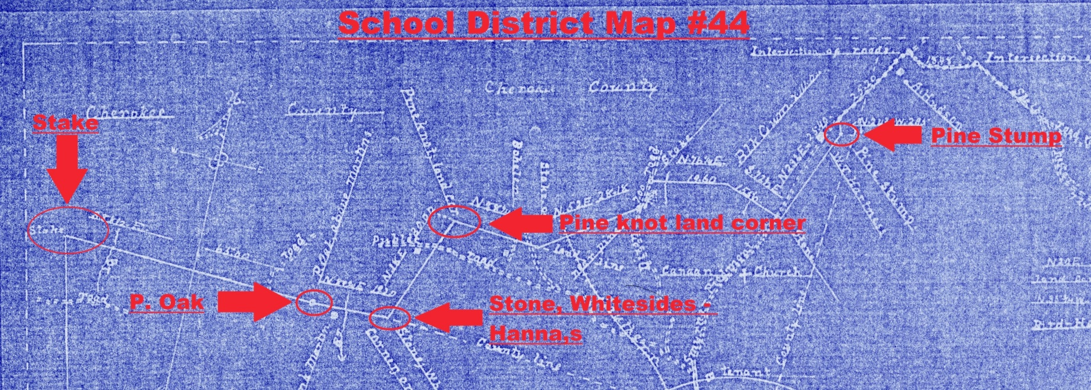
Cherokee-York County Line
School District Map #44 shows the district line leaving the county line near the Smyrna-Piedmont Road and traversing around roughly 400 acres of Cherokee County to be included as part of School District #44

Slide 23
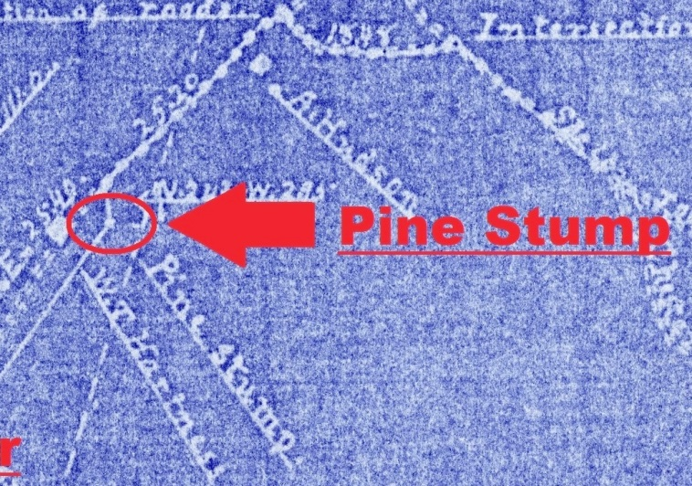
Cherokee-York County Line
But it also shows the school district cornering on a “Pine Stump” just east of the road and W. T. Hartness house – and just west of the county line
This graphical representation is the most accurate information we have to locate this end of Segment 2

Slide 24

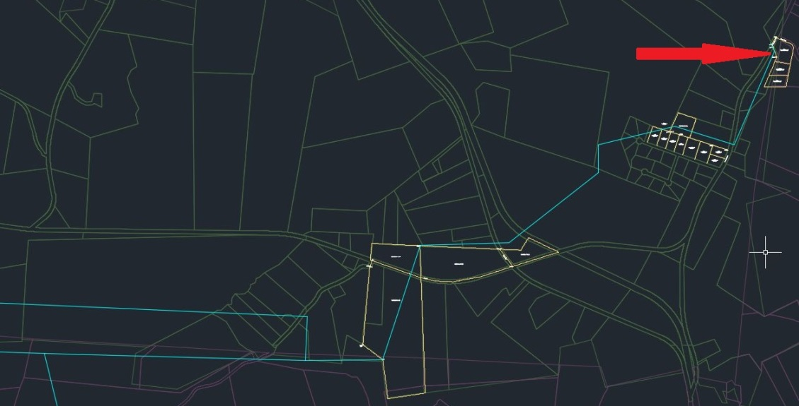
Cherokee-York County Line

Slide 25
Cherokee-York County Line
On the previous slide the blue line on the lower image is a plot of the bearings and distances from the School District #44 map overlain on current GIS information
From this it is obvious that most bend points were existing property corners in 1913-1916, and most are still there today
And, the “Pine Stump” is one of them

Slide 26
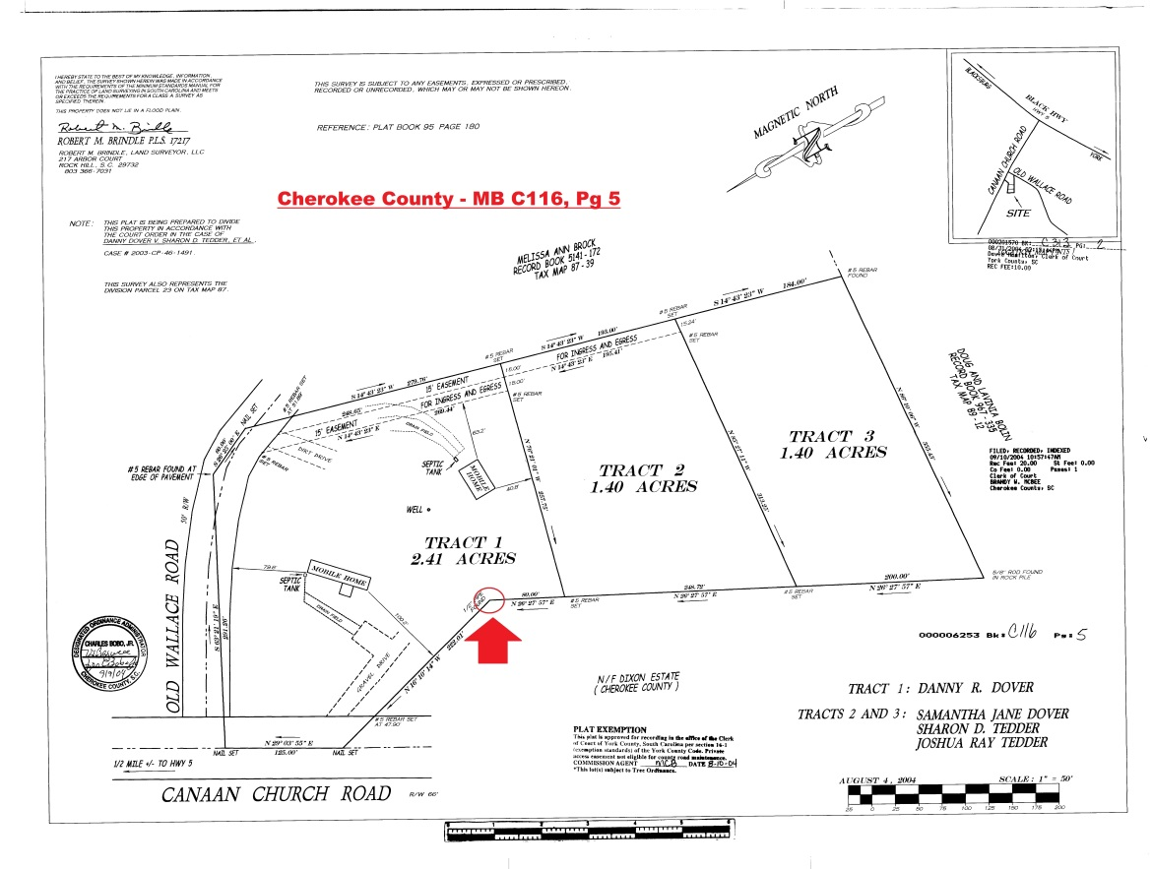
Cherokee-York County Line
From our research we determined that the ½” Iron Pipe, shown here, is the perpetuated corner of the “Pine Stump”
Our field staff located this corner
From the School District #44 map we scaled the distance from “Pine Stump” to county line and then created a point at that same distance from the ½” Iron Pipe to establish Segment 2’s alignment

Slide 27
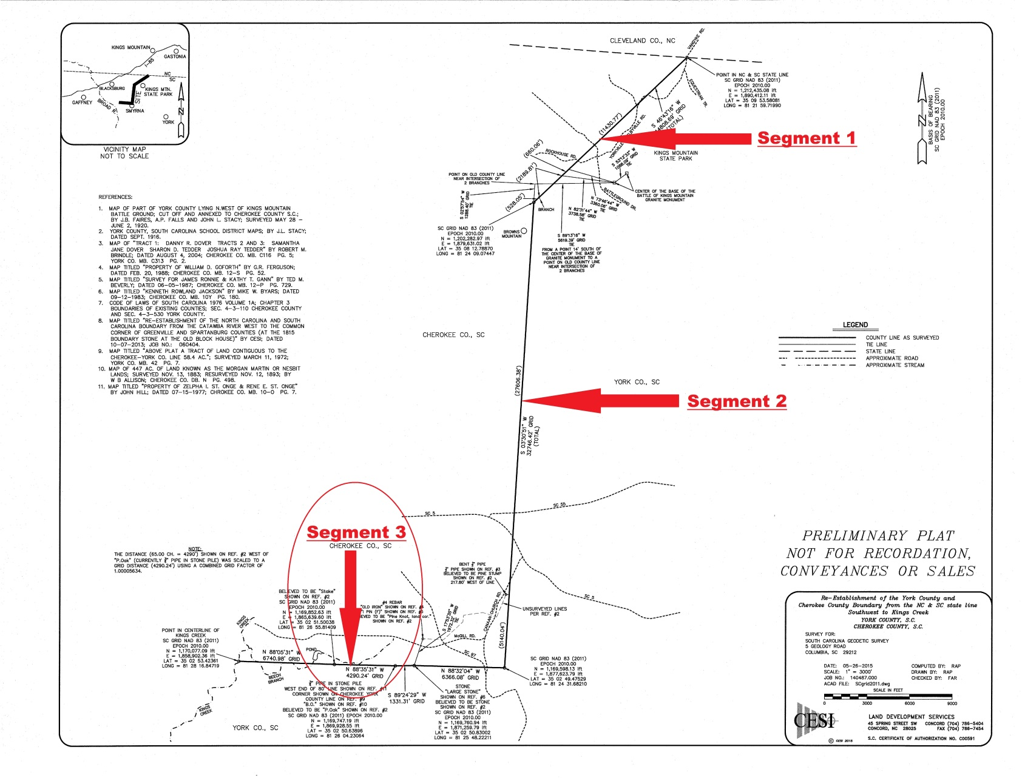
Cherokee-York County Line

Slide 28
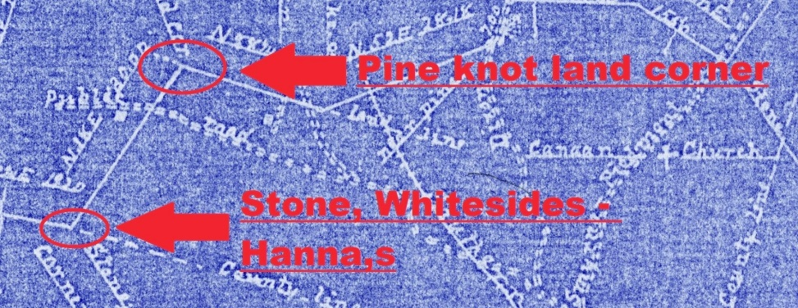
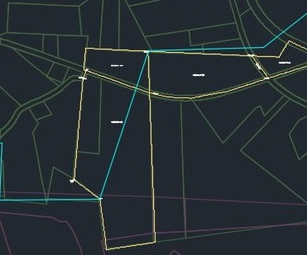
Cherokee-York County Line
Both the “Pine knot land corner” and “Stone, Whitesides-Hanna,s” are still property corners today
Current descriptions (1983) still describe the second one as “Large Stone”

Slide 29
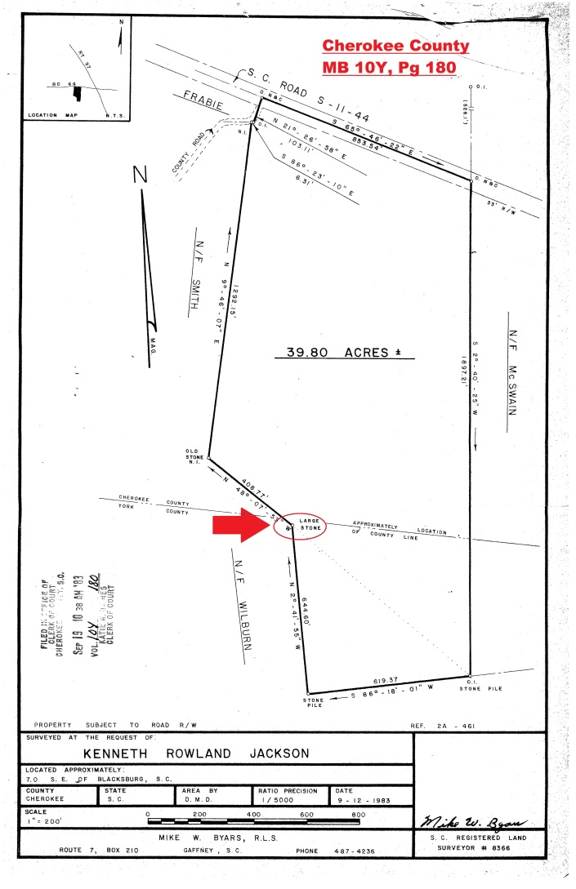
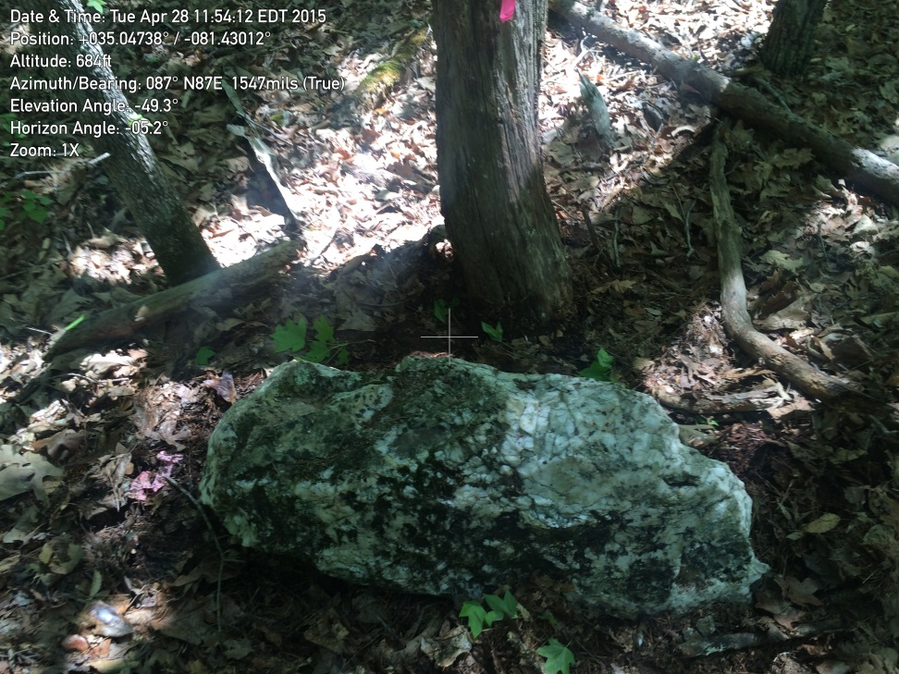
Cherokee-York County Line
It is a large stone!
Distance to “Pine knot” checks within less than 0.5%

Slide 30
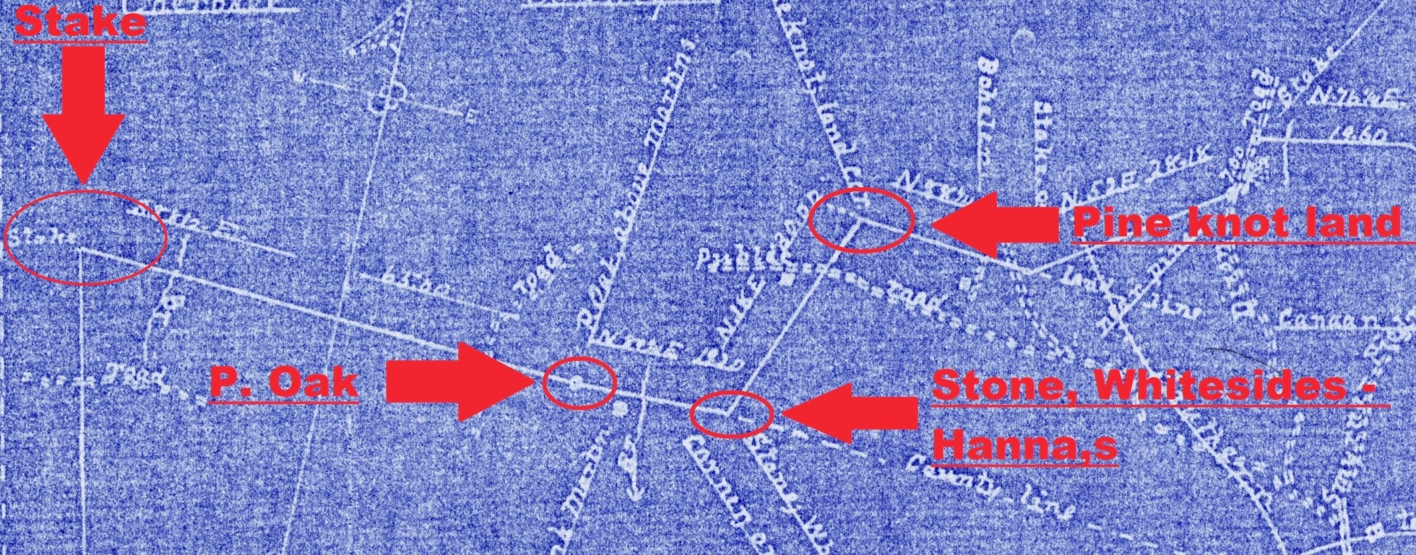
Cherokee-York County Line
Following the map west our research and field work found a ¾” Iron Pipe in a Stone Pile at the location we determined should have been the “P. Oak”

Slide 31
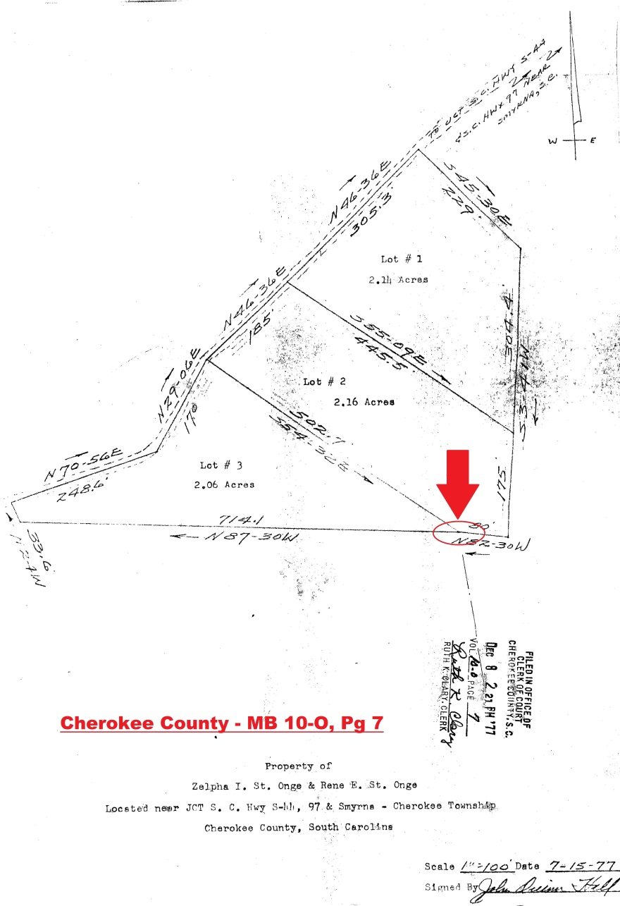
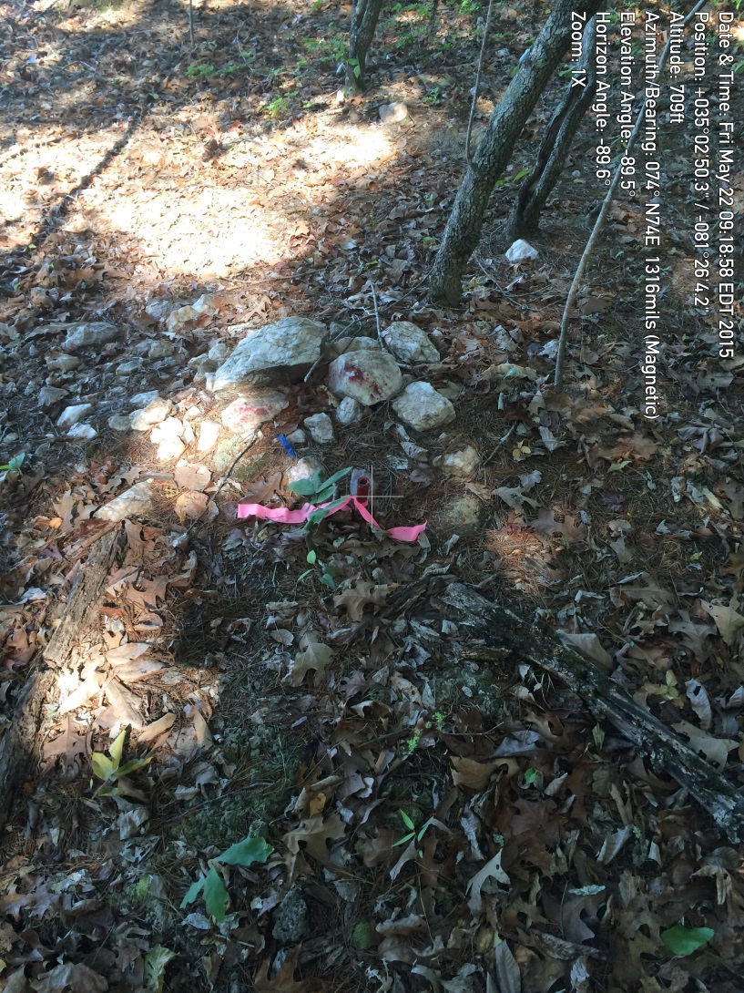
Cherokee-York County Line

Slide 32

Cherokee-York County Line
From that point we continued to use the bearings and distances on the School District #44 map to establish a calculated point for the “Stake” on the county line where District #44 corners with School District #18

Slide 33
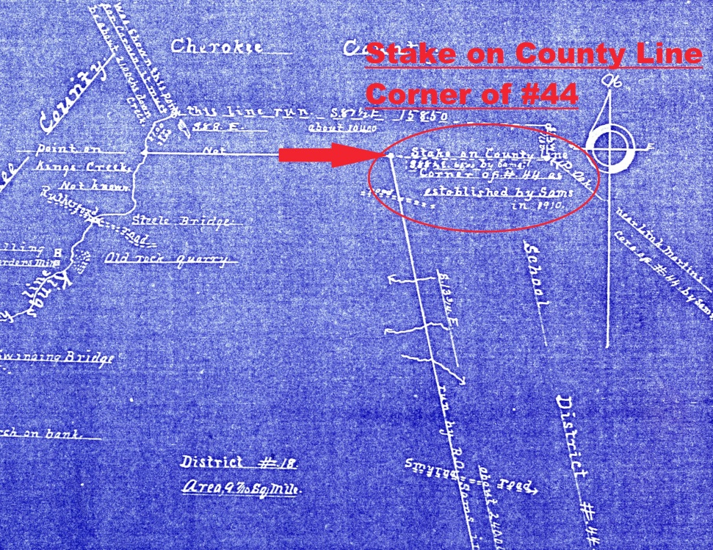
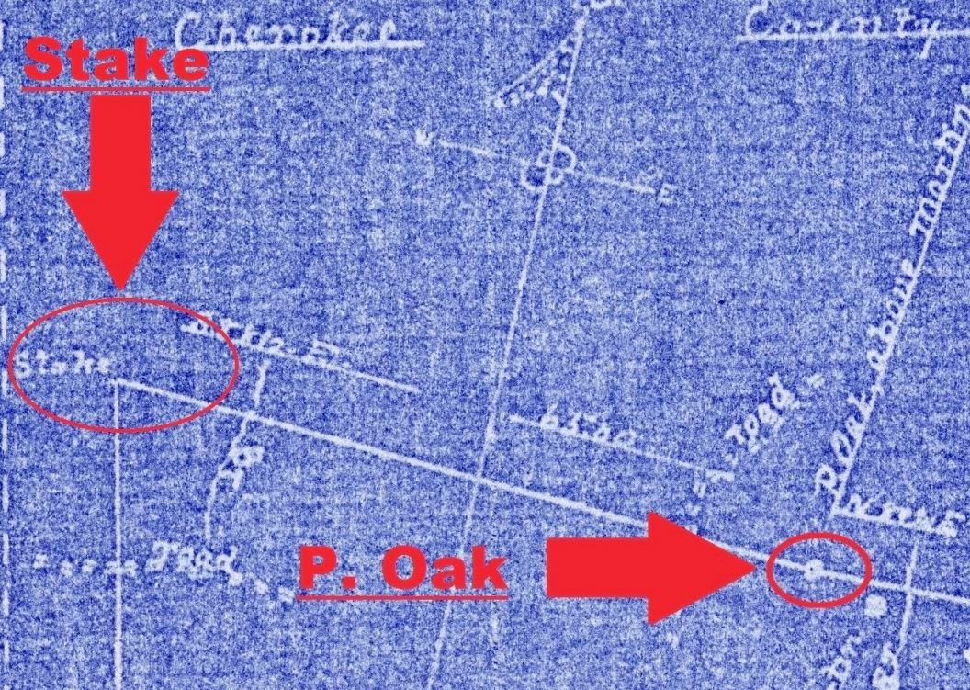
Cherokee-York County Line

Slide 34
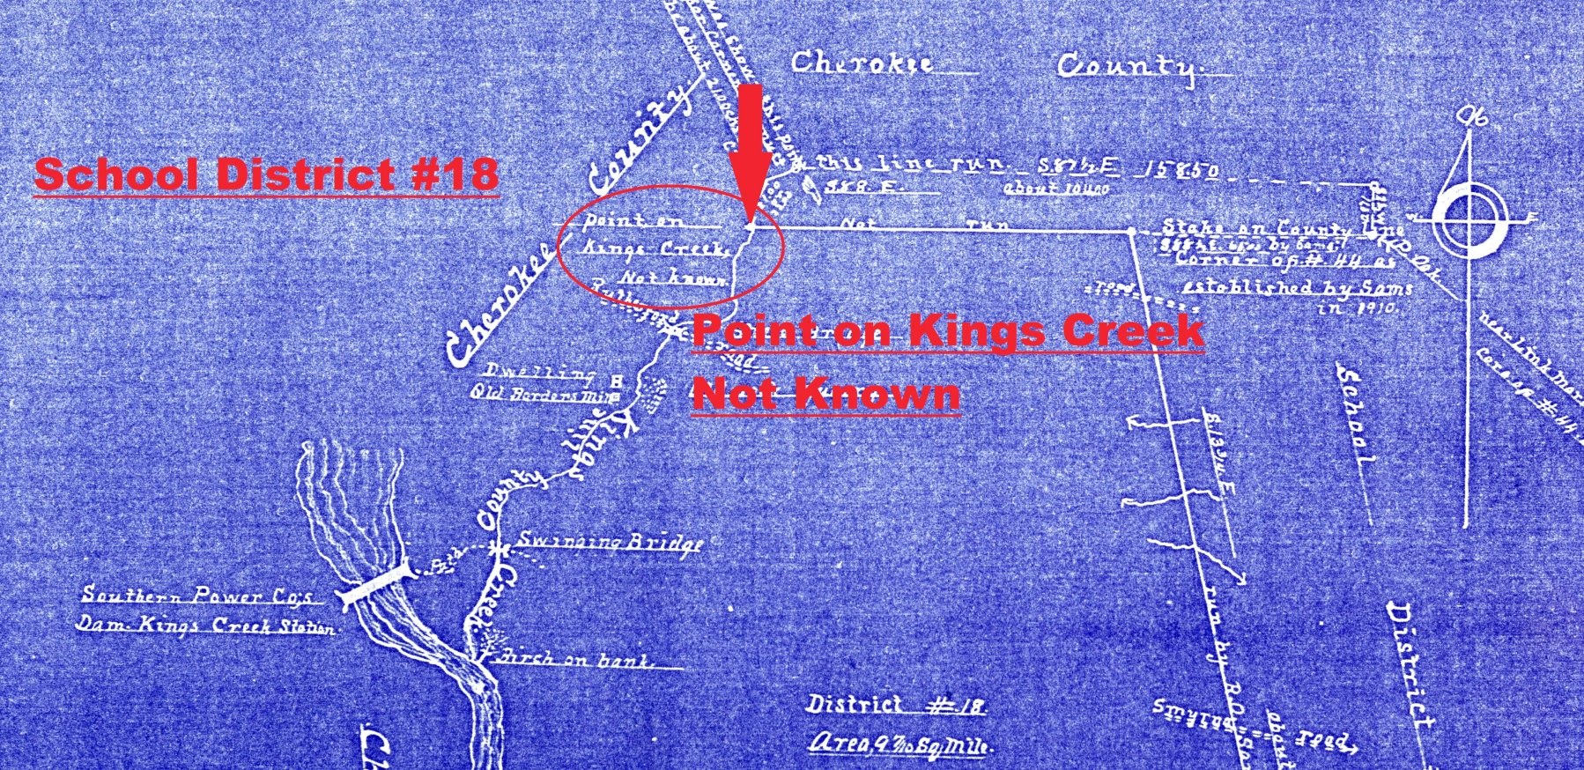
Cherokee-York County Line
We then followed the map and intersected Kings Creek using the creek centerline as determined by orthophotography

Slide 35
Cherokee-York County Line
Stacy did not survey (“not run”) this last line, but was shown another point further up Kings Creek as the starting point for the county line
He determined that the starting point he was shown was incorrect and calculated the correct point for the county line in Kings Creek
His map states “it must be about 21.00 chains down creek”

Slide 36
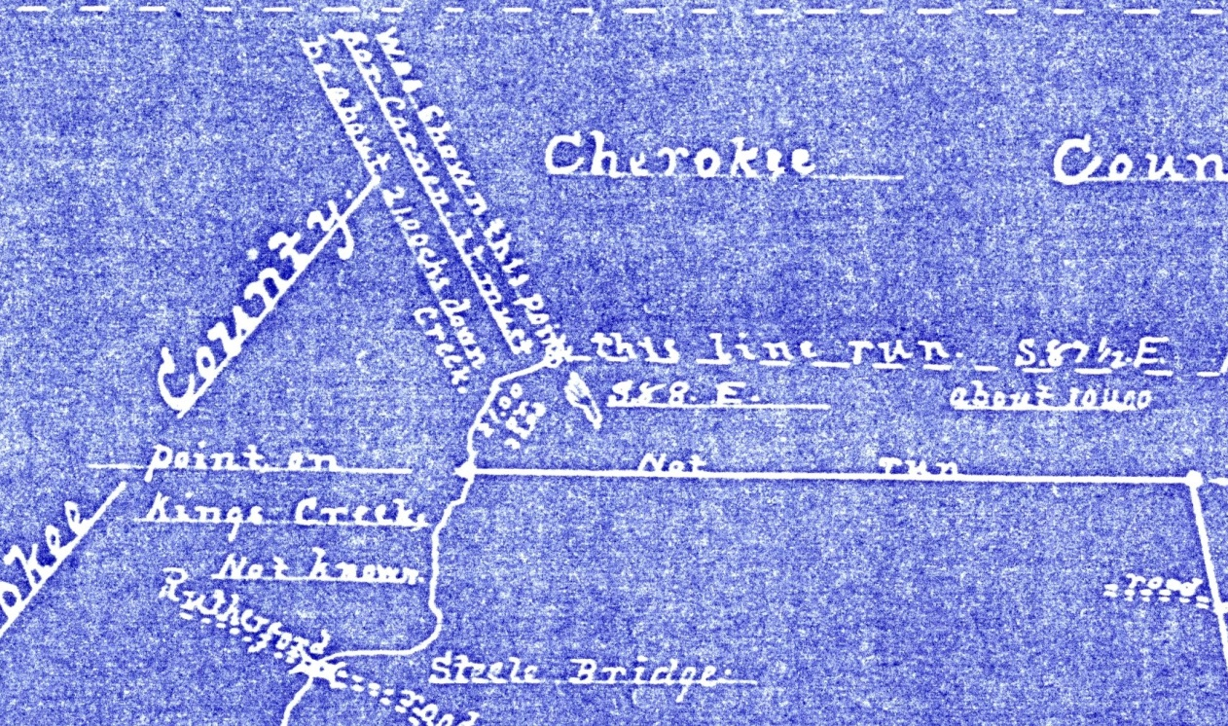
Cherokee-York County Line

Slide 37
Cherokee-York County Line
We believe the point Stacy was shown was the intersection of Kings Creek and Beech Branch
Measuring from orthophotographs the county corner we have calculated from Stacy’s map is 1360’ (20.6 chains) down Kings Creek from its intersection with Beech Branch

Slide 38
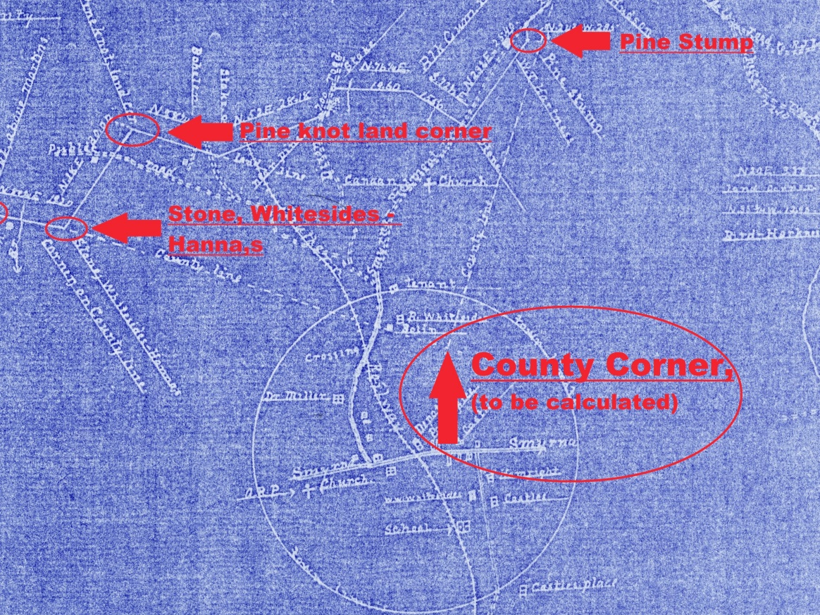
Cherokee-York County Line
Stacy’s map gave us the location of Segment 3 from the “Large Stone” west to Kings
Creek
We now needed to calculate the county line east from the “Large Stone” to the intersection with Segment 2

Slide 39
Cherokee-York County Line
To accomplish that we used an “average alignment”
This was a line, originating at the calculated point in Kings Creek, and passing through the “Large Stone/Stone, Whiteside’s-Hanna’s”
This line was extended from that stone until it intersected Segment 2

Slide 40
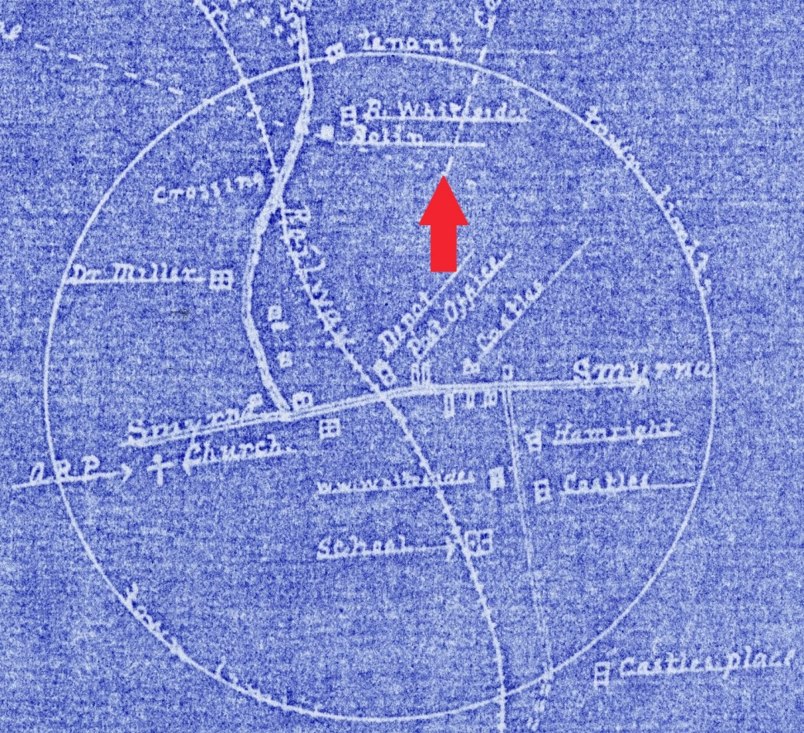
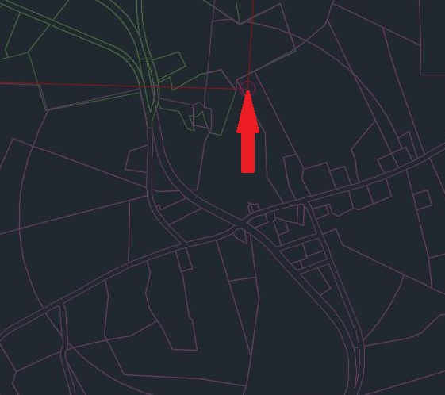
Cherokee-York County Line

Slide 41
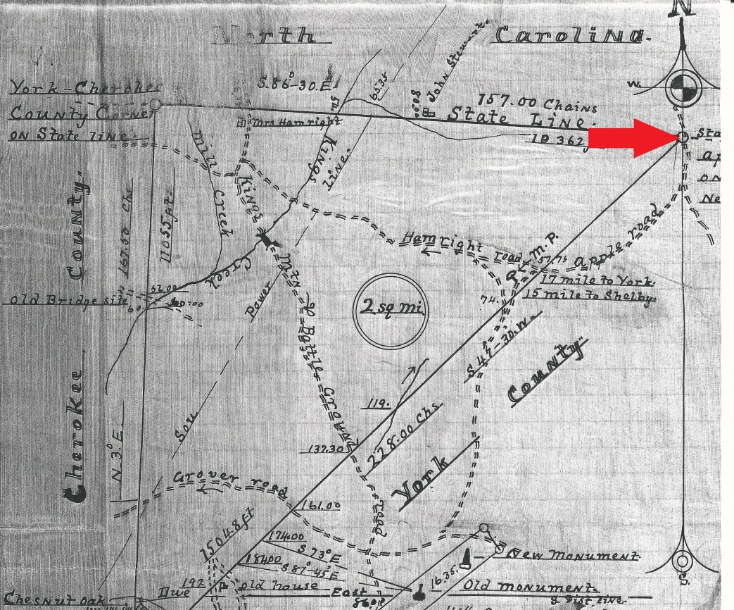
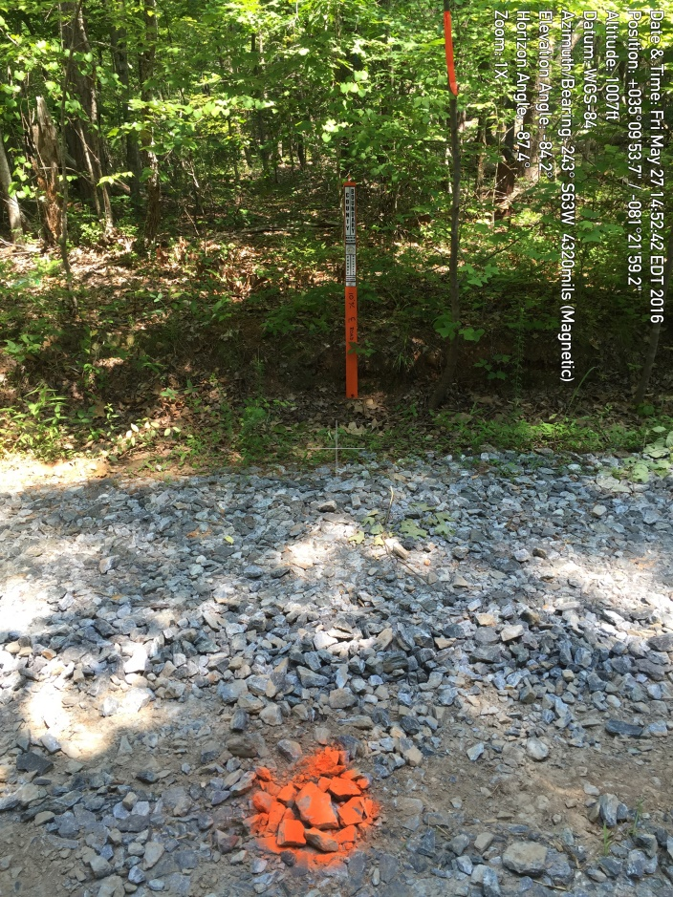
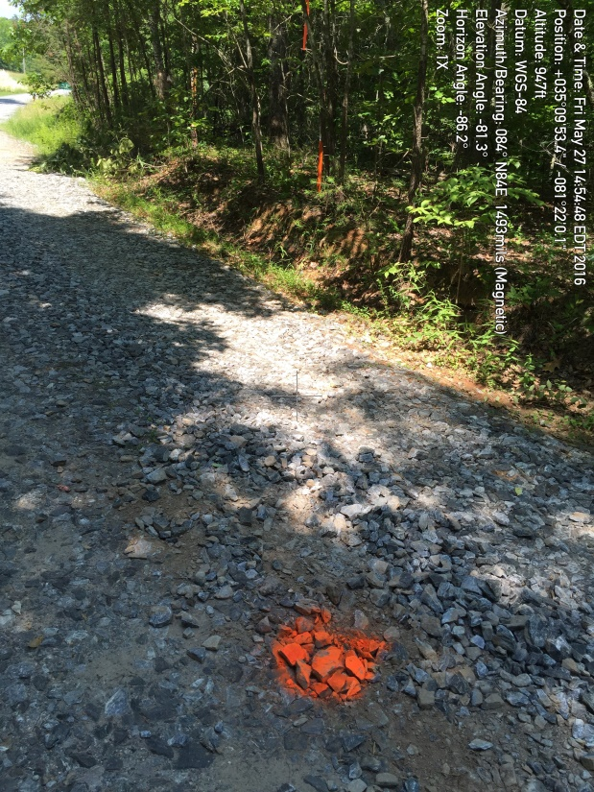
Cherokee-York County Line

Slide 42
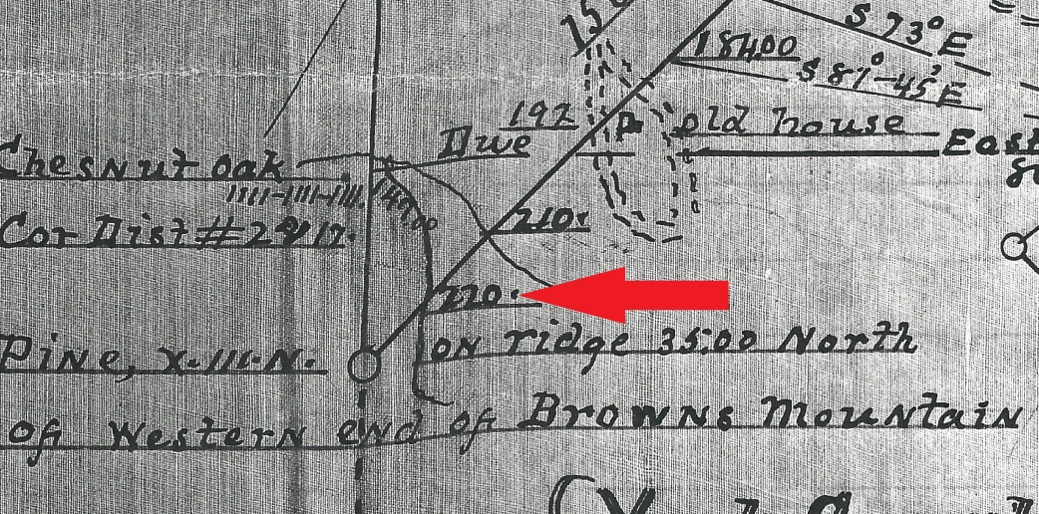
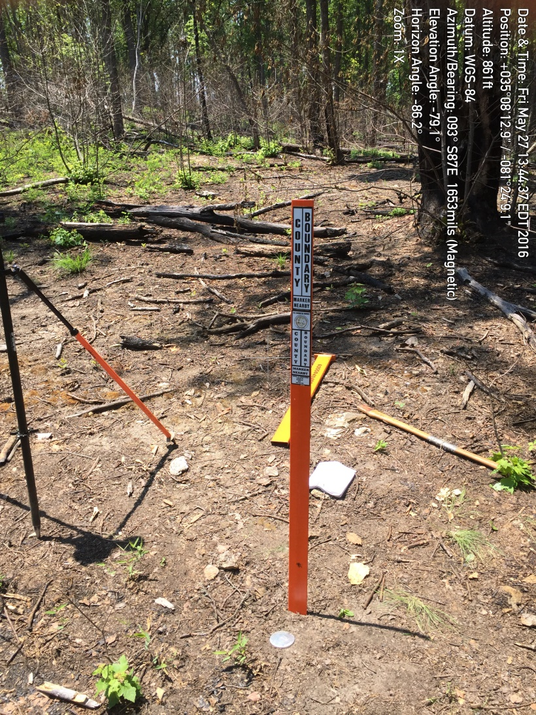
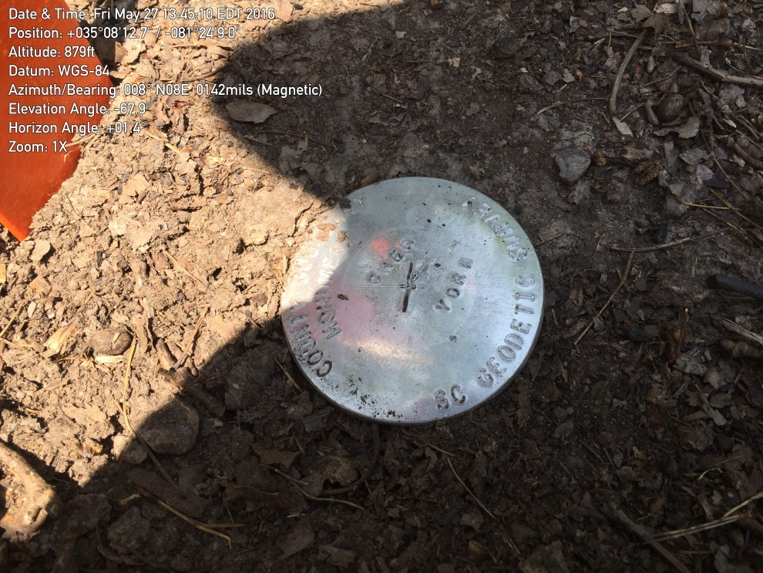
Cherokee-York County Line

Slide 43
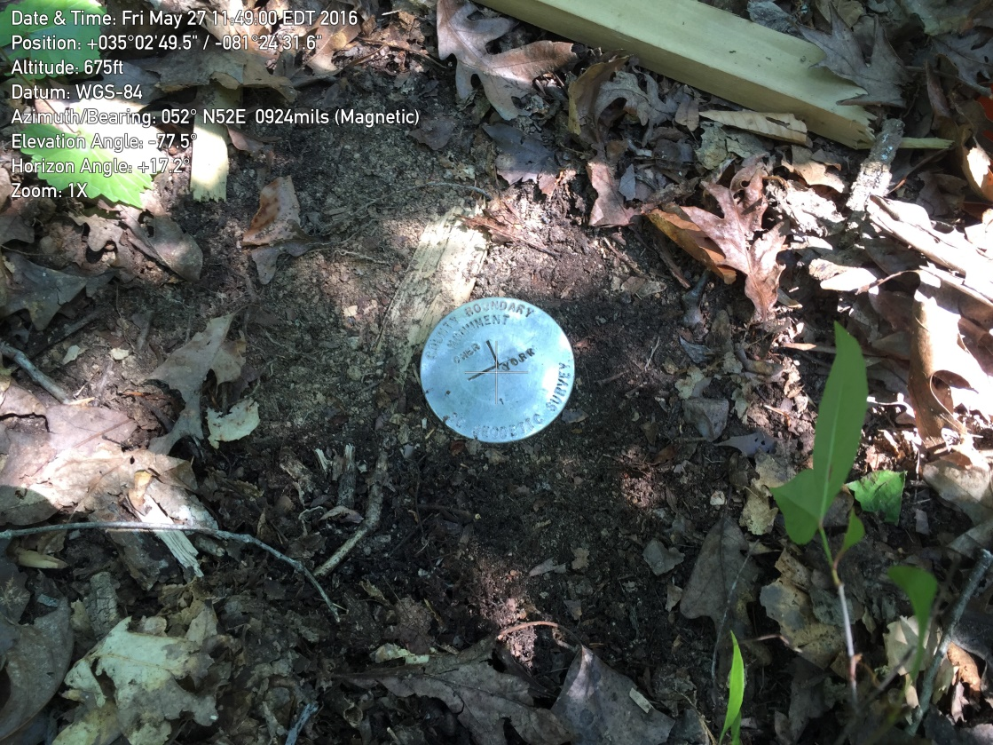
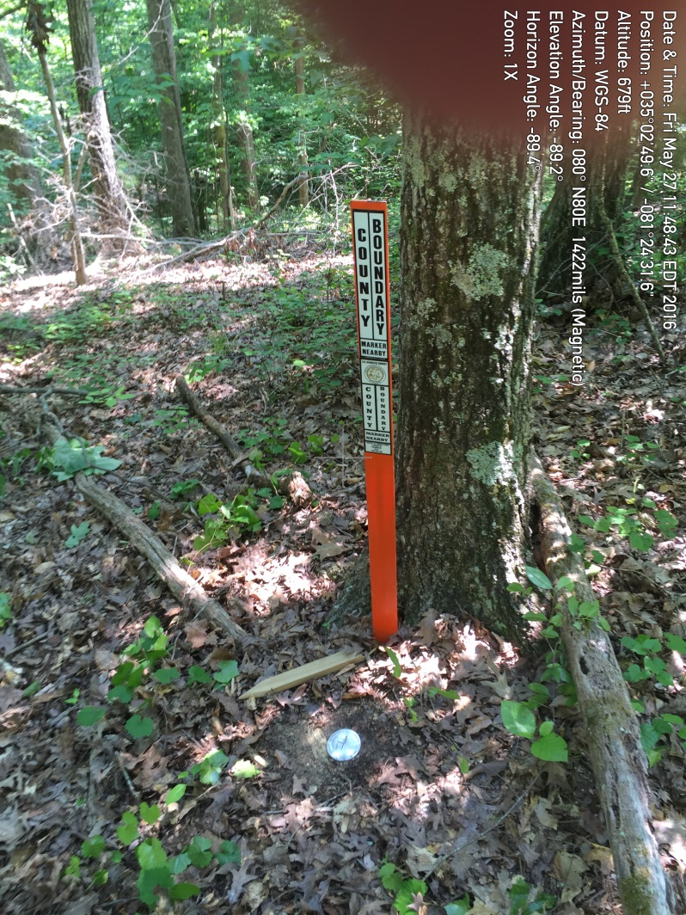

Cherokee-York County Line

Slide 44
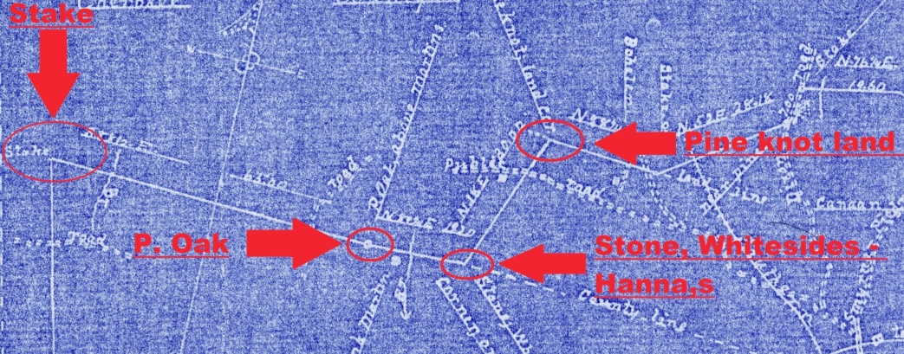
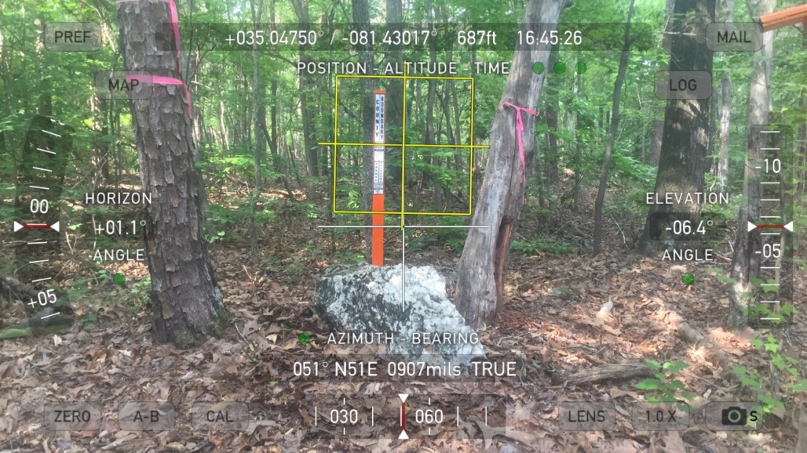
Cherokee-York County Line

Slide 45

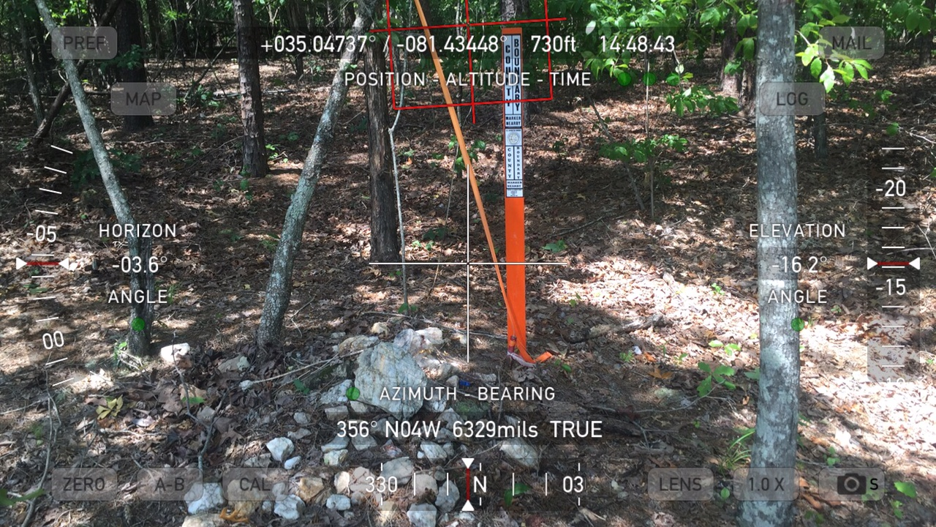

Cherokee-York County Line

Slide 46
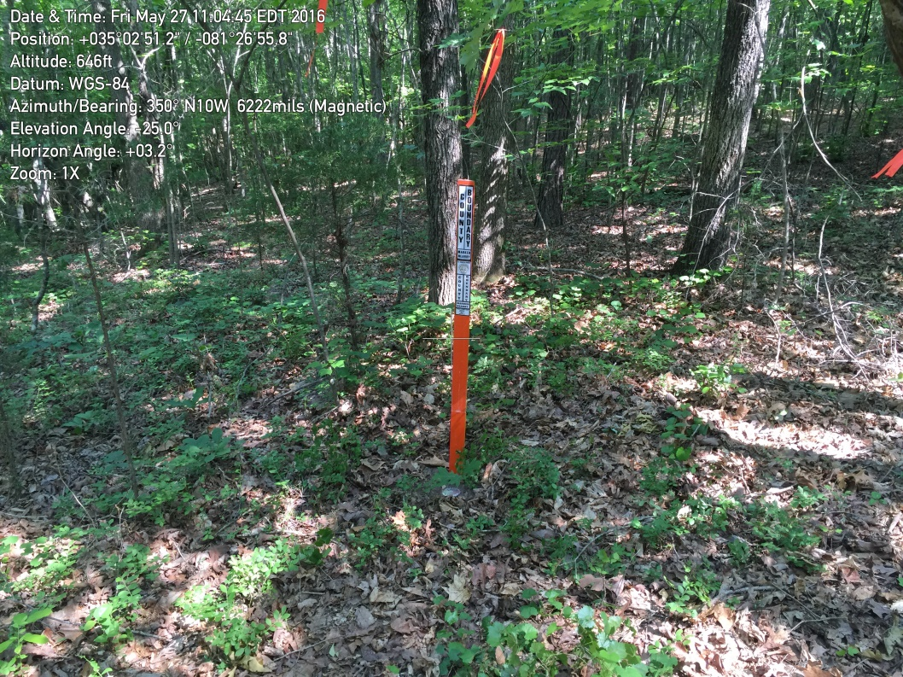
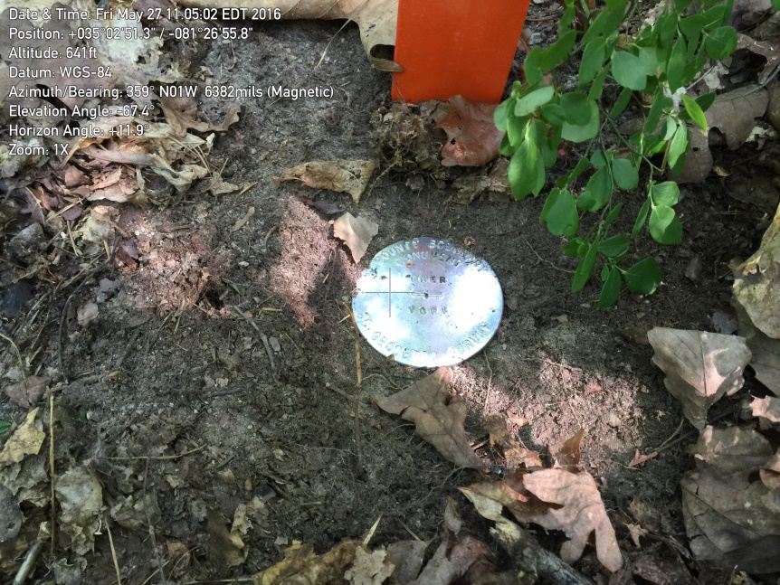
Cherokee-York County Line

Slide 47

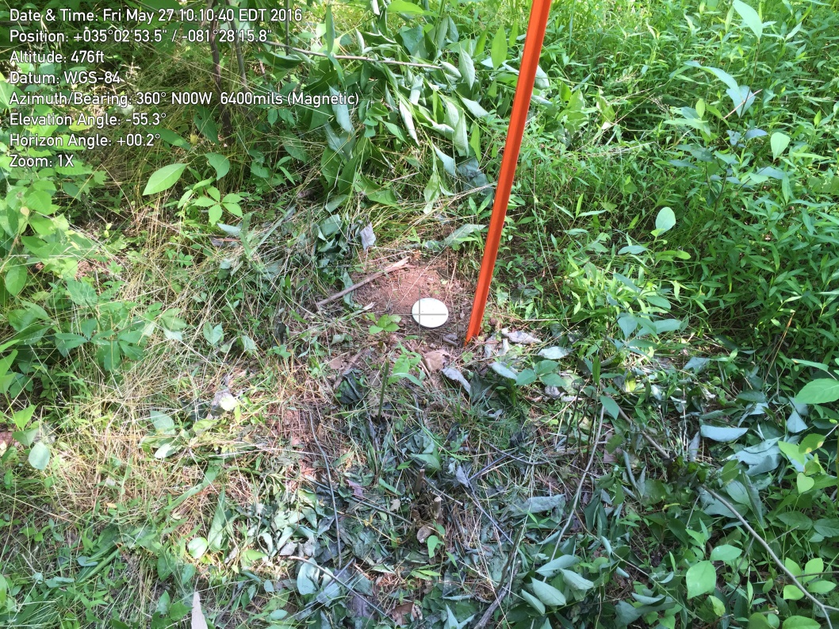
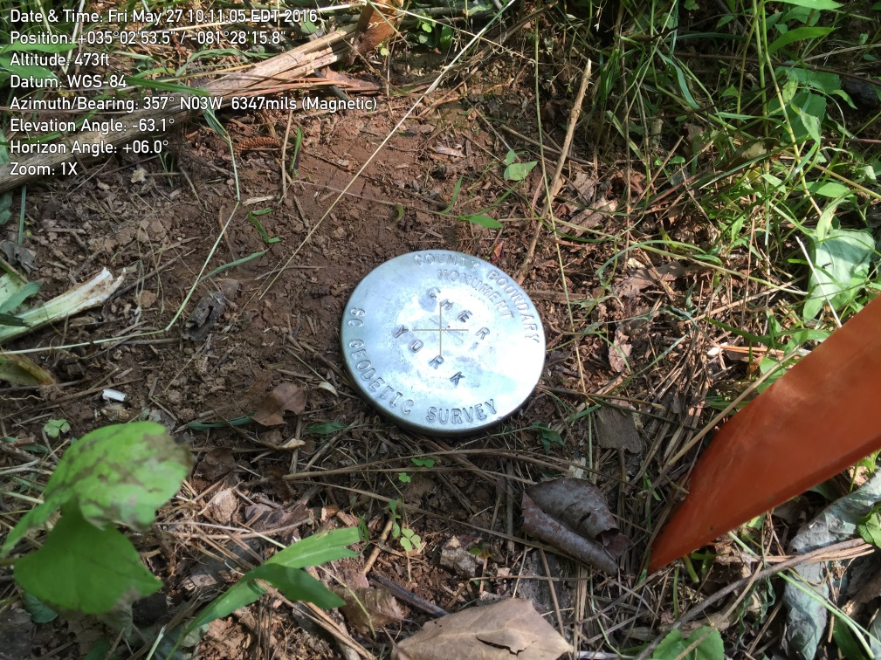
Cherokee-York County Line
100’ East of Centerline of Kings Creek

Slide 48

SC Code of Law and Act 262 Of 2014
Role of South Carolina Geodetic Survey
      (1994) Dispute between two or more counties- SCGS will act as mediator to resolve the dispute
      (1994/2014) SCGS to assist counties in defining and monumenting the locations of county boundaries and positioning the monuments using geodetic surveys where counties are ill-defined, unmarked, or poorly marked
      (2014) SCGS will clarify county boundaries as defined in Chapter 3, Title 4
      (2014) SCGS will analyze archival and other evidence and perform field surveys to position geographically all county boundaries in accordance with statutory descriptions

Slide 49
Steps for Clarifying Boundaries
Notify County Administrators in advance of planned work
Conduct historical research for documentary evidence of boundaries
Perform field work to locate monuments and corroborating evidence and position on State Plane Coordinates
Share preliminary findings with county officials for impact analysis and to plan public meetings
Receive feedback and input from local officials and public
Review and update findings, as appropriate
Work to build cooperation with affected parties

Slide 50
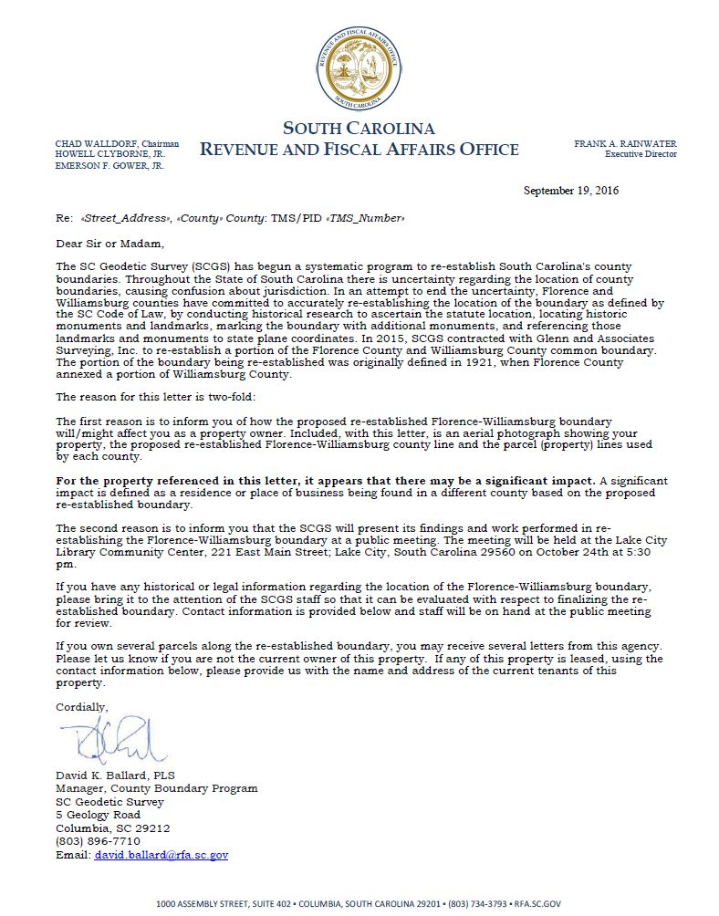
Public Meeting Notification
Steps for Clarifying Boundaries

Slide 51
Act 262 of 2014
Steps for Clarifying Boundaries
SCGS Requirements:
    Upon reestablishing county boundary, SCGS shall certify its work and within 30 days of certification:
        Provide copies to the administrator of each affected county;
        Provide written notification to affected parties
        Provide notice and copies to the public through its official website and or other means it considers appropriate; and
        Notify as it determines appropriate, other affected state and federal agencies
    (Initiates 60 Day Appeal Process)
  Certified Surveys submitted to Secretary of State, Register of Deeds Offices, and South Carolina Department of Archives with Cover Letter
  Date of the cover letter is the date the surveys become effective
  Introduce Legislation to update Code of Law to reflect clarified boundary with State Plane Coordinates

Slide 52
Act 262 of 2014
Affected Parties Disagreeing with SCGS:
    May file request for a contested case hearing with the SC Administrative Law Court
    This decision may be appealed
    “Affected Party”
              Governing body of an affected county
              Governing body of a political subdivision of this State
              An elected official, other than a statewide elected official
              A property owner or an individual residing in the certification zone
              A business entity located in the certification zone
              A nonresident individual who owns or leases real property situated in the certification zone

Slide 53
Cherokee-York County Line
Impacts

Slide 54
SIGNIFICANT IMPACTS?
A significant impact is defined as a residence or place of business being found in a different county based on the re-established boundary.
Reviewed All of the Properties Along the 12.5 Mile Section of Re-established Boundary, Approximately 80 Properties :
Determined 8 Significant Impacts
With 5 being found to be in York County
And 3 being found to be in Cherokee County

