Slide 1
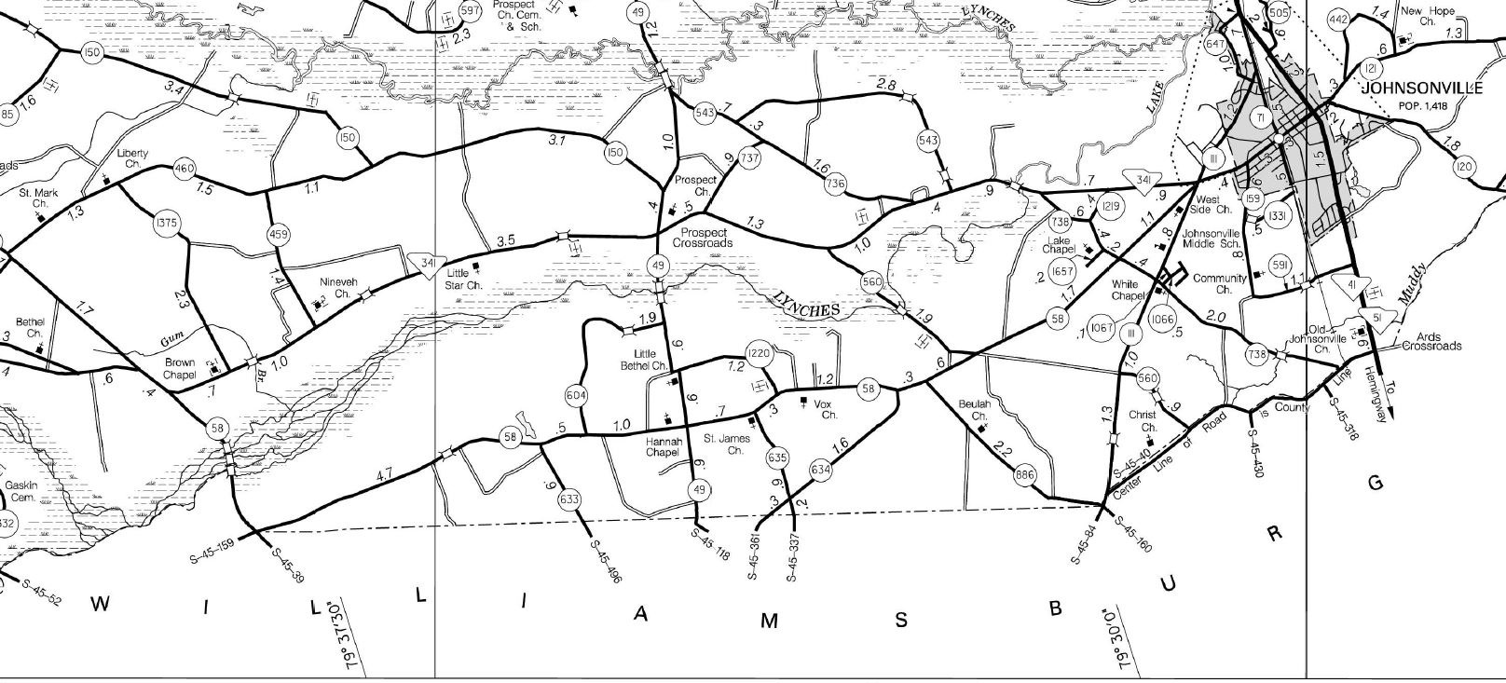
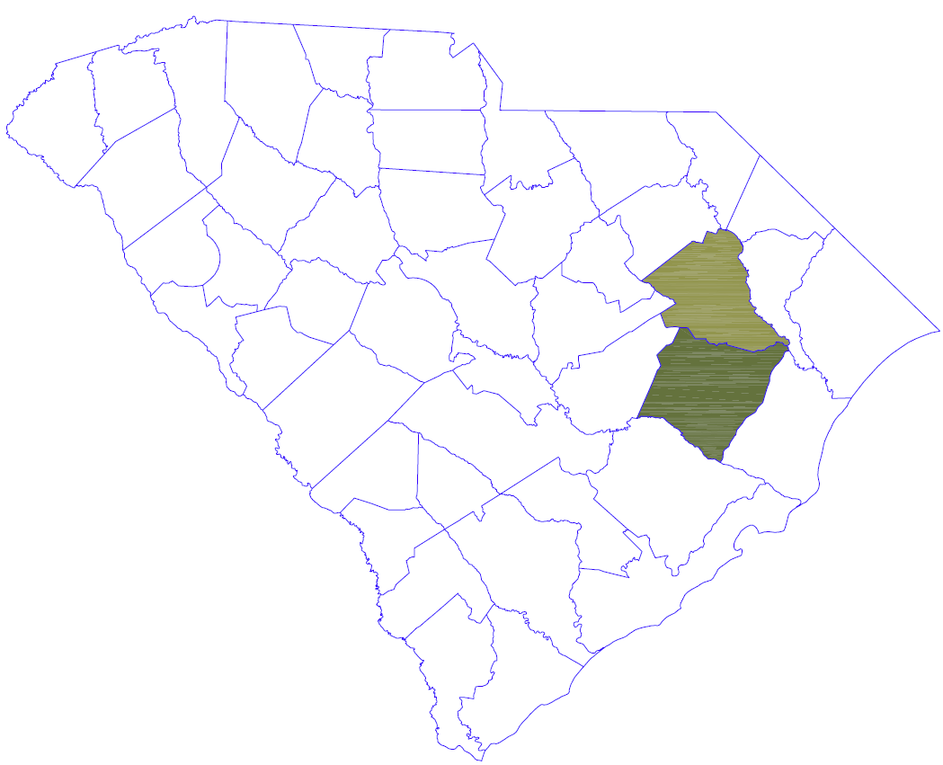
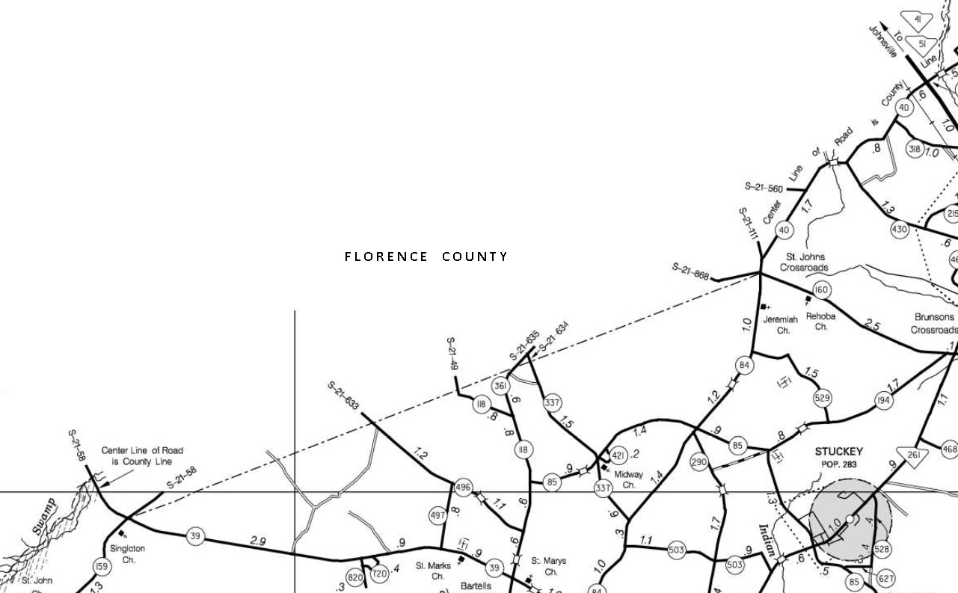

PORTION OF
FLORENCE -WILLIAMSBURG
COMMON BOUNDARY
RE-ESTABLISHMENT PRESENTATION

Slide 2
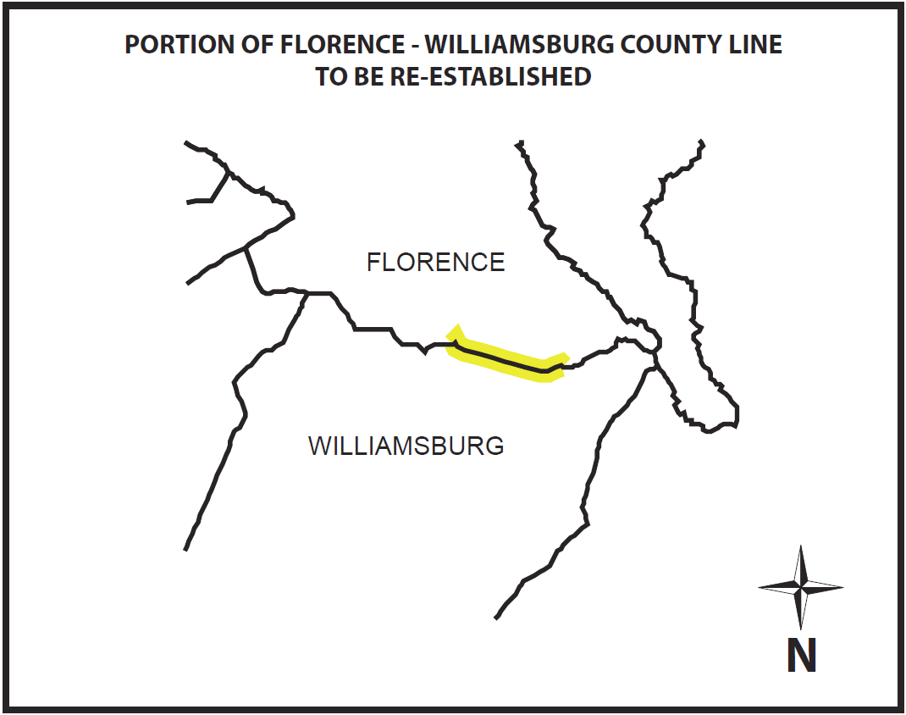

Slide 3
Prepared by
Glenn Associates Surveying, Inc.
11547 State Highway 215 S
P.O. Box 12
Jenkinsville, South Carolina 29065
(803) 345.5297 www.glennassociates.com
South Carolina Licensed Professional Land Surveyors
Michael R. Mills, Sr., SCPLS #11606
Brian B. Bonds, SCSPLS #28582

Slide 4

SC Code of Law and Act 262 Of 2014
Role of South Carolina Geodetic Survey
      (1994) Dispute between two or more counties- SCGS will act as mediator to resolve the dispute
      (1994/2014) SCGS to assist counties in defining and monumenting the locations of county boundaries and positioning the monuments using geodetic surveys where counties are ill-defined, unmarked, or poorly marked
      (2014) SCGS will clarify county boundaries as defined in Chapter 3, Title 4
      (2014) SCGS will analyze archival and other evidence and perform field surveys to position geographically all county boundaries in accordance with statutory descriptions

Slide 5
Steps for Clarifying Boundaries
Notify County Administrators in advance of planned work
Conduct historical research for documentary evidence of boundaries
Perform field work to locate monuments and corroborating evidence and position on State Plane Coordinates
Share preliminary findings with county officials for impact analysis and to plan public meetings
Receive feedback and input from local officials and public
Review and update findings, as appropriate
Work to build cooperation with affected parties

Slide 6
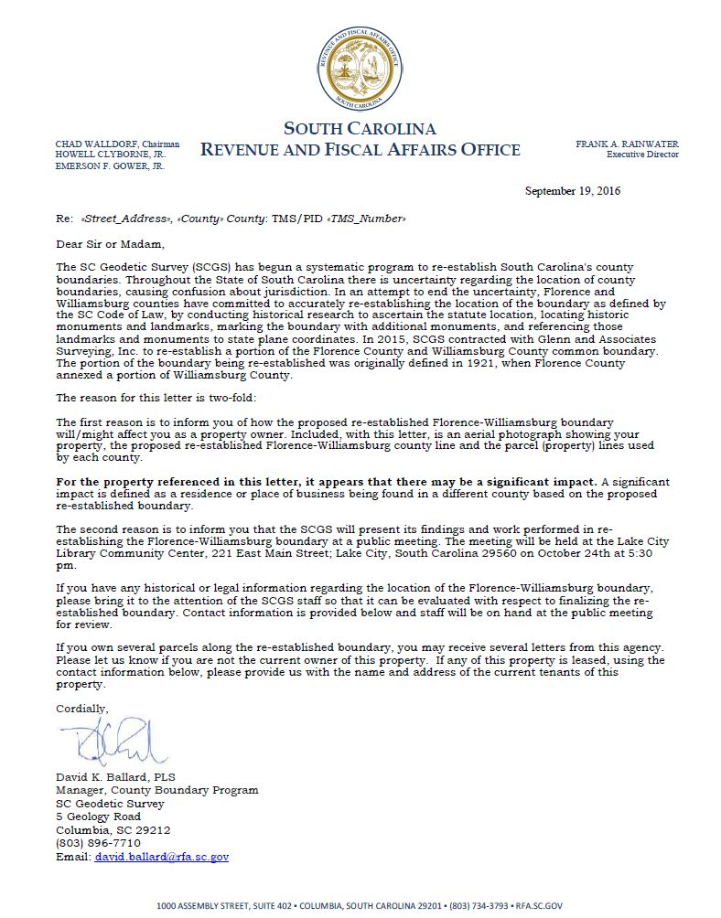
Public Meeting Notification

Slide 7
THE FLORENCE COUNTY ANNEXATION –
WILLIAMSBURG COUNTY
FLORENCE COUNTY WAS CREATED ON DECEMBER 22, 1888.
ITS PARENT COUNTIES COMPRISED OF DARLINGTON, MARION, WILLIAMSBURG, AND CLARENDON COUNTIES. AFTER FLORENCE COUNTY WAS CREATED, IT HAS UNDERGONE FOUR ANNEXATIONS.
THIS EXHIBIT IS TO PROPERLY RETRACE THE FOURTH AND FINAL ANNEXATION ALONG THE SOUTHERN ROUTE OF THE ANNEXATION. THE PETITION FOR THE FOURTH ANNEXATION OCCURRED ON MARCH 4, 1921 AND COMPRISED 45.3 SQUARE MILES.

Slide 8
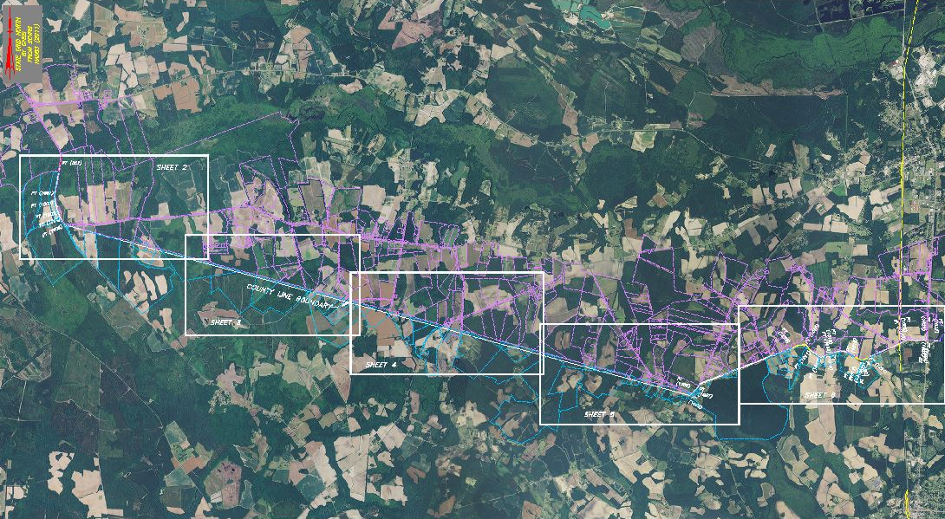
SUBJECT PORTION OF THE COMMON BOUNDARY LINE

Slide 9
THE FLORENCE COUNTY ANNEXATION-
WILLIAMSBURG COUNTY
The following is a description of the survey to describe the subject portion location of the county line between Florence County and Williamsburg County, South Carolina.
This is a list of the items used to prepare this current plat:
Field survey data; using modern surveying practices
Physical evidence on or near the subject county line
Reference material
  South Carolina Code of Laws
  S. C. Archive documents
  Plats of Record
  SCDOT Highway plans
  USGS Quadrangle Maps
  Soil Survey of Williamsburg County, SC

Slide 10
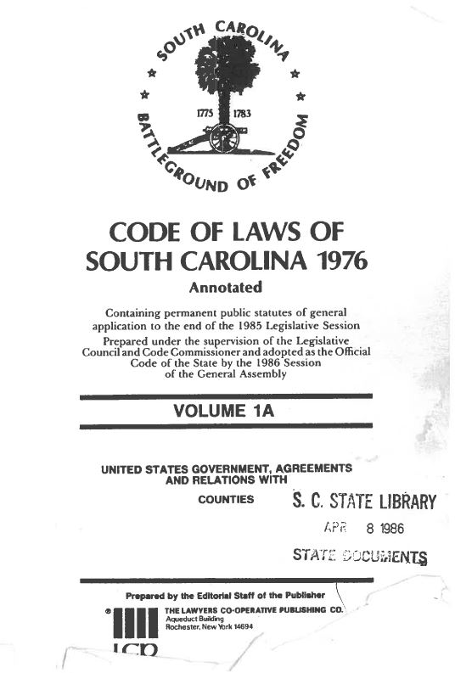
THE FLORENCE COUNTY ANNEXATION-
WILLIAMSBURG COUNTY

Slide 11
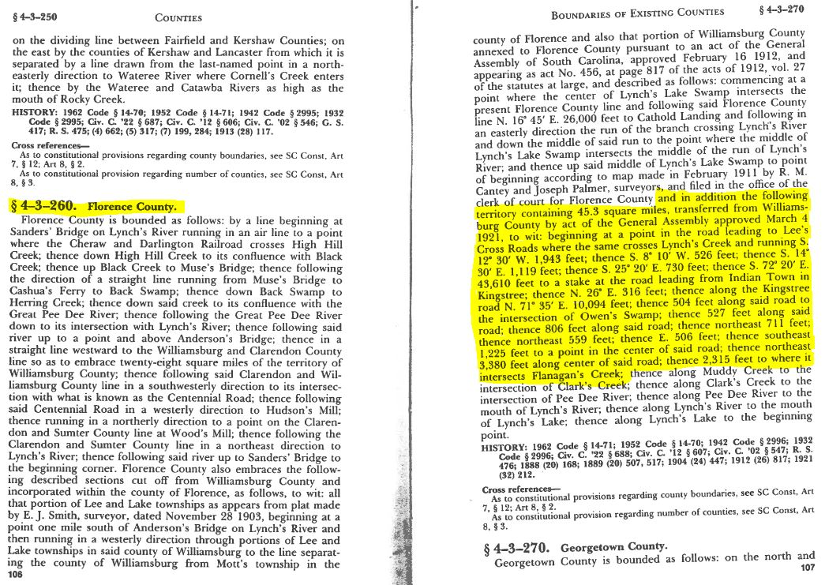
The South Carolina Code of Laws-Florence County

Slide 12
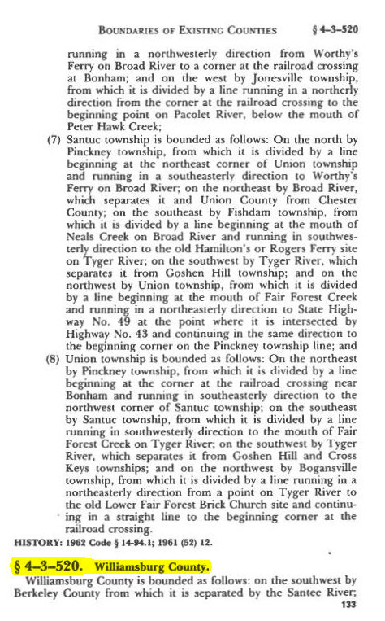
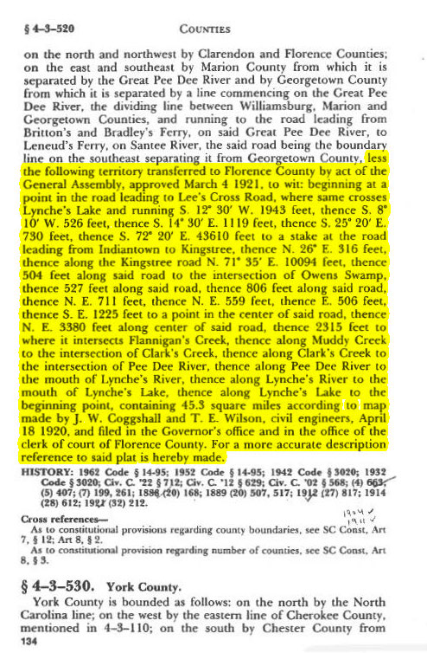
The South Carolina Code of Laws-Williamsburg County

Slide 13
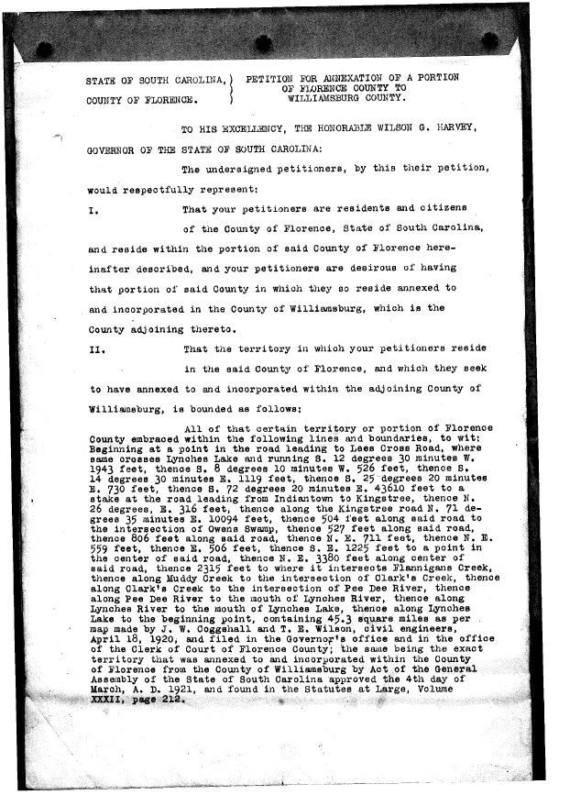
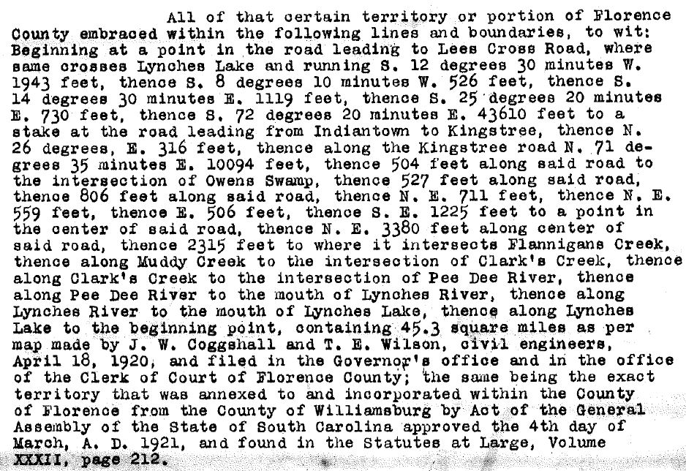
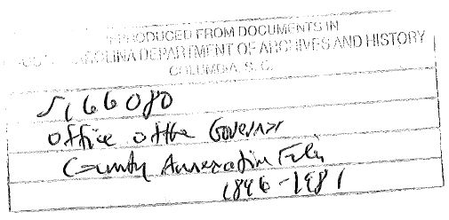
PETITION FOR ANNEXATION OF A PORTION OF
FLORENCE COUNTY TO WILLIAMSBURG COUNTY
Unsuccessful
Petition

Slide 14
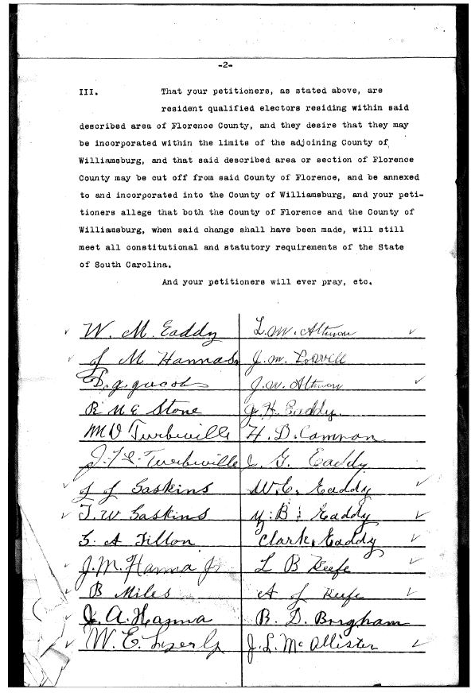
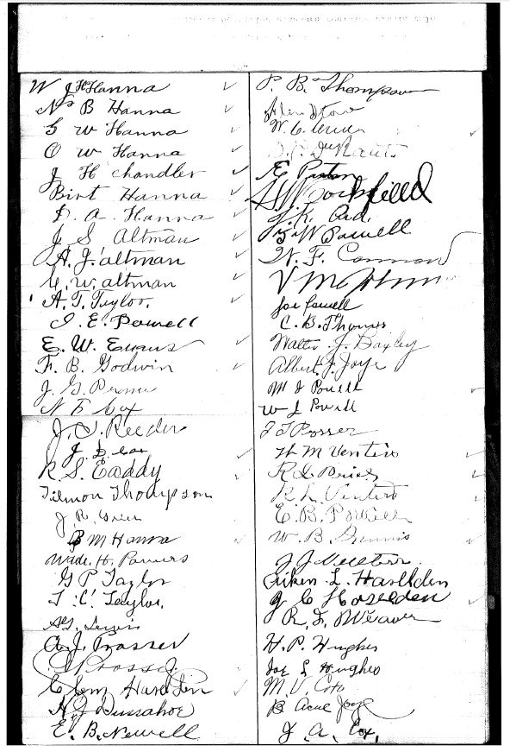
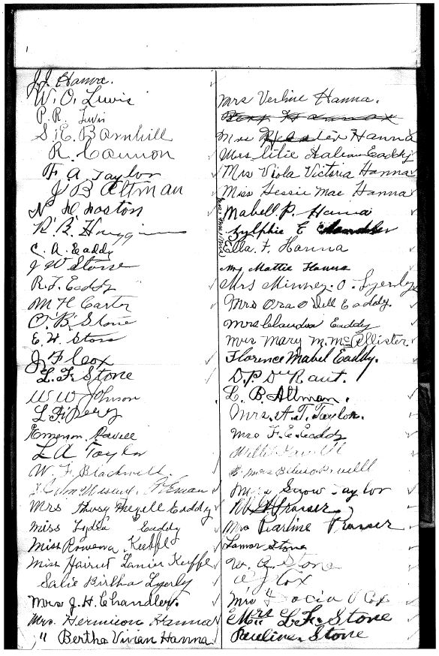
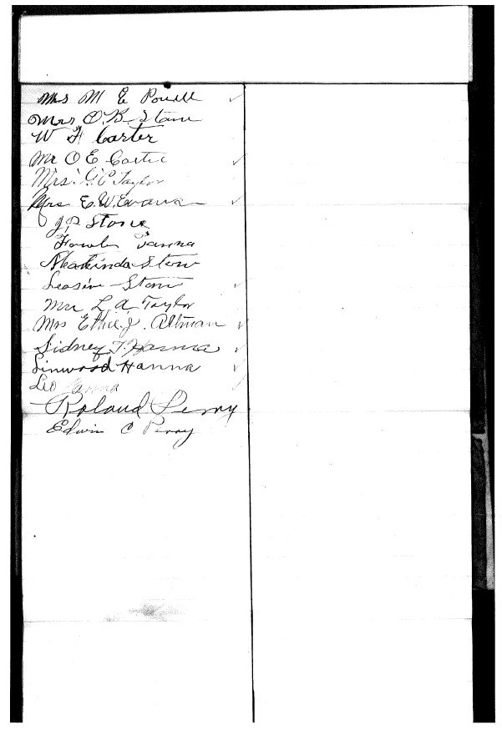
PETITION FOR ANNEXATION OF A PORTION OF
FLORENCE COUNTY TO WILLIAMSBUTG COUNTY
Unsuccessful Petition to Reverse Original Annexation

Slide 15
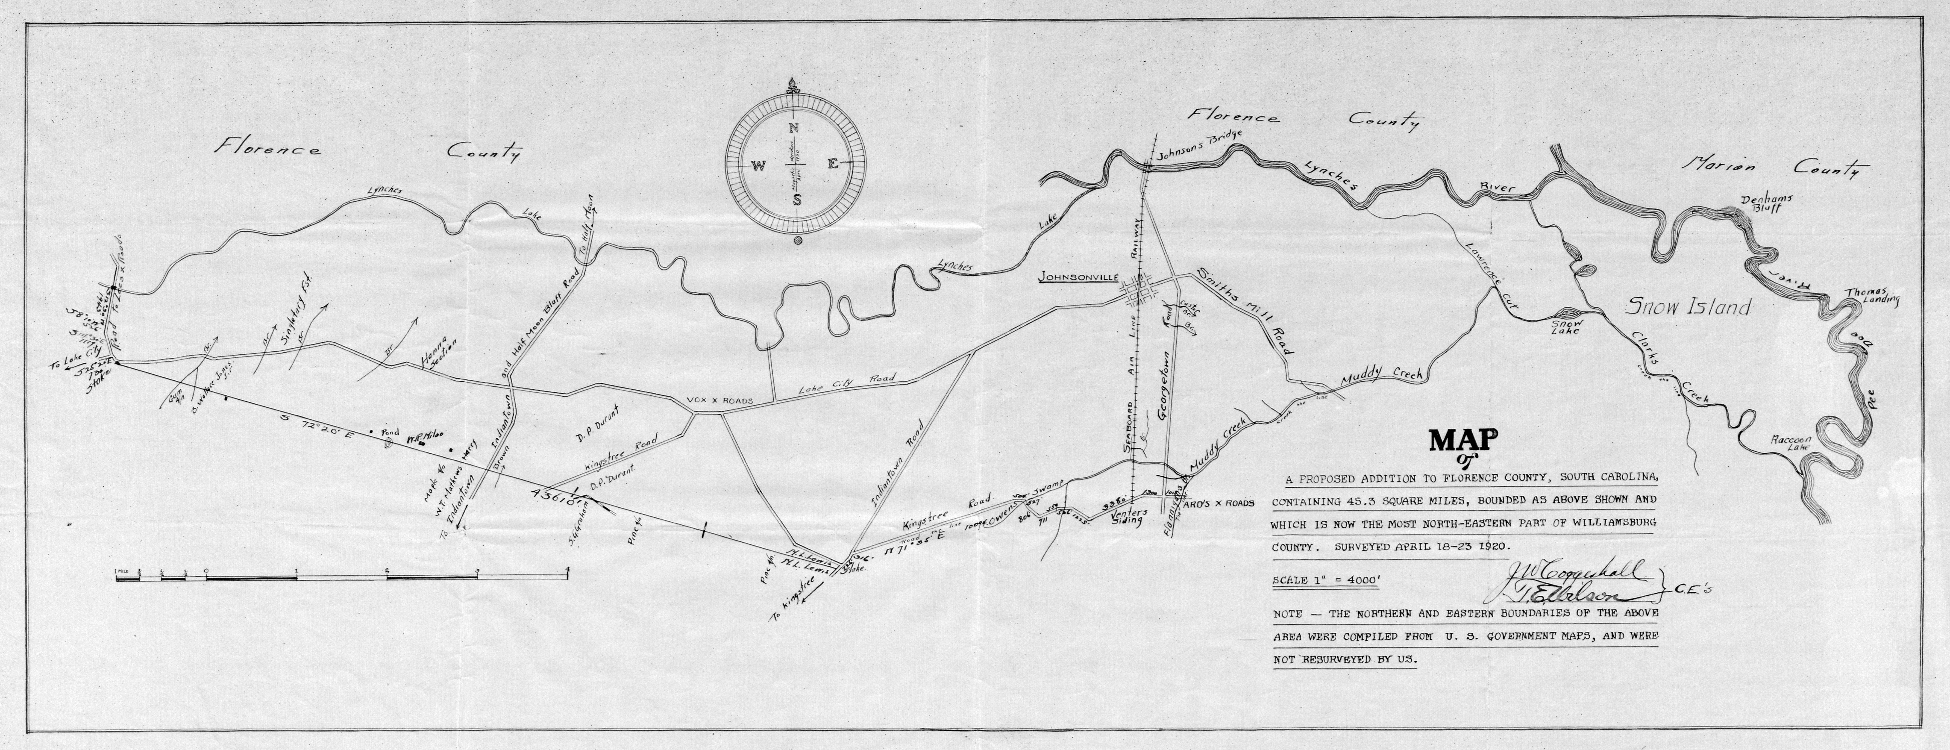
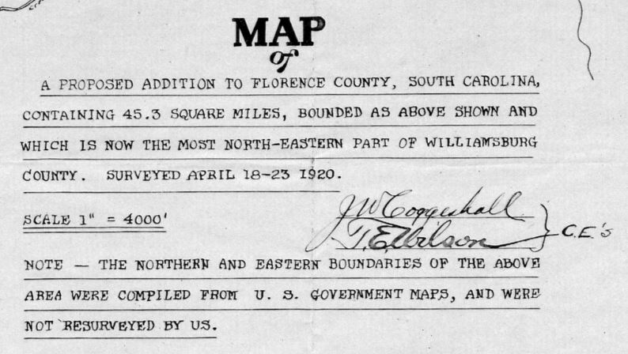
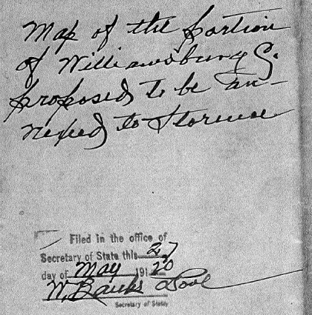
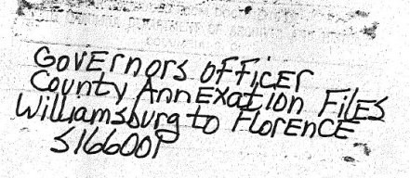
The April 18th, 1920 Coggeshall-Wilson Boundary Plat
References

Slide 16
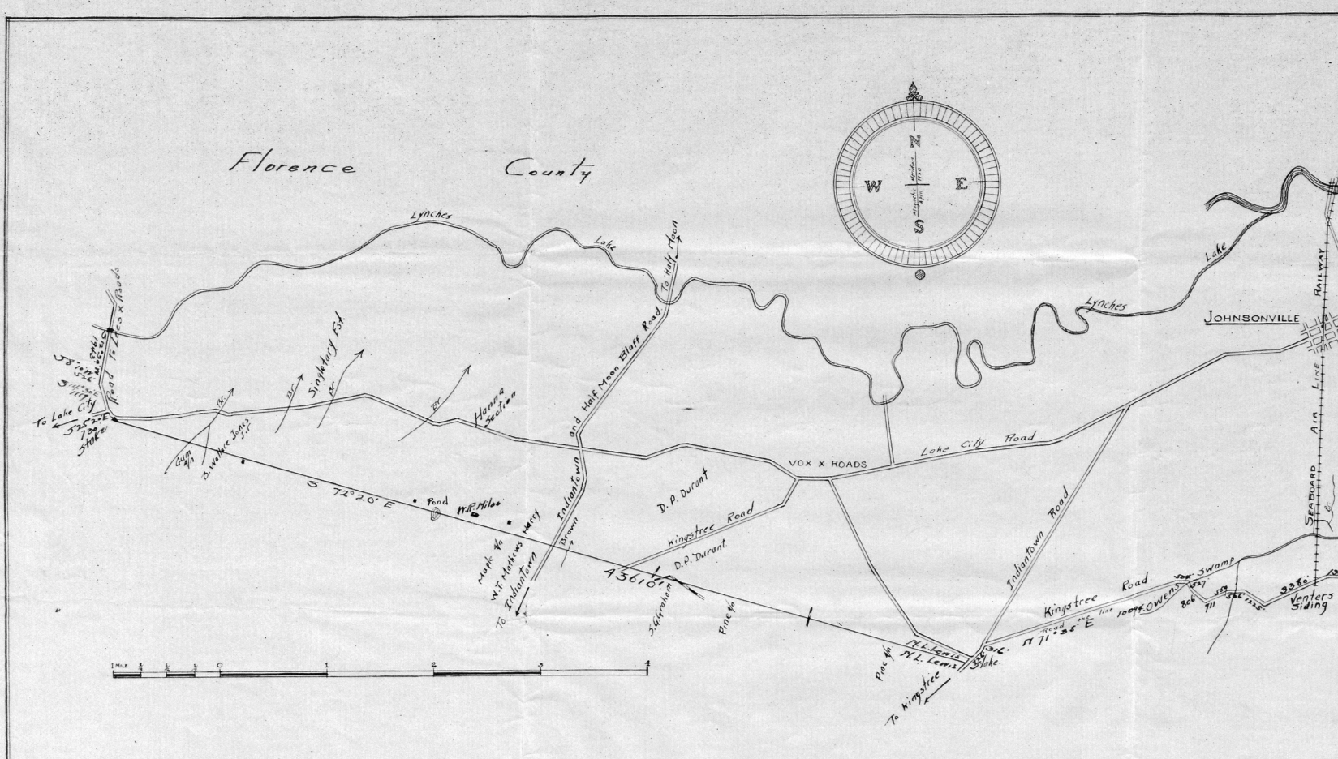
The April 18th, 1920 Coggeshall-Wilson Boundary Plat-WEST Detail

Slide 17
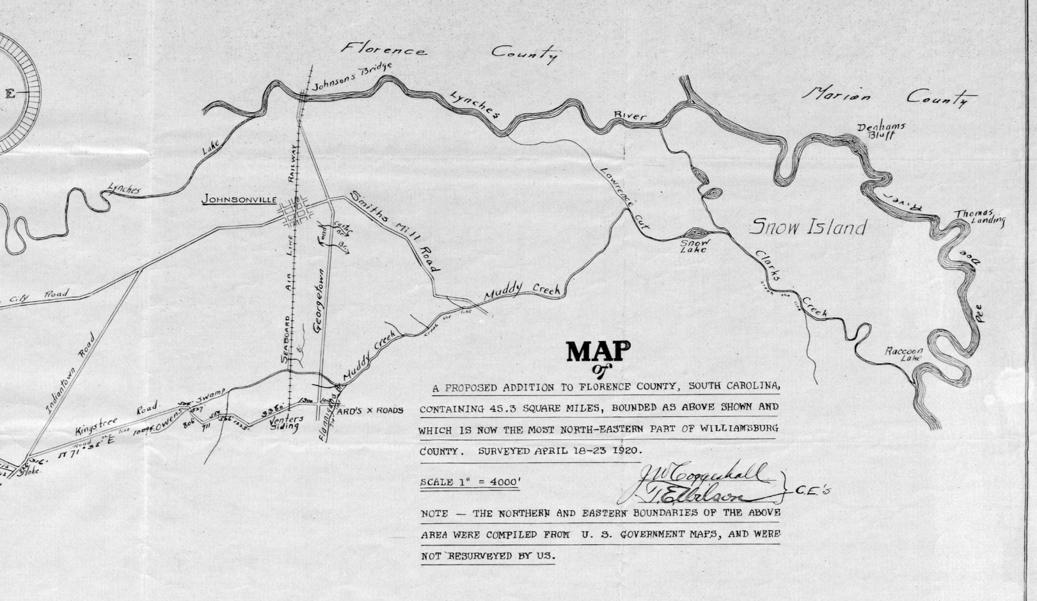
The April 18th, 1920 Coggeshall-Wilson Boundary Plat-EAST Detail

Slide 18
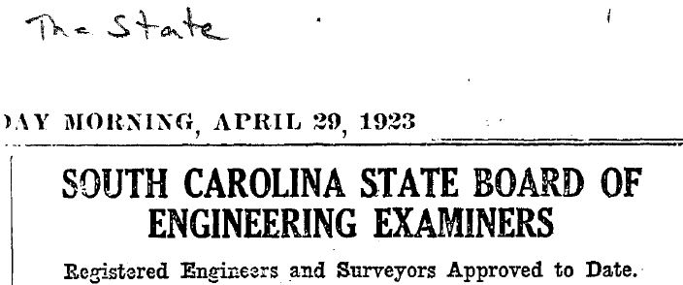
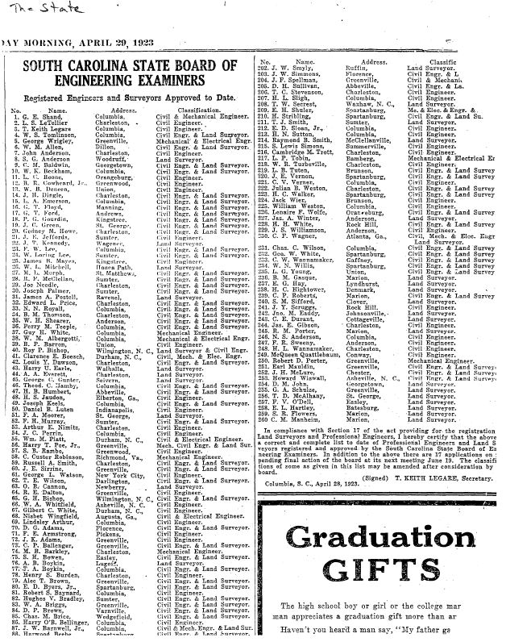
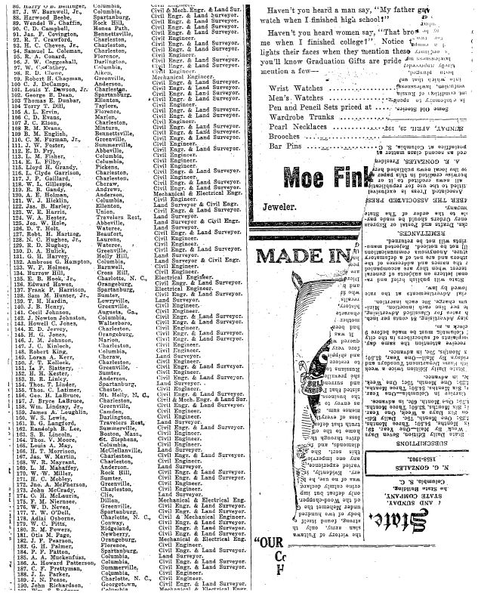

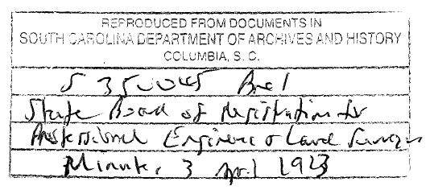
1920’s Surveyors
Reference

Slide 19
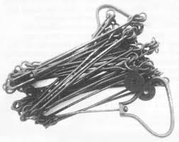
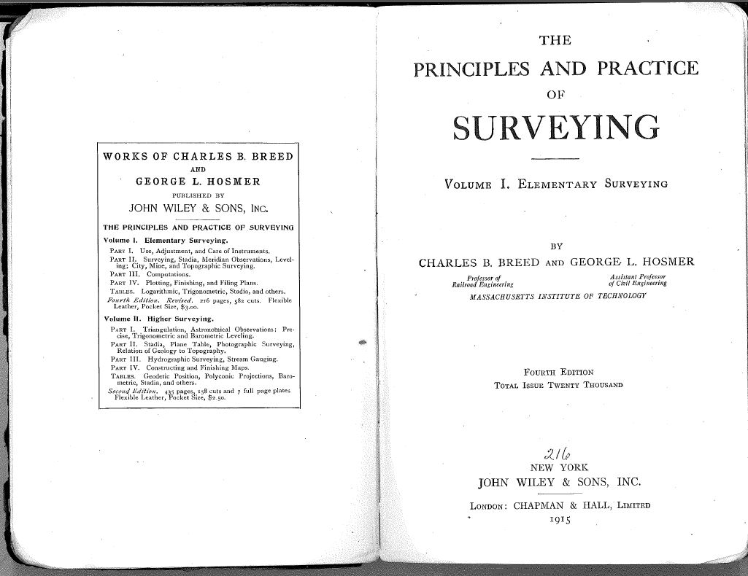
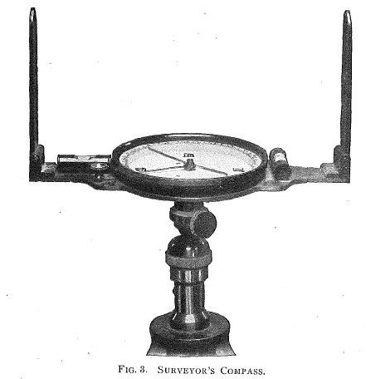
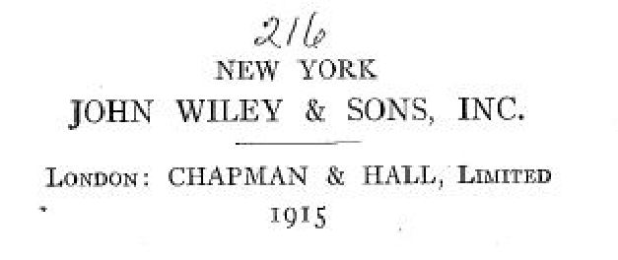
1920’s Surveying Instruments and Practice

Slide 20
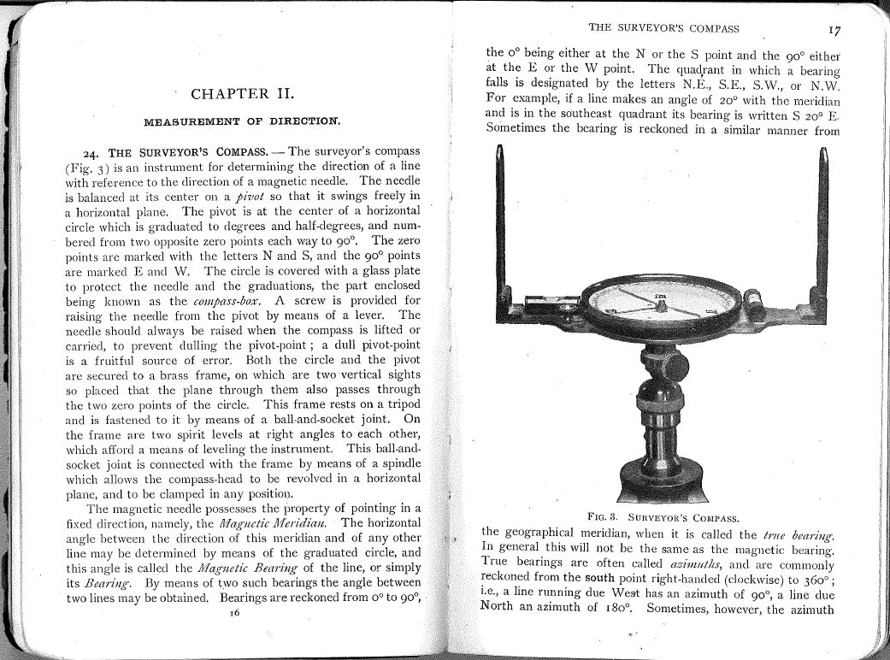
1920’s Surveying Instruments and Practice

Slide 21
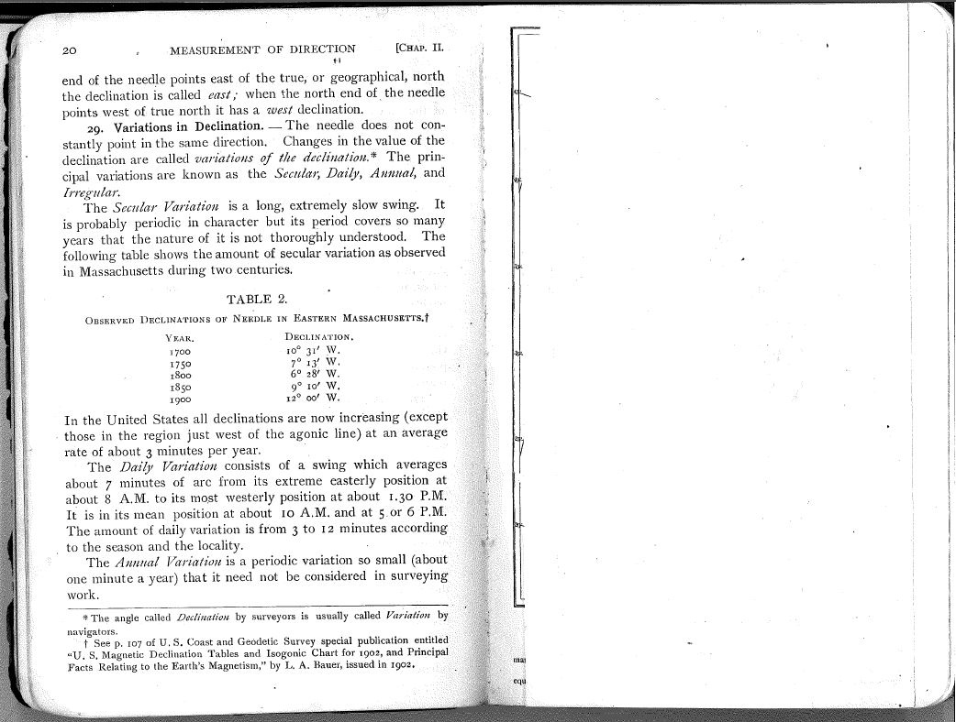
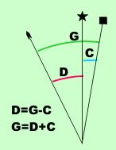
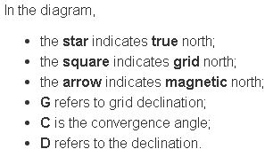
1920’s Surveying Instruments and Practice
Declination is defined as the angle between magnetic north and the true north.
The angle between grid north and true north is called the convergence angle.
To obtain the true declination it is necessary to add or subtract the convergence angle to the Magnetic Declination.
Bearings for the current re-survey plat are NAD83 (2011) SC Grid

Slide 22
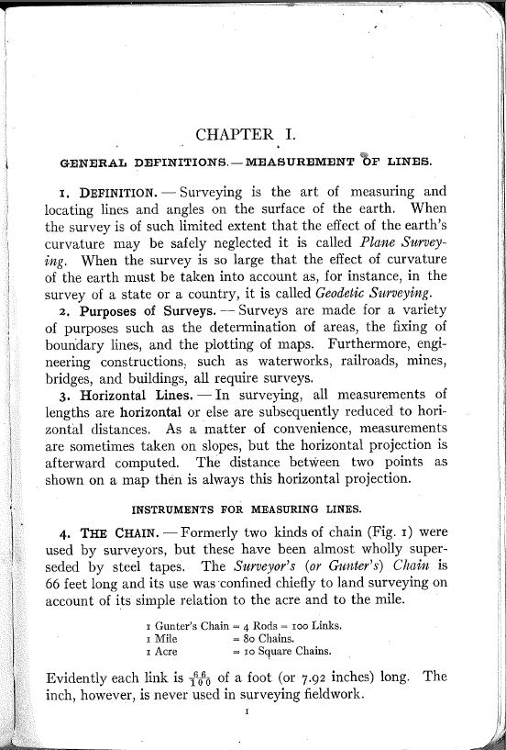

1920’s Surveying Instruments and Practice

Slide 23
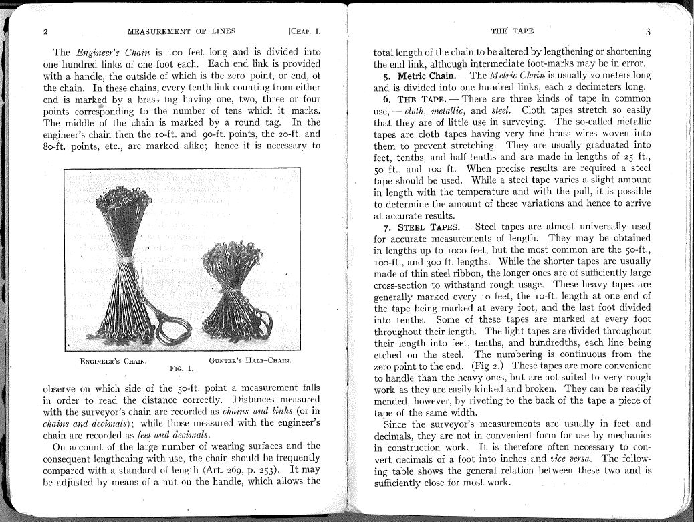
1920’s Surveying Instruments and Practice

Slide 24
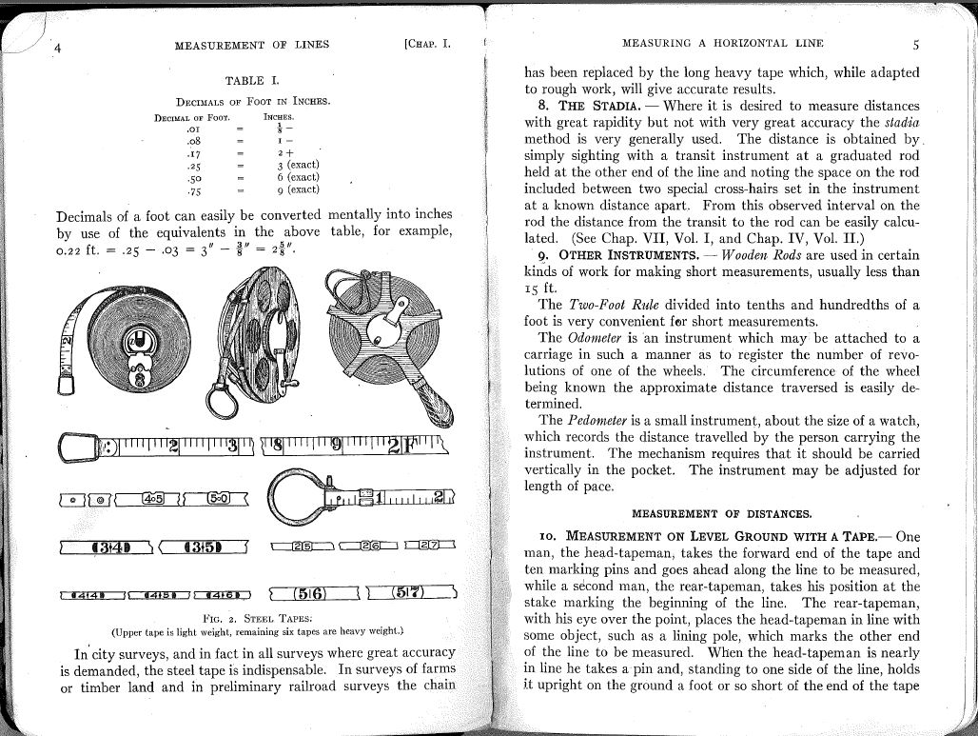
1920’s Surveying Instruments and Practice

Slide 25
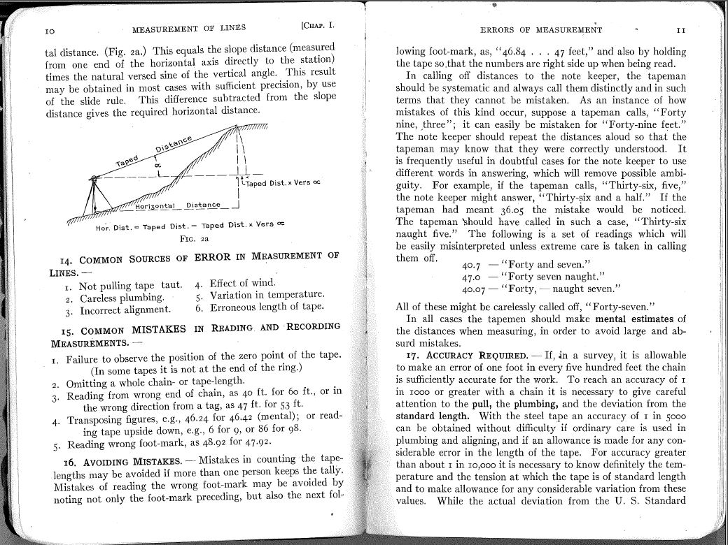
1920’s Surveying Instruments and Practice

Slide 26
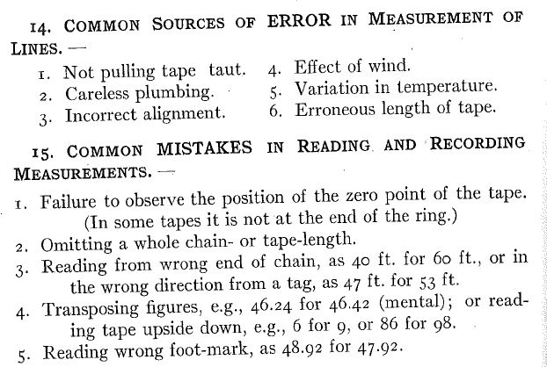
1920’s Surveying Instruments and Practice

Slide 27
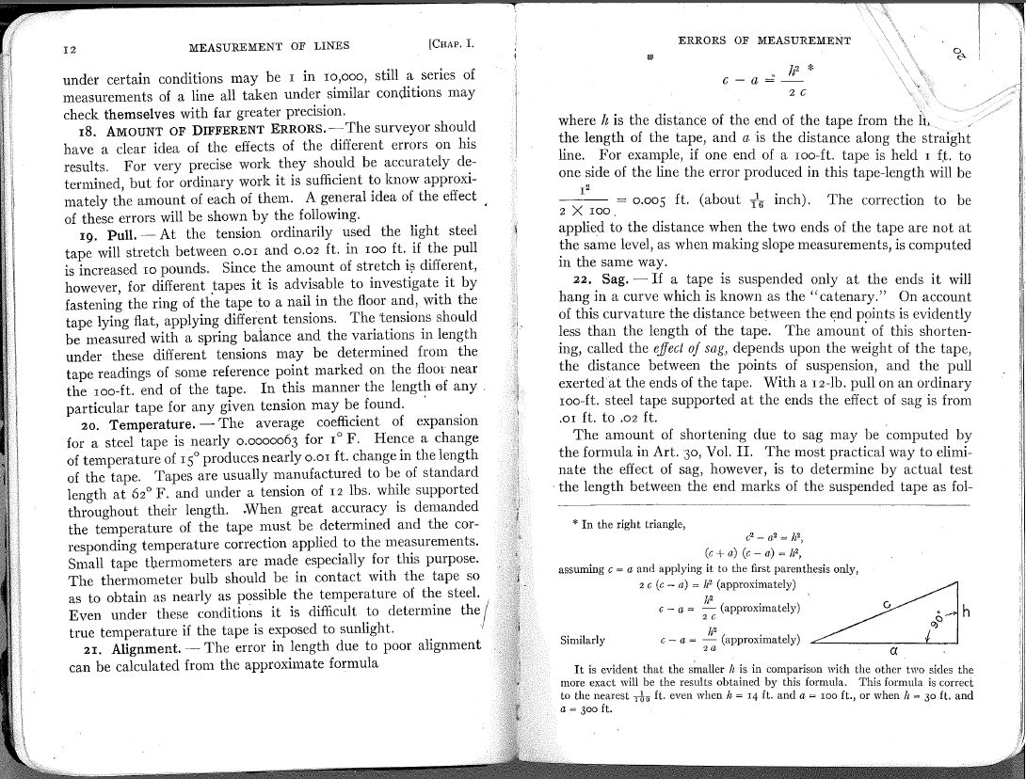
1920’s Surveying Instruments and Practice

Slide 28
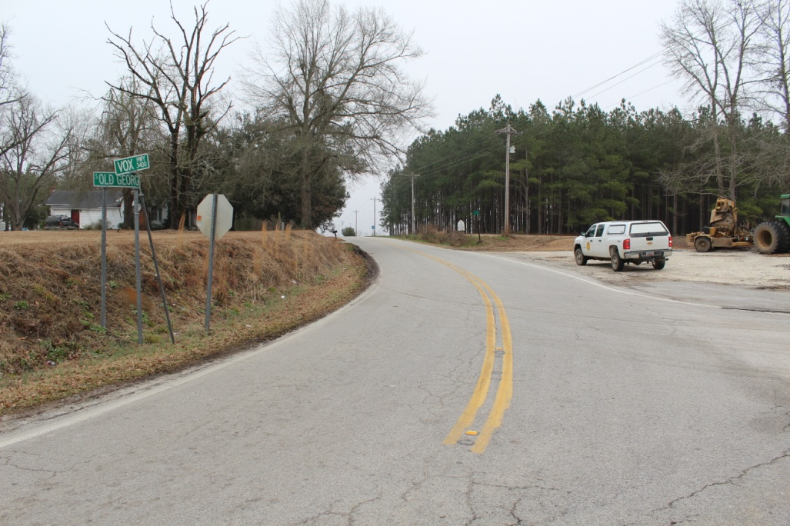
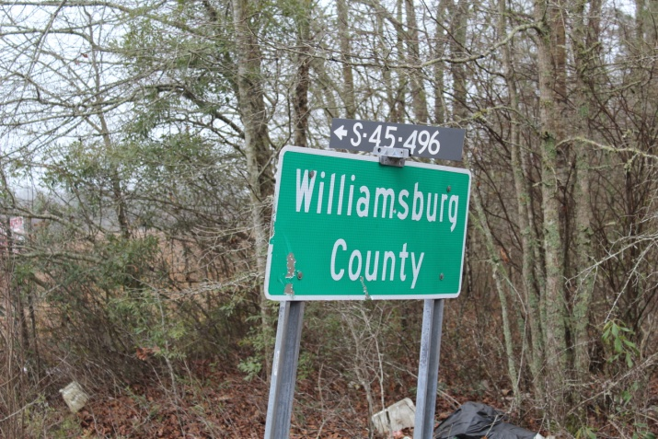
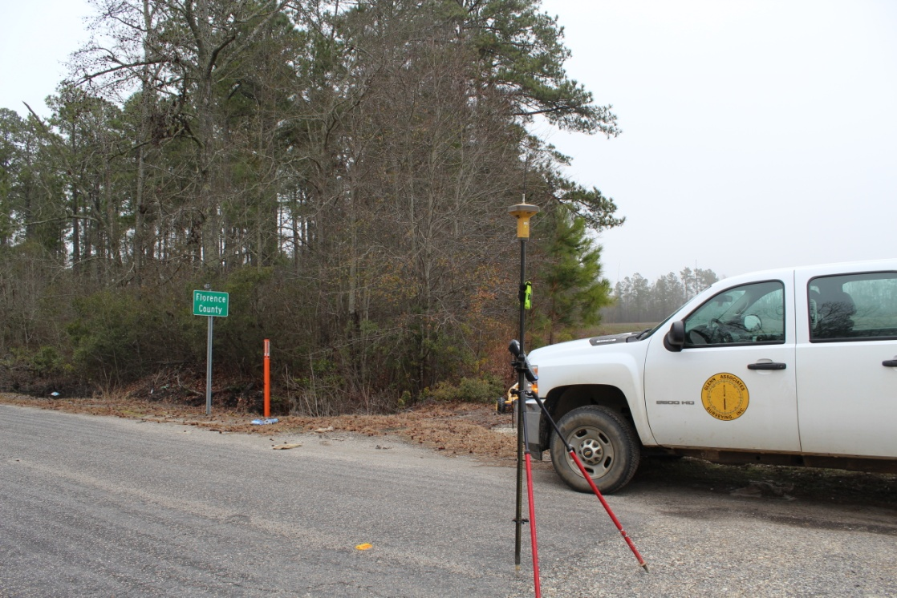
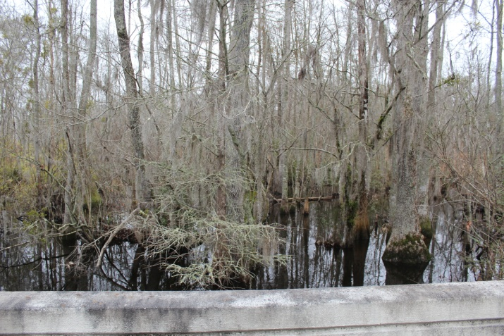
Photographs

Slide 29
Survey Comparison 1920’s : 2015’s
1920
Equipment (Likely)
Staff Compass and Tape (Chain)
2015
Topcon GR3 GNSS Base and Receiver
Topcon
1” Total station
(records angles and distances)

Slide 30
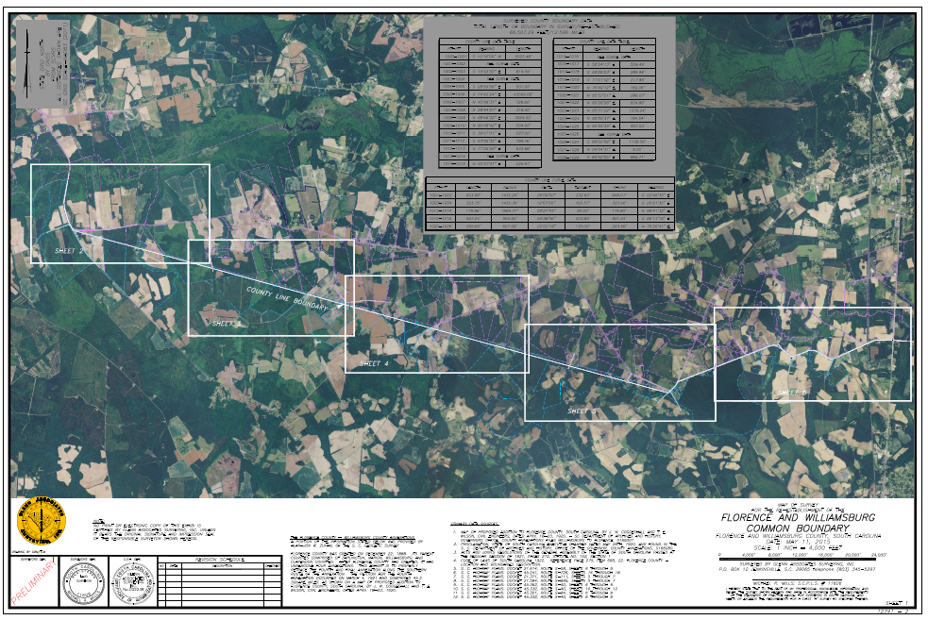
2015 Map of Survey

Slide 31
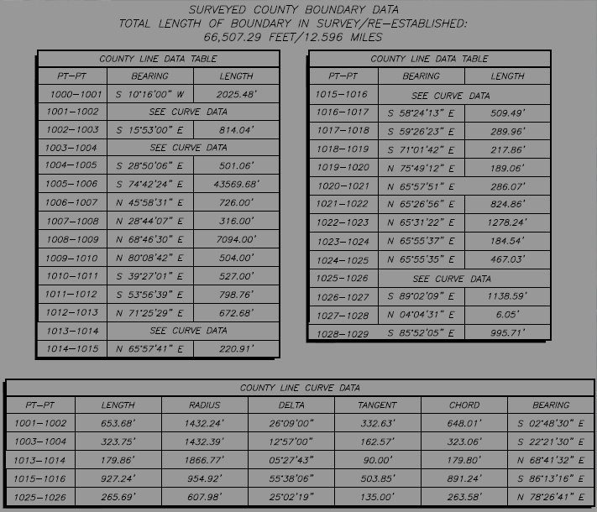
2015 Map of Survey

Slide 32
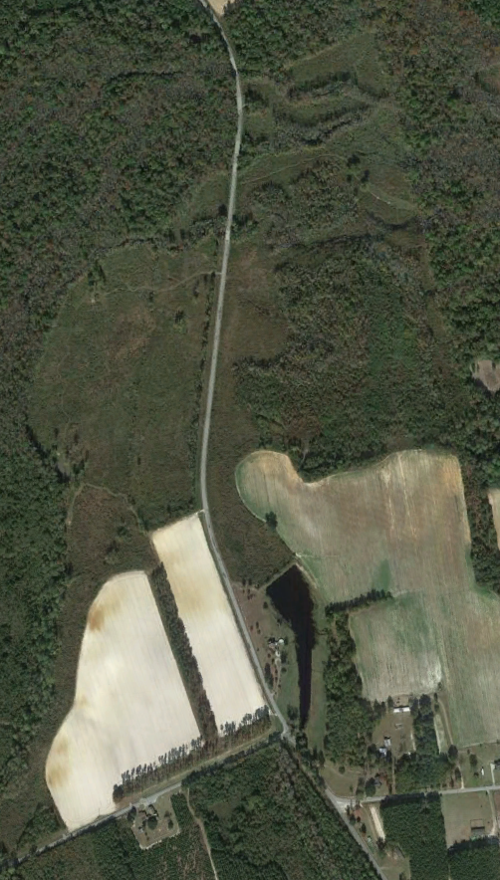
Lynches Creek along Old Georgetown Road to the
Road Intersection with Vox Highway
Section 1

Slide 33
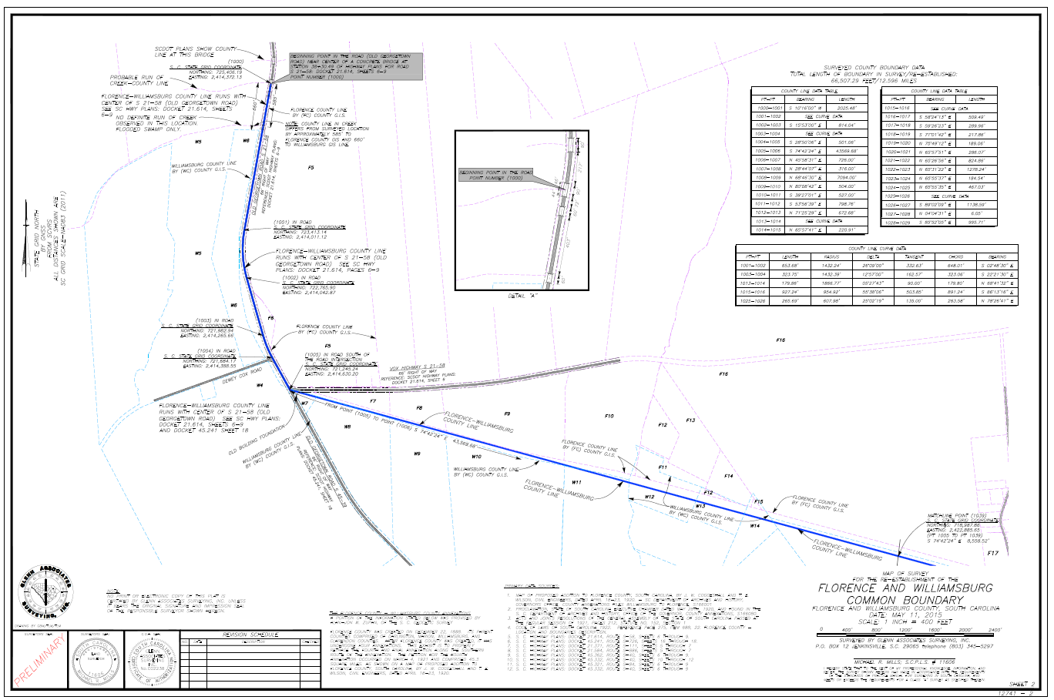
2015 Map of Survey

Slide 34
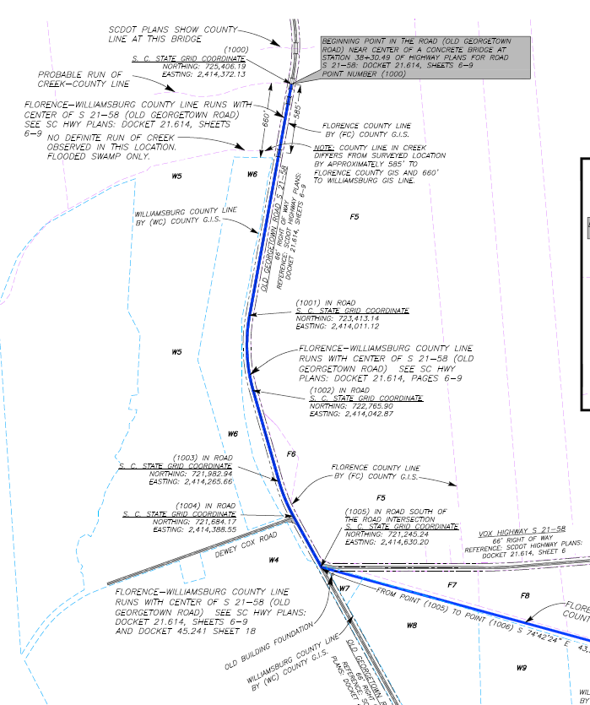
2015 Map of Survey

Slide 35


Point of Beginning
Lynches Creek

Slide 36


Coggeshall-Wilson Plat 1944 Aerial Photo
Aerial References:
UNIVERSITY OF SOUTH CAROLINA
THOMAS COOPER LIBRARY
SOUTH CAROLINA FORESTRY COMMISSION

Slide 37

Coggeshall-Wilson Plat 1928 Williamsburg County Soil Map
References:
Soil Survey of Williamsburg County, SC
By W.J. Latimer, B.H. Hendrickson, F.R., Lesh, A.H Hasty, W.E. Tharp, and C.S. Simmons
UNIVERSITY OF SOUTH CAROLINA
USDA Historical Soil Survey Maps of SC Digital Collection

Slide 38

Lynches Creek and Old Georgetown Road
Probable Run of Lynches Creek
Old Georgetown Road
S 21-58
County Line

Slide 39

Lynches Creek and Old Georgetown Road-Aerial
Bridge
POB Coggshall-Wilson Plat
Bridge
Bridge
GIS Mapping
Bridge

Slide 40

2015 Map of Survey
Soils Map

Slide 41

2015 Map of Survey

Slide 42


South Carolina Department of Transportation (SCDOT) Plans

Slide 43

SCDOT Plans-Florence County Old Georgetown Road S 21-58
Dashed line indicates dirt road of 1971 was not outside of SCDOT R/W
GIS Line Location
Resurvey 2015 indicates County Line being at this run

Slide 44

SCDOT Plans-Florence County Old Georgetown Road S 21-58

Slide 45



County Line along the Old Georgetown Road
North View
South View
The field evidence supports that the current road appears to be in the same location as the Coggeshall-Wilson plat. No evidence of old roadbed.
South View

Slide 46


SCDOT Plans-Williamsburg County Old Georgetown Road S-39

Slide 47



SCDOT Plans-Williamsburg County Old Georgetown Road S-39

Slide 48


SCDOT Plans-Aerial Comparison
1944 SCDOT Plans 2013

Slide 49

Aerial \ Soil –Coggeshall-Wilson Plat Comparison
1944 1928

Slide 50

Aerial –Coggeshall-Wilson Plat Comparison
USDA 2011

Slide 51

2015 Map of Survey

Slide 52



Field Photos

Slide 53



Field Photos

Slide 54

Road Intersection with Vox Highway to current Cowhead Road
Section 2

Slide 55

2015 Map of Survey

Slide 56

2015 Map of Survey

Slide 57

2015 Map of Survey

Slide 58



Point of Beginning Section 2
2013
1944

Slide 59



Coggeshall-Wilson Plat – 1944 Aerial
Coggeshall-Wilson Plat
1944

Slide 60

Coggeshall-Wilson Plat – 1928 Soil
Coggeshall-Wilson Plat
1928

Slide 61

2015 Map of Survey

Slide 62

Old Farm Road
Old Farm Road

Slide 63


2015 Map of Survey

Slide 64




Quail Road (Florence)-Williamson Road (Williamsburg)
S 45-496
Pavement Edge
S 21-633

Slide 65

2015 Map of Survey

Slide 66


Arrowhead Road (Florence)
South View

Slide 67



Blackberry Road (Florence)

Slide 68

2015 Map of Survey

Slide 69


Blackberry Road (Williamsburg)

Slide 70

2015 Map of Survey

Slide 71


Whispering Pines Road at Altman Road (Williamsburg)
Altman Road

Slide 72

2015 Map of Survey

Slide 73


St . James Road ( Florence-Williamsburg)
St. James Road

Slide 74

2015 Resurvey Plat

Slide 75


Intersection County Road s 45-84 with Cowhead( Florence) Cow Head (Williamsburg)

Slide 76





Intersection County Road s 45-84 with Cowhead( Florence) Cow Head (Williamsburg)

Slide 77







Intersection County Road S 45-84 with Cowhead( Florence) Cow Head (Williamsburg)

Slide 78




Coggeshall-Wilson Plat
1944 Aerial Photos

Slide 79


Coggeshall-Wilson- 2015 Map of Survey
Coggeshall-Wilson Plat
2015 Resurvey Plat

Slide 80
Detail of the western end point of county boundary shown on Coggeshall-Wilson plat as S72 20E 43,610’. Resurvey of this line indicates bearing of S74 42 24E and 43,569.68’ distance.
Difference in direction can be attributed to several variables such as method of collection i.e. magnetic compass as opposed to GNSS , NAD 83 (2011) datum Local attraction or instrumental errors or errors in observation in magnetic compass.
See above cited reference of 1920’s survey that may point to less accurate methods that give possible explanation for differences in distance between the 1920 survey and the 2015 resurvey distance.

Slide 81


Coggeshall-Wilson Plat
1944 Aerial Photo

Slide 82

Coggeshall-Wilson Plat
1928 Soil Map

Slide 83



Declination Comparison
Coggeshall-Wilson plat bearing S 72°20’ E
Calculated Adjusted Bearing S 74°39’ 17” E
2015 Plat Bearing S 74°42’24” E
2°19’17”

Slide 84

The bearing and distance for the portion of the county line (43,569.68') was determined by first establishing the county line boundary corners (1006, 1007, and 1008).

Slide 85
These three corners were established by overlaying alignment of the highway plans for W. County road (S 21-40) and Midway road (S 21-111 and S 45-84) onto current field survey data. (1008) is at the intersection of the alignment of highway plans for W. County road (S 21-40), and Midway road (S 21-111). (1007) is along the highway plans alignment for the referenced distance of 316' to (1007) and then turning along the highway alignment of Midway road (S 45-84) for the reference distance of 726' to (1006) as shown on the referenced Coggeshall-Wilson plat.

Slide 86

The Coggeshall-Wilson plat clearly shows a distance of 726 ‘ and 316' for describing the line length along S 21-84/S-21-111 (Midway road).
The 726’ distance is omitted from the Statue Description.

Slide 87


Plat Magnification
Additionally, the 726’ appears to be mislabeled as “N 26° E” in the Statue Description.
Scrivener's Error

Slide 88



SCDOT Plans- Midway Road S 21-111

Slide 89

SCDOT Plans- Highlighted comparison
Rotated View
Midway Road
Coggeshall-Wilson Plat
Represents Depicted County Line
Represents Indiantown\Midway Road
Represents Cowhead Road

Slide 90

2015 Resurvey Plat

Slide 91

Road Intersection Cowhead Road along W. County Road (formally Kingstree Road) to Flannigan’s Creek
Section 3

Slide 92

2015 Map of Survey

Slide 93

2015 Map of Survey

Slide 94




Point of Beginning
Section 3

Slide 95




County Road S 45-84 (Williamsburg)
W. County Line Road

Slide 96

2015 Map of Survey

Slide 97


The reference material indicates from the county boundary corner (1008) along W. County road (formally Kingstree road according to the Coggeshall-Wilson plat) is bearing N 71°35' E, 10,094'. However, by using the highway plans for this road (S 21-40) and the field survey data, the Coggeshall-Wilson plat distance appears to be in error. It is our determination that the distance is 7,094.00' instead of 10,094.00' for this line.
This conclusion is based on observed evidence of the location of the current road and by the study of highway plans and historical aerial photography and lack of evidence in the field to show the road extended to a distance of 10,094’.

Slide 98



SCDOT Plans-Williamsburg S 45-40
Rotated View

Slide 99



SCDOT Plans-Williamsburg S 45-40
Rotated View

Slide 100



SCDOT Plans-Williamsburg S 45-40
Rotated View

Slide 101



SCDOT Plans-Williamsburg S 45-40
Rotated View

Slide 102

2015 Map of Survey

Slide 103


County Road S 45-40 and S 45-430 (Williamsburg)
W. County Line Road

Slide 104


SCDOT Plans-Williamsburg S 45-40
Rotated View

Slide 105



SCDOT Plans-Williamsburg S -40
Rotated View

Slide 106



SCDOT Plans-Williamsburg S 45-40
Rotated View

Slide 107

Beginning at Midway road and bearing N 68°46‘30" E along W. County road, 7,094.00' is near the start of a curve of the current road. The highway plans for W. County road (S 21-40) show an old road at or near this point (1009) that turns to an easterly direction. The Coggeshall-Wilson plat and the referenced code of laws state the county boundary in an easterly direction for 504.00' with road, and then turns southeasterly with the road for 527'. This old road eventually ties back into the current road as indicated on the highway plans (S 21-40).

Slide 108

The county line follows the old roadbed. During the field survey, the old roadbed was indiscernible. The Coggeshall-Wilson plat distances were used in our determination of the county boundary corners (corners 1009-1010-1011).

Slide 109
2015 Map of Survey
As the county boundary reconvenes with road alignment of W. County line road (S 45-40) at corner (1011), it continues with the road alignment to the intersection of W. County line and Wall road. By employing the highway plans for the road and by field survey data, county line corner (1012) was determined.
From point (1012) the county line runs with the road alignment (corners 1012 through 1016) to point (1017). The county line east of point (1017), leaves the road alignment as indicated on highway plans S 21-40, docket 45.332 pt.2, sheet 11. During our field survey, a discernible road bed was determined and data collected for the old roadbed. Corners (1018), (1019), (1020), and (1021) are along old roadbed.

Slide 110

2015 Map of Survey

Slide 111
As the county boundary reconvenes with road alignment of W. County line road (S 21-40) at corner (1011), it continues with the road alignment to the intersection of W. County line and Wall road. By employing the highway plans for the road and by field survey data, county line corner (1012) was determined.
From point (1012) the county line runs with the road alignment (corners 1012 through 1016) to point (1017). The county line east of point (1017), leaves the road alignment as indicated on highway plans S 21-40, docket 45.332 pt.2, sheet 11. During our field survey, a discernible road bed was determined and data collected for the old roadbed. Corners (1018), (1019), (1020), and (1021) are along old roadbed.

Slide 112


SCDOT Plans- W. County Line Road S 45-40

Slide 113


County Road S 45-40 (Williamsburg)
W. County Line Road

Slide 114



Slide 115

County Road S 45-40 (Williamsburg)
W. County Line Road

Slide 116



County Road S 45-40 (Williamsburg)
W. County Line Road

Slide 117


County Road S 45-40 (Williamsburg)
W. County Line Road

Slide 118


SCDOT Plans

Slide 119


SCDOT Plans-

Slide 120

Intersection of County Road S 45-40 (Williamsburg) and SC Highway 41/51
SC Hwy 51
W. County Line Road

Slide 121

2015 Map of Survey

Slide 122


County Road S 45-40 (Williamsburg) at Flanagan’s Creek

Slide 123
Act 262 of 2014
Steps for Clarifying Boundaries
SCGS Requirements:
    Upon reestablishing county boundary, SCGS shall certify its work and within 30 days of certification:
        Provide copies to the administrator of each affected county;
        Provide written notification to affected parties
        Provide notice and copies to the public through its official website and or other means it considers appropriate; and
        Notify as it determines appropriate, other affected state and federal agencies
    (Initiates 60 Day Appeal Process)
  Certified Surveys submitted to Secretary of State, Register of Deeds Offices, and South Carolina Department of Archives with Cover Letter
  Date of the cover letter is the date the surveys become effective
  Introduce Legislation to update Code of Law to reflect clarified boundary with State Plane Coordinates

Slide 124
Act 262 of 2014
Affected Parties Disagreeing with SCGS:
    May file request for a contested case hearing with the SC Administrative Law Court
    This decision may be appealed
    “Affected Party”
              Governing body of an affected county
              Governing body of a political subdivision of this State
              An elected official, other than a statewide elected official
              A property owner or an individual residing in the certification zone
              A business entity located in the certification zone
              A nonresident individual who owns or leases real property situated in the certification zone

Slide 125
SIGNIFICANT IMPACTS?
A significant impact is defined as a residence or place of business being found in a different county based on the re-established boundary.
Reviewed Over 150 Properties Along the 12.5 Mile Section of Re-established Boundary:
Determined 5 Significant Impacts
With 4 being found in Florence
And 1 being found in Williamsburg

Slide 126
QUESTIONS?

Slide 127



FLORENCE AND WILLIAMSBURG COMMON BOUNDARY

