Slide 1



BERKELEY - CHARLESTON
COUNTY BOUNDARY RE-ESTABLISHMENT
(Portion from Tri-County Corner to the Cooper River)

Slide 2
Overview
Reason for boundary clarification
Why is the SC Geodetic Survey the chosen agency
The requirements and duties of the SC Geodetic Survey
Explanation of our methods
Boundary clarification procedure
Legal process for individuals disagreeing with SCGS findings
Statutory description of county boundary
Research and findings
Monumentation and Survey
Conclusion

Slide 3
The Reason…
Passage of time and growth has led to confusion over statutory county descriptions and the locations of county boundary lines
Exact and precise locations and boundaries of state’s political subdivisions are critical for services, enforcement of property rights and election of public officials.
Technology exists now to cost-effectively provide definite and permanent markers of boundary lines
Necessary for state government and political subdivisions

Slide 4
Why the SC Geodetic Survey?
Over the last 30+ years, the South Carolina Geodetic Survey has worked with South Carolina counties to help resolve some of the ambiguities present in the current Code of Law
SC Geodetic Survey was also used in the clarification of the NC/SC boundary
In the early 90’s Greenville and Spartanburg counties asked the Geodetic Survey to help them work out the location of their Statutory Boundary. Their boundary was clarified and placed into law.
After it’s completion the General Assembly decided to enact legislation assigning the SC Geodetic Survey as the mediator to resolve disputes between counties.

Slide 5
The duties of the SC Geodetic Survey (SCGS) with respect to determining county boundaries
SC Code of Laws §27-2-105
Act No. 262 of 2014
(1994) Dispute between two or more counties- SCGS will act as mediator to resolve the dispute
(1994/2014) SCGS to assist counties in defining and monumenting the locations of county boundaries and positioning the monuments using geodetic surveys where counties are ill-defined, unmarked, or poorly marked
(2014) SCGS will clarify county boundaries as defined in Chapter 3, Title 4
(2014) SCGS will analyze archival and other evidence and perform field surveys to position geographically all county boundaries in accordance with statutory descriptions
(2014) To amend section 27-2-105, Code of Laws of South Carolina, 1976, relating to the duties of the South Carolina Geodetic Survey (SCGS) with respect to determining county boundaries, so as to authorize and direct the SCGS to clarify county boundaries and mediate boundary disputes between counties by providing a procedure allowing the SCGS administratively to adjust county boundaries, to provide the procedures including notice that SCGS must follow in making such adjustments, to provide that affected parties may appeal these adjustments to the Administrative Law Court in a de novo hearing, to provide the method of determining the effective date of these administrative county boundary adjustments and the notice requirements for these adjustments to be effective and to provide that nothing contained in this administrative process restricts the authority of the General Assembly by legislative enactment to adjust or otherwise clarify county boundaries by legislative enactment.

Slide 6

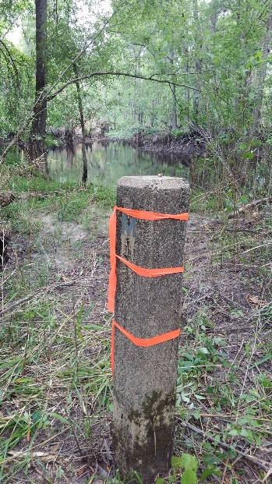
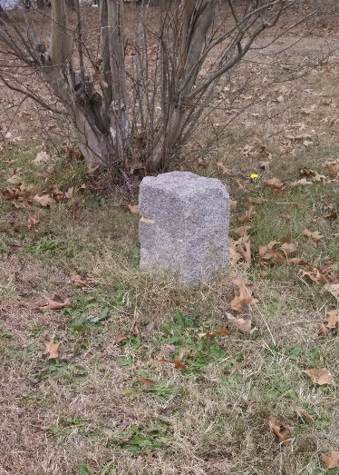
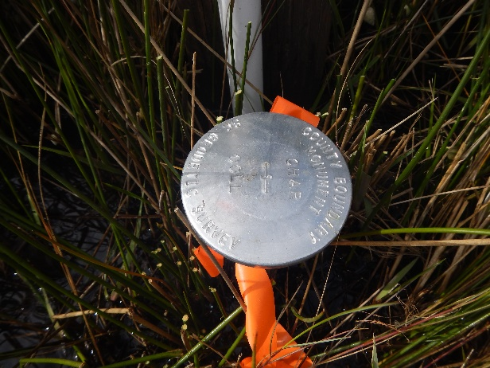
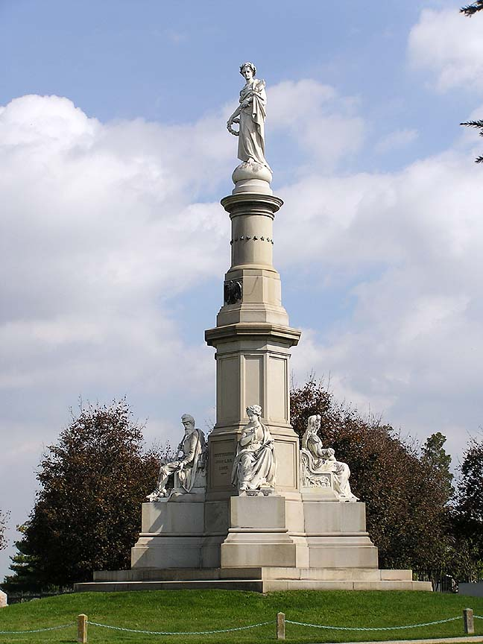
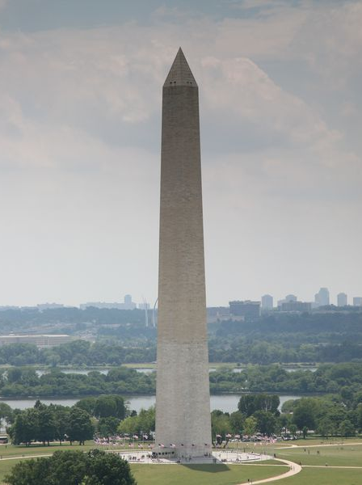
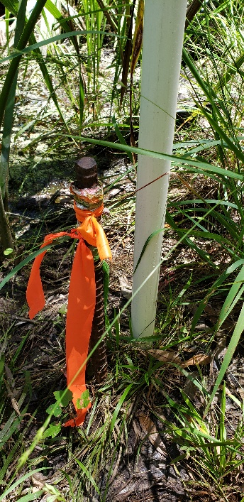
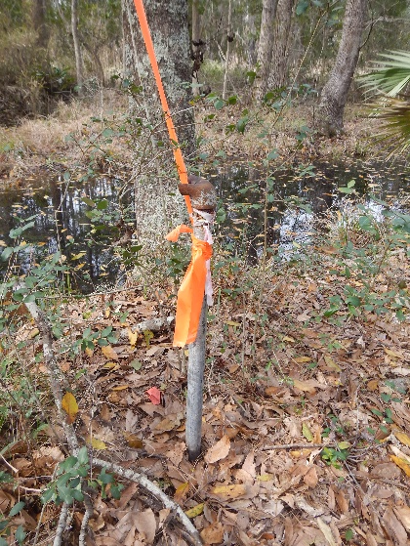

MONUMENTS
VS
MONUMENTS

Slide 7
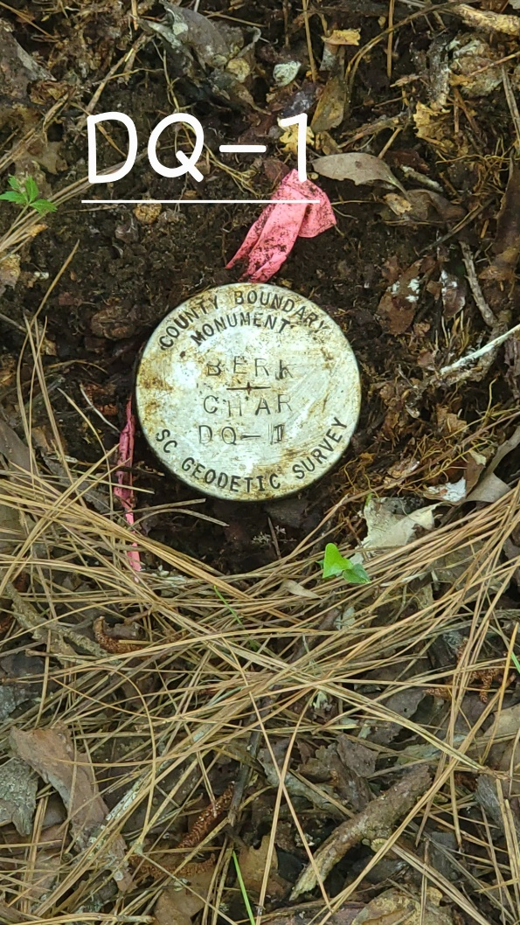
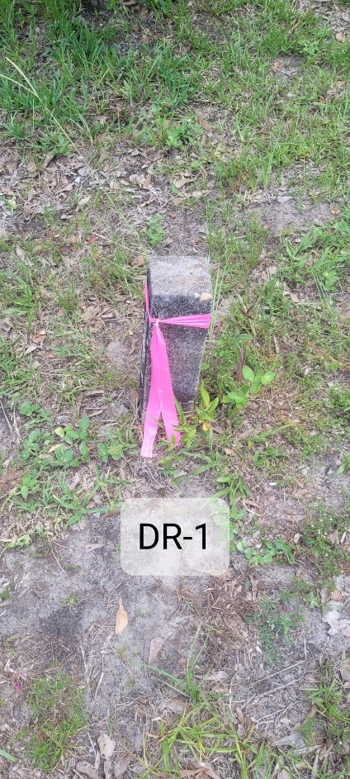
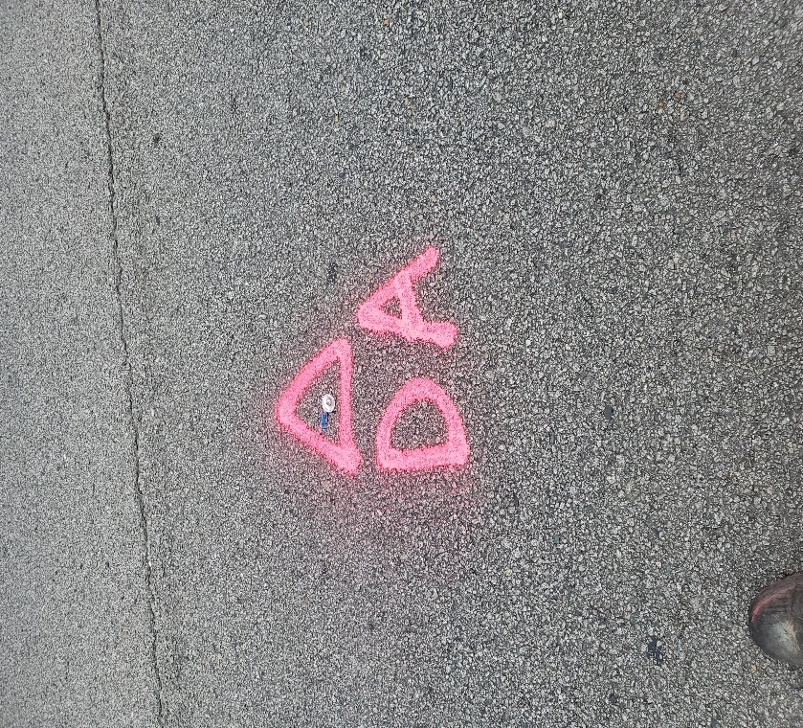
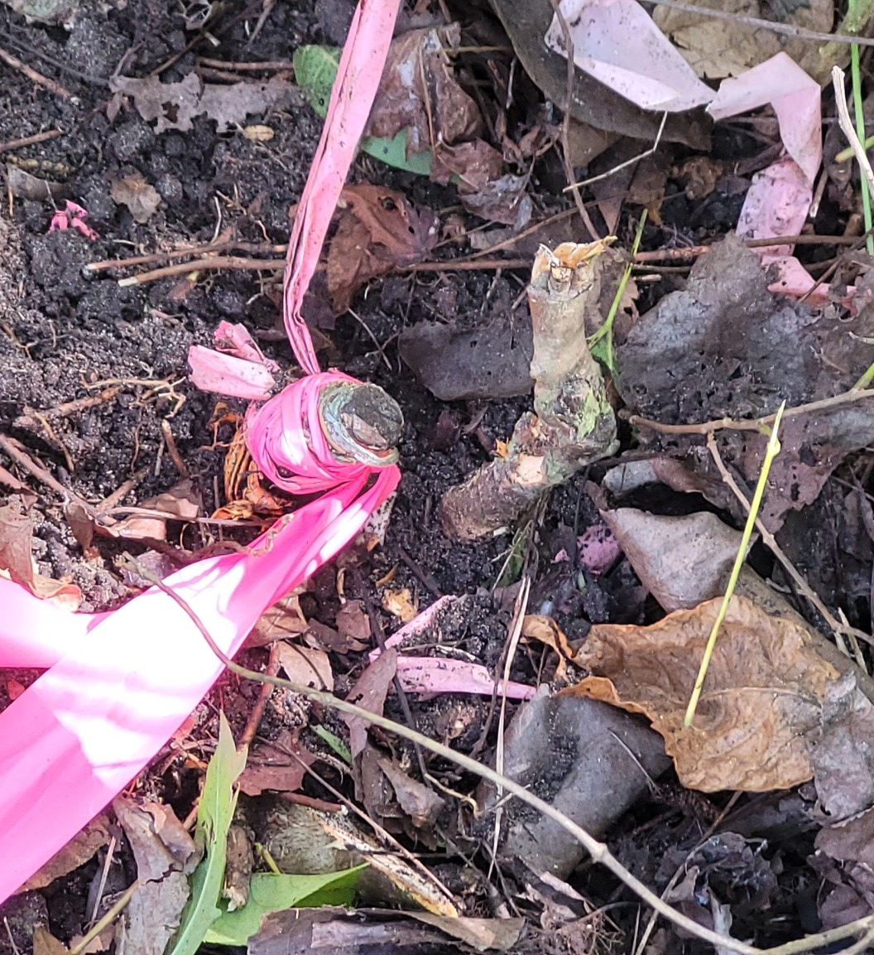
Geodetic Surveys & Common Geographic Coordinate Systems
Why we use them for boundary surveys.

Slide 8
Scatter Gram of Differences
Between Observations
2 – Five Minute Sessions
RMSE(2-D) = 0.020m @95%
0.015m = ~0.05’
Axis Units in Meters

Slide 9
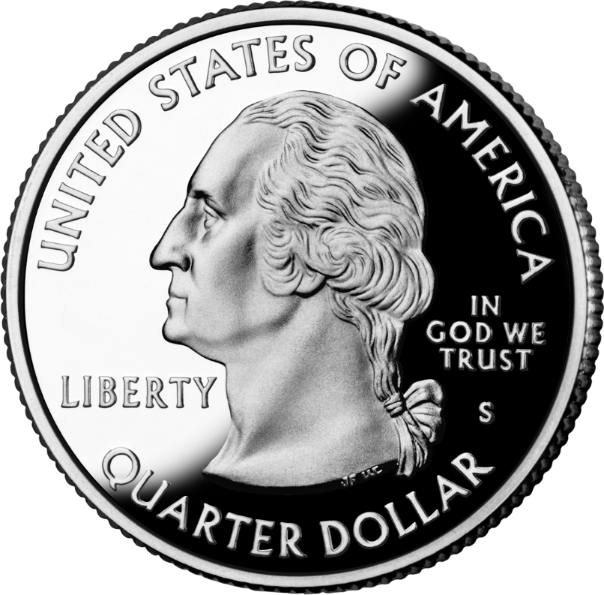
Scatter Gram of Differences
Between Observations
2 – Five Minute Sessions
RMSE(2-D) = 0.020m @95%
0.015m = ~0.05’
Axis Units in Meters

Slide 10
Act 262 of 2014
Steps for Clarifying Boundaries
SC Code of Law SECTION 27-2-105
SCGS Requirements:
    Upon reestablishing county boundary, SCGS shall certify its work and within 30 days of certification:
        Provide copies to the administrator of each affected county;
        Provide written notification to affected parties
        Provide notice and copies to the public through its official website and or other means it considers appropriate; and
        Notify as it determines appropriate, other affected state and federal agencies
    (Initiates 60 Day Appeal Process)
  Certified Surveys submitted to Secretary of State, Register of Deeds Offices, and South Carolina Department of Archives with Cover Letter
  Date of the cover letter is the date the surveys become effective
  Introduce Legislation to update Code of Law to reflect clarified boundary with State Plane Coordinates

Slide 11
SCGS Steps for Clarifying Boundaries
Notify County Administrators in advance of planned work
Conduct historical research for documentary evidence of boundaries*
Perform field work to locate monuments and corroborating evidence and position on State Plane Coordinates*
Share preliminary findings with county officials for impact analysis and to plan public meetings
Hold public meeting
Receive feedback and input from local officials and public
Review and update findings, as appropriate
Certify plats*
Send out mailings to affected parties along boundary*
60day window for appeals*
Record/File plats*

Slide 12
SC Code of Law SECTION 27-2-105
Affected Parties Disagreeing with SCGS:
    May file request for a contested case hearing with the SC Administrative Law Court
    This decision may be appealed
    “Affected Party”
              Governing body of an affected county
              Governing body of a political subdivision of this State
              An elected official, other than a statewide elected official
              A property owner or an individual residing in the certification zone
              A business entity located in the certification zone
              A nonresident individual who owns or leases real property situated in the certification zone

Slide 13
Chapter 5, Title 4
Change of Boundaries
  S.C. Code § 4-5-120: Procedure for annexing part of county- governing body or 10 percent of registered voters petition in writing, shall deposit with the clerk of court an amount of money sufficient to cover the expenses of surveys , plats, annexation commission and the election to be held to determine whether the proposed annexation shall be effected and then file such resolution or petition in the office of the clerk of court
  S.C. Code § 4-5-130: Appointment of Commission for annexation- once presented to the governor then within 30 days the governor shall appoint a commission of four persons
  S.C. Code § 4-5-140: Employment of Surveyors- commission may contract for survey and location of the proposed change of line and for such purpose may employ 3 surveyors
  S.C. Code § 4-5-170: Governor shall order election; voting place; eligible electors- to be held in an area sought to be transferred and an election to be held in the county to which the area is proposed to be transferred
  Propose and adopt Legislation

Slide 14
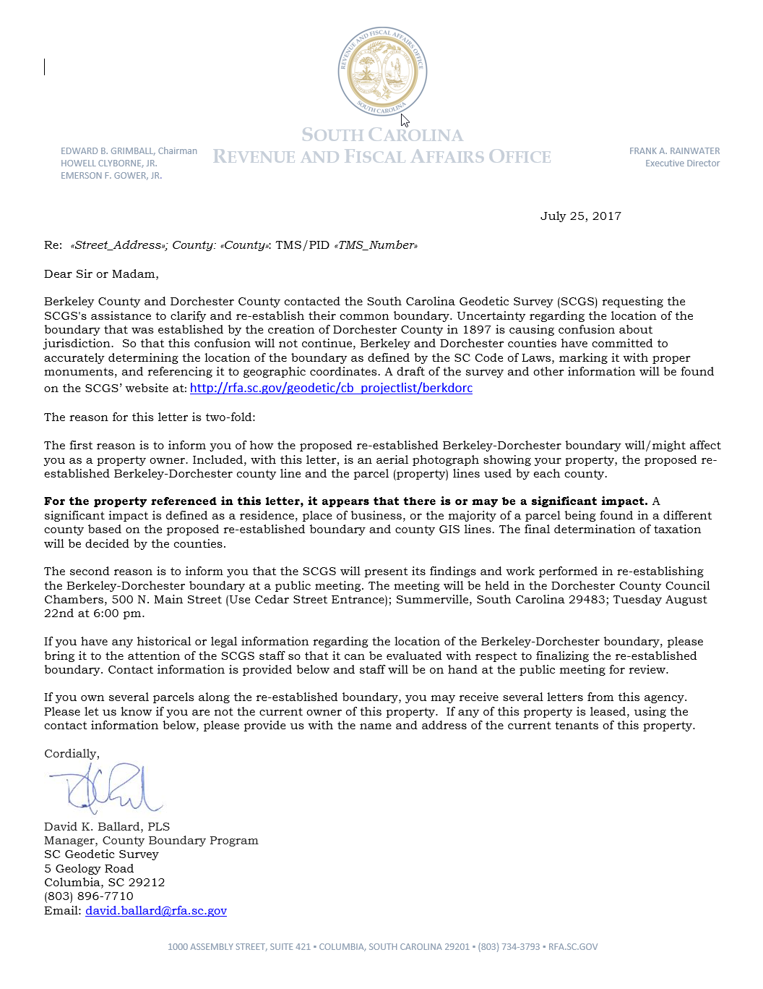
Public Meeting Notification (Example)

Slide 15
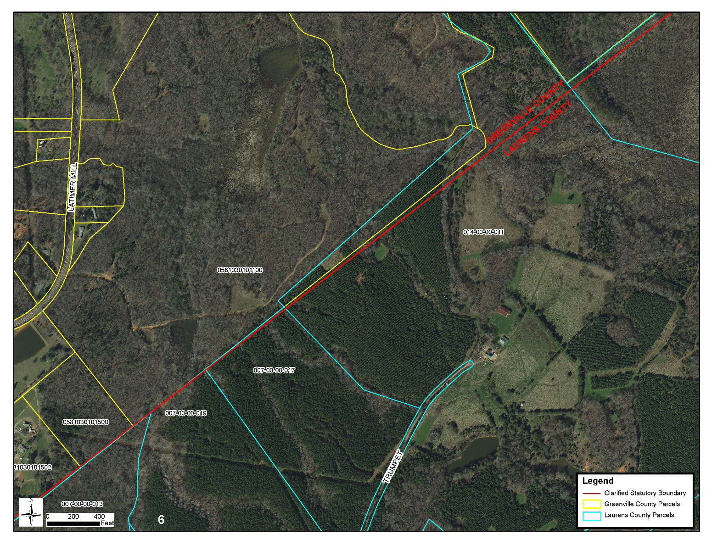
Public Meeting Notification (Example)

Slide 16
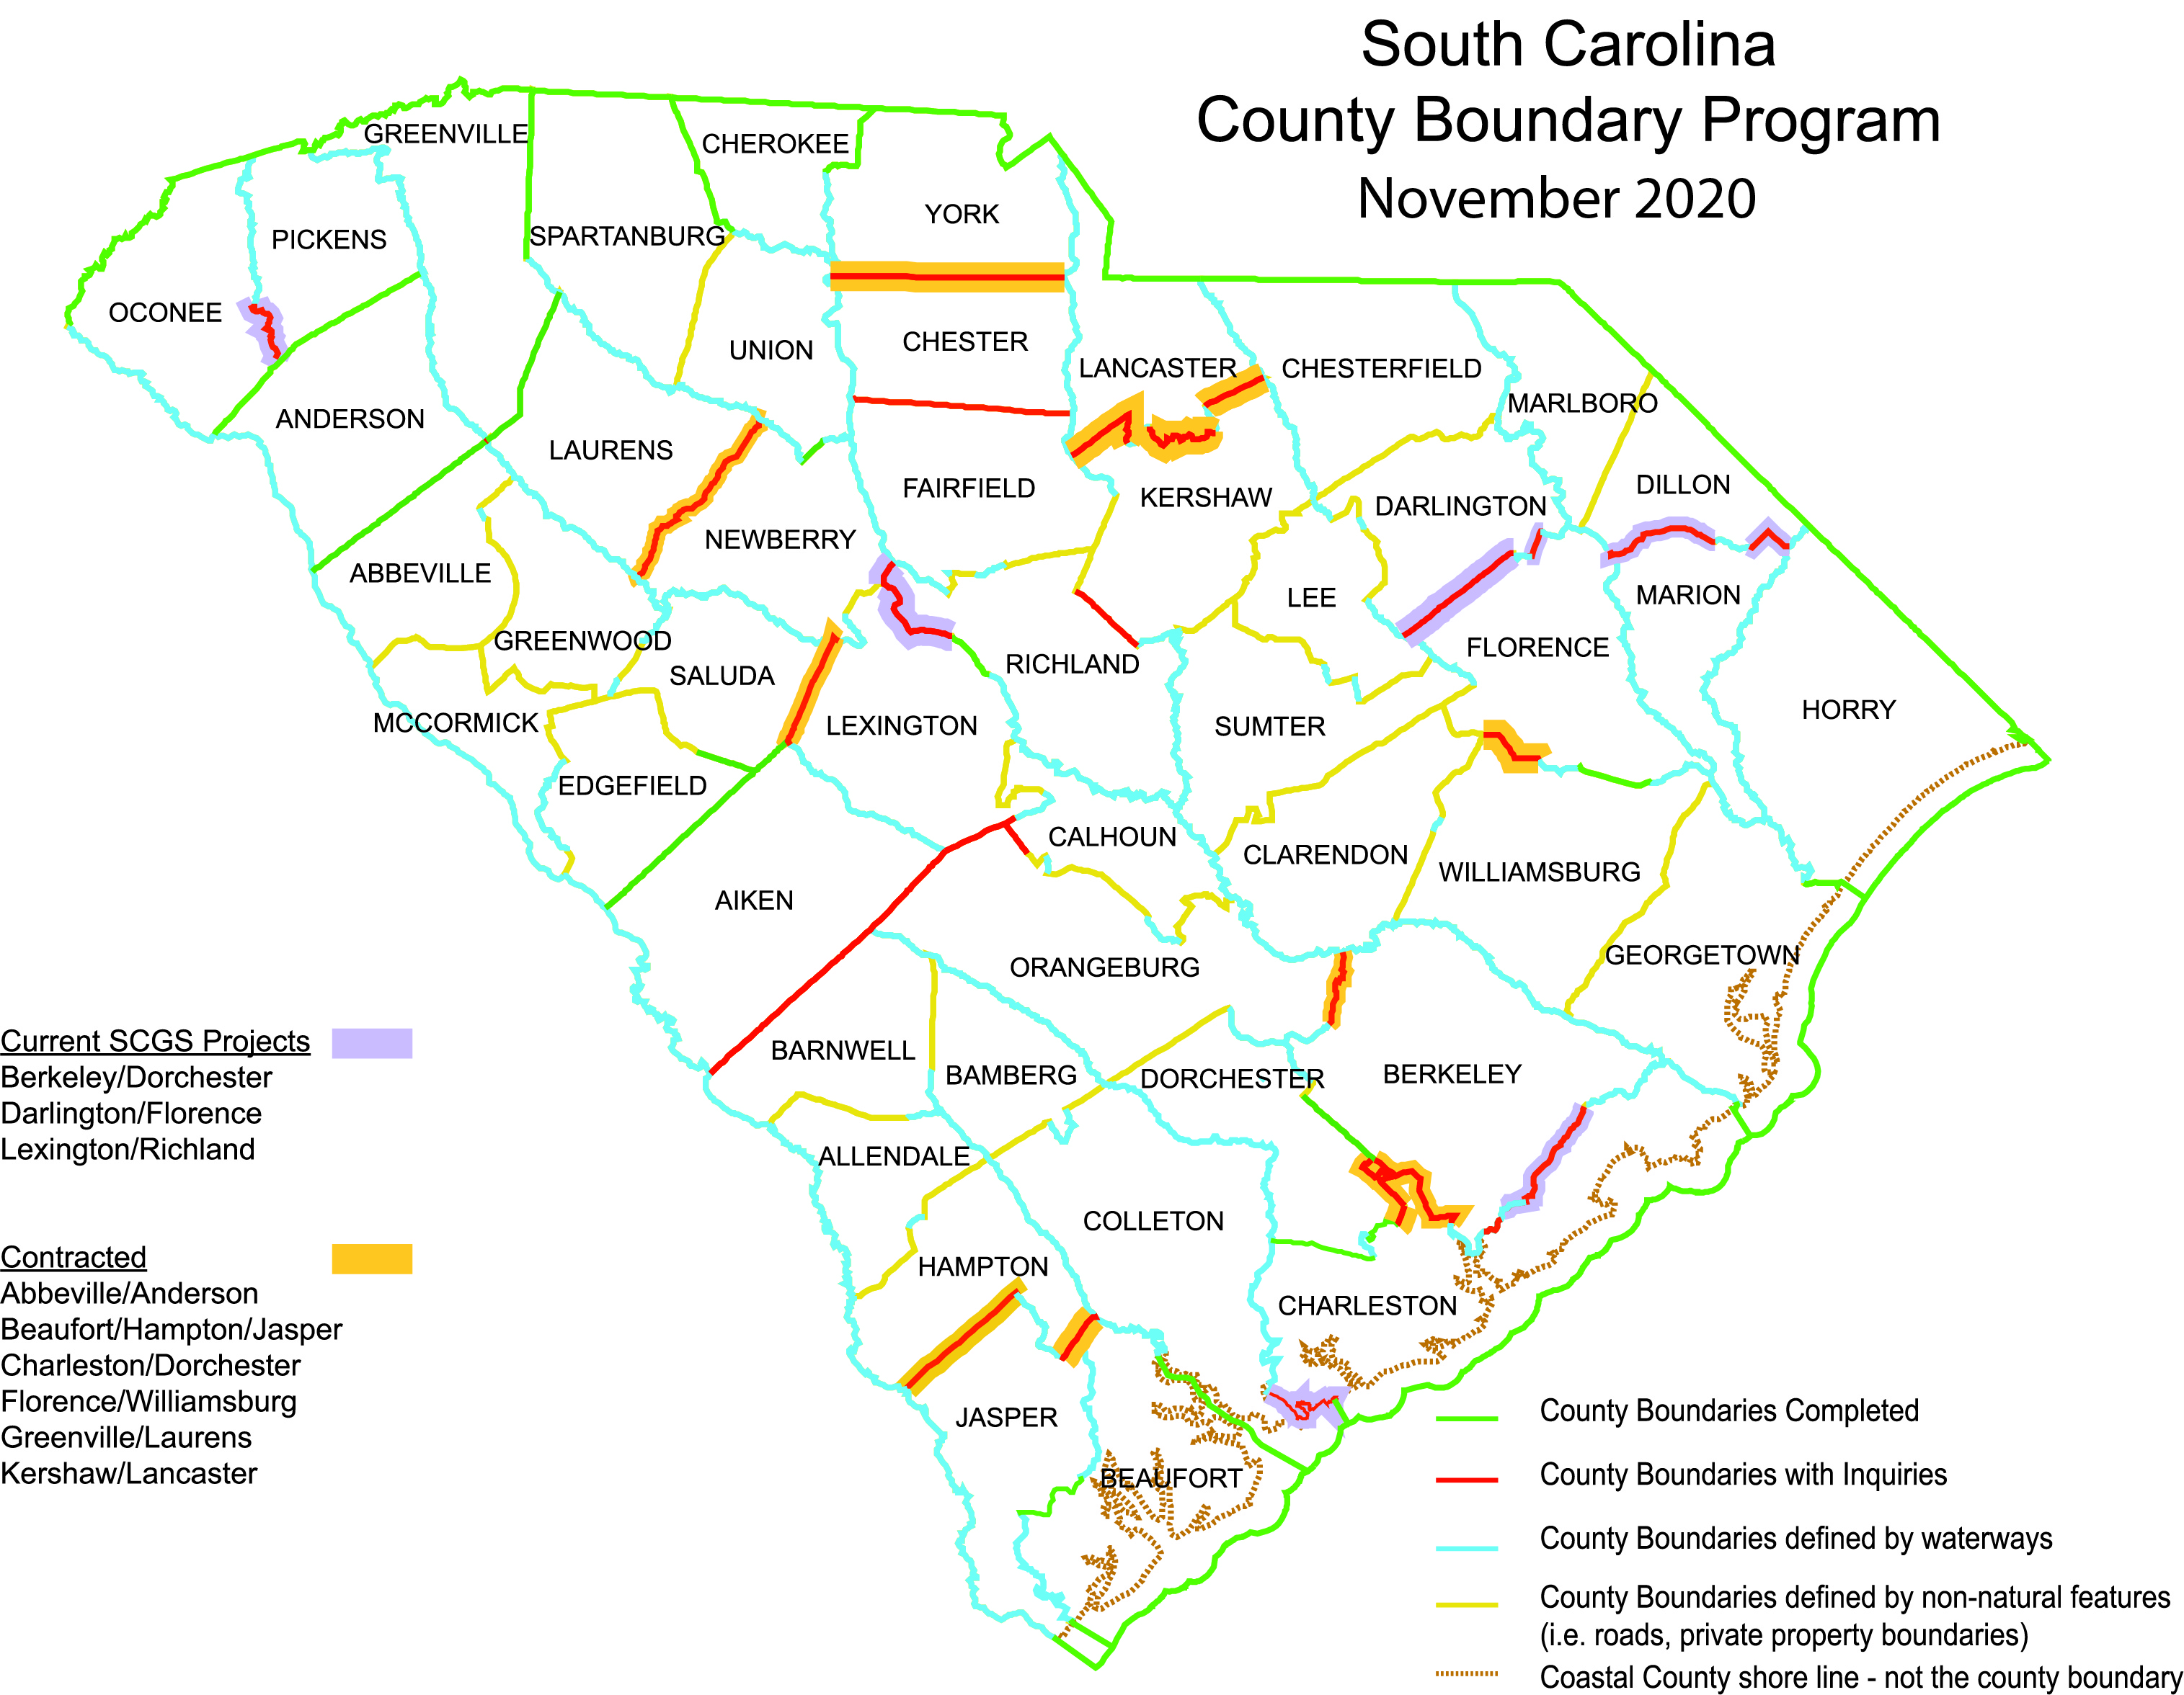

Slide 17
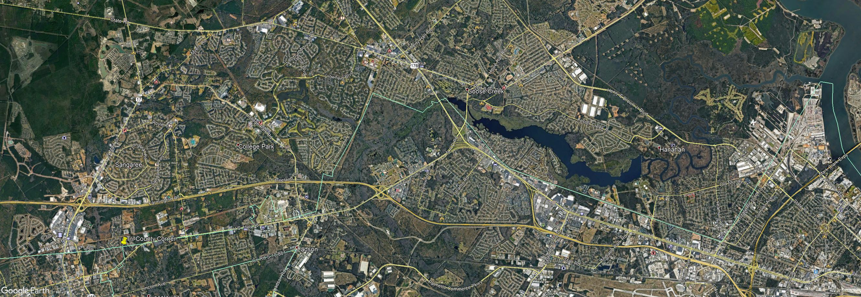

Slide 18
Lines are Established by Legislative Acts
1976 South Carolina Code of Laws
Unannotated
Updated through the end of the 2019 Session
Title 4 - Counties
CHAPTER 3.
BOUNDARIES OF EXISTING COUNTIES

Slide 19
SECTION 4-3-100: Charleston County
“…thence S 50° 20' E to intersection with the eastern right‑of‑way line of U.S. Highway 78, a distance of 83.9 chains; thence southeastward following the southeastern right‑of‑way line of U.S. Highway 78 to its intersection with the southern right‑of‑way line of the S.C. Highway S10‑76 (Ladson Road), a distance of 259.1 chains; thence eastward following the southern right‑of‑way line of S.C. Highway S10‑76 (Ladson Road) to its intersection with the eastern boundary of the Elms Tract, now owned by the Goose Creek Land Company; thence southward following the eastern boundary of said tract to its intersection with the center line of Goose Creek; thence eastward following the center line of Goose Creek to its intersection with the western right‑of‑way line of the CSX Corporation; thence southward following said western right‑of‑way line to its intersection with the southern right‑of‑way line of Secondary State Highway S‑8‑13 (Remount Road); thence eastward by a straight line to its intersection with the center line of Goose Creek at its mouth; thence following a line with a true azimuth of 147° (bearing of S 33° E) to the center line of the Cooper River; …”

Slide 20
Charleston County; additional area of Berkeley County transferred to Charleston County. (1992 Act 337)
That portion of Block B611, Tract 207.02 of Berkeley County commencing at an iron pipe on the northeasterly right-of-way line of U.S. Route 78, the point being 295 feet more or less in a northwesterly direction from the intersection of the northeasterly right-of-way line of U.S. Route 78 and the northwesterly right-of-way line of Craven Road, the point also being the southwesterly property corner of Craven Subdivision and the point of beginning of this description: then along the northeasterly right-of-way line of U.S. Route 78, north 45° 27' 39" west, 91.03 feet to a point of transition width, being a concrete monument; then continuing along the right-of-way line, south 44° 32' 21" west, 10.00 feet to a point of transition of right of-way width, being an unmarked point 0.16 feet in a southeasterly direction from a concrete monument; then continuing along the right-of-way line, north 45° 27' 39" west, 312.94 feet to a point of curvature, being an iron pipe; then continuing along the right-of-way line, along the arc of a 11459.16 foot radius curve, curving to the left, having a chord length of 479.67 feet bearing north 46° 39' 37" west, 479.70 feet to a poi of tangency, being an iron pipe; then continuing along the right-of-way line, north 47° 51' 34" west, 538.49 feet to a point of transition of right-of-way width, being an iron pipe; then continuing along the right-of-way line, north 42° 08' 26" east, 10.00 feet to a point of transition of right-of-way width, being an iron pipe; then continuing along the right-of-way line, north 47° 51' 34" west, 180.63 feet to a point of transition of right-of- way width, being an unmarked point 0.14 feet in a northeasterly direction from a concrete monument; then continuing along the right-of-way line, south 42° 08' 26" west, 10.00 feet to a point of transition of right-of- way width, being an iron pipe; then continuing along the right-of-way line, north 47° 51' 34" west, 1665.96 feet to a point, being a bolt in pavement; then departing the right-of-way line, north 20° 10' 15" east, along the easterly property line of lands of Otis R. Droze, 99.96 feet to a point, being an iron pipe; then continuing along the easterly property line, north 20° 31' 24" east, 263.86 feet to a point, being an iron pipe; then continuing along the easterly property line of Katony Subdivision north 18° 47' 06" east, 19.26 feet to an iro pipe; north 20° 46' 59" east, 256.45 feet to an iron pipe; north 20° 18' 11" east, 135.35 feet to an iron pipe; north 21° 11' 36" east, 157.10 feet to an iron pipe on the southwesterly right-of-way of Camelia Street; then departing the property line, north 68° 35' 47" east, along the southwesterly right-of-way line 154.01 feet to a point, being an iron pipe; then departing the southwesterly right-of-way line, south 20° 01' 04" west, along the westerly property line of Herbert E. Craven, Jr., 167.86 feet to a point being an iron pipe; then departing the westerly property line south 37° 37' 25" east, along the southerly property line of Herbert E. Craven Jr., 48.81 feet to a point being an iron pipe; then continuing along the southerly property line, south 69° 27' 18" east, 41.22 feet to an iron pipe; south 88° 32' 29" east, 82.16 feet to an iron pipe; south 66° 37' 25" east, 138.17 feet to an iron pipe, north 82° 00' 31" east, 58.20 feet to an iron pipe; then departing the southerly property line, north 34° 53' 20" east, along the easterly property line southerly property line of F. M. Craven 224.51 feet to a point being an iron pipe; then departing the southern property line, north 32° 11' 08" east, along the easterly property line of F. M. Craven 537.83 feet to a point being an iron pipe; then continuing along the easterly property line north 00° 59' 51" east, 39.03 feet to a point being an iron pipe; then departing the easterly property line, north 57° 27' 05" west, along the northern property line of F. M. Craven 387.68 feet to a point being an iron pipe; then departing the northerly property line, south 70° 03' 33" east, along the southerly property line of Betty M. Craven 375.38 feet to a point bein an iron pipe; then continuing along the southerly property line, south 69° 10' 06" east, 347.30 feet to a point being an iron pipe; then departing the southerly property line, south 00° 59' 51" west, along a westerly property line of lands of Charles T., Jr., and Annette W. Blocker, 612.74 feet to a point being an iron pipe; then departing the westerly property line, north 76° 08' 19" east, along a southerly property line of lands of Charles T., Jr., and Annette W. Blocker, 130.71 feet to a point being an old axle; then north 76° 09' 03" east along a southerly property line of land of Charles T., Jr., and Annette W. Blocker, Ronnie Smith, and Rachael Waring, et al., 1584.77 feet to a point being an old axle; then departing the southerly property line, south 10° 18' 53", along a westerly property line of lands of J. Roland Wright and Dilys M. Usry, 559.09 fee to a point being a mark on a railroad rail; then departing the westerly property line, south 34° 05' 57" west, along a northwesterly property line of lands of Coastal Carolina Flea Market, Inc., 1628.30 feet to a point being an iron rod; then departing the northwesterly property line, south 73° 21' 16" east, along a southwesterly property line of lands of Coastal Carolina Flea Market, Inc., 788.99 feet to a point being an iron rod; then departing the southwesterly property line, south 40° 22' 33" west, along a northwesterly property line of Craven Subdivision, 1322.59 feet to a point on the northeasterly right-of-way line of U. S. Route 78, being an iron pipe and the point of beginning of this description Herbert E. Craven, Jr., 257.85 feet t a point being an iron pipe; then departing the easterly property line, south 59° 40' 57" east, along the southerly property line of F. M. Craven 224.51 feet to a point being an iron pipe; then departing the southern property line, north 32° 11' 08" east, along the easterly property line of F. M. Craven 537.83 feet to a point being an iron pipe; then continuing along the easterly property line north 00° 59' 51" east, 39.03 feet to a point being an iron pipe; then departing the easterly property line, north 57° 27' 05" west, along the northern property line of F. M. Craven 387.68 feet to a point being an iron pipe; then departing the northerly property line, south 70° 03' 33" east, along the southerly property line of Betty M. Craven 375.38 feet to a point being an iron pipe; then continuing along the southerly property line, south 69° 10' 06" east, 347.30 feet to a point being an iron pipe; then departing the southerly property line, south 00° 59' 51" west, along a westerly property line of lands of Charles T., Jr., and Annette W. Blocker, 612.74 feet to a point being an iron pipe; then departing the westerly property line, north 76° 08' 19" east, along a southerly property line of lands of Charles T., Jr., and Annette W. Blocker, 130.71 feet to a point being an old axle; then north 76° 09' 03" east along a southerly property line of land of Charles T., Jr., and Annette W. Blocker, Ronnie Smith, and Rachael Waring, et al., 1584.77 feet to a point being an old axle; then departing the southerly property line, south 10° 18' 53", along a westerly property line of lands of J. Roland Wright and Dilys M. Usry, 559.09 fee to a point being a mark on a railroad rail; then departing the westerly property line, south 34° 05' 57" west, along a northwesterly property line of lands of Coastal Carolina Flea Market, Inc., 1628.30 feet to a point being an iron rod; then departing the northwesterly property line, south 73° 21' 16" east, along a southwesterly property line of lands of Coastal Carolina Flea Market, Inc., 788.99 feet to a point being an iron rod; then departing the southwesterly property line, south 40° 22' 33" west, along a northwesterly property line of Craven Subdivision, 1322.59 feet to a point on the northeasterly right-of-way line of U. S. Route 78, being an iron pipe and the point of beginning of this description

Slide 21
SECTION 4-3-80: Berkeley County
“…beginning at the intersection of the present line between Charleston County and Berkeley County with the western line of the right of way of Atlantic Coast Line Railroad, and running thence northwardly with the western line of said right of way to its intersection with the run of Goose Creek; thence with the run of Goose Creek in a westerly direction to its intersection with the eastern boundary of Elms Tract, now owned by Goose Creek Land Company; thence northwardly along the eastern boundary of said tract to its intersection with the southern line of the Ladson Road; thence westwardly with the southern line of said Ladson Road to its intersection with the eastern line of the Blue House Road; thence on a bearing N. 50° 20' W. to the southeast corner of Dorchester County;…”

Slide 22
SECTION 4-3-85. Berkeley County; additional area of Charleston County transferred to Berkeley County. (2004 Act 244)
The following described portion of Charleston County is transferred and annexed to Berkeley County:
All that area, approximately 4.04 acres, now lying in the County of Charleston and identified as a portion of TMS #487‑00‑00‑026 located adjacent to Crowfield Plantation Development and shown on a map prepared by ADC Engineer, Inc., designated as Job #02227 and dated December 4, 2002.

Slide 23
Survey Update
Field Work is at 100% Complete, monuments have been set.
We have not encountered any boundary problems outside the “expected” normal that is seen in tracing a 50 plus year old line.

Slide 24
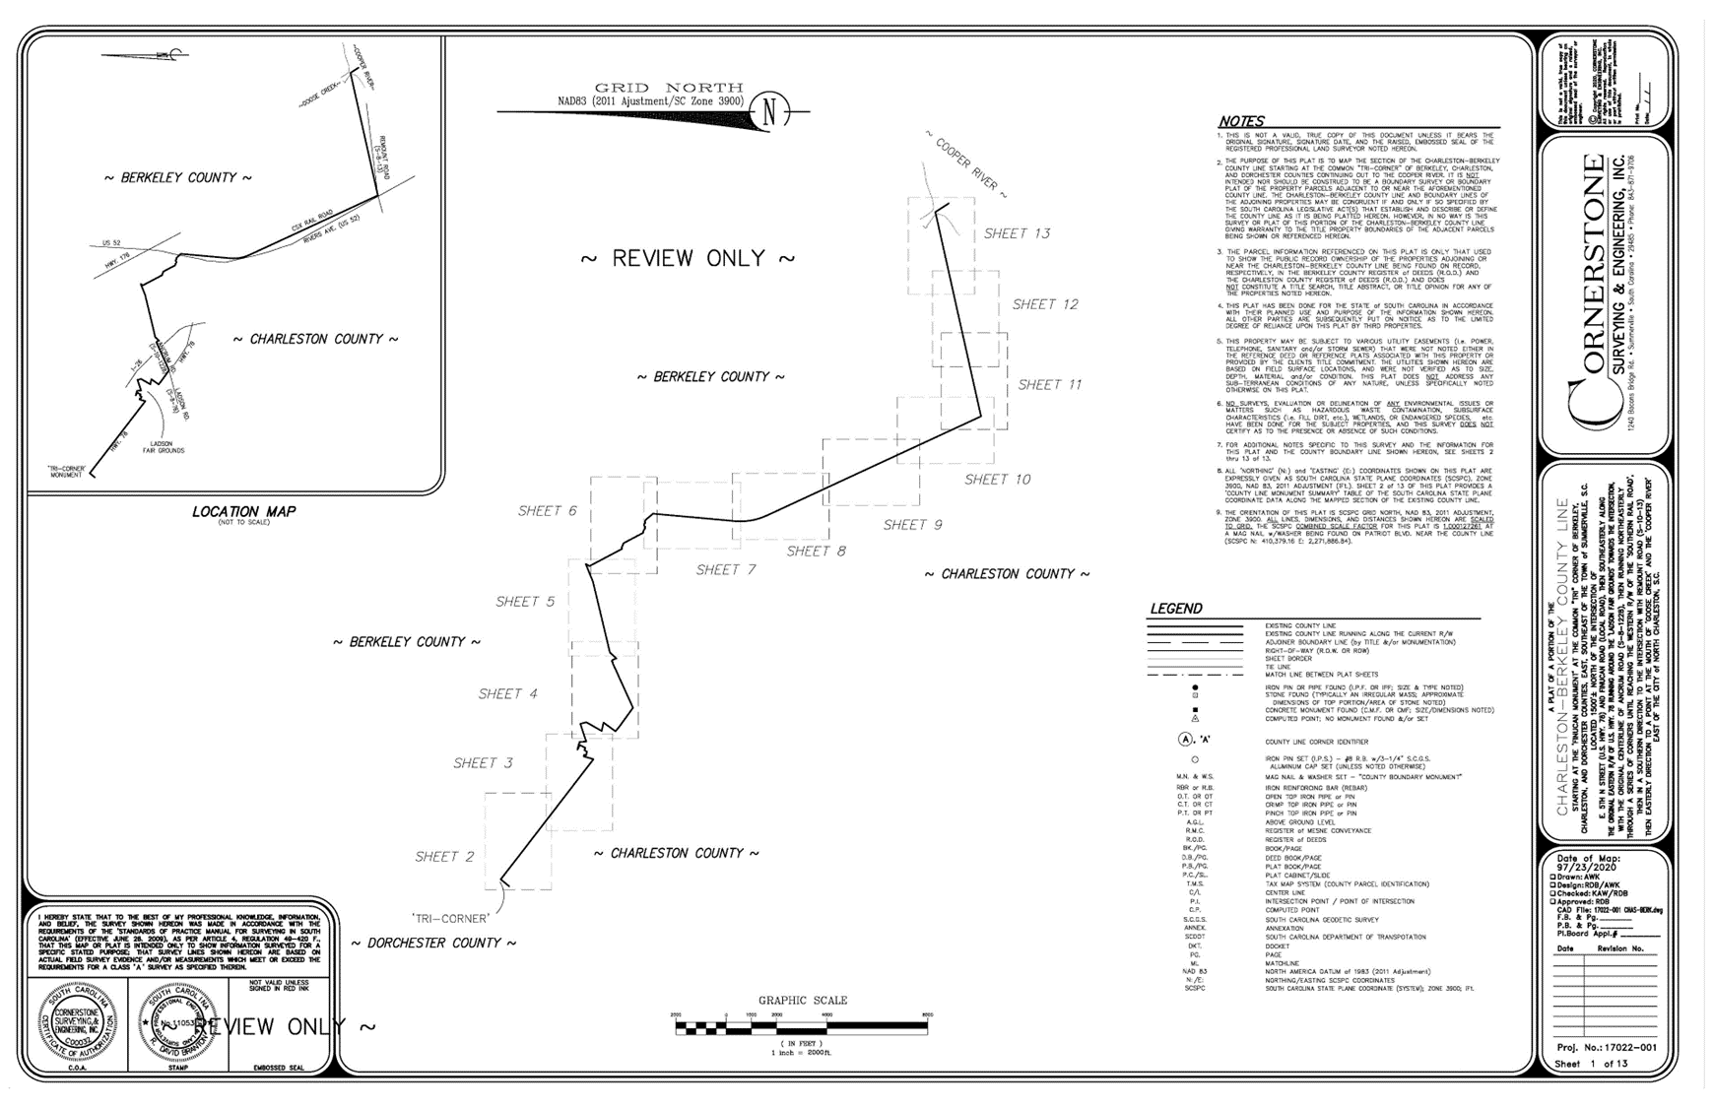

Slide 25
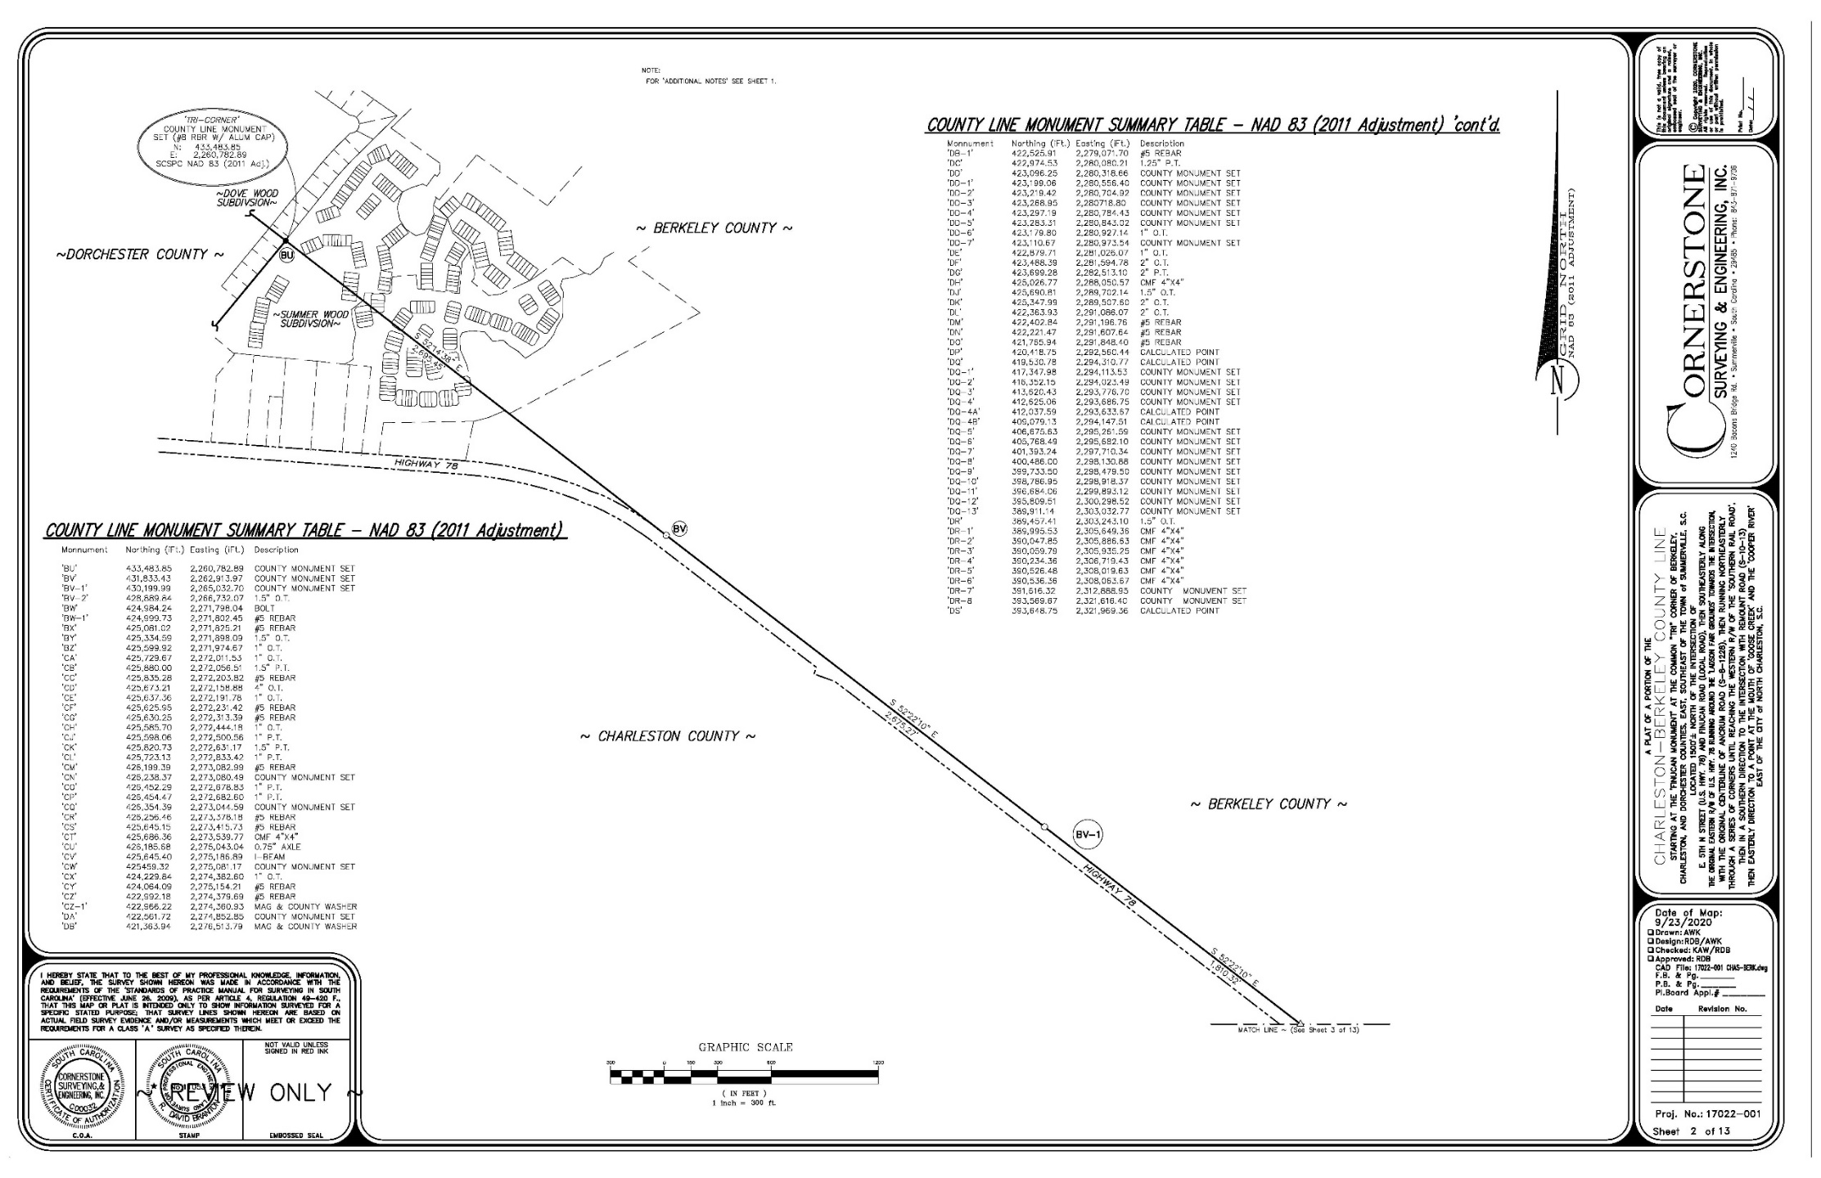

Slide 26
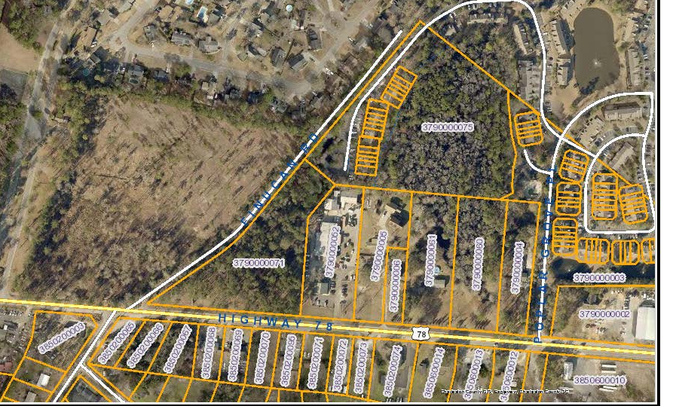
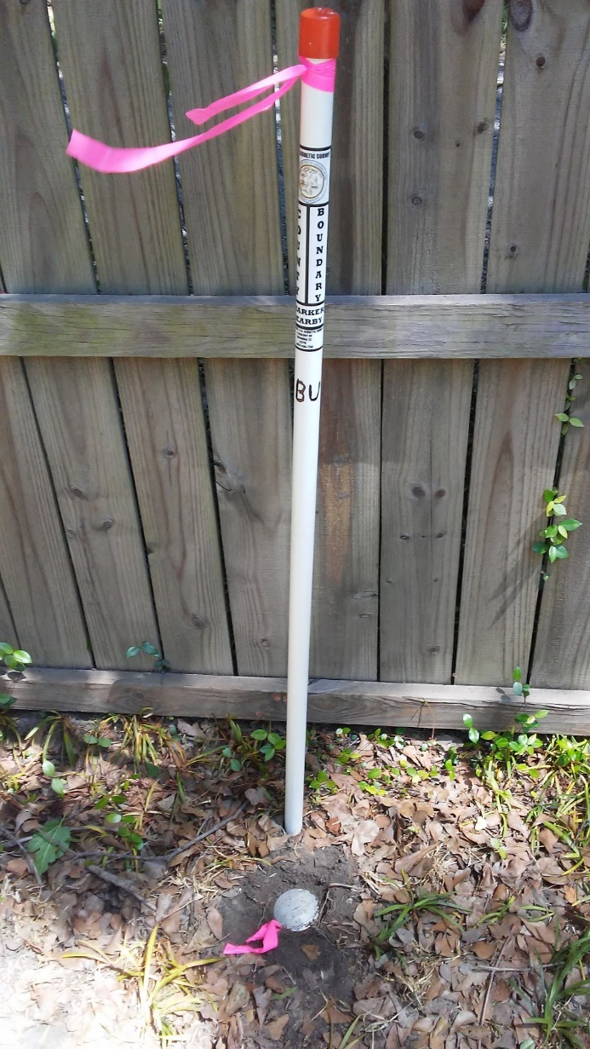
Monument “BU”
Tri-County Corner

Slide 27
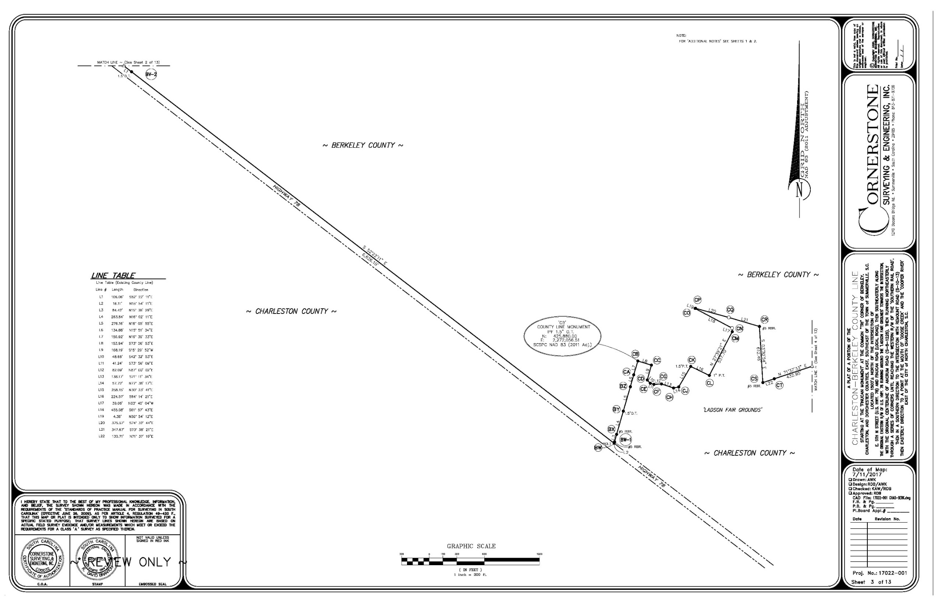

Slide 28
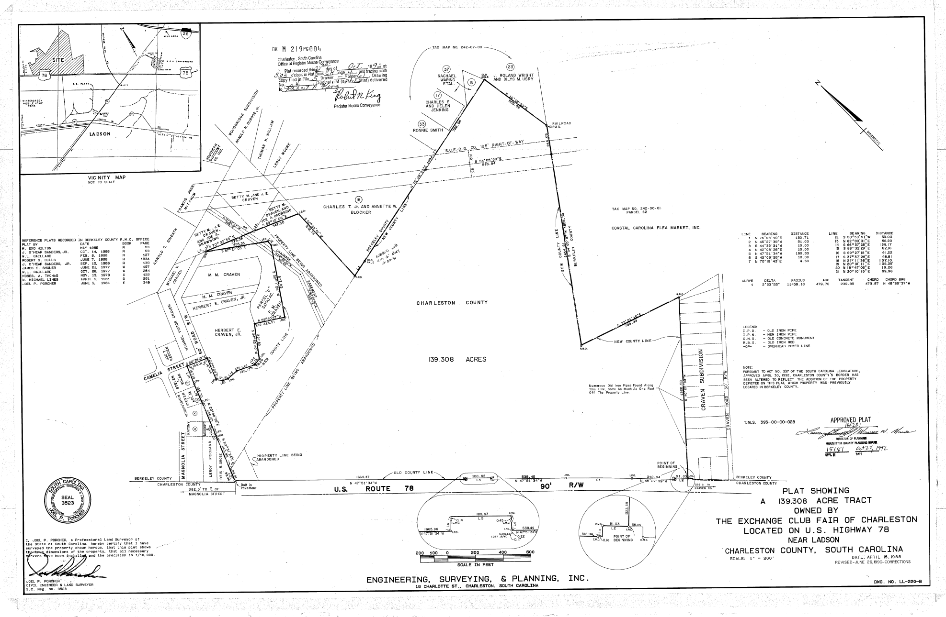
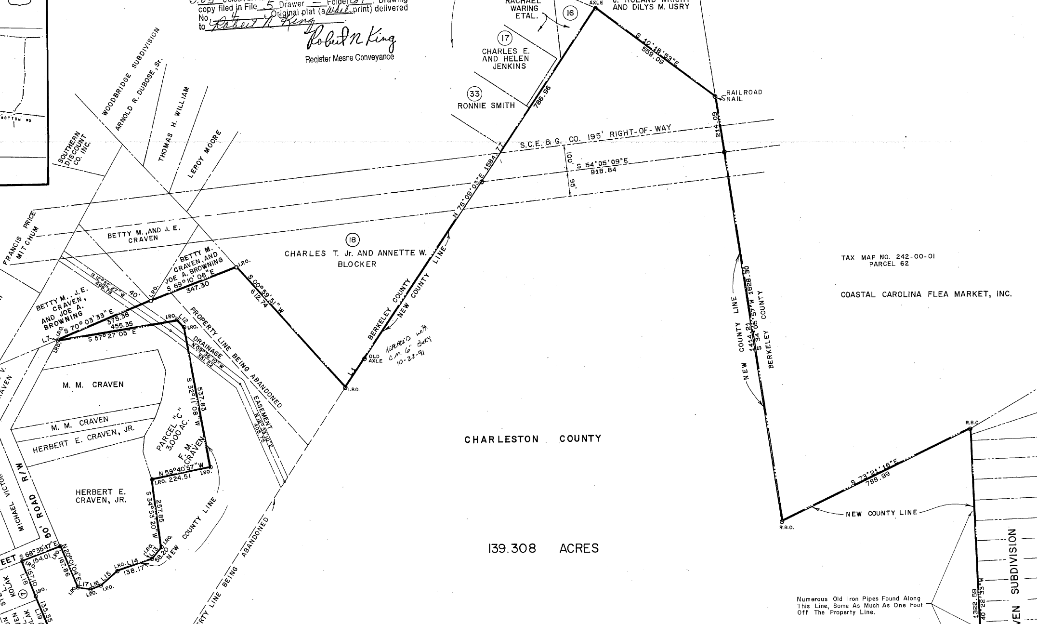

Slide 29
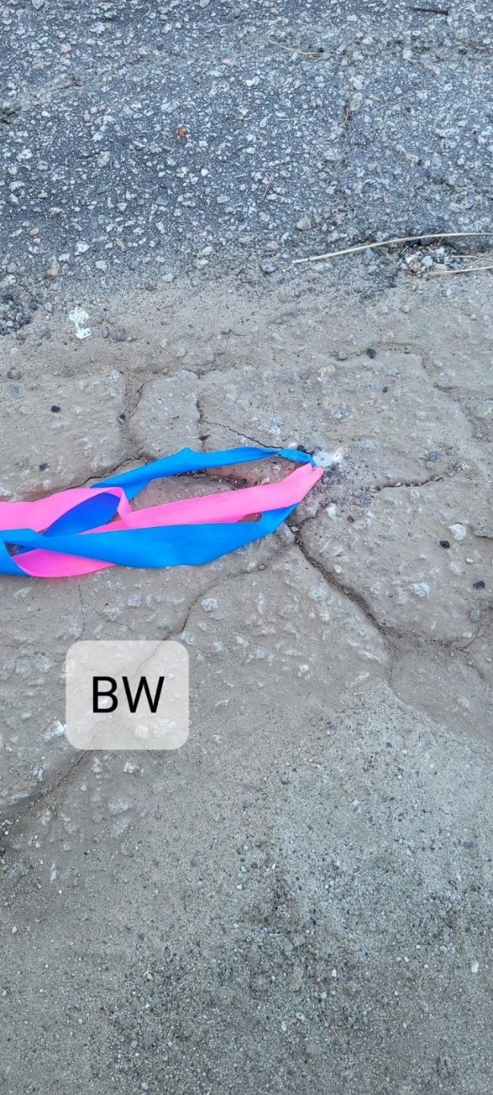
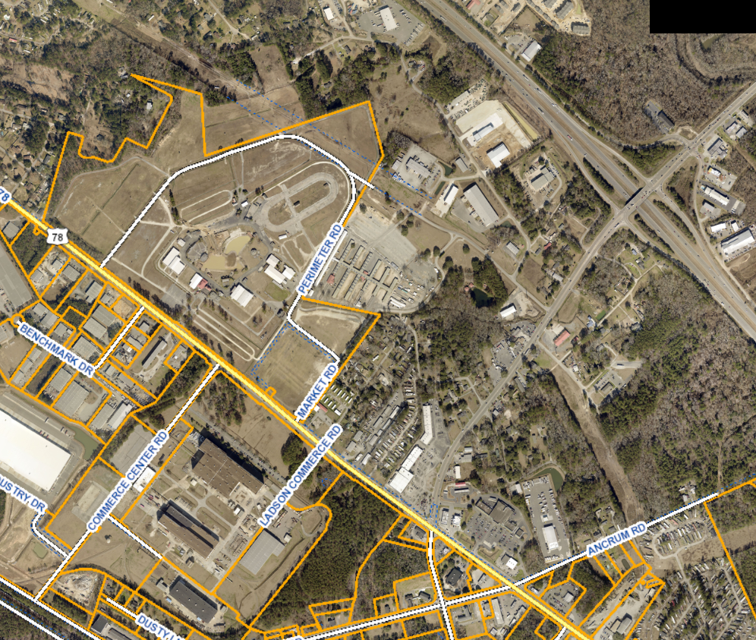
BW
Fairgrounds

Slide 30
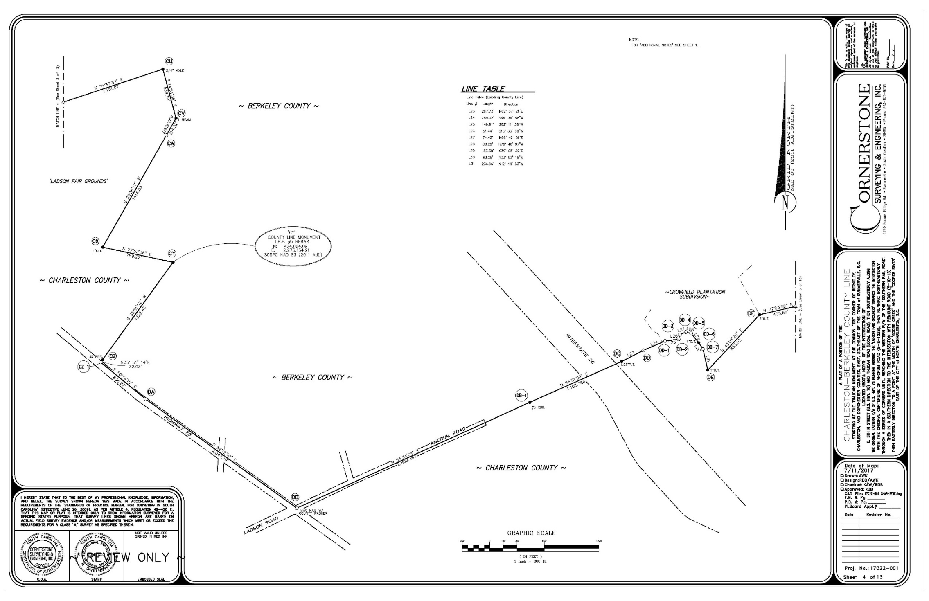

Slide 31
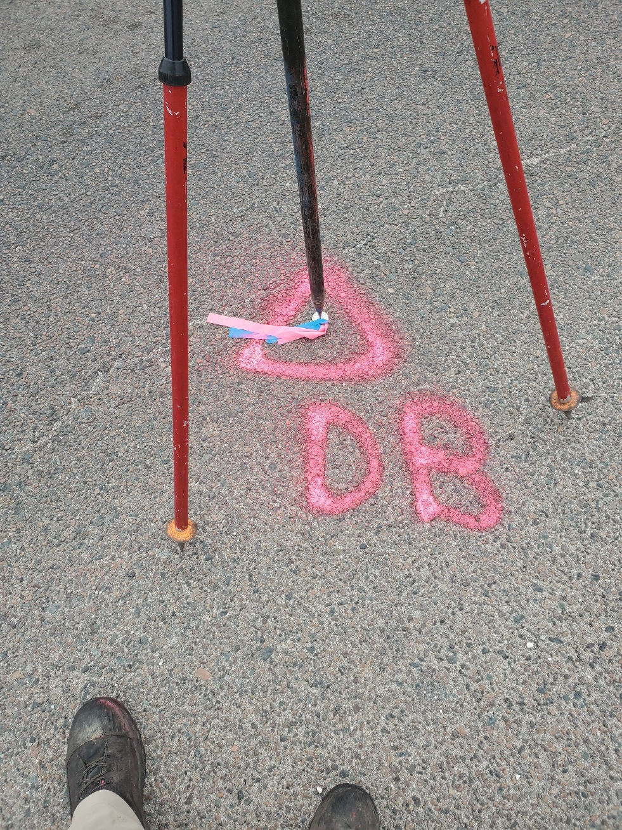
DB

Slide 32
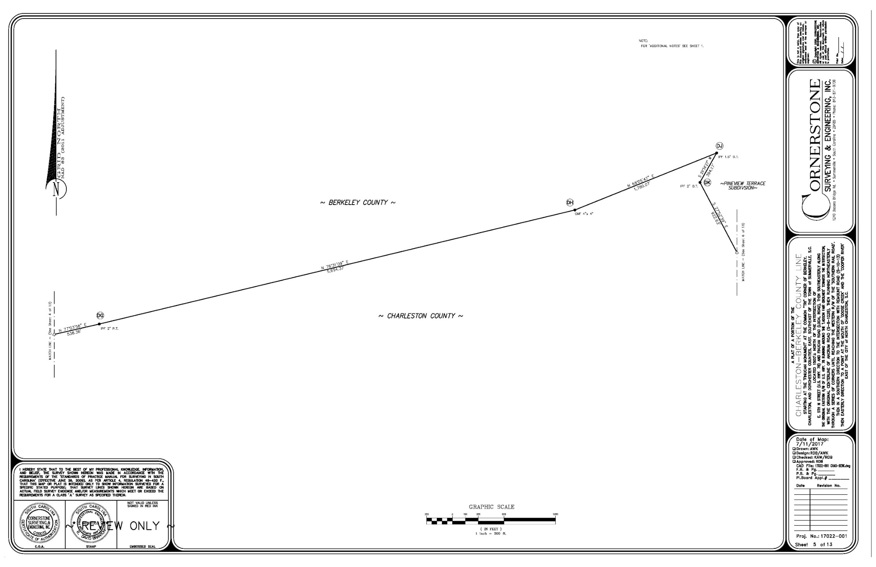

Slide 33
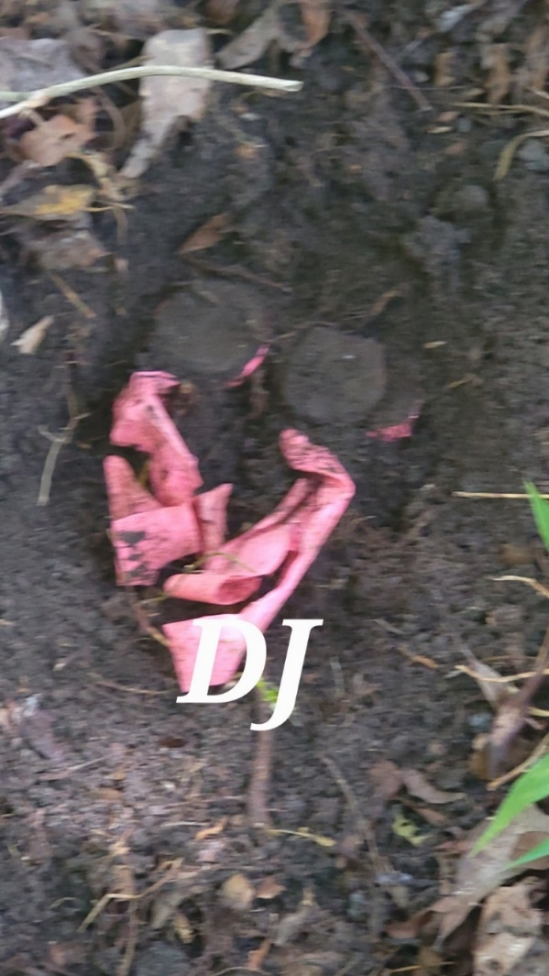
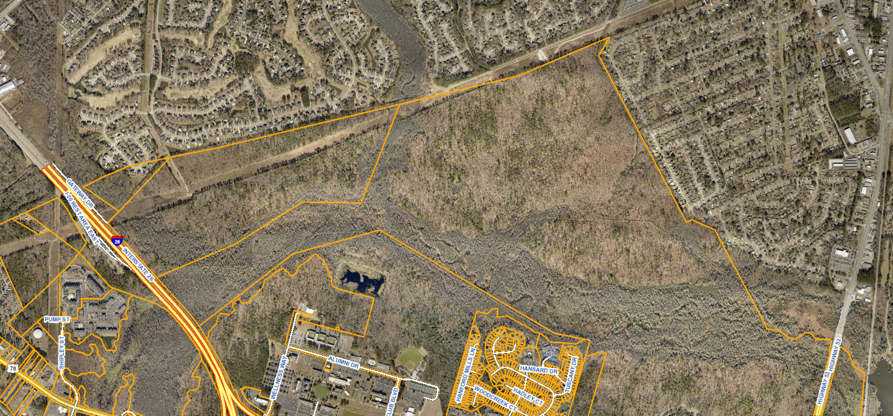
DJ

Slide 34
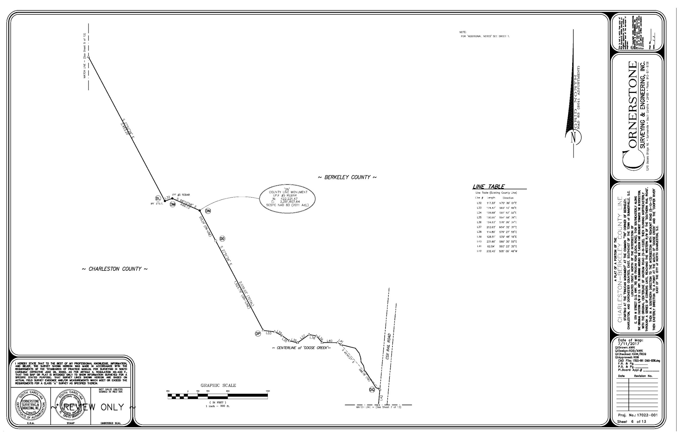

Slide 35
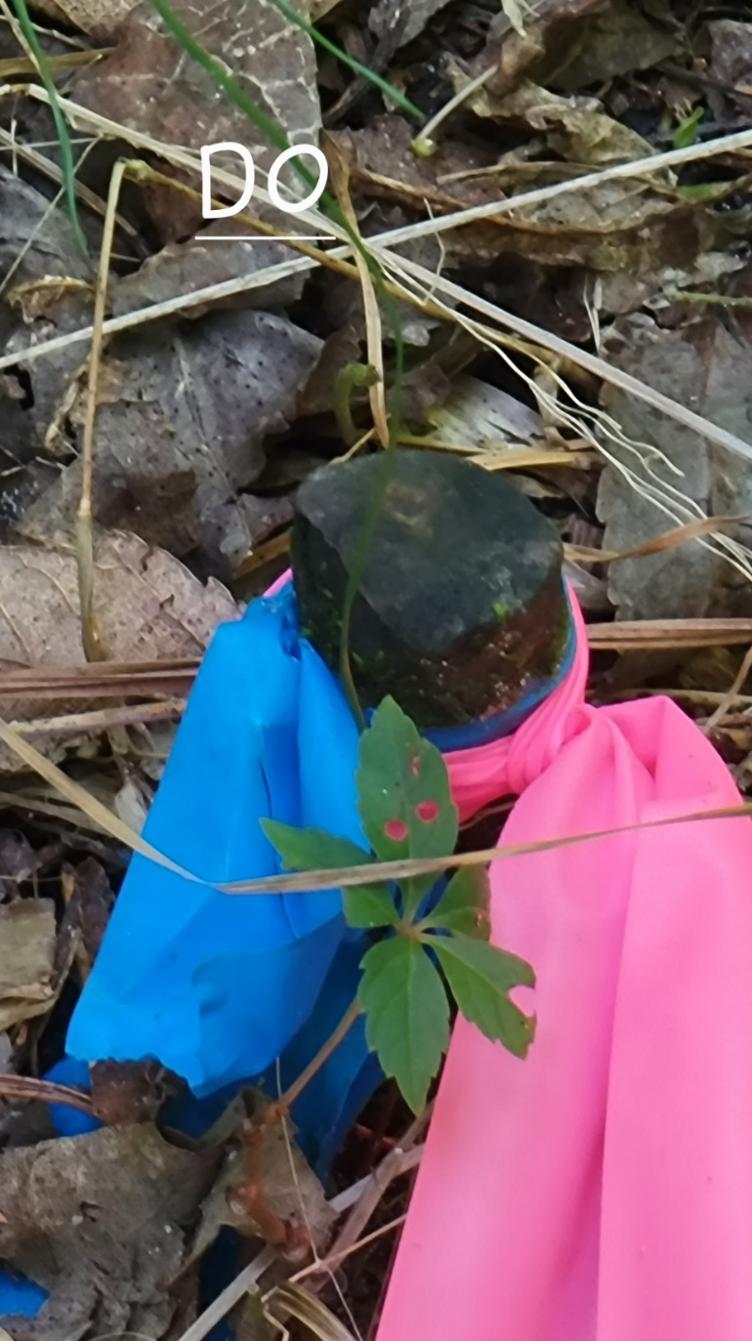

DO

Slide 36
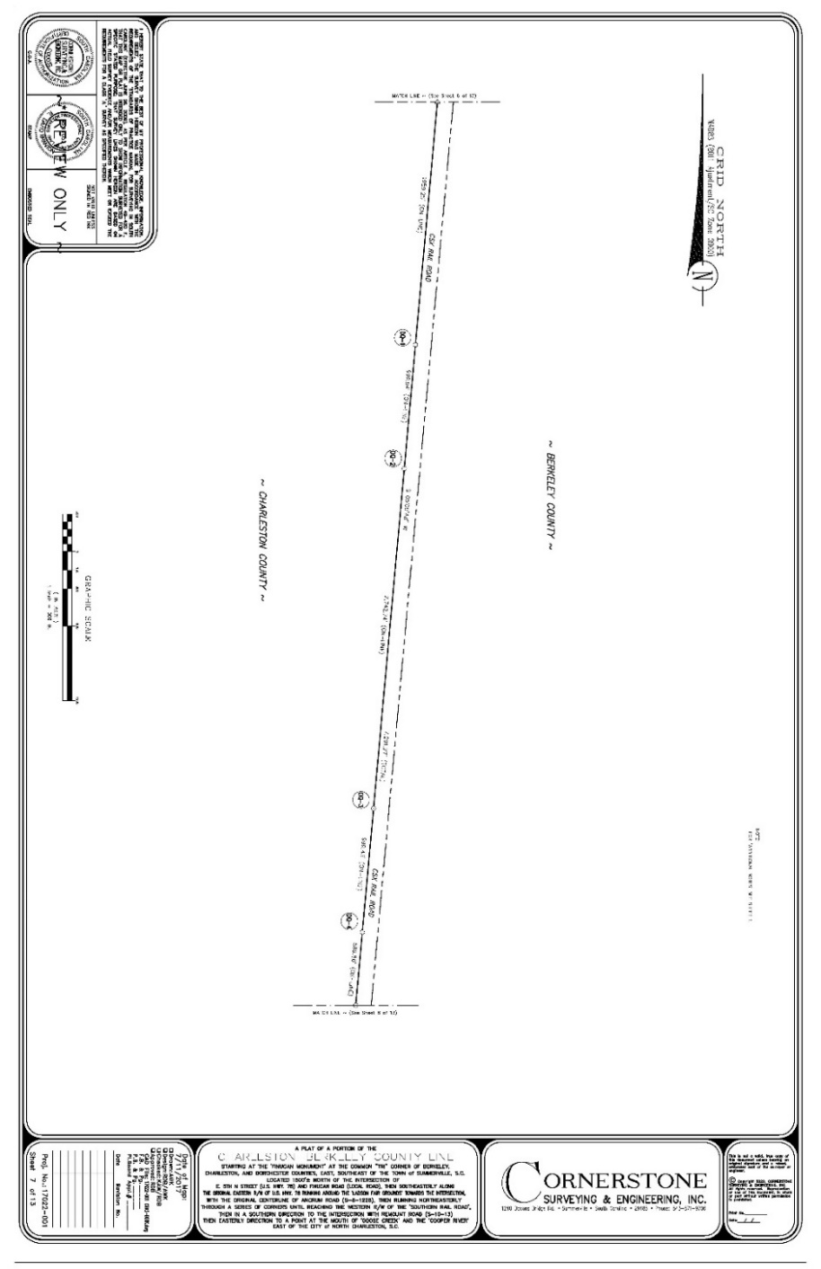
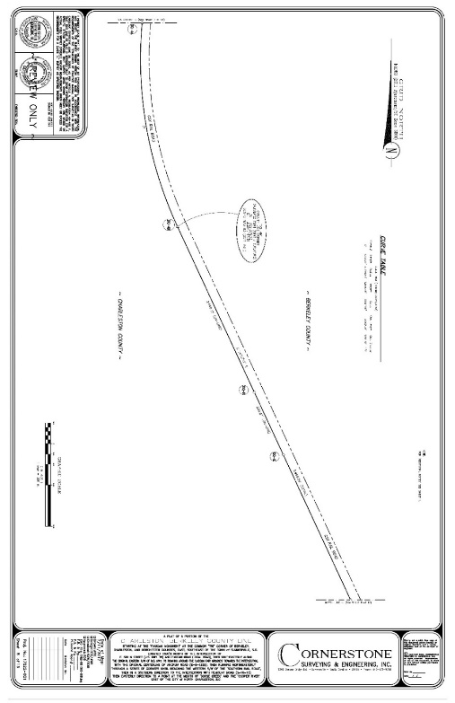
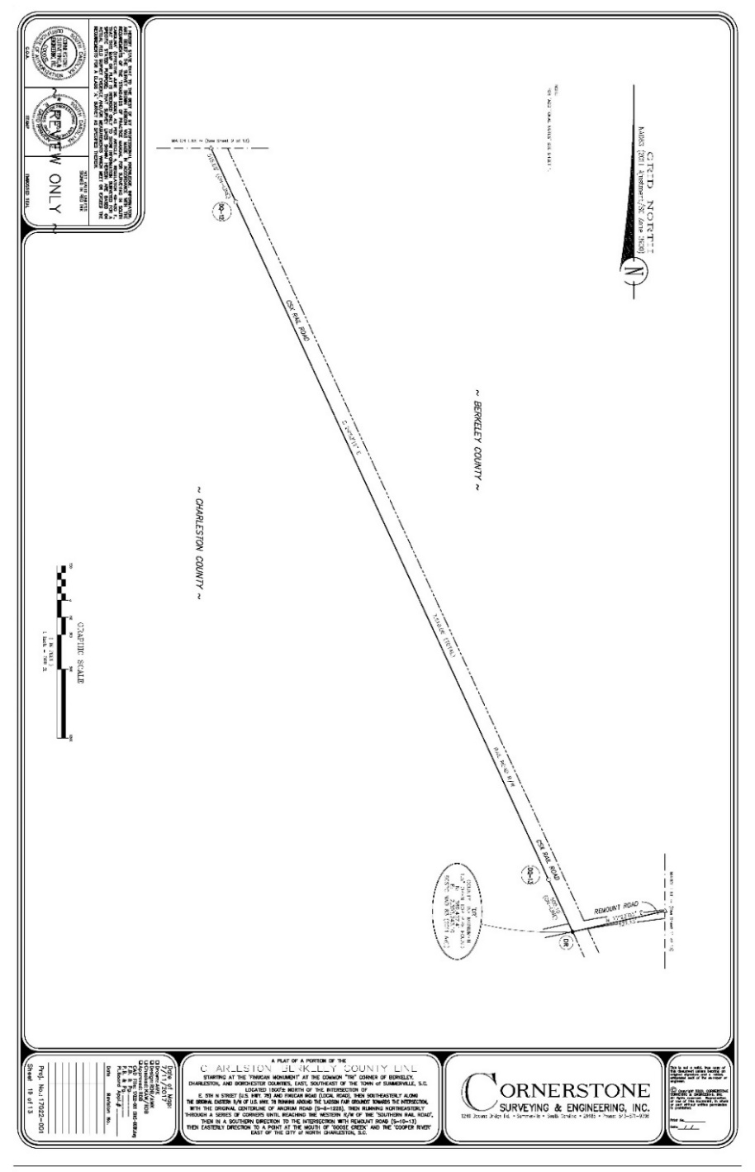
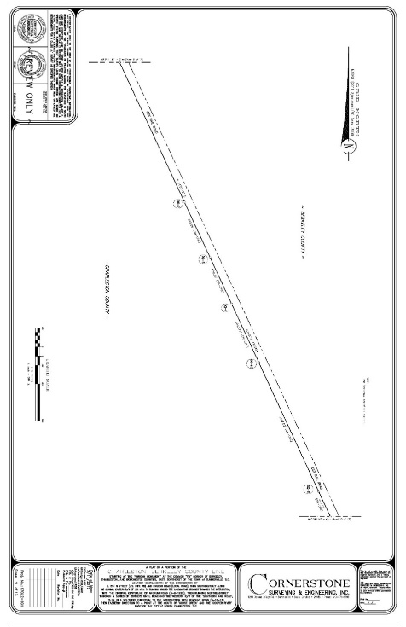

Slide 37
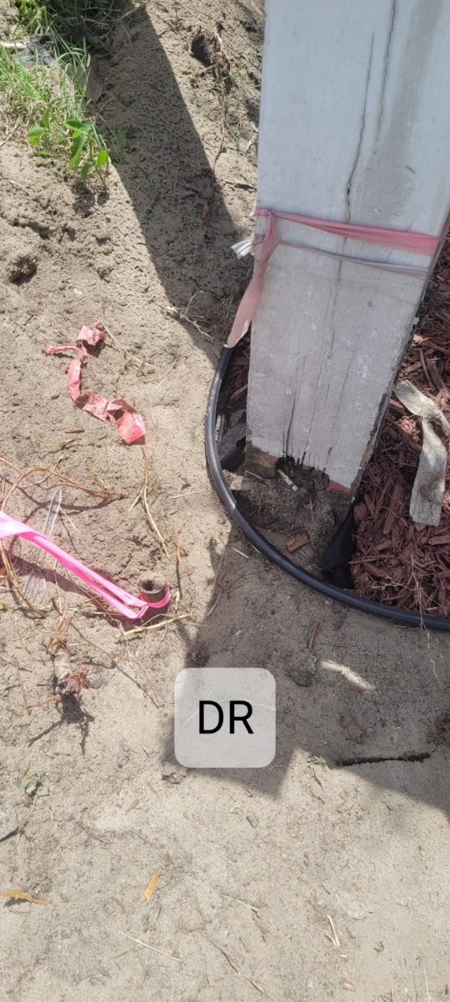
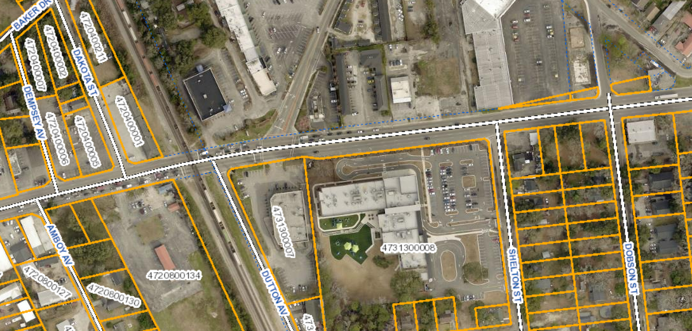
DR

Slide 38
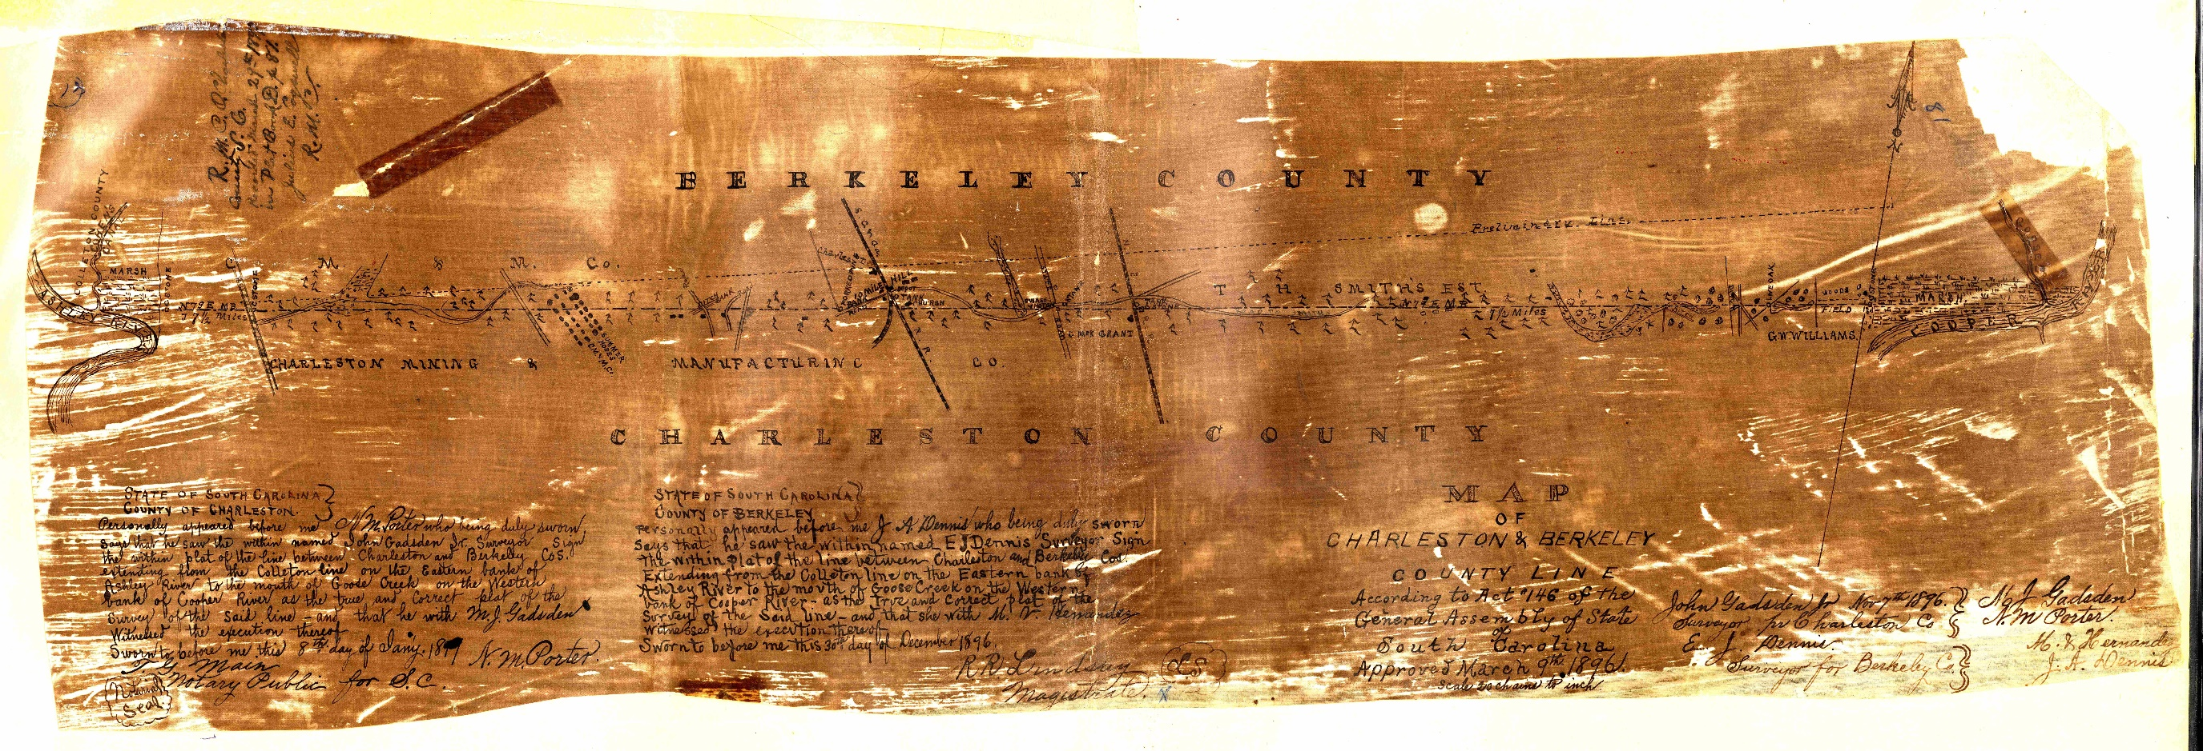

Slide 39
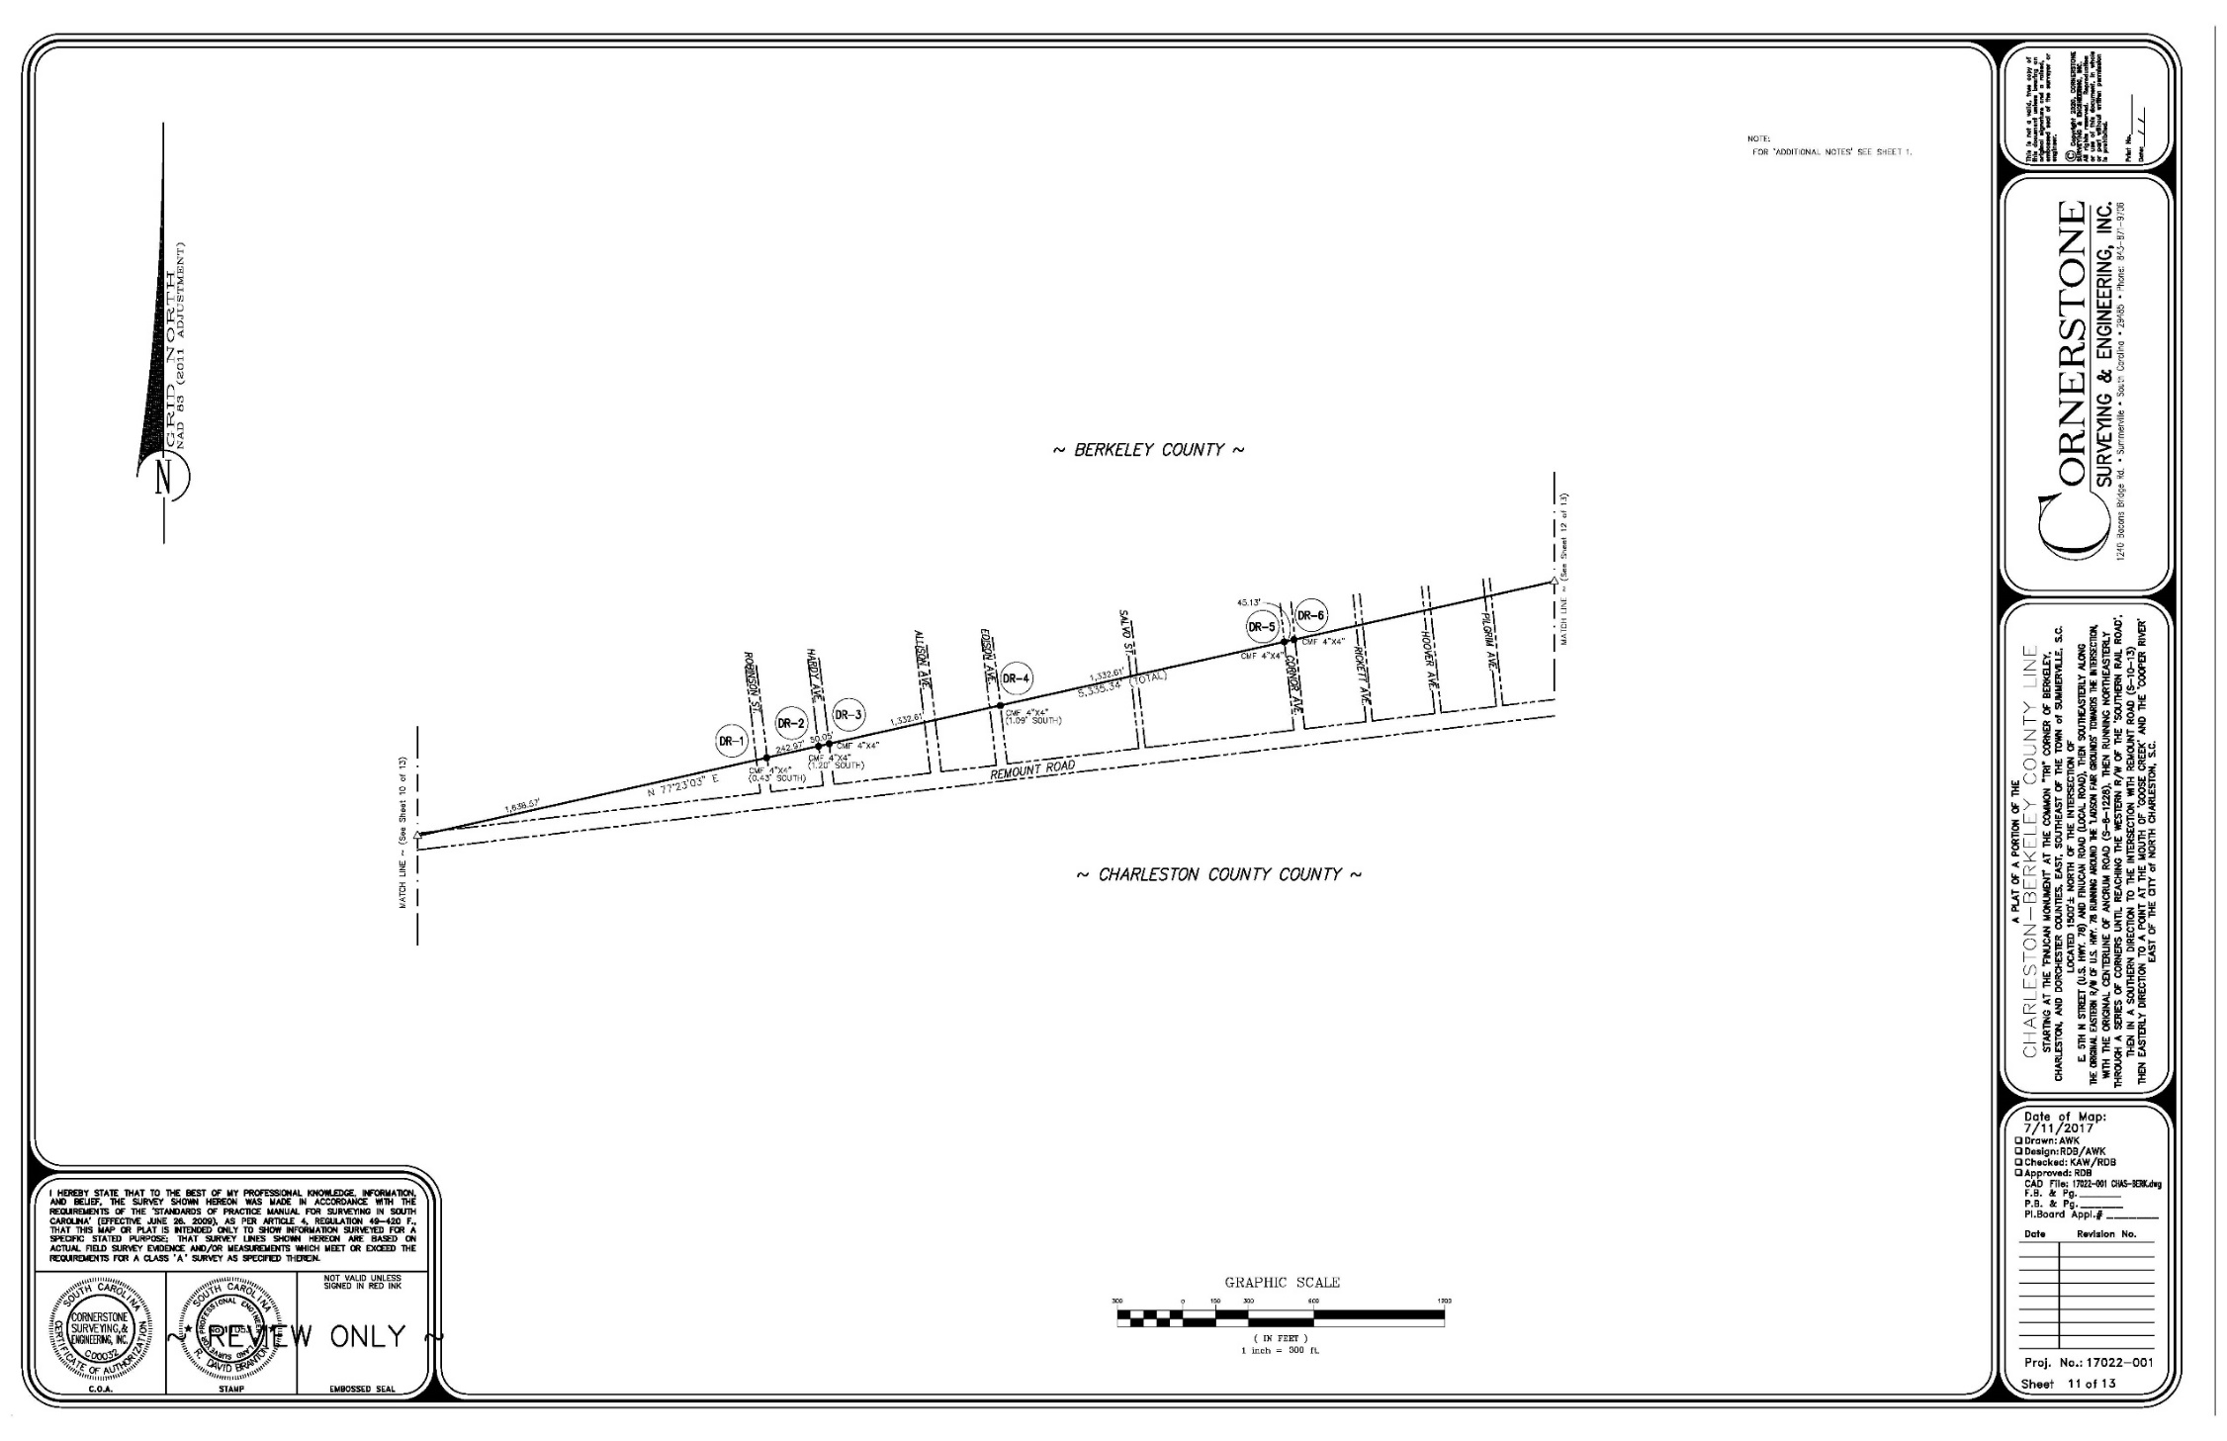

Slide 40
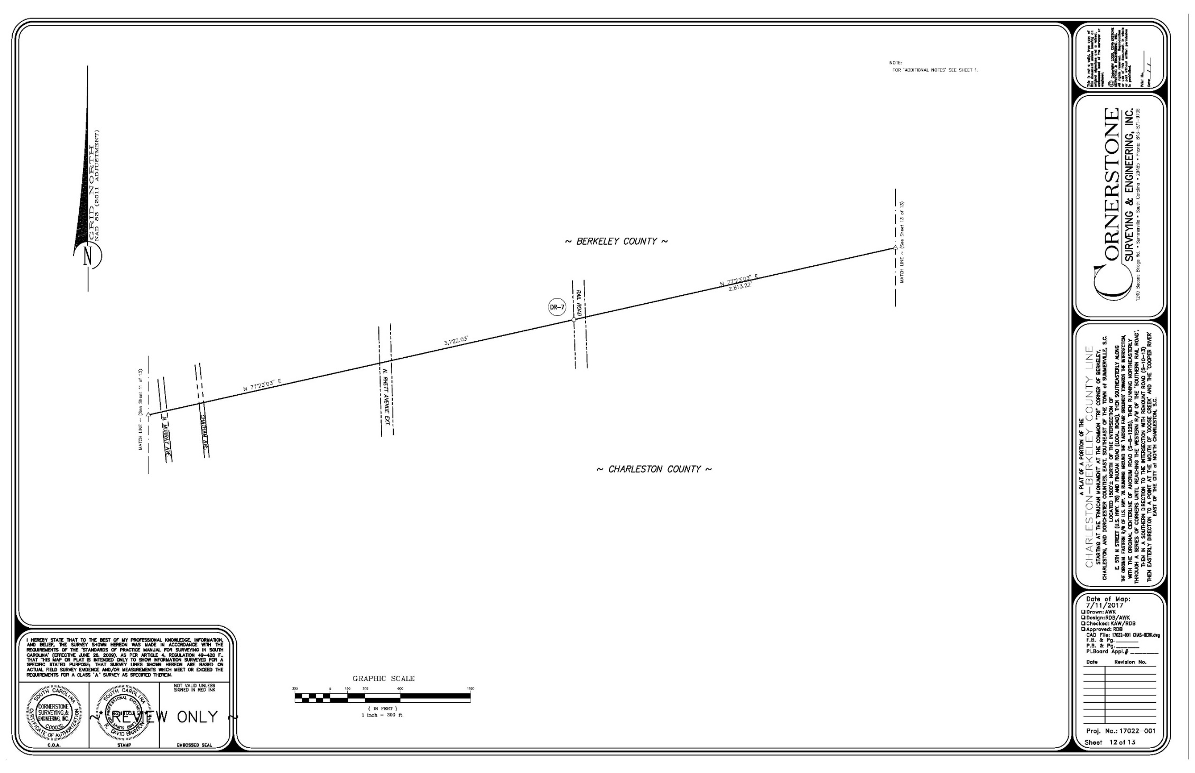

Slide 41
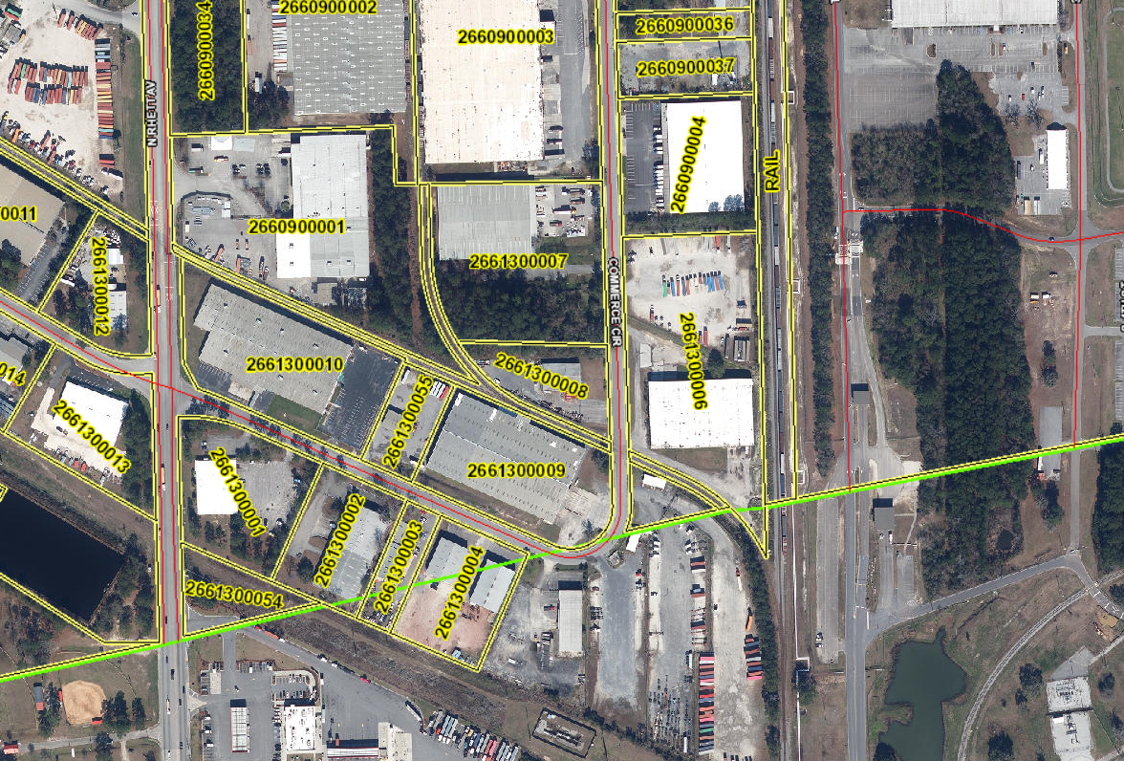
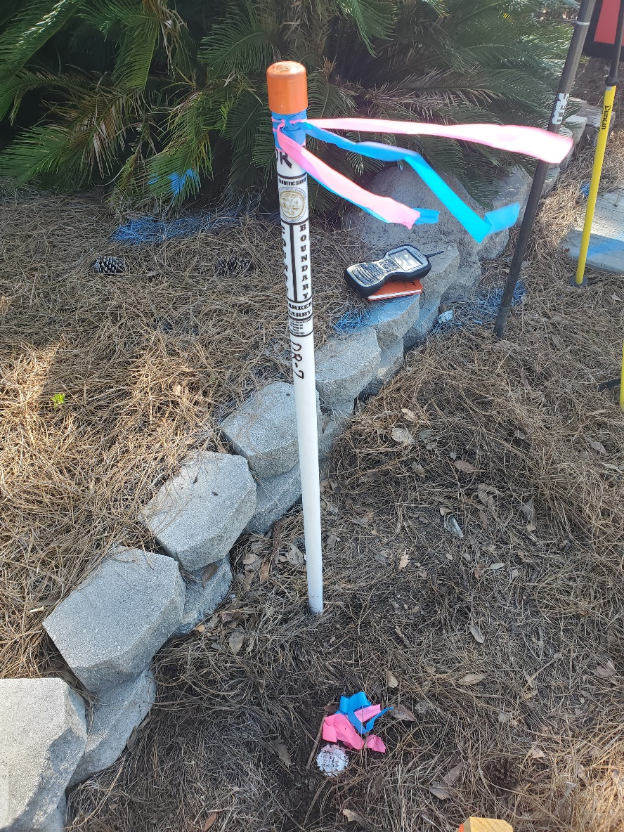
DR-7

Slide 42
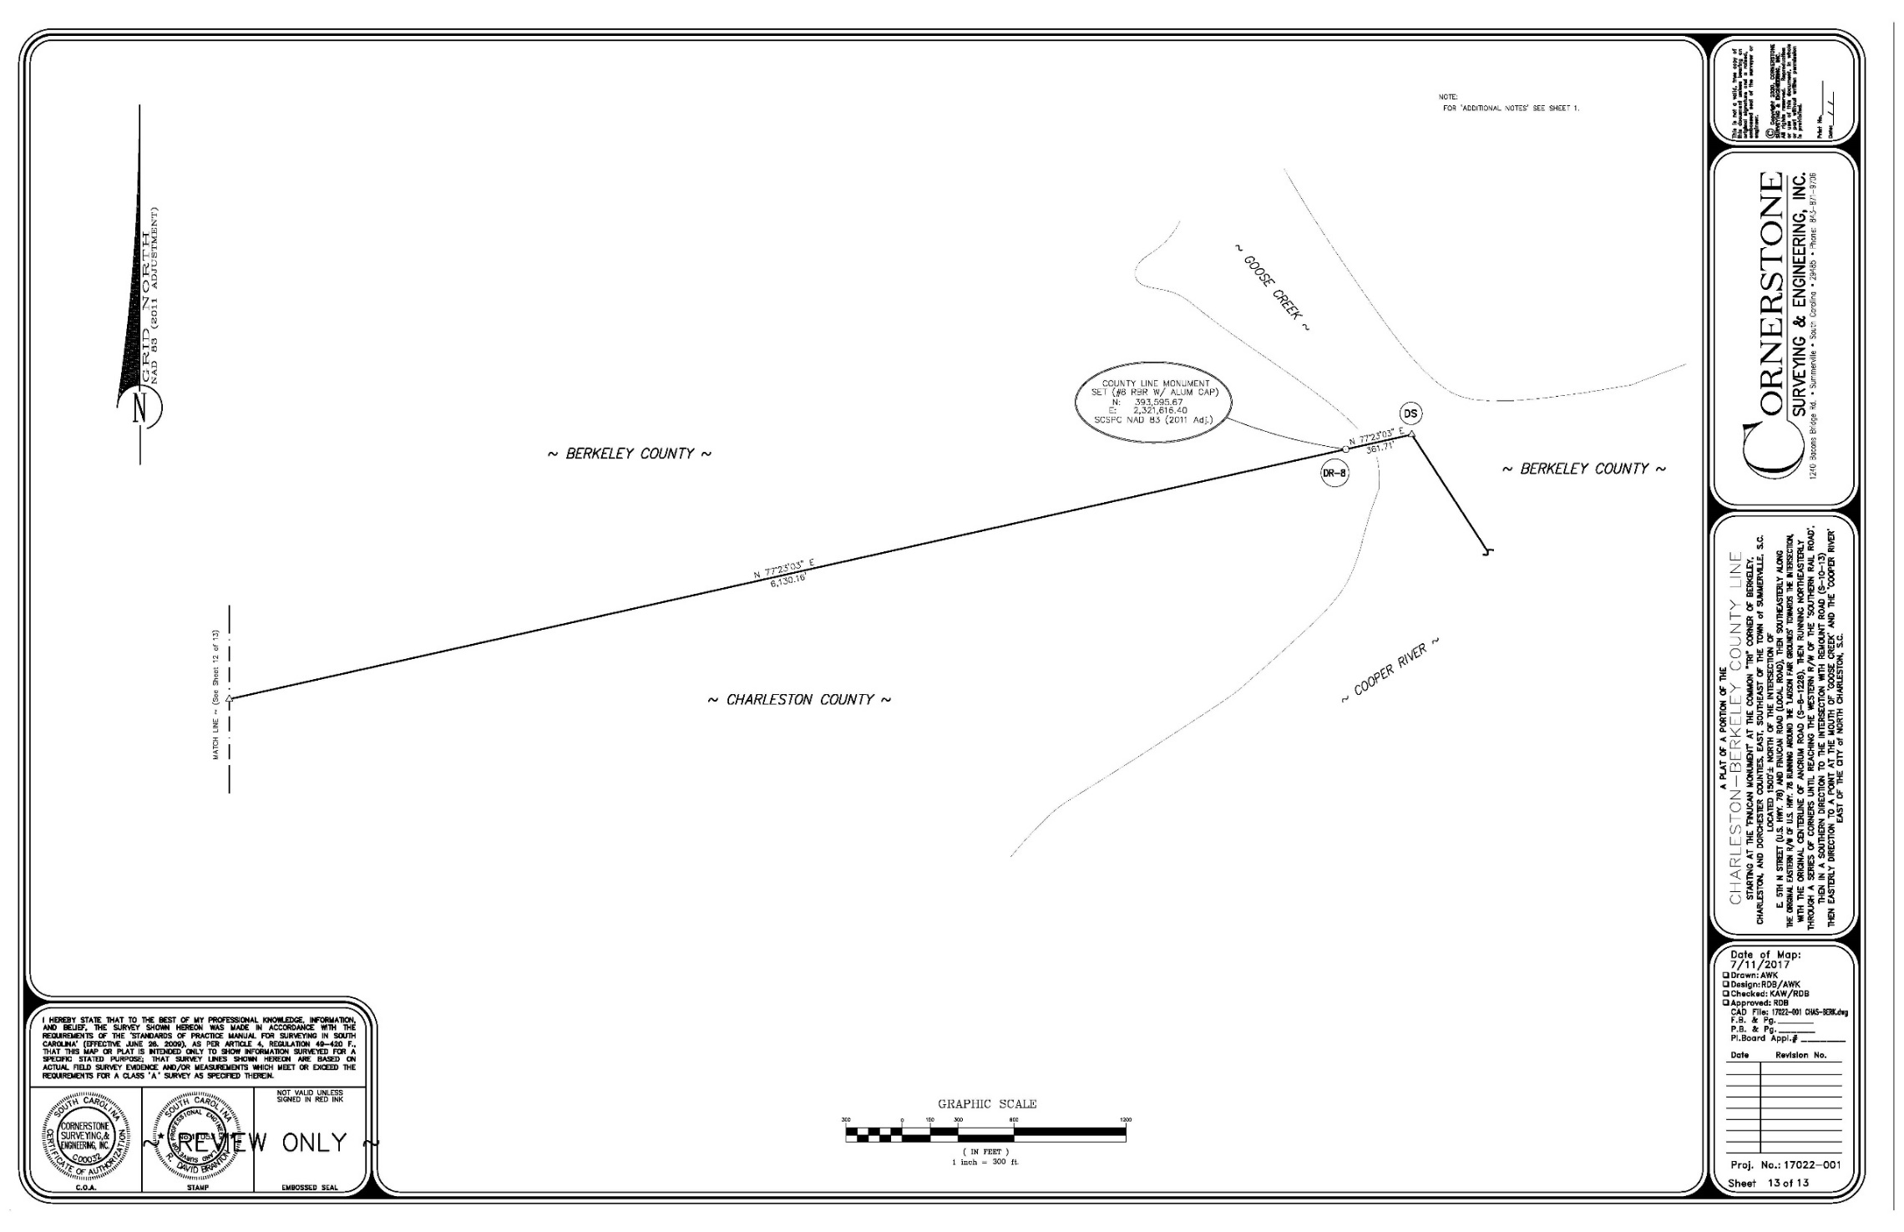

Slide 43
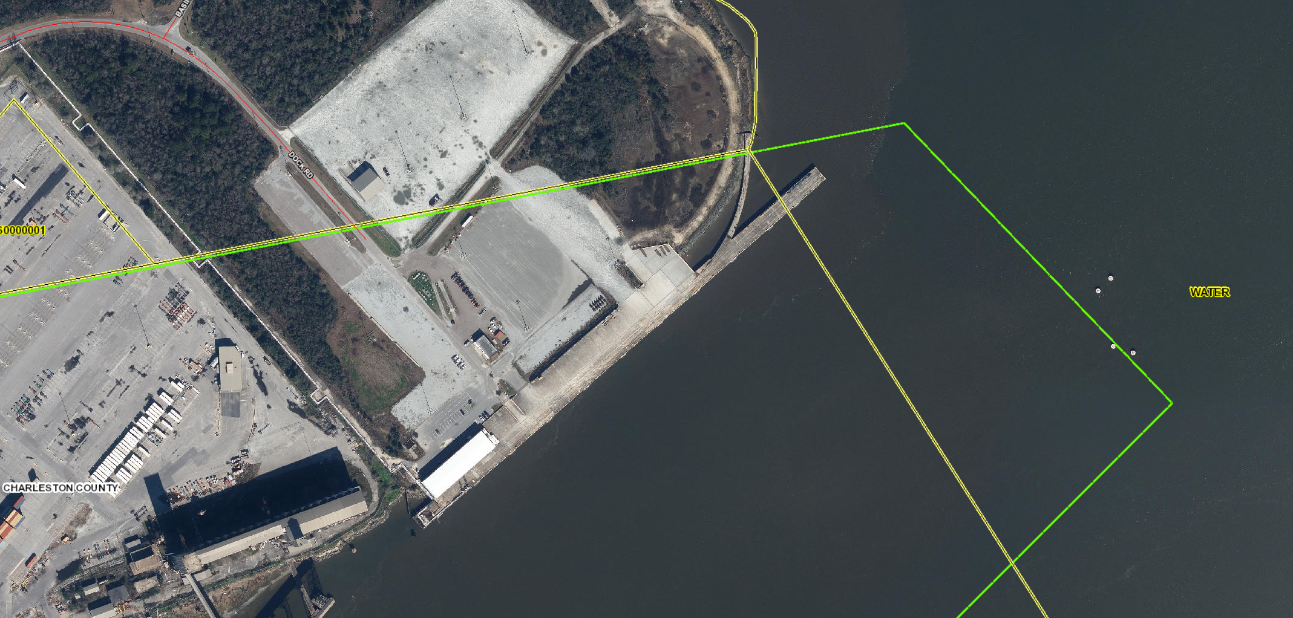
DR-8
DS

Slide 44
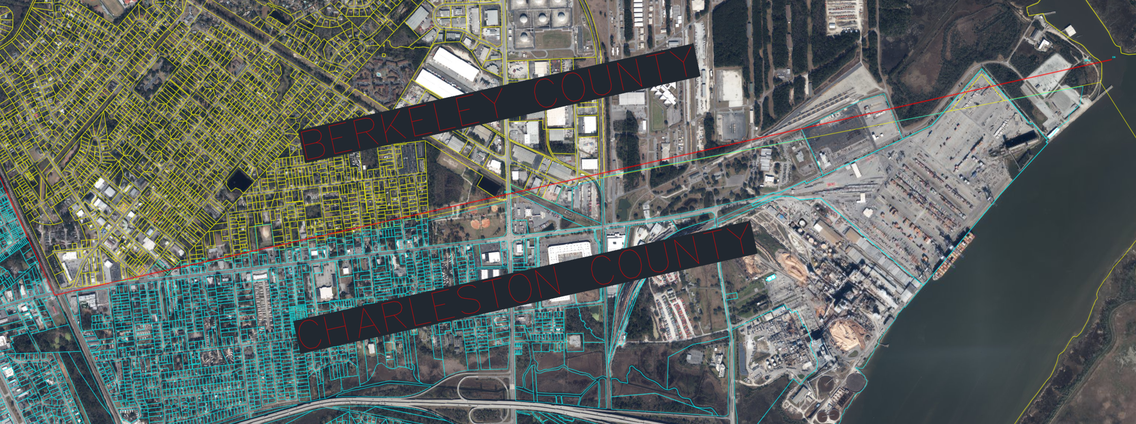
GIS

Slide 45
WHAT HAPPENS NEXT:
-PUBLIC MEETING
-CERTIFICATION OF PLAT
-NOTIFY AFFECTED PARTIES
-60 DAY APPEAL WINDOW
-RECORD/FILE PLAT UNDER COVER LETTER
-DATE OF LETTER IS THE EFFECTIVE DATE OF THE BOUNDARY

Slide 46
QUESTIONS?
Or Information You Would Like to Provide?
Project Page:
https://rfa.sc.gov/programs-services/geodetic/county/berkeley-charleston-ncharleston
PLEASE CALL: 803-734-0959
or EMAIL: boundary@rfa.sc.gov
We Will Work to Address Questions Promptly or Direct Questions to the Appropriate Agency or Jurisdictional Entity

